Slide 1
Cl215 MTO-I Multicomponent distillation
Module 5

Slide 2
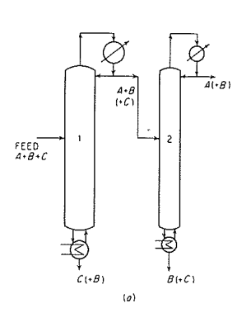
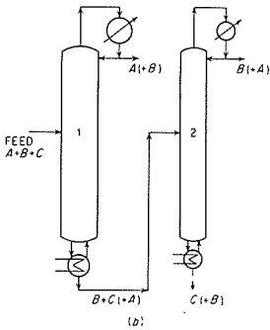
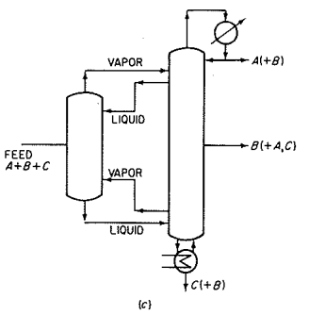
Separation of 3 components: Schemes

Slide 4
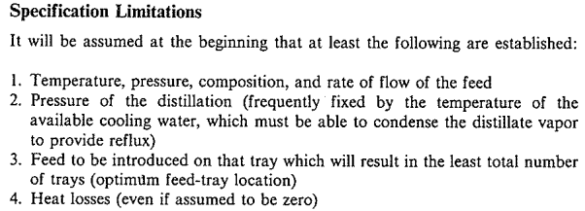
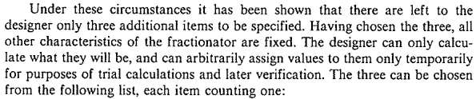

Slide 5
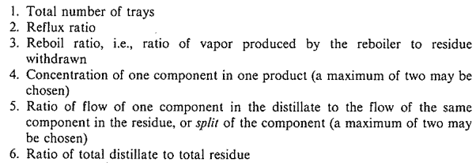

Slide 8
Degrees of freedom for binary distillation column
To determine the degrees of freedom (DoF) for a binary distillation column, you apply Degrees of Freedom Analysis using the Gibbs phase rule and overall mass and energy balances. Here's a step-by-step explanation:
Key Assumptions for Binary Distillation:
Binary mixture (2 components)
Steady-state
Ideal stages or theoretical stages
No chemical reactions
Constant pressure and molar overflow (if assumed)

Slide 9
General Formula for Degrees of Freedom:
DoF=Number of variables−Number of independent equations
Use the Gibbs Phase Rule:
F = C − P + 2
Where:
F = degrees of freedom
C = number of components
P = number of phases
But for a distillation column, the Gibbs phase rule alone isn’t enough — we also apply process degrees of freedom analysis, especially when considering number of stages, feed stage, reflux ratio, flowrates, etc.

Slide 10
Typical Binary Distillation Column DoF Breakdown:
For a column with:
N stages
1 feed stream
2 product streams (Distillate + Bottoms)
You usually have:
2N+2 mole balances (for 2 components per stage + 2 for product specs)
Variables include: flowrates, compositions, stage temperatures, stage pressures, etc.

Slide 11
Common DoF Value for Binary Distillation:
If you assume:
Feed composition and flowrate are known
Total condenser and reboiler
Constant molar overflow
Stage efficiency or number of stages known
Then you typically have 2 degrees of freedom, which means:
You must specify 2 variables, such as:
Reflux ratio + distillate composition
Distillate rate + bottom composition
Reflux ratio + number of stages
These 2 specifications allow you to solve the entire system.
Example (Shortcut):
For a binary distillation column, the degrees of freedom = 2, assuming:
Column is fully specified except for operating conditions
You can vary reflux ratio and distillate flowrate (or composition)

Slide 12
Degrees of Freedom (DoF) for a 3-Component Distillation Column
The degrees of freedom (DoF) define the number of independent variables that must be specified to fully design or operate a distillation column.
For a 3-component (ternary) system, the DoF depends on:
Number of components (C = 3)
Feed streams
Column configuration (e.g., number of products, heat exchangers)

Slide 13
Gibbs Phase Rule (Basics)
For a non-reactive system at equilibrium:
F=C−P+2
F: Degrees of freedom
C: Number of components (3)
P: Number of phases (2 for vapor-liquid equilibrium)
For a single equilibrium stage:
F=3−2+2=3(e.g., T,P, and composition)F=3−2+2=3 (e.g., T,P, and composition)

Slide 14
Degrees of Freedom for a Full Distillation Column (Process variable Perspective)
A distillation column with:
3 components (e.g.,methanol/ethanol/water),
1 feed stream,
2 product streams (distillate + bottoms),
1 condenser and 1 reboiler,
has a total DoF given by:
F = C + N_{feeds}​+ N_{heaters/coolers}​ + 5
F = 3 + 1 + 2 + 5 = 11
The "+5" accounts for pressure, condenser duty, reboiler duty, reflux ratio, and product flow rate

Slide 15
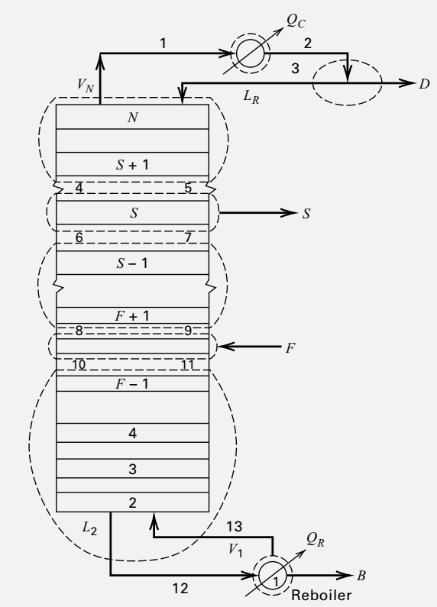
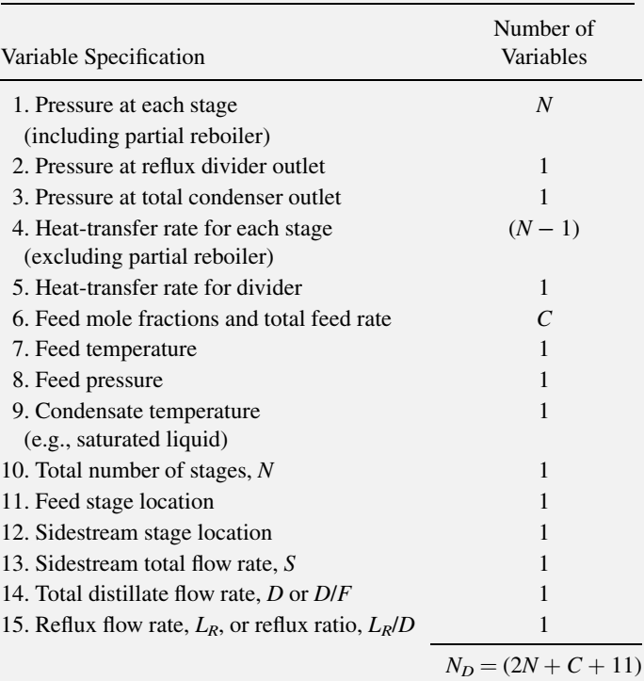
Degrees of Freedom

Slide 16
















Introduction

Slide 17






























Slide 18




































Slide 19


Slide 20
Key components
The designer must select the two "key” components between which it isdesired to make the separation.
The light key(LK) will be the component that it is desired to keep out of the bottom product, and the heavy key(HK) the component to be kept out of the top product. Lighter than LK called LNK (light non-key) and heavier than HK is called HNK (heavy non-key)
Specifications will be set on the maximum concentrations of the keys in the top and bottom products.
The "non-key" components that appear in both top and bottom products are known as "distributed" components; and those that are not present, to any significant extent, in one or other product, are known as "nondistributed" components.

Slide 21
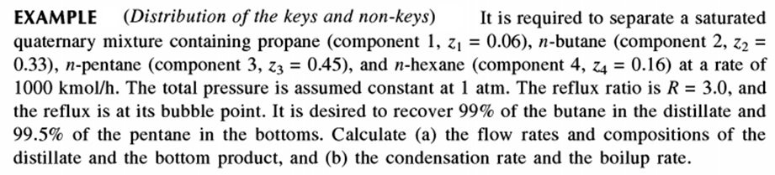
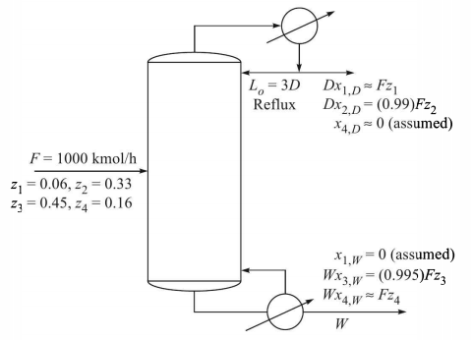

Slide 22
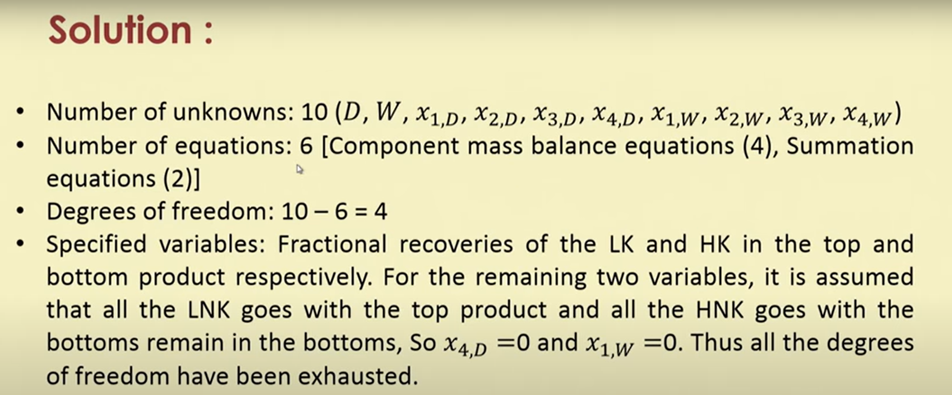
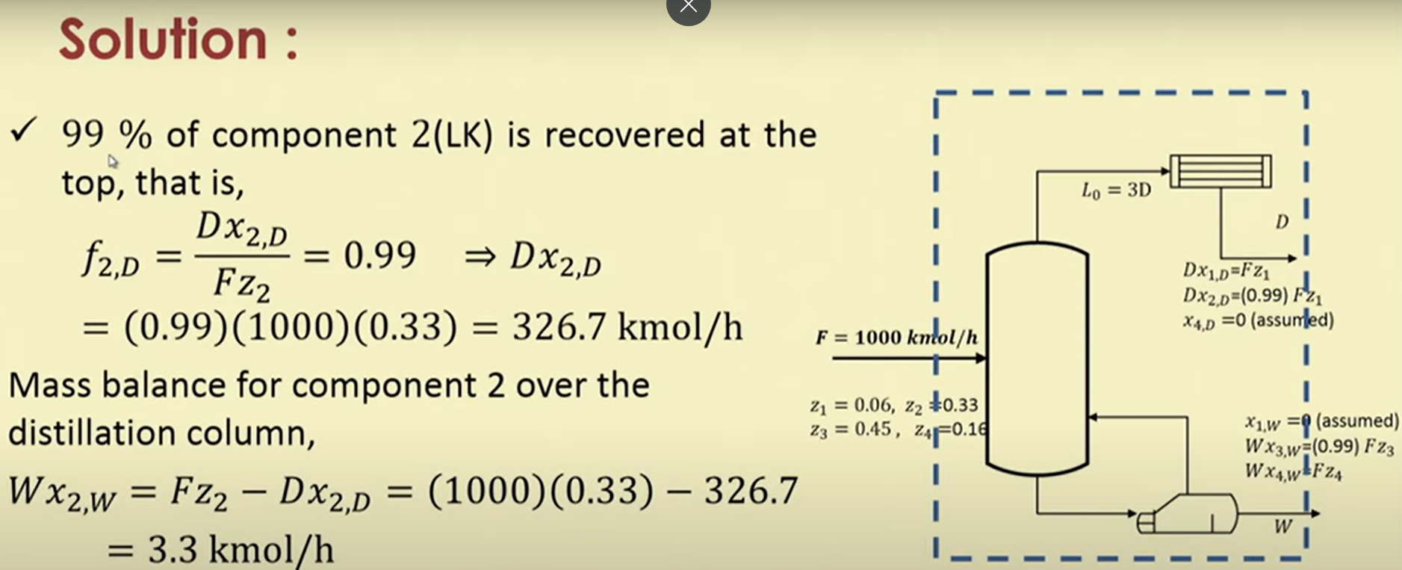

Slide 23
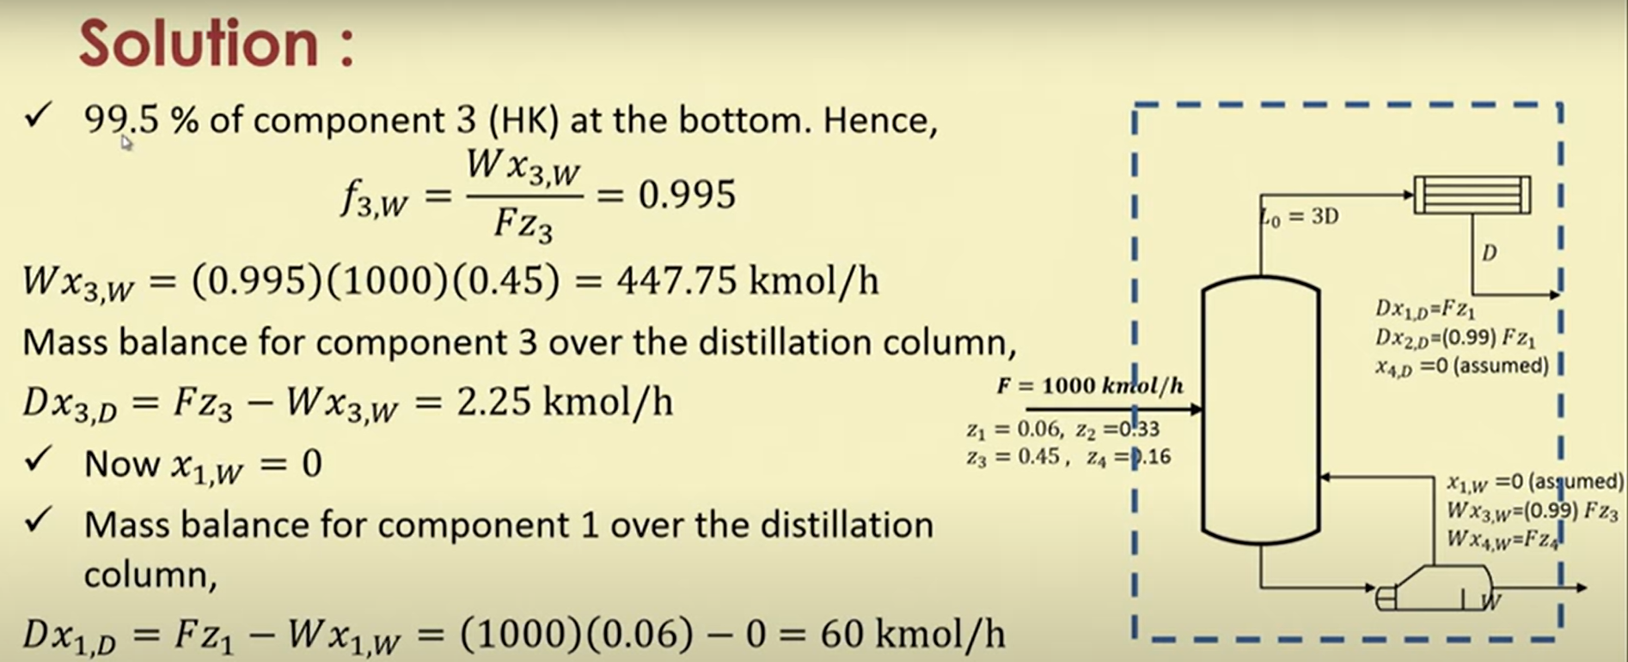
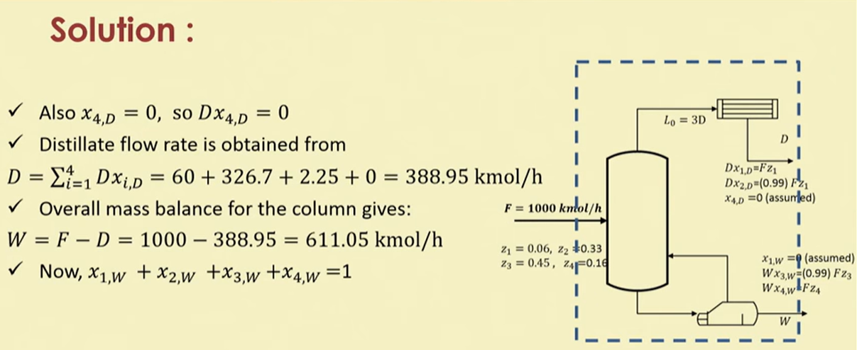

Slide 24
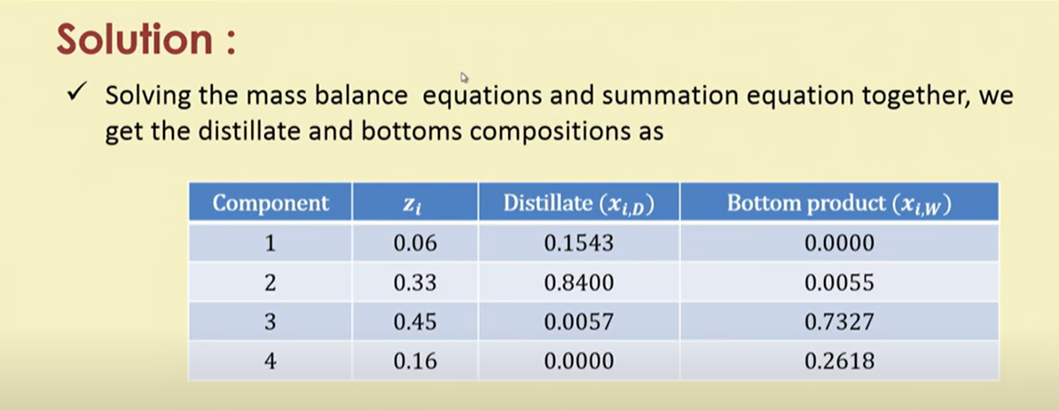
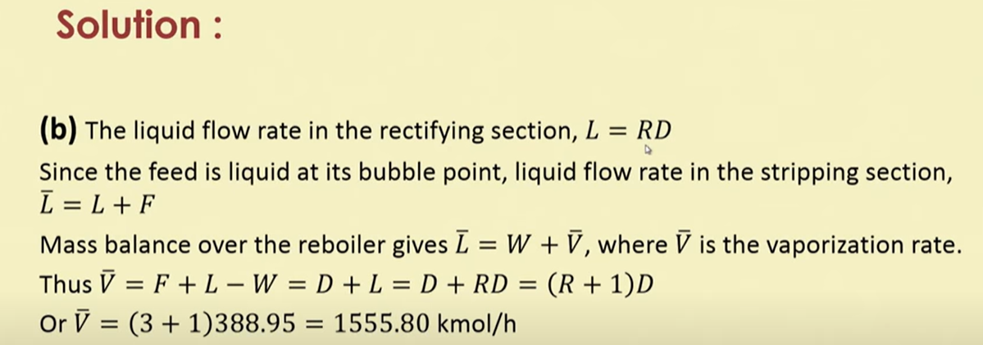

Slide 26
Method of calculation/design
Operating conditions (temperature and pressure) are to be fixed. The pressure can be fixed.
The condenser pressure is calculated based on cooling water available in condenser and the maximum temperature driving force available in condenser.
The LK and HK compositions will be fixed and other compositions (trial compositions) in top and bottom product will be calculated from desired compositions or fractional recoveries.
Once the compositions and the operating conditions are fixed then detailed or exact design calculation can be started. But before that short-cut method can be applied to calculate minimum no. of stages, minimum reflux ratio and no of actual plates by FUG method

Slide 27


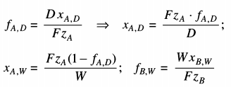
Fenske’s method for minimum no. of ideal stages at total reflux

Slide 28



Slide 29
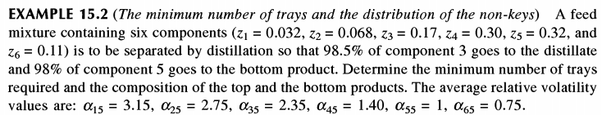

Slide 30
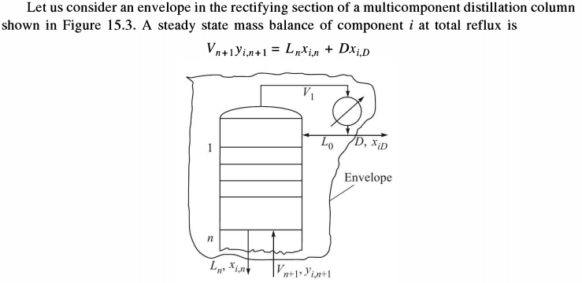


Slide 31
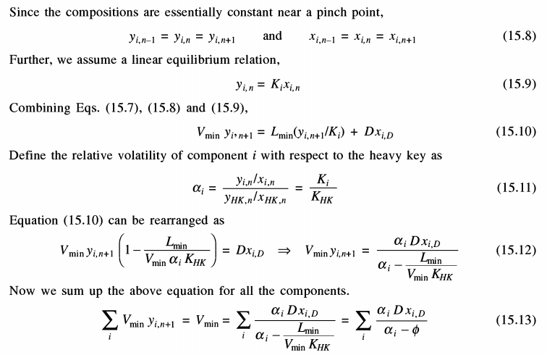

Slide 32
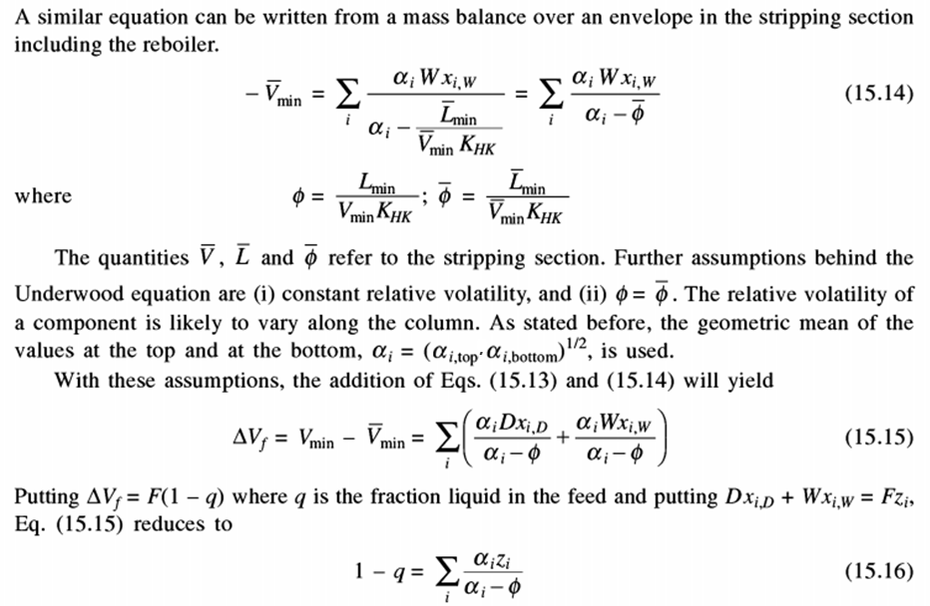

Slide 33
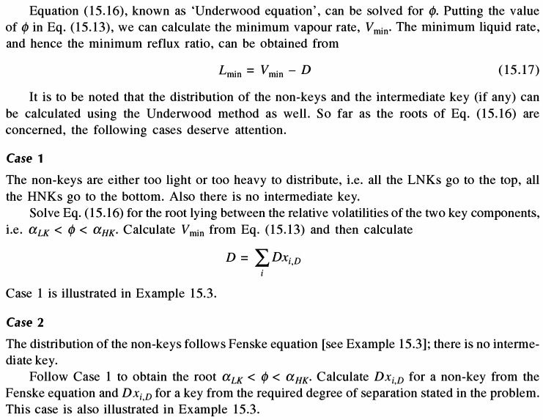

Slide 34
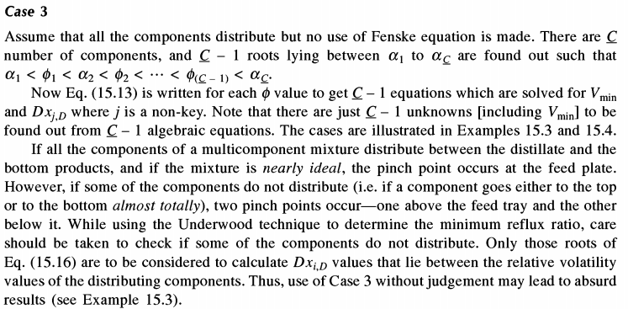

Slide 35
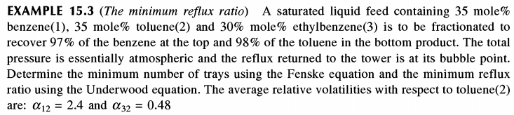

Slide 36
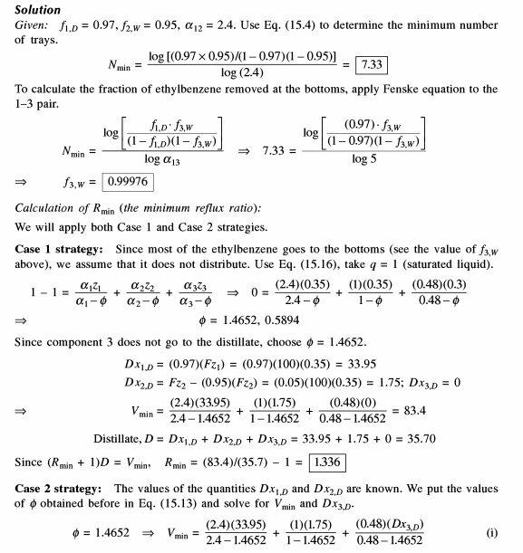


Slide 37


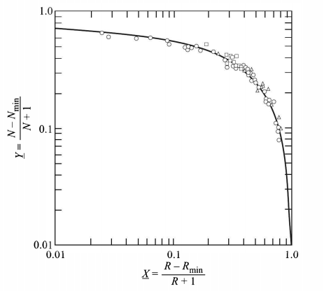

Slide 38
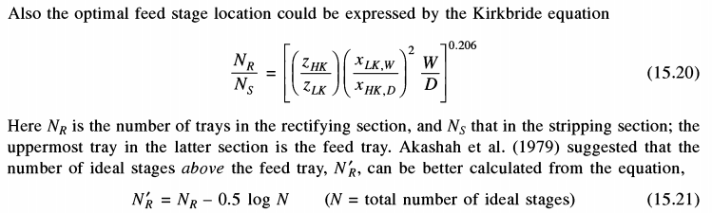

Slide 39



Slide 40
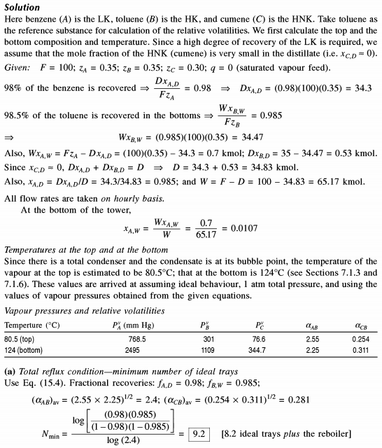

Slide 41
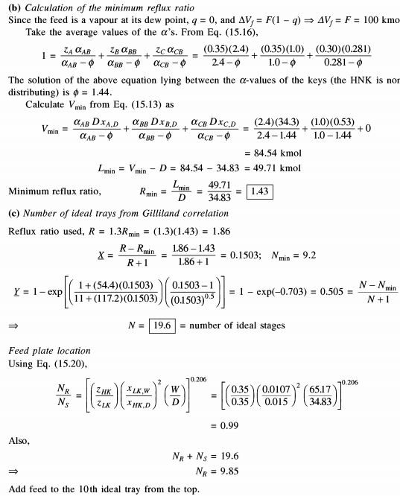

Slide 42

