Slide 1
Syn gas and associated petrochemicals
CL 355 Petrochemicals Technology
Module 4

Slide 2
Steam reforming of light hydrocarbon
Feed pretreated to remove sulphur and halogens traces. H₂S is removed using zinc oxide. ZnO + H₂S → ZnS + H₂O.
Organic sulphur removed by hydrotreating and H₂S removal from the feed. Halogens are removed using adsorption technique.
Steam reforming for hydrogen production is accomplished in four steps:
1. Reforming. This involves the catalytic reaction of methane with steam at temperatures in the range of 1400 to 1500°F (760–816°C), according to the following equation:
CH₄ + H₂O → CO + 3H₂ (endothermic)
The reaction is carried out by passing the gas through catalyst-filled tubes in a furnace. The catalyst usually is in the form of hollow cylindrical rings ranging up to 3/4 inch in diameter. It consists of 25 to 40% nickel oxide deposited on a low-silica refractory base. The steam to hydrocarbon ratio varies and is about 2.5 – 3.5.

Slide 3
2. Shift conversion. More steam is added to convert the CO from step 1 to an equivalent amount of hydrogen by the following reaction:
CO + H₂O → CO₂ + H₂ (exothermic)
The reaction and is conducted in a fixed-bed catalytic reactor at about 650°F (343°C). Multiple catalyst beds in one reactor with external cooling between beds are commonly employed to prevent the temperature from getting too high, as this would adversely affect the equilibrium conversion. The catalyst used is a mixture of chromium and iron oxide. It is interesting to note that these reactors operate at low temperatures. Therefore, cooling is carried out for the furnace reactor product and steam is generated. Similarly, steam is generated after the high temperature shift reactor also.

Slide 4
3. Gas purification. The third step is removal of carbon dioxide by absorption in a circulating amine or hot potassium carbonate solution. Several other treating solutions are in use. The treating solution contacts the hydrogen and carbon dioxide gas in an absorber containing about 24 trays, or the equivalent amount of packing. Carbon dioxide is absorbed in the solution, which is then sent to a still for regeneration of solvent.
4. Methanation. In this step, the remaining small quantities of carbon monoxide and carbon dioxide are converted to methane by the following reactions:
CO + 3H₂ → CH₄ + H₂O
CO₂ + 4H₂ → CH₄ + 2H₂O
This step is also conducted in a fixed-bed catalytic reactor at temperatures of about 700 to 800°F (427°C). Both reactions are exothermic and, if the feed concentration of CO and CO₂ is more than 3%, it is necessary to recycle some of the cooled exit gas to dissipate the heat of reaction. The catalyst contains 10 to 20% nickel on a refractory base. The product from methanation reaction consists of 97 % H₂.

Slide 5
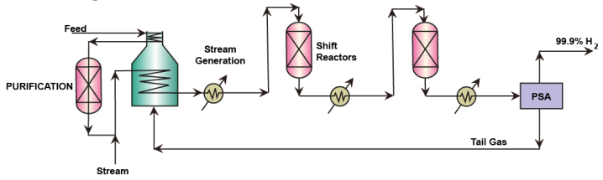
Alternatively, in some modern refineries, the low temperature shift reactor product is fed to a pressure swing adsorption (PSA) unit which produces 99.9 % hydrogen as a main product.
The PSA also produces a tail gas which is used as a fuel in the furnace used in the reformer process.
PSA technology also is incapable for CO and CO₂ removal as the adsorbents are not competent enough to separate these components to a large extent. But they can effectively do separation when hydrocarbons are present but not oxides in the hydrogen rich stream. Therefore, from PSA perspective as well it is important to remove CO₂ bulk with amine scrubbing followed with methanation reaction for both CO and CO₂ conversion. Activated carbon is used as the adsorbent.

Slide 6
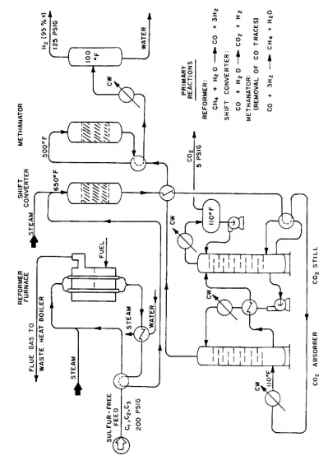

Slide 7
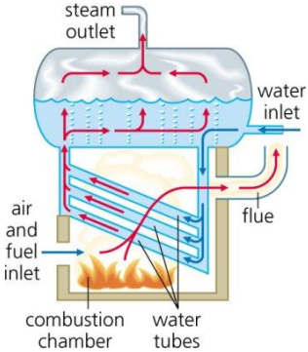
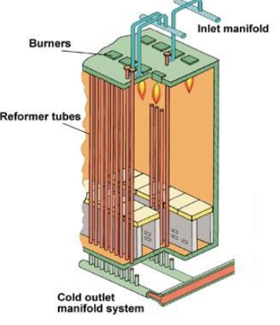
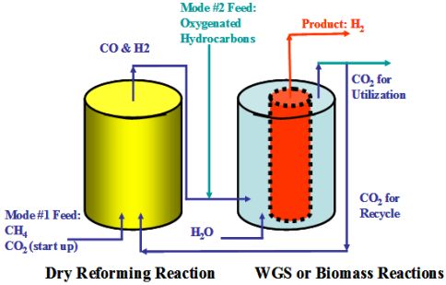
Furnace: Steam Production
Steam Reformer
Water Gas Shift Reactor (WGS)

Slide 8
PETROCHEMICALS based on C1, C2, C3

Slide 9
Manufacture of Methanol from Synthesis Gas
- Synthesis gas is H₂ + CO
- When synthesis gas is subjected to high pressure and moderate temperature
conditions, it converts to methanol.
- Followed by this, the methanol is separated using a series of phase separators
and distillation columns.
- The process technology is relatively simple
Reactions
- Desired: CO + 2H₂ → CH₃OH
- Side reactions: CO + 3H₂ → CH₄ + H₂O
2CO + 2H₂ → CH₄ + CO₂
- All above reactions are exothermic
- Undesired reaction: zCO + aH₂ → alchohols + hydrocarbons
- Catalyst: Mixed catalyst made of oxides of Zn, Cr, Mn, Al.

Slide 10
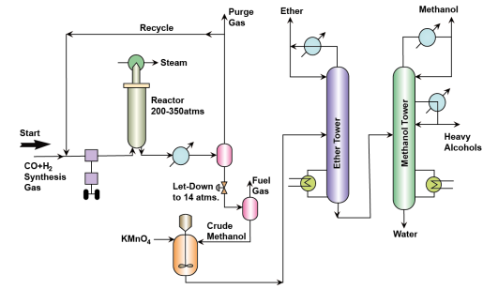
PFD-Methanol from synthesis gas

Slide 11
Process description of Methanol production from Syn gas
H₂ and CO adjusted to molar ratio of 2.25
- The mixture is compressed to 200 – 350 atms
- Recycle gas (Unreacted feed) is also mixed and sent to the compressor
- Then eventually the mixture is fed to a reactor. Steam is circulated in the heating tubes to maintain a temperature of 300 – 375 ºC.
  After reaction, the exit gases are cooled
  - After cooling, phase separation is allowed. In this phase separation operation methanol and other high molecular weight compounds enter the liquid phase and unreacted feed is produced as the gas phase.
  - The gas phase stream is purged to remove inert components and most of the gas stream is sent as a recycle to the reactor.
  - The liquid stream is further depressurized to about 14 atms to enter a second phase separator that produces fuel gas as the gaseous product and the liquid stream bereft of the fuel gas components is rich of the methanol component.
  - The liquid stream then enters a mixer fed with KMNO4 so as to remove traces of impurities such as ketones, aldehydes etc.
  - Eventually, the liquid stream enters a distillation column that separates dimethyl ether as a top product.
  - The bottom product from the first distillation column enters a fractionator that produces methanol, other high molecular weight alcohols and water as three different products.

Slide 12
Petrochemicals based on methane
(Formaldehyde and Chloromethanes)
Formaldehyde production
Reactions:
Oxidation: CH₃OH + 0.5O₂ → HCHO + H₂O (exothermic)
  Pyrolysis: CH₃OH → HCHO + H₂ (endothermic)
  Undesired reaction: CH₃OH + 1.5 O₂ → 2H₂O + CO₂ (exothermic)
The reactions are carried out in vapour phase. Catalyst: Silver or zinc oxide catalysts on wire gauge are used

Slide 13
Synthesis gas (CO + H₂)
This is mixture of CO and H₂
This can be produced by
coal gasification (water gas process)- the process is based on reaction of coke with steam and air. 2C + O₂→2CO,
C + H₂O →CO + H₂
Natural gas steam reforming process-catalytic oxidation of methane by steam. Catalyst is nickel on alumina, 700 deg C.
Naphtha reforming process

Slide 14
Synthesis gas to petrochemicals
Methanol
Molecular wt. 32.04
Melting point -97.8 degC
Boiling pt 64.7 DegC
Process – catalytic hydrogenation of CO.
Chemical reaction- CO + 2H₂ → CH₃OH
side reactions CO + 3H₂ →CH₄ + CO₂
2CO +2H₂ → CH₄ + CO₂

Slide 15
Hydrogen and CO in a mole ratio of 2.25 is compressed 3000-5000 psi, mixed with recycle gas, and fed to a high pressure converter. Internal preheat is usually used. The reactor is copper lined steel and contains a mixed catalyst of zinc oxide, chromium oxide, manganese oxide or aluminum oxide.
Temperature is maintained at 300-375 Deg C by proper space velocity and heat exchange design.
The exit gases are cooled by heat exchange reactant stream and then water
The methanol condenses.
The liquid methanol is depressurized, purified by permanganate to retraces of ketones, aldehydes, and other impurities, sent to a stripper to remove light ends such as dimethyl ether, and to a fractionator to separate methanol from the higher molecular weight compounds.

Slide 16
Formaldehyde from Methanol
Formaldehyde production Reactions:
a) Oxidation: CH₃OH + 0.5 O₂ → HCHO + H₂O exothermic
b) Pyrolysis: CH₃OH → HCHO + H₂ endothermic
c) Undesired reaction: CH₃OH + 1.5 O₂→ 2H₂O + CO₂ exothermic
The reactions are carried out in vapour phase.
Catalyst: Silver or zinc oxide catalysts on wire gauge are used.
Operating temperature and pressure: Near about atmospheric pressure and 500 – 600 °C

Slide 17
Process description
Air is sent for pre-heating using reactor outlet product and heat integration concept.
- Eventually heated air and methanol are fed to a methanol evaporator unit which enables the evaporation of methanol as well as mixing with air.
The feed ratio is about 30 – 50 % for CH₃OH: O₂
- After reaction, the product is a vapour mixture with temperature 450 – 600 °C.
- After reaction, the product gas is cooled with the heat integration concept and then eventually fed to the absorption tower.
- The absorbent in the absorption tower is water as well as formaldehyde rich water.
- Since formaldehyde rich water is produced in the absorption, a portion of the rich water absorbent solution from the absorber is partially recycled at a specific section of the absorber.
- From the absorber, HCHO + methanol rich water stream is obtained as the bottom product.
- The stream is sent to a light end stripper eventually to remove any light end compounds that got absorbed in the stream. The vapors from the light end unit consisting of light end compounds can be fed at the absorption unit at specific location that matches with the composition of the vapors in the absorption column.
- Eventually, the light end stripper bottom product is fed to a distillation tower that produces methanol vapour as the top product and the bottom formaldehyde + water product (37 % formaldehyde concentration).
Pure formaldehyde is not stable and tends to produce a trimer or polymer. Formaldehyde is stable in only water and therefore, 37% formaldehyde solution with 3 – 15 % methanol (stabilizer) is produced as formalin and sold

Slide 18
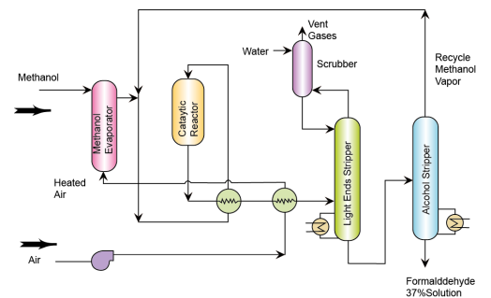
Flow sheet of Formaldehyde production

Slide 19
Manufacture of Chloromethanes from methane
Chloromethanes namely methyl chloride (CH₃Cl), methylene chloride (CH₃Cl2), Chloroform (CHCl₃) and Carbon Tetrachloride (CCl₄) are produced by direct chlorination of Cl₂ in a gas phase reaction without any catalyst.
Reactions:
CH₄ + Cl₂→ CH₃Cl + HCL
CH₃Cl + Cl₂→ CH₂Cl₂ + HCL
CH₂Cl₂ + Cl₂→ CHCl₃ + HCL
CHCl₃ + Cl₂→ CCl₄ + HCL
The reactions are very much exothermic.
The feed molar ratio affects the product distribution. When CH₄/Cl₂ is about 1.8, then more CH₃Cl is produced. On the other hand, when CH₄ is chosen as a limiting reactant, more of CCl₄ is produced. Therefore, depending upon the product demand, the feed ratio is adjusted.

Slide 20
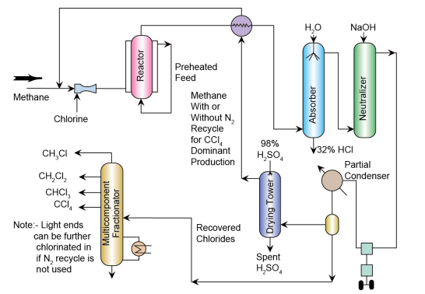
PFD-Chloromethanes

Slide 21
Methane and Cl2 are mixed and sent to a furnace
- The furnace has a jacket or shell and tube system to accommodate feed preheating to desired furnace inlet temperature (about 280 – 300 ºC).
- To control temperature, N2 is used as a diluent at times.
- Depending on the product distribution desired, the CH4/Cl2 ratio is chosen.
- The product gases enter an integrated heat exchanger that receives separated CH₄ (or a mixture of CH₄ + N₂) and gets cooled from the furnace exit temperature (about 400 ºC).
- Eventually, the mixture enters an absorber where water is used as an absorbent and water absorbs the HCl to produce 32 % HCl.
- The trace amounts of HCl in the vapour phase are removed in a neutralizer fed with NaOH.
- The gas eventually is compressed and sent to a partial condenser followed with a phase separator. The phase separator produces two streams namely a liquid stream consisting of the chlorides and the unreacted CH₄/N₂.
- The gaseous product enters a dryer to remove H₂O from the vapour stream using 98% H2SO4 as the absorbent for water from the vapour.
- The chloromethanes enter a distillation sequence. The distillation sequence consists of columns that sequentially separate CH₃Cl, CH₂Cl₂, CHCl₃ and CCl₄.

Slide 22
Consumption pattern of Chloromethanes
as Solvents
Intermediate products e.g.,
CH₃Cl + Si → (CH₃)₂SiCl₂ (silicones)
CH₃Cl+ Pb → (CH₃)₄Pb
CH₃Cl + Na-cellulose → methylcellulose

Slide 23
Petrochemicals from C₂ compounds
Ethylene and acetylene are the raw materials for C2 petrochemicals like ethylene di chloride, vinyl chloride, polyethylene etc

Slide 24
Ethylene dichloride
Reactions - C₂H₄ + Cl₂ →C₂H₄Cl₂
Undesired products: Propylene dichloride and Polychloroethanes
Reaction occurs in a liquid phase reactor with ethylene dichloride serving as the liquid medium and reactants reacting the liquid phase
Catalyst is FeCl₃ or Ethylene dibromide

Slide 25
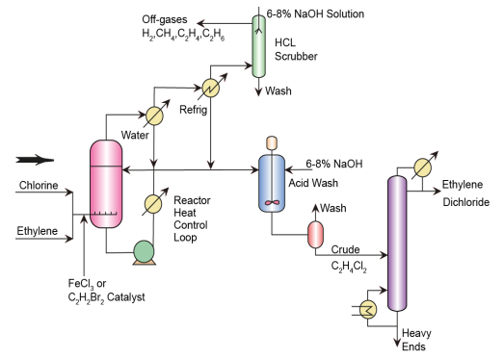
PFD-Vinyl Chloride from Ethylene

Slide 26
Vinyl chloride production
Reaction
- C₂H₄Cl₂→ CH₂CHCl + HCl
- Charcoal is used as the catalyst
The reaction is a reversible gas phase reaction

Slide 27
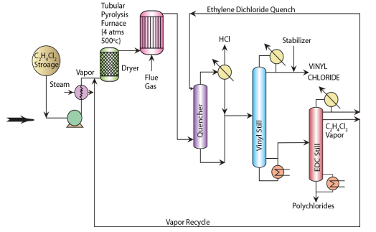

Slide 28

Ethylene Oxide
Reactions:
C₂H₄ + 0.5 O₂ → + CO₂ + H₂O
Ethylene to air ratio: 3 – 10 %
- Side reaction products: CO₂, H₂O
- Catalyst: Silver oxide on alumina
- Operating temperature and pressure: 250 – 300 ºC and 120 – 300 psi
- Suppressing agent for side reactions: Ethylene dichloride
- Reaction is exothermic

Slide 29
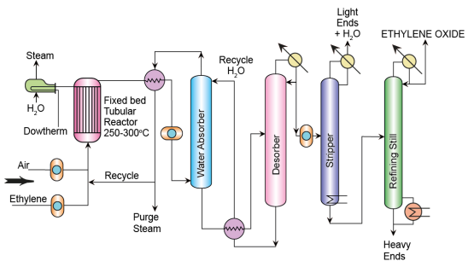
Flow sheet of production of ethylene oxide

Slide 30
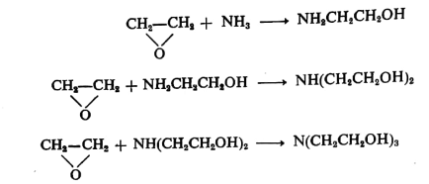
Ethanolamines
Reactions
- Ethylene Oxide + Ammonia → Monoethanolamine
- Monoethanolamine + Ethylene Oxide → Diethanolamine
- DIethanolamine + Ethylene Oxide → Triethanolamine
- The above reactions are series reaction scheme
- Reaction is exothermic
- Ammonia is in aqueous phase and ethylene oxide is in vapour state. Therefore, the reaction will be gas-liquid reaction
- Ethylene oxide is the limiting reactant

Slide 31
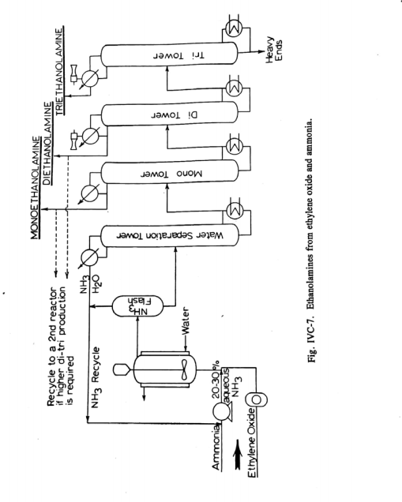

Slide 32
Topic to be read by students from Dryden’s book
Vinyl acetate (from acetylene and acetic acid)
Acetaldehyde
Acetic acid

Slide 33
Polyethylene
Three main types of PE plastics are obtained—low density polyethylene (LDPE), linear low density polyethylene (LLDPE), and high density polyethylene (HDPE)
PE is the polymer (poly + monomer) of ethylene molecules
Polymerization of ethylene molecules into heavy
molecular weight PE is a reaction in which a chain of macromolecule, is produced by the combination of ethylene molecules.
Ethylene combines with other molecules of ethylene in the presence of a catalyst (Ziegler–Natta catalyst) under a certain pressure and temperature.

Slide 34
The reaction steps
initiation, propagation, and termination
A radical molecule is formed in the presence of the catalyst in the initiation step.
The radical then starts combining with the monomers repeatedly in the propagation stage.
The propagation continues indefinitely as long as the monomer molecules are available during reaction until quenched at the termination stage.
The reaction is exothermic and hence it is essential to control temperature by a proper heat removal system.

Slide 35
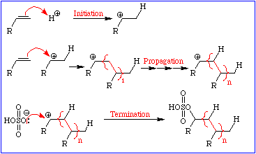

Slide 36
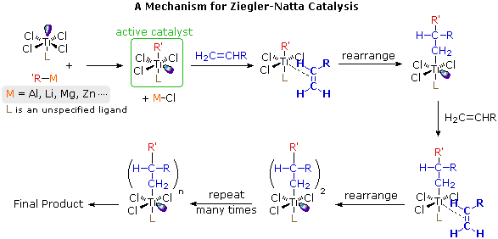
Ziegler-Natta catalysts are prepared by reacting certain transition metal halides with organometallic reagents such as alkyl aluminum, lithium and zinc reagents.

Slide 37
Types of PE
Three main types of PE plastics are obtained—low density polyethylene
(LDPE, branched 0.92 gm/cc), linear low density polyethylene (LLDPE, linear or less branched, 0.92-0.93 gm/cc), and high density polyethylene (HDPE, crystalline, 0.96 gm/cc)

Slide 38
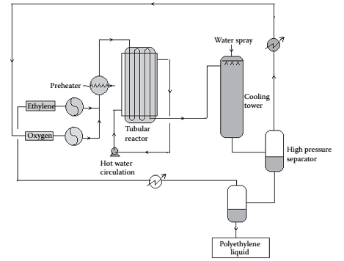
Low Density Polyethylene

Slide 39
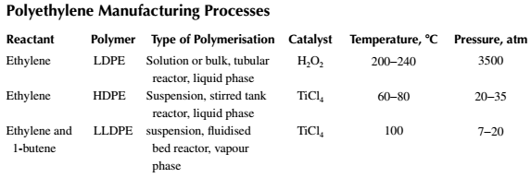

Slide 40
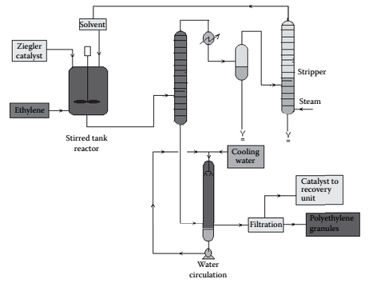
High Density Polyethylene

Slide 41
HDPE is manufactured by the suspension polymerization method.
High purity ethylene is introduced into the reactor vessel in which a catalyst (Ziegler-Natta catalyst, TiCl₄ in alkyl aluminium) is suspended in benzene at a pressure of 20−35 atm and at a temperature of 60°C−80°C.
The ratio of alkyl aluminium and titanium chloride determines the size of the polymer. The greater the ratio, the greater the molecular weight of the polymer.
The polymer mixture is separated from ethylene and inerts in a flash drum
Polymer is water washed and filtered to recover the catalyst (water soluble) and reused.
Recovery of the catalyst from the polymer is not complete. Catalyst consumption is about 1 g of titanium (Ti) per 1500 kg of polymer.
Modern catalyst consumption is about 1 gm/6000 kg of polymer
Catalyst in ppm level is remained with polymer as impurity.

Slide 42
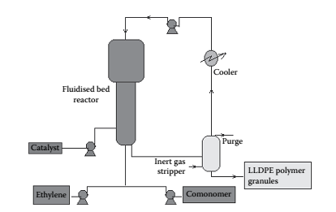
LINEAR LOW DENSITY POLYETHYLENE

Slide 43
LLDPE is a copolymer of ethylene and 1-butene having linear structure.
It is produced by a low pressure fluidized bed process where the temperature and pressure are 100°C and 7−20 atm (0.7−2 MPa), respectively.
Gaseous monomers are used to fluidize the polymer granules (seeding) previously prepared.
During polymerization, additional polymers are produced of specific sizes depending on the seed polymers present.
Unreacted monomers are separated from the effluent and recycled to the reactor.
A long residence time in the range of 3−5 h is required for a reaction.
The process is shown in Figure

Slide 44
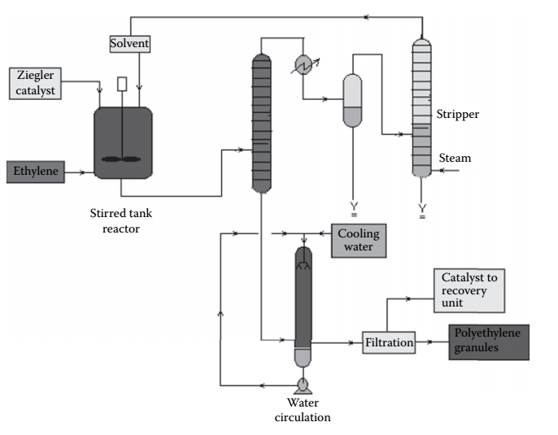
Low pressure Ziegler process for high density polyethylene manufacture

Slide 45
HDPE
HDPE is manufactured by the suspension polymerization method. In this method, high purity ethylene is introduced into the reactor vessel in which a catalyst (Ziegler-Nutta catalyst, TiCl₄ in alkyl aluminum) is suspended in benzene at a pressure of 20−35 atm and at a temperature of 60°C−80°C. The ratio of alkyl aluminium and titanium chloride determines the size of the polymer. The greater the ratio, the greater the molecular weight of the polymer. After the reaction, the polymer mixture is separated from ethylene and inerts in a ﬂash drum. The polymer is water washed and filtered to recover the catalyst (water soluble) and reused.
However, recovery of the catalyst from the polymer is not complete. Catalyst consumption is about 1 g of titanium (Ti) per 1500 kg of polymer. This is due to the high residual presence of the catalyst within the polymer. The presence of this impurity limits the HDPE’s applications. A modern catalyst has been developed that can yield 6000 kg polymer per gram of Ti, where the contamination of Ti metal in the polymer is a few parts per million.
HDPE has a rigid and translucent property and is suitable for making electrical goods, bottles, ropes, etc. The main economic advantage of HDPE is that it can be manufactured at much lower pressure as compared to LDPE.

Slide 46
Propylene and allied chemicals
Sources of propylene
1. steam cracking of naphtha
2. catalytic cracking of petroleum distillate- fluidized catalytic cracking of petroleum distillate (bp 350-550°C)

Slide 47
Polypropylene
Polypropylene is a valuable polymer and is used as plastic for making pipes, ropes, fibers, etc.
It is manufactured by catalytic reaction in a stirred tank reactor, where Ti and aluminum halides are used as catalysts at a temperature of 60°C−70°C and a pressure of 1−2 Mpa.
Unreacted monomer is recycled after it is separated from the catalyst and polymer mixture in a flash chamber under vigorous stirring conditions.
The mixture of polymer and catalyst is then passed to a centrifugal separator where a catalyst and polypropylene polymer is recovered.
The spent catalyst in the presence of alcohol is carried out to recover the active components of the catalyst for its reuse.

Slide 48
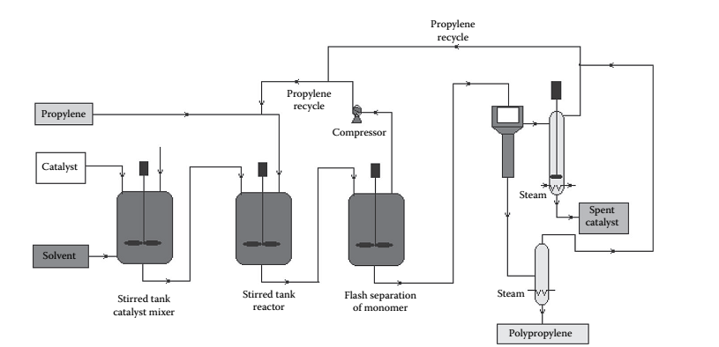
PFD-Polypropylene

Slide 49

Petrochemicals from propylene
Isopropanol
Molecular wt. 60.1
M.P. -89.5 Deg C
B.P. 82.5 deg C

Slide 50
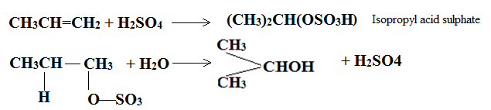
Isopropanol
Direct catalytic hydration of propylene
Hydration of propylene via sulfation and hydrolysis.
The primary reaction is a liquid-liquid reaction in which propylene is absorbed into a tray tower fed with sulphuric acid
Operating conditions: Room temperature, but 20 – 25 atms pressure
Reaction is highly exothermic
Chemical reaction:
Sulfation and Hydrolysis

Slide 51
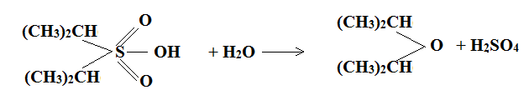
Side reaction: ether formation
Diisopropyl sulphate

Slide 52
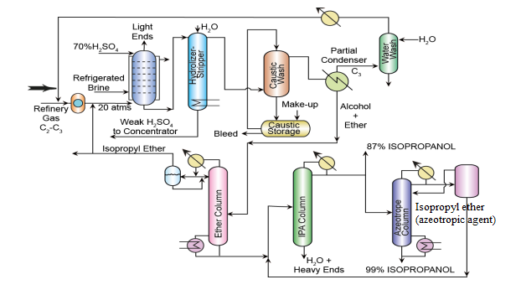
25 atm, 20-30 ⁰C

Slide 53
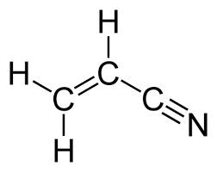
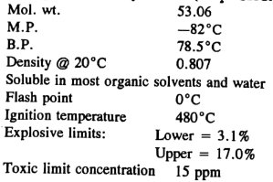

Acrylonitrile from Propylene
Uses
Reactions
C₃H₆ + NH₃ + O₂→ C₃H₃N + H₂O
The reaction is exothermic
Stoichiometric ratio: C₃H₆ : NH₃ : O₂ = 1:1:1.5
Operating conditions: 1.5 – 3 atms pressure and 400 – 500ºC
By products: Acetonitrile and Hydrogen cyanide from side reactions
Catalyst: Mo-Bi catalyst

Slide 54
