Slide 1
Aromatic based Chemicals
CL355 Petrochemicals Technology
Module 3

Slide 2
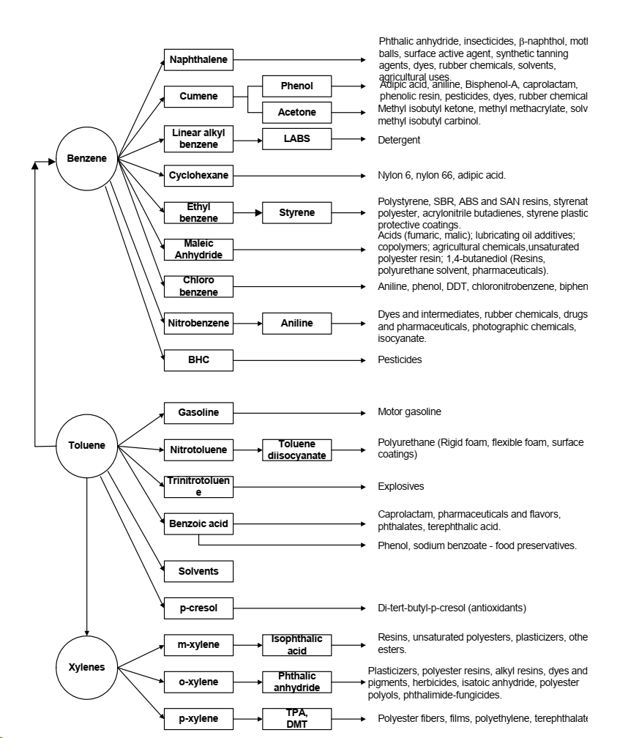

Slide 3
Alkylation of Benzene to manufacture Ethyl benzene
Benzene alkylation is conducted to manufacture ethyl benzene which is the raw material for making styrene.
Ethyl benzene is made by alkylation of benzene which is a Friedel-Craft reaction using anhydrous aluminum chloride (or phosphoric acid) as the catalyst. The reaction temperature is set at 95°C and pressure at 1 atm.
The feed steam must be very dry and the reaction should be carried out in absence of moisture and air.
Benzene (wet) is sent first to an azeotropic distillation unit that separates water and produces dry Benzene from the bottom. Dry Benzene is required so as to avoid unnecessary reactions in the alkylation reactor as well as damage to the catalyst as alumina can get formed.
High purity dry benzene and about 98% dry ethylene in ratio of benzene/ethylene 10:6 are made to react at about 90-95ºC and near normal pressure. Lesser amount of ethylene than stoichiometric quantity is used in order to reduce the yield of polyalkylated benzene.
A small amount of ethyl chloride is used as promoter which contributes hydrogen and chlorine free radicals.

Slide 4
The reactor could be a jacketed tower where water is used as a cooling fluid in the jacket to control the reactor temperature.
The alkylator product is sent to a cooler which upon cooling to 40ºC separates the aluminum chloride complex stream from the product stream. The other stream from the cooler is the ethylbenzene rich product stream.
The aluminum chloride stream is partially recycled to the alkylator so as to maintain the required catalyst requirements. The other portion of the AlCl₃ complex is sent to a dealkylator unit in which the feed is heated to 200 ºC. By doing so, the polyethylbenzenes formed in the alkylator are converted to benzene and ethylbenzene (cracking reaction).
The benzene and ethylbenzene are returned to the cooler.
The delkylator produces a residue product consisting of tar + AlCl₃ mixture.
From this mixture, AlCl₃ is recovered using water extraction as AlCl₃ is soluble in water. From there AlCl₃ is recovered from the water and returned back to the alkylation reactor.
The product stream from the cooler consisting of ethylbenzene is mixed with 50 % NaOH to remove acidic impurities. Eventually, after settling waste is eliminated.

Slide 5
The purified ethylbenzene then enters a stripper that separates ethylbenzene + benzene from the polyalkylbenzenes. The polyalkylbenzenes are sent to a polyalkyl still that separates the benzene + ethylbenzenes from the polyalkylbenzenes (bottom product). The polyalkyl still is operated under vacuum.
The polyalkylbenzenes are fed to the dealkylator and the benzene + ethylbenzene rich stream is sent to a heat integrated exchanger that extracts heat from the vent gases and then eventually enters the alkylation reactor.
The top product from the stripper is ethylbenzene + benzene and it enters a benzene column that separates wet benzene from crude ethylbenzene. The wet benzene is recycled to the azeotropic dryer where it is mixed with fresh wet benzene to enter the azeotropic dryer.
The crude ethylbenzene is further purified in a fractionator where the bottom product is mixed with the top product of the polyalkyl still. Thereby, the stream enters the heat integrated exchanger.
The ethylbenzene is further subjected to caustic wash and finally it is sent to a dryer to produce dry ethylbenzene.

Slide 6
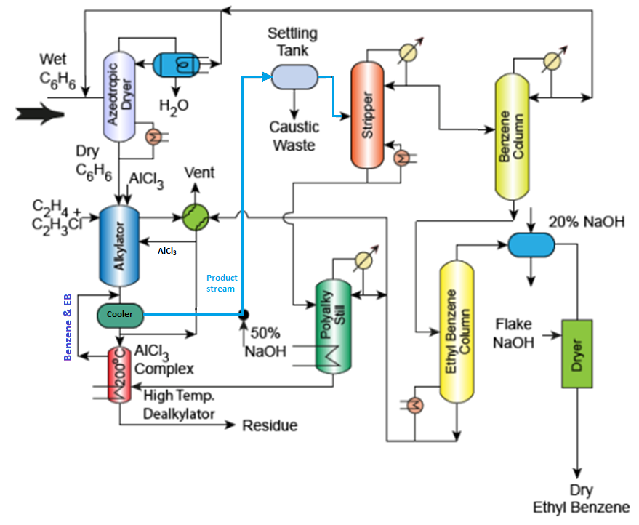
https://nptel.ac.in/courses/103103029

Slide 7
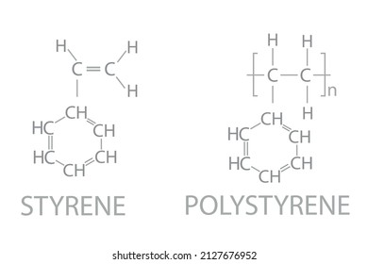
Styrene from Ethylbenzene
The ethylbenzene (dry) is heated with superheated steam to enter the catalytic dehydrogenator. Excess steam is used in this process. The feed pre-heating is carried out using the product vapour stream. The reaction is gas phase catalytic reaction.
The vapour stream after cooling with the feed stream in a heat integrated exchanger is fed to a quench tower using steam quenching.
After quenching, partial condensation of the quenched vapors produces three streams one being the vapour vent, the other being water and the third being the organic phase rich with styrene.
The styrene rich stream is sent first to a benzene column to recover the benzene + toluene and this is sent to a benzene-toluene distillation column to recover benzene. The benzene is sent to the azeotropic distillation unit as a raw-material.
The bottom product from the benzene column enters an ethylbenzene column which separates ethylbenzene from the styrene stream. The ethylbenzene stream is mixed with the dry ethylbenzene to enter the catalytic dehydrogenator.
The bottom product from the ethylbenzene column is the styrene enriched stream and this is sent to the finishing column where styrene is further purified from unwanted impurities such as tar. The tar is further batch distilled to recover styrene from the tar. The styrene finishing column also produces styrene product. Both styrene products from batch still and styrene finishing column are mixed and cooled to store as styrene product.
All three columns namely benzene, ethylbenzene and finishing columns are operated under vacuum.
Colorless or yellowish oily liquid
Density | 0.909 g/cm³
M. P. | −30 °C
B.P. | 145 °C

Slide 8
Styrene is primarily produced via the endothermic catalytic dehydrogenation of ethylbenzene (EB). This process converts ethylbenzene to styrene and hydrogen, typically achieving 50–60% single-pass conversion
Reaction Conditions
Temperature: 500–700°C, with a common, optimized operating range of 580–640°C.
Pressure: Low pressure favors the forward reaction, typically operating from vacuum (0.3 bar) up to 5 bar, but close to 1.0 bar (atmospheric) is commonly used to optimize yield.
Catalyst: Potassium-promoted iron oxide.
Steam/Ethylbenzene Ratio: Steam is used as a heating source and for catalyst regeneration, with a ratio of 3 to 20 moles of steam per mole of ethylbenzene.
Reactor Type: Series of adiabatic packed bed reactors or radial-flow reactors.

Slide 9
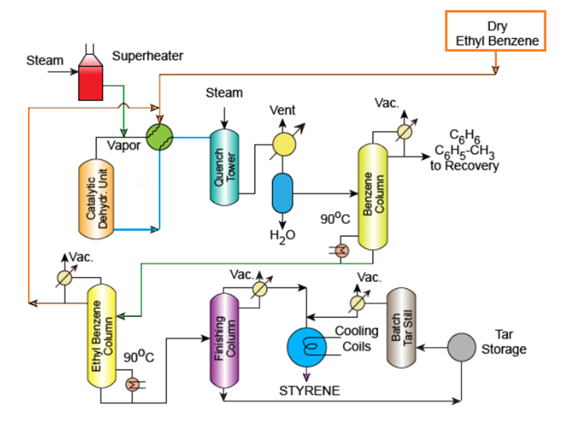
Styrene from Ethylbenzene: PFD

Slide 10
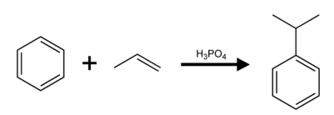
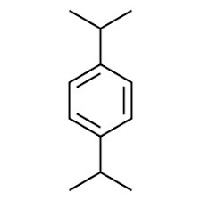
PROCESSES OF MANUFACTURE OF CUMENE
Currently almost all cumene is produced commercially by two processes.
1. A fixed bed, Kieselguhr supported phosphoric acid catalyst system developed by UOP (Universal Oil Products Platforming Process).
2. A homogeneous AlCl₃ and hydrogen chloride catalyst system developed by Monsanto.
UOP Cumene Process:
Propylene feed fresh benzene feed and recycle benzene are charged to the upflow reactor, which operates at 25 atm. and at 200-260°C. The solid phosphoric acid catalyst provides an essentially complete conversion of propylene on a one-pass basis. The typical reactor effluent yield contains 94.8 Wt. % cumene and 3.1 Wt. % of diisopropylbenzene. The remaining 2.1 % is primarily heavy aromatics. This high yield of cumene is achieved without transalkylation of diisopropylbenzene and is unique to the solid phosphoric acid catalyst process.
The cumene product is 99.9 Wt. % pure and the heavy aromatics, which have an octane number of 109, can either be used as high octane gasoline blending components or combined with additional benzene and sent to a transalkylation section of the plant where diisopropylbenzene is converted to cumene. The overall yields of cumene for this process are typically 97-98 Wt. % with transalkylation and 94-96 Wt. % without transalkylation.
+

Slide 11
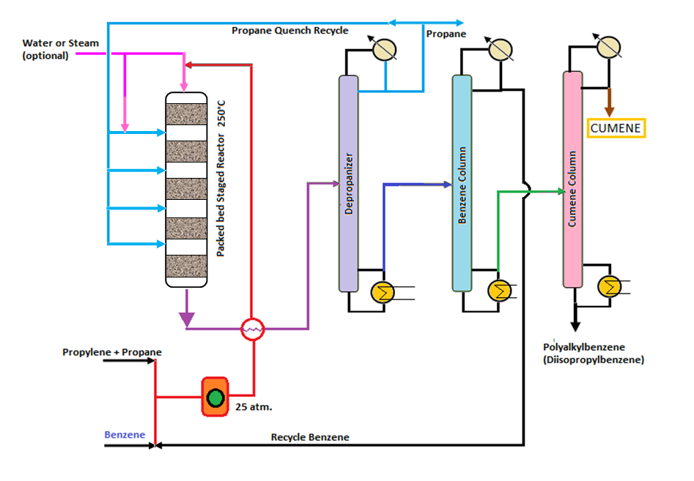
Cumene from Benzene: PFD

Slide 12
Cumene production
Propylene obtained from refinery processes as a mixture of propylene and propane.
The mixture along with benzene is compressed to 25 atm. pressure.
Eventually the mixture enters a heat integrated exchanger to heat the pre-heat the feed mixture.
The feed mixture enters a packed bed reactor.
The stream distribution in the packed bed reactor corresponds to cold shot arrangement i.e., cold propane from the distillation column in the process is added after every reactor with the product stream so that the temperature of the stream is controlled.
Here, propylene is the limiting reactant and therefore, presumably all propylene undergoes conversion.
Here, propane does not react but is a diluents or inert in the system. In that way it controls the reaction temperature.
The reactor units are maintained at about 250 ºC.
The product vapors are cooled using the heat integrated exchanger.
The vapors then pass to a depropanizer which separates propane from the product mixture.
The bottom product consisting of benzene, cumene and polyalkyl benzenes enters another distillation column which separates benzene from the mixture of cumene and polyalkyl benzene. The benzene stream is recycled to enter the compressor.
The bottom product from the benzene column is sent to a cumene column which produces cumene as top product and poly alkyl benzene as bottom product.

Slide 13
Monsanto – Lummus Crest Cumene Process:
Dry benzene, fresh and recycle and propylene are mixed in the alkylation reaction zone with AlCl₃ and hydrogen chloride catalyst at a temperature of less than 135°C and a pressure of less than 0.4 Mpa. The effluent from the alkylation zone is combined with recycle polyisopropyl benzene and fed to the transalkylation zone, where polyisopropyl benzenes are transalkylated to cumene. The strongly acidic catalyst is separated from the organic phase by washing the reactor effluent with water and caustic.
The distillation system is designed to recover a high purity cumene product. The unconverted benzene and polyisopropyl benzene are separated and recycled to the reaction system. Propane in the propylene feed is recovered as liquid petroleum gas. The overall yields of cumene for this process can be high as 99 Wt. % based on benzene and 98 Wt. % based on propylene. But these processes have been used more extensively for the production of ethylbenzene than for the production of cumene.

Slide 14
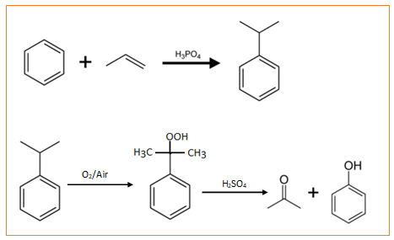
Phenol manufacture from cumene
This process is now widely used method for phenol production. Benzene is alkylated first with propylene to cumene, which is air-oxidized to cumenehydroperoxide. The latter is catalytically decomposed into an equimolar mixture of phenol and acetone.
The purified cumene is air-oxidized to cumene hydroperoxide at about 100-130ºC and near atm. pressure in slightly alkaline condition. The conversion per pass is of order of 35-40% restrict the formation of by-products. The cumene hydroperoxide is separated from the unconverted cumene , which is recycled.
The final stage of the process is the decomposition of cumene hydroperoxide, which is carried out in the presence of hot (70-90ºC) dilute H₂SO₄ (10-25%). The decomposition products are neutralized by alkali wash and separated by distillation.
The product yield is 60 wt% phenol. This process is also a production method for acetone.

Slide 15

Fresh cumene is mixed with hydrogenated unreacted cumene, cumene + alpha methyl styrene (recycle streams) . The pre-purification step involves converting unsaturates such as alpha methyl styrene and others to saturates. This is done by using nickel catalyst at 100 ºC and feeding hydrogen to the pre-purification reactor. The product from this unit then mixes with the fresh cumene.
The fresh cumene and processed cumene and alpha methyl styrene are fed to the oxidation reactor. The oxidation reactor refers to a gas liquid reaction between air (Oxygen) and the cumene.
An emulsion of cumene is prepared in the oxidation reactor by adding alkali to it.
The pH is maintained in the range of 8.5 – 10.5 to suit good emulsification conditions.
After reaction, vent gases are condensed and recycled back and the product is sent to a cleavage unit. The cleavage unit consists of a stirrer and is fed with fresh and recycled H₂SO₄ aqueous solution to enable the hydrolysis of cumenehydroperoxide.
The product streams from the cleavage unit enter a settler (phase separator) which upon gravity settling yields two streams namely the acid rich aqueous stream and the phenol rich organic stream. The aqueous stream consists of the sulphuric acid and is sent back to the cleavage unit as a recycle stream.
alpha methyl styrene

Slide 16
The organic stream consists of cumene (unreacted), phenol (product), acetone (side product), alpha methyl styrene (side product) and acetophenone (side product).
The organic stream from the gravity settler unit then enters a scrubber fed with water. In this operation, water extracts the remaining acids in the organic stream and produces crude phenol stream. Water leaving the unit consists of acidified wash water.
The crude phenol then enters a distillation unit that separates acetone from the other components.
The bottom product from this distillation column enters a vacuum distillation column that produces cumene as a top product.
The bottom product from the distillation column enters another vacuum distillation unit to produce alpha methyl styrene.
The bottom product of this distillation column enters the final vacuum distillation unit to produce phenol as top product and acetophenone as the bottom product.

Slide 17
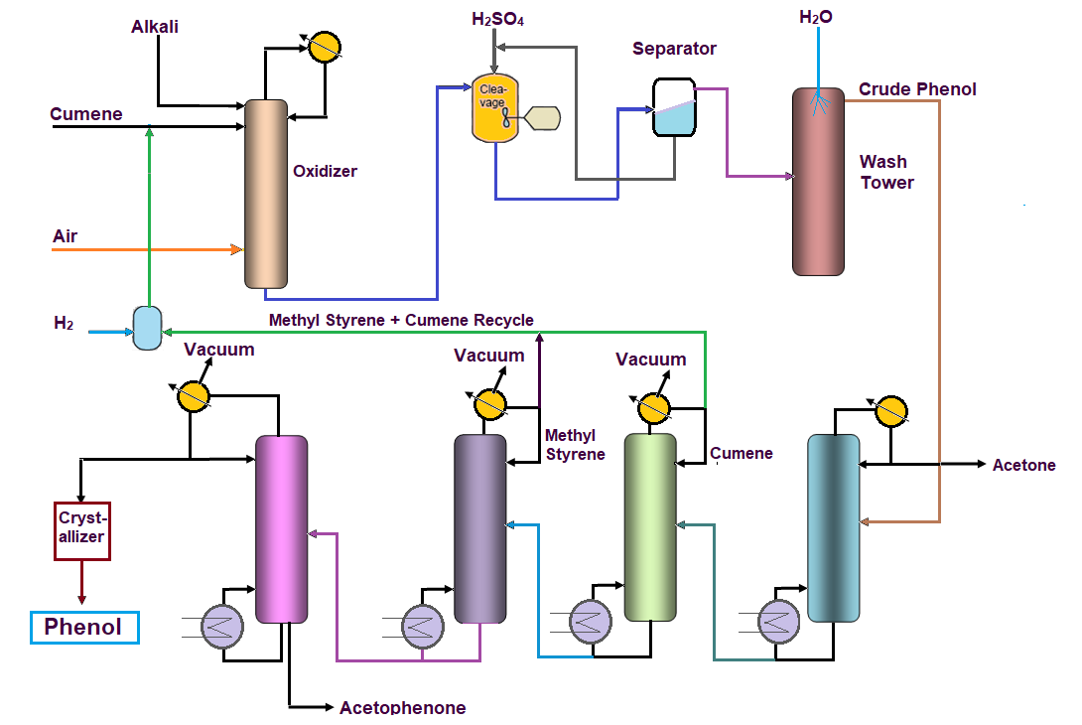
Phenol from Cumene

Slide 18
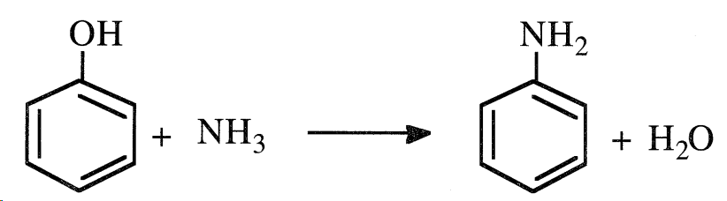
Aniline (C₆H₅NH₂) from Phenol
Aniline (aminobenzene) is an oily liquid that turns brown when exposed to air and light. The compound is an important dye precursor.
Phenol reacts with ammonia at 300∘C in the presence of anhydrous ZnCl₂ to give aniline.
Ammonolysis of phenol occurs in the vapor phase. In the Scientific Design Co. process, a mixed feed of ammonia and phenol is heated and passed over a heterogeneous catalyst in a fixed-bed system. The reactor effluent is cooled, the condensed material distilled, and the unreacted ammonia recycled. Aniline produced this way should be very pure.

Slide 19
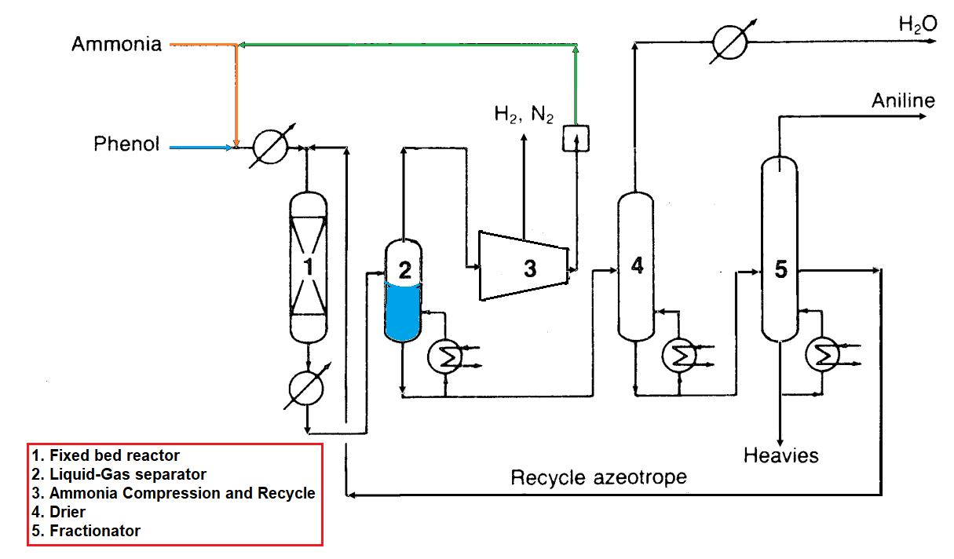
Aniline from Phenol

Slide 20
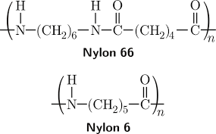
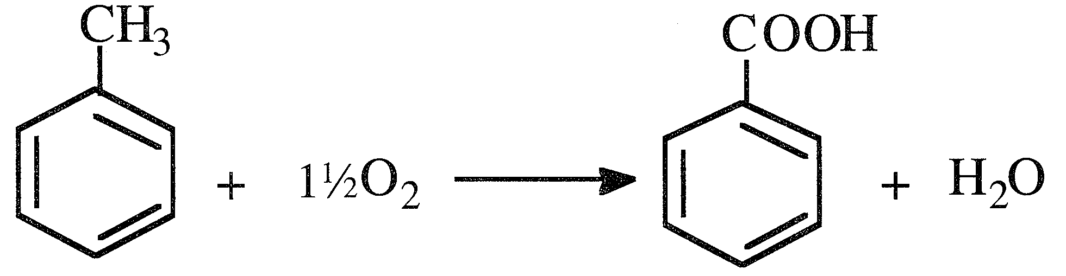
Caprolactam Production
Caprolactam, a white solid that melts at 69°C, can be obtained either in a fused or flaked form. It is soluble in water, ligroin, and chlorinated hydrocarbons. Caprolactam’s main use is to produce nylon 6.
Other minor uses are as a crosslinking agent for polyurethanes, in the plasticizer industry, and in the synthesis of lysine.
Oxidizing toluene in the liquid phase over a cobalt acetate catalyst produces benzoic acid. The reaction occurs at about 165°C and 10 atmospheres. The yield is over 90% .
Benzoic acid (benzene carboxylic acid) is a white crystalline solid with a characteristic odor. It is slightly soluble in water and soluble in most common organic solvents. Though much benzoic acid gets used as a mordant in calico printing,
it also serves to season tobacco, preserve food, make dentifrices, and kill fungus. Furthermore it is a precursor for caprolactam, phenol, and terephthalic acid.

Slide 21
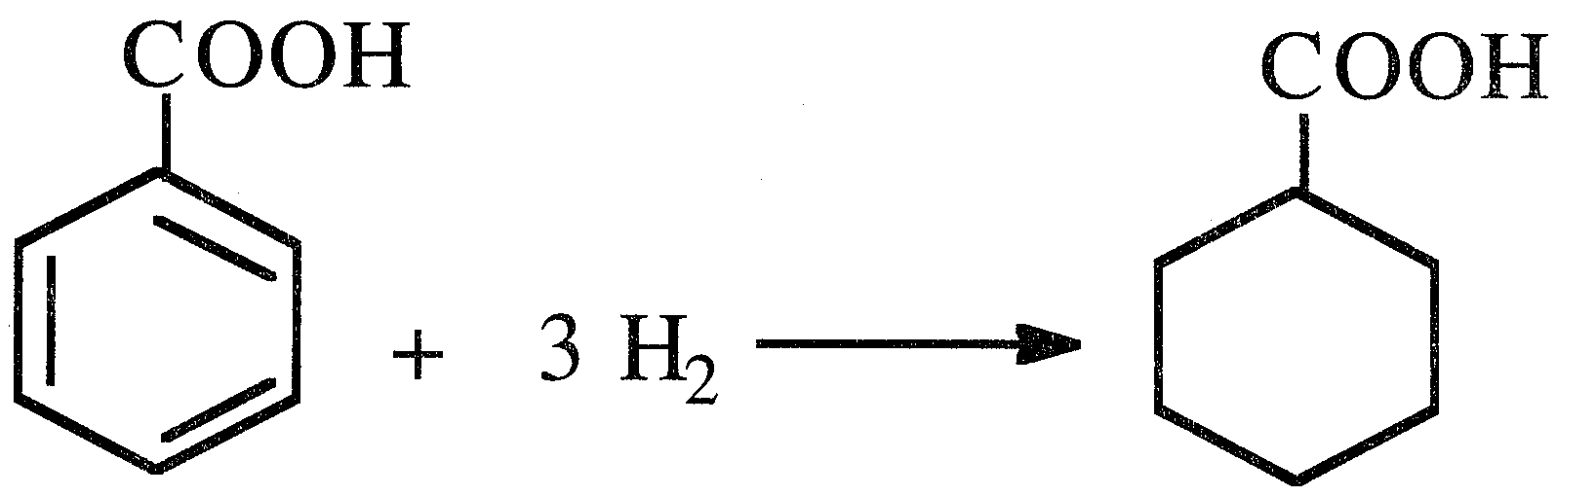
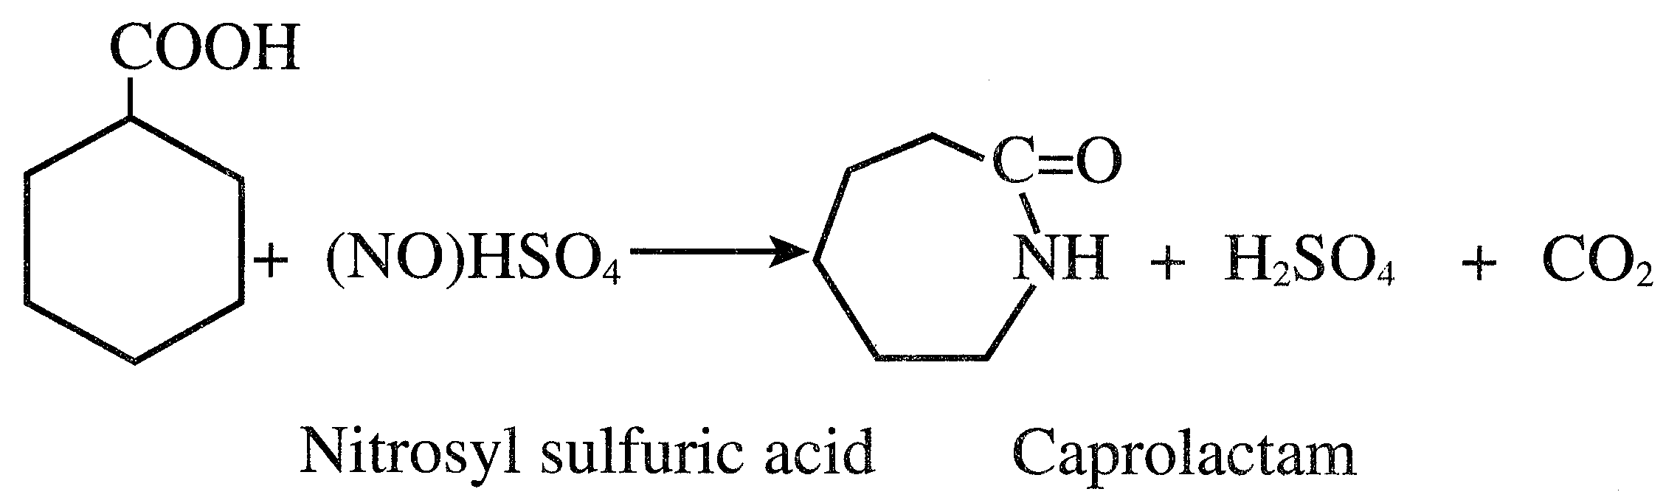
The first step in producing caprolactam from benzoic acid is its hydrogenation to cyclohexane carboxylic acid at approximately 170°C and 16 atmospheres over a powder palladium carbon catalyst.
The resulting acid is then converted to caprolactam through a reaction with nitrosyl-sulfuric acid.
In the process, toluene is first oxidized to benzoic acid. Benzoic acid is then hydrogenated to cyclohexane carboxylic acid, which reacts with nitrosylsulfuric acid yielding caprolactam.
Nitrosyl sulfuric acid comes from reacting nitrogen oxides with oleum. Caprolactam comes as an acidic solution that is neutralized with ammonia and gives ammonium sulfate as a byproduct of commercial value. Recovered caprolactam is purified through solvent extraction and fractionation

Slide 22
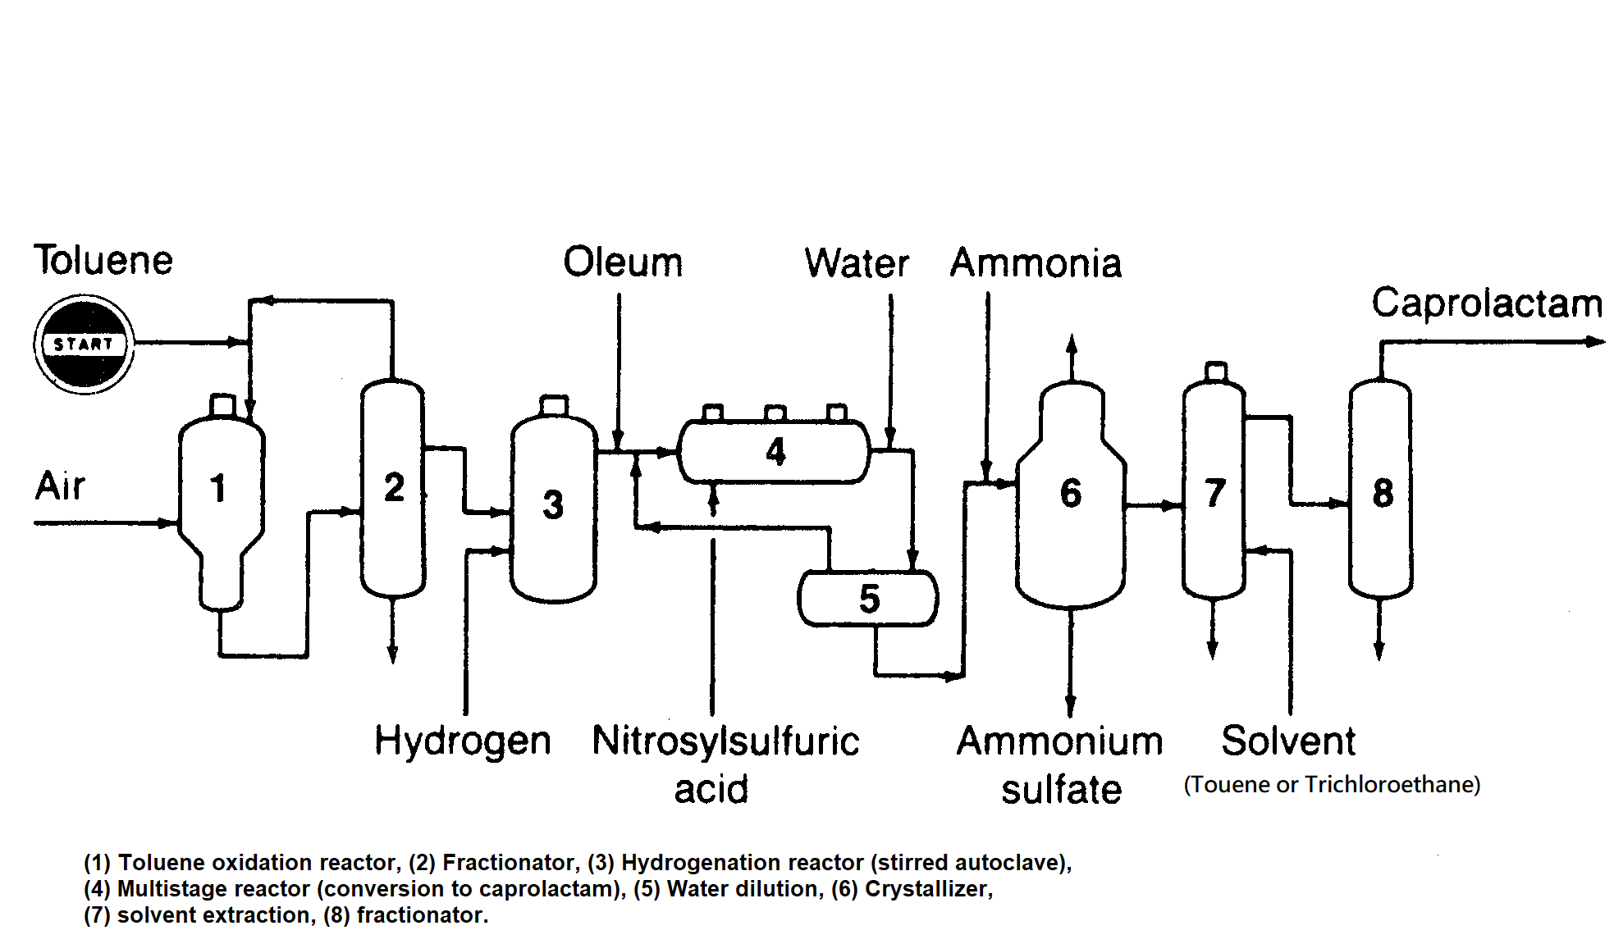
Caprolactam Production: Process flow diagram

Slide 23
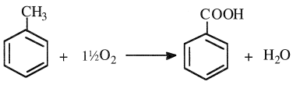
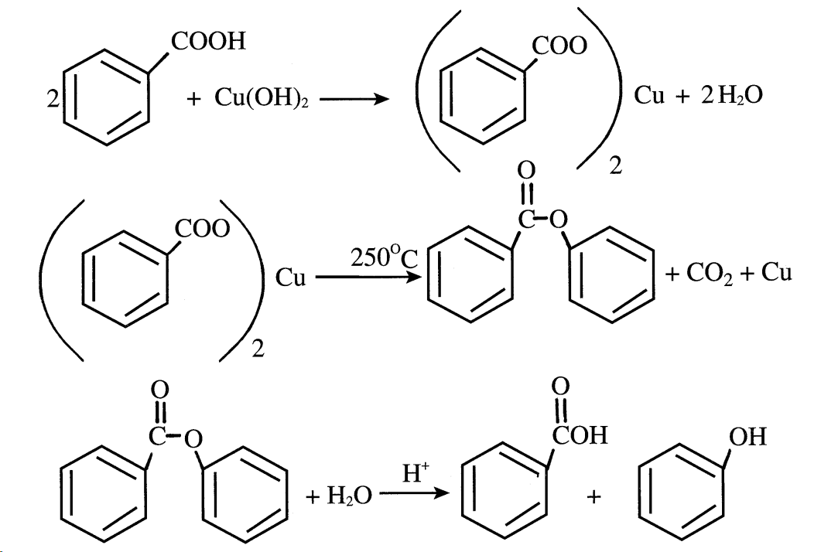
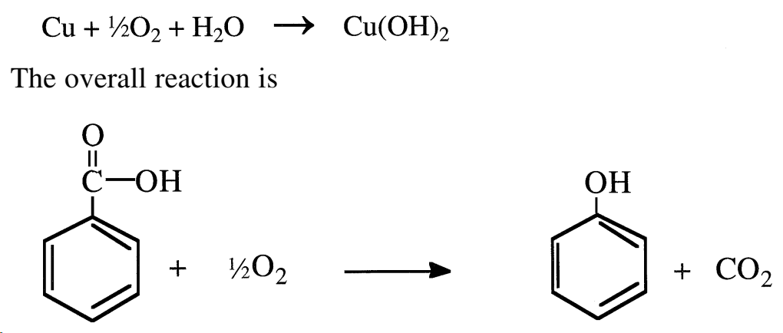
Phenol from Benzoic acid
Phenol BP = 181°C
Benzoic acid BP= 250°C
Benzoic acid (benzene carboxylic acid) is a white crystalline solid with a characteristic odor. It is slightly soluble in water and soluble in most common organic solvents. Though much benzoic acid gets used as a mordant in calico printing, it also serves to season tobacco, preserve food, make dentifrices, and kill fungus. Furthermore it is a precursor for caprolactam, phenol, and terephthalic acid.
Phenol can be obtained from benzoic acid by treating molten benzoic acid with an oxidizing gas, preferably air, and steam at 2OO-250 °C. A copper salt soluble in the molten acid is used as a catalyst. A compound selected from the group consisting of the salts of Mg, Na, K, Co, Sn, preferably a salt of Mg (Magnesium benzoate) or Co, is used as a promoter. The catalyst is preferably employed in amounts between 1 and of the molten acid, whereas the promoter is present in a ratio of 0.004- 0.17 mols per mol of molten acid.

Slide 24
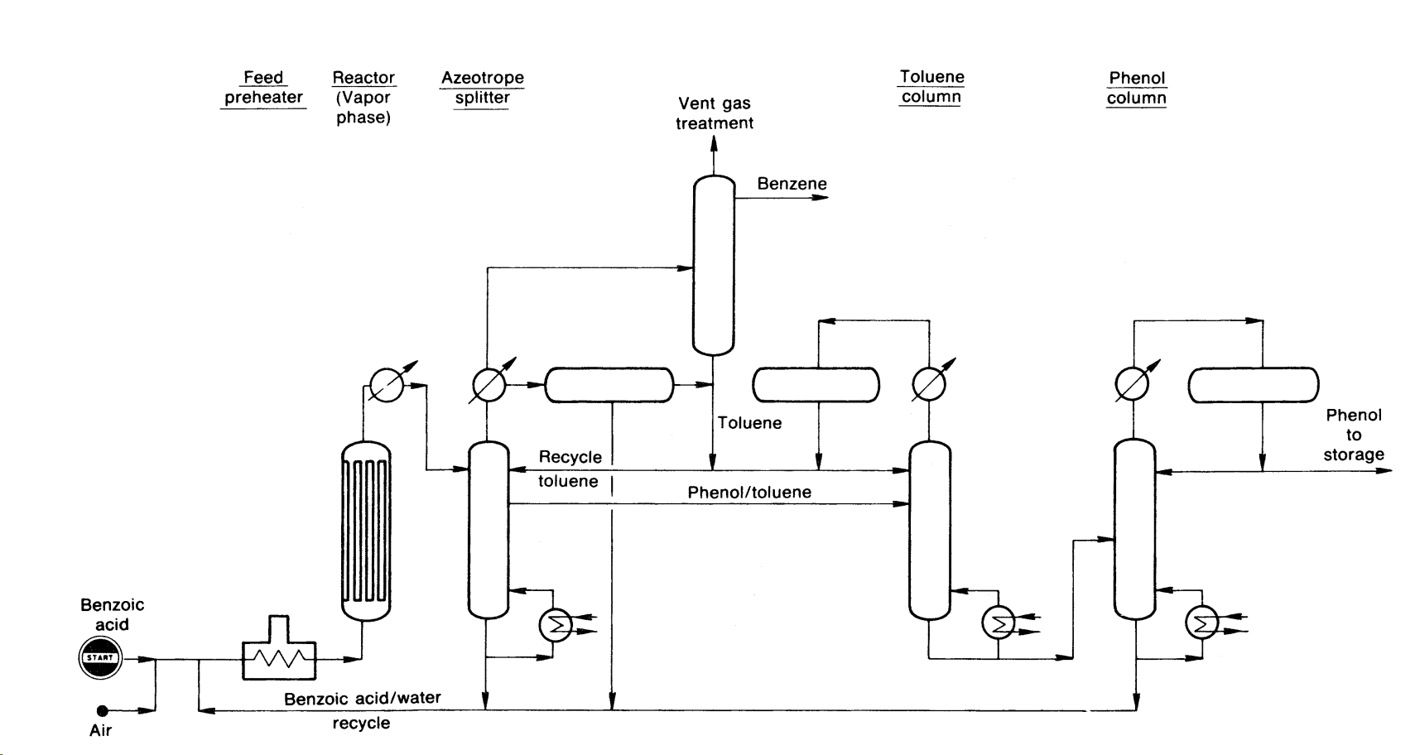
Phenol from Benzoic acid

Slide 25
Terephthalic acid and Dimethyl Terephthalate
In most applications, and especially in the field of fibers, monomer purity is an essential factor in polymer quality. This is why dimethyl terephthalate is used in preference to terephthalic acid, which is more difficult to purify. Terephthalic acid does not melt but sublimes at 300 °C under 101.3kPa pressure. It is also practically insoluble in water and in most organic solvents. However, dimethyl terephthalate melts at 141°C and boils at 284 °C, at atmospheric pressure. It is soluble in ether and hot methyl alcohol, and can be purified by crystallization or distillation.
The most widespread industrial method to manufacture terephthalic acid and dimethyl terephthalate is based on the oxidation of para-xylene.
The catalyzed oxidation of p-xylene produces terephthalic acid (TPA). Cobalt acetate promoted with either NaBr or HBr is used as a catalyst in an acetic acid medium. Reaction conditions are approximately 200°C and 15 atmospheres. The yield is about 95%.
Special precautions must be taken so that the reaction does not stop at the p-toluic acid stage. One approach is to esterify toluic acid as it is formed with methanol. This facilitates the oxidation of the second methyl group.
The resulting dimethyl terephthalate (DMT) may be hydrolyzed to terephthalic acid.

Slide 26
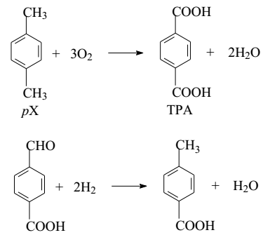
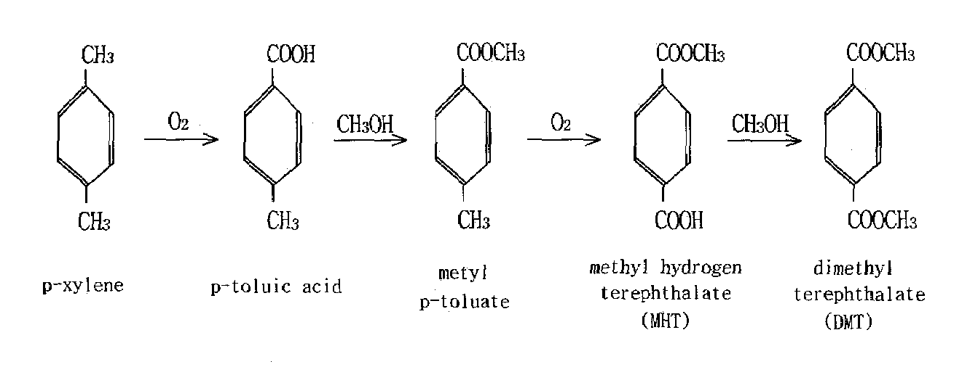
Terephthalic acid
The para-Xylene(pX) oxidation is typically conducted at 190-205 °C and 15-30 bar. A catalyst mixture of cobalt and manganese acetates is employed and hydrobromic acid or sodium bromide acts as the catalyst promoter. Aqueous acetic acid is used as the reaction medium. The oxidation reaction is highly exothermic with the heat of reaction of approximately 1,300 kJ/mol for pX conversion to TPA. The reaction involves a complex free radical chain mechanism and is believed to proceed through the sequential reactions shown in Figure.

Slide 27
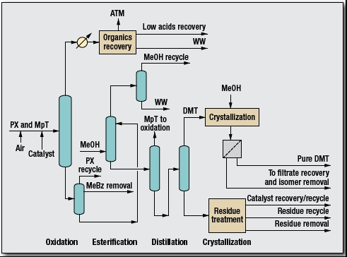
DMT from para-xylene: PFD (Witten process)
AcOH
solvent
MpT= methyl p-toluate

Slide 28
Process description
The common method for the production of DMT from p-xylene and methanol consists of four major steps: oxidation, esterification, distillation and crystallization.
A mixture of paraxylene (PX) and PT-ester is oxidized with air in the presence of a heavy metal catalyst. All useful organics are recovered from the off gas and recycled to the system.
The acid mixture resulting from the oxidation is esterified with methanol to produce a mixture of esters.
The crude ester mixture is distilled to remove all the heavy boilers and residue produced; the lighter esters are recycled to the oxidation section.
The raw DMT is then sent to the crystallization section for removal of DMT isomers and aromatic aldehydes. This purification produces DMT that meets world-market specifications and is preferred in some polyester applications.
Byproducts are recovered for sale or burned for fuel value, and usable intermediate materials are recycled.

Slide 29
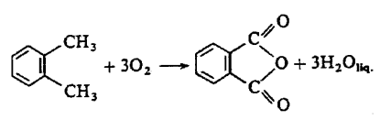
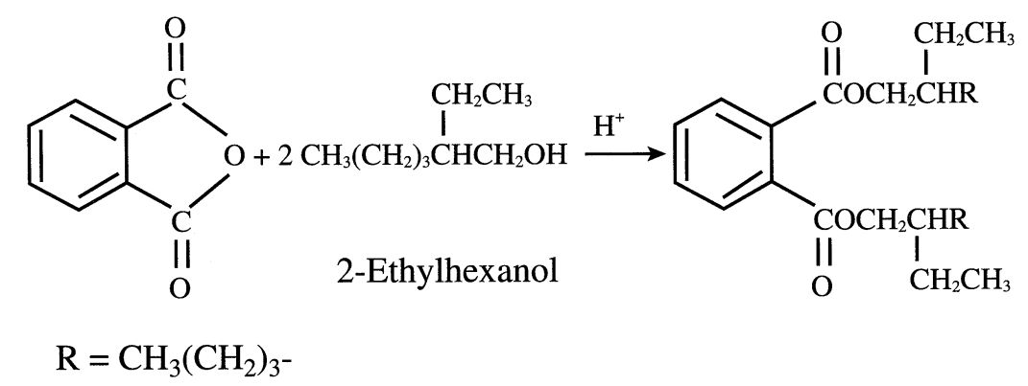
Phthalic Anhydride from o-xylene
Phthalic anhydride is solid with m.p. 131°C and sublimates at 284.5 °C at 1 atm. pressure
Phthalic Anhydride is produced through a catalytic oxidation reaction involving o-xylene and oxygen from air according to the following reactions:
The V₂O₅ + TiO₂/Sb₂O₃ catalyst is supported mainly with ceramics or silicon carbide. It has a surface area in an order of 10 Low surface area is preferred because it minimize diffusional effect which would increase the residence time.
The reaction is highly exothermic with a conversion of 63 % in the first reaction, 7% in the second reaction and 5 % in the third reaction. The process contains some major units such as reactor with a cooling system, distillation columns, vessels, fired heater as well as flash drums.
The catalyst is in fixed bed multitube reactor running at a range between 1-3 bar and 300-400 ºC would receive the mixture. The reactor design is essentially a shell and tube set up where the catalyst is held in the tubes. Salt solution is circulated to cool the reactor in the shell side. The salt solution that gets heated up is sent to a waste heat recovery boiler to generate process steam. Since the reaction is highly exothermic (-265 kcal/mole), the reacting gas should be cooled to prevent temperature increasing. Air to hydrocarbon ratio 60/1 to 120/1
Phthalic anhydride is used as a versatile intermediate in organic chemical reactions, mainly because it is bifunctional and is cheaply available. It may also be used in the manufacture of phathalate plasticizers like Di-n-octyl phthalate (DOP) and di(2-ethylhexyl) phthalate (DEP)

Slide 30
Phthalic Anhydride from o-xylene: reaction and side reactions
 | Reaction | Type
1 | 𝐶₈𝐻₁₀ + 3𝑂₂ → 𝐶₈𝐻₄𝑂₃ + 3𝐻₂𝑂 (O-xylene ) (Phthalic anhydride) | Main reaction
2 | 𝐶₆𝐻₄(𝐶𝑂)₂𝑂 + 7.5𝑂₂ → 8𝐶𝑂₂ + 2𝐻₂𝑂 (Phthalic anhydride) | Side reactions
3 | 𝐶₆𝐻₄(𝐶𝐻₃)₂ + 10.5𝑂₂ → 8𝐶𝑂₂ + 5𝐻₂𝑂
4 | 𝐶₆𝐻₄(𝐶𝐻₃)₂ + 7.5𝑂₂ → 𝐶₂𝐻₂(𝐶𝑂)₂𝑂 + 4𝐻₂𝑂 + 4𝐶𝑂₂ (o-xylene) (Maleic anhydride)
5 | 𝐶₂𝐻₂(𝐶𝑂)₂𝑂 + 3𝑂₂ → 4𝐶𝑂₂ + 𝐻₂𝑂
6 | 𝐶₆𝐻₄(𝐶𝐻₃)₂ + 3𝑂₂ → 𝐶₆𝐻₅(𝐶𝑂𝑂𝐻) + 𝐶𝑂₂ + 2𝐻₂𝑂 (O-xylene ) (Benzoic acid)
7 | 𝐶₆𝐻₅(𝐶𝑂𝑂𝐻) + 7.5𝑂₂ → 7𝐶𝑂₂ + 3𝐻₂𝑂

Slide 31
PHYSICAL & CHEMICAL PROPERITIES
Material | Formula | M.W. (g/mol) | Boiling Point (ºC) | Melting Point (ºC) | ΔHv (KJ/mol)
O-xylene | C8H10 | 106.17 | 144.4 | -24 | 36.24
Phthalic Acid | C8H6O4 | 166.13 | --- | 210 | ---
Phthalic Anhydride | C8H6O3 | 148.12 | 284 | 131 - 134 | 52.1
Maleic Anhydride | C4H2O3 | 98.06 | 202 | 52.8 | 49.1
Vanadium Pentoxide | V2O5 | 181.88 | 1750 | 670 | ---
Water | H2O | 18.02 | 100 | 0 | 40.66
Air | --- | 28.85 | -194.5 | --- | ---
Nitrogen | N2 | 28 | -195.80 | -210 | 5.57
Oxygen | O2 | 32 | -182.96 | -218.79 | 6.82
Hydrogen | H2 | 2.02 | -252.7 | --- | 0.90
Carbon Monoxide | CO | 28.01 | -191.5 | -205.02 | 6
Carbon Dioxide | CO2 | 44.01 | -56.6 | -78.5 | 16.4

Slide 32
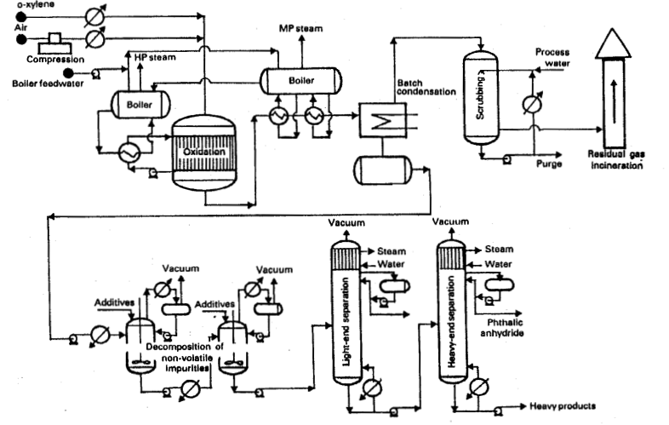
Crude PA storage
Maleic anhydride

Slide 33
Process description
The method most widely used to recover phthalic anhydride from the reactor effluent consists in passing this stream through cyclic condensation systems. In some of theme, operating as crystallizers, the anhydride solidifies by cooling in finned tubes, whereas in the others, hot oil is introduced to melt their content and to recover the previously-deposited product. In this way, up to 99% of the phthalic anhydride in the effluent can be recovered.
The residual gases, which contain most of the maleic anhydride co-product, are scrubbed with water and then discharged into atmosphere and burned. The scrubbing water also contain small amounts of phthalic acid, benzoic acid and citraconic acids. Maleic acid is recovered in anhydride form. The crude phthalic anhydride, in a purity of 99-99.5 wt%, contains different acids (phthalic, maleic, benzoic acids). It is heated at atmospheric pressure(in presence of additives to decompose non-volatile impurities, polymers and colored products) to dehydrate the phthalic acid and to convert the colored impurities into high-boiling products that are easier to remove.
This is followed by vacuum distillation in two successive columns. In the first column, maleic anhydride and benzoic acid and toluic acids are obtained in the distillate. In the second column, phthalic anhydride is collected at the top. The high-boiling residues are removed at the bottom of the second column.

Slide 34
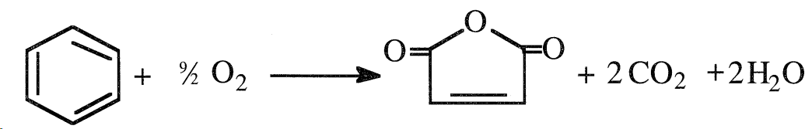
Maleic Anhydride from benzene
Benzene oxidation is the oldest method to produce maleic anhydride. The reaction occurs at approximately 380°C and atmospheric pressure. A mixture of V₂O₅ is the usual catalyst. Benzene conversion reaches 90%, but selectivity to maleic anhydride is only 50–60%; the other 40–50% is completely oxidized to CO_{2.}
Operating temperature is 400 – 500 ºC , 0.8-1 atmg, Catalyst is V₂O₅.
The process technology is similar to phthalic anhydride production. Benzene or butane is first vaporized in excess air.
Then the mixture enters the catalytic tubular reactor (with shell arrangement). The catalytic reactor is circulated with salt solution so as to absorb the heat generated using the reaction.
The reactor products enter a waste steam recovery boiler where the boiler water is converted to steam.
The product vapors eventually enter an integrated heat exchanger to exchange heat with the pre-heated feed stream.
Eventually, the vapors are condensed followed with gravity settling to remove tar as a product in the gravity settling. The vapors then enter a water scrubber to obtain 40 % maleic acid solution. The leaving gases consist mainly of CO₂.
The maleic acid from the absorber is partially sent to a dehydrator that removes water using azeotropic distillation principle. The purified maleic anhydride product is further sent to vacuum distillation to obtain the maleic anhydride product.
Maleic anhydride can be used as a highly reactive and versatile raw material. It can be used in the manufacture of alkyd resins, which in turn are used for making paints and coatings. It can also be used in making agricultural chemicals like herbicides, pesticides and plant growth regulators.
ΔH = -422 kCal/mol

Slide 35
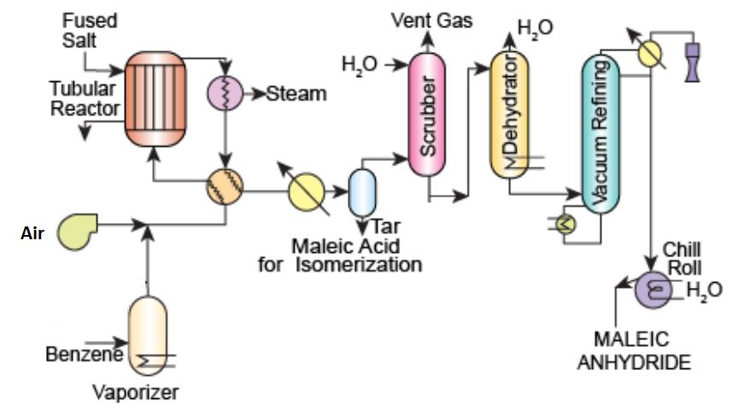
Maleic anhydride from Benzene: process flow diagram

Slide 36
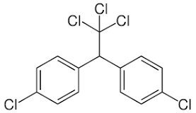
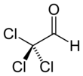
DDT (Dichlorodiphenyltrichloroethane)
DDT is a pesticide and is manufactured from benzene, chlorine and ethanol using sulfuric acid as a catalyst. DDT is produced by a reaction between monochlorobenzene and chloral in the presence of Oleum as catalyst.
Monochlorobenzene + Chloral → DDT + H₂O
Chloral, also known as trichloroacetaldehyde or trichloroethanal, is the organic compound with the formula Cl₃CCHO. This aldehyde is a colorless liquid that is soluble in a wide range of solvents.
Chloral is prepared by first forming chloral hydrate. The reaction for chloral is presented as
4Cl₂ + C₂H₅OH + H₂O → Cl₃CCH(OH)₂ + 5HCl
Then chloral hydrate is allowed to distill in the presence of sulfuric acid which dessicates the chloral hydrate to chloral.
Cl₃CCH(OH)₂ → Cl₃CCHO + H₂O
DDT is mainly used as a pesticide. DDT was the first of the modern insecticides. However, the use of this chemical has been restricted to some degree due to its harmful ill effects.

Slide 37
Chloral production
Dry chlorine is initially absorbed into ethanol at room temperature. During this process, the alcohol turns into a syrupy fluid. The operation takes place in a chlorination tank, which yields chloral hydrate and HCl.
HCl is removed from the chlorination tank using a partial condenser. Scrubbing is used to recover gas from non-condensable HCl. The liquid from the partial condenser is returned to the chlorinator.
The condensate from the chlorination tank is routed to a still, where it is distilled in the presence of sulfuric acid, which acts as a desiccant.
Eventually, the still is operated at high temperatures, with steam used for heating. Because chloral hydrate conversion to chloral is a sensitive reaction, cooling water is circulated in the jacket to keep the operation under control.
After the reaction, the batch still produces waste acid at the bottom and clear chloral liquid at the top, as well as vent gases. Eventually, chloral is treated with lime to remove the dissolved acidic impurities.
The purified crude chloral is then distilled in another still to remove any chloral hydrates present in the stream. As a result, the second distillation unit also operates in the presence of H₂SO₄.The vapors released during this step (from the partial condenser) are directed to the vent scrubber.
The distillation unit eventually produces chloral, and the chloral hydrate is recycled back into the chloral hydrate converter.

Slide 38
DDT production
Purified chloral, monochlorobenzene, and oleum are allowed to enter the DDT condensation unit.
After condensation, the organic layer and spent acid are withdrawn. The organic layer consists of DDT and monochlorobenzene. This is first neutralized with soda ash.
After the reaction, the organic layer is sent to a dryer, where the vapors enter a total condenser, which is followed by a gravity separator.
The gravity settling unit separates monochlorobenzene from the other organic impurities.
The monochlorobenzene is recycled back to the condensation unit that is meant for preparing the DDT.
The Dryer produces DDT powder which is sent for casting/pelletization process to obtain the DDT in either flakes or in pellets for sale.

Slide 39
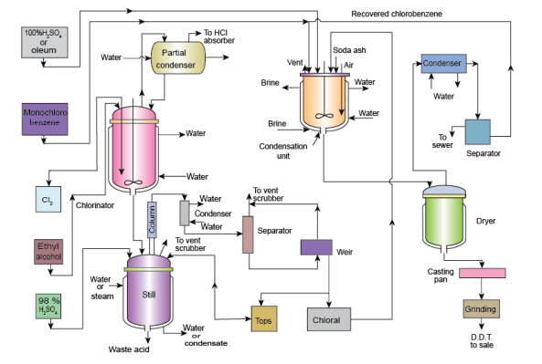
DDT production: process flow diagram

