Slide 1
CL355:
Petrochemicals Technology
Module 1

Slide 2
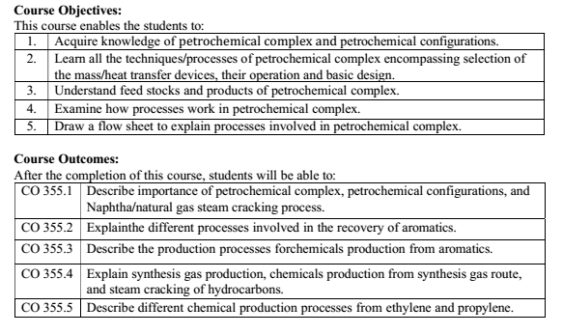

Slide 3
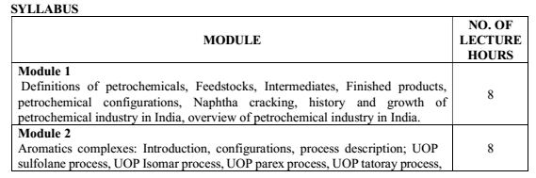
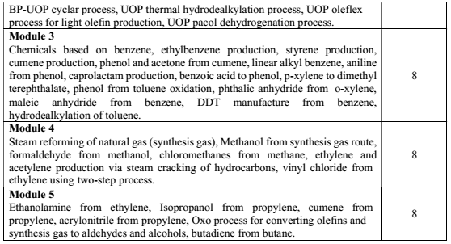

Slide 4
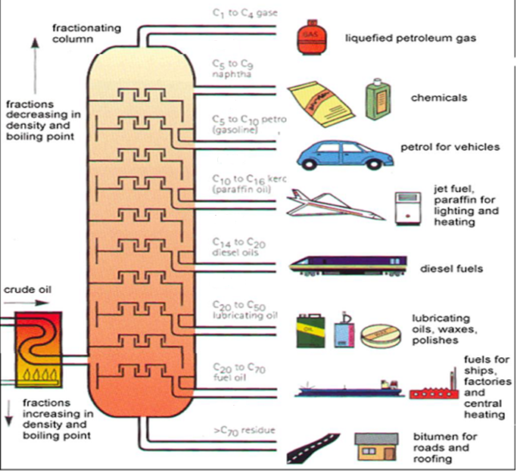
Petroleum Refinery

Slide 5
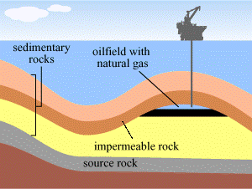

Slide 6
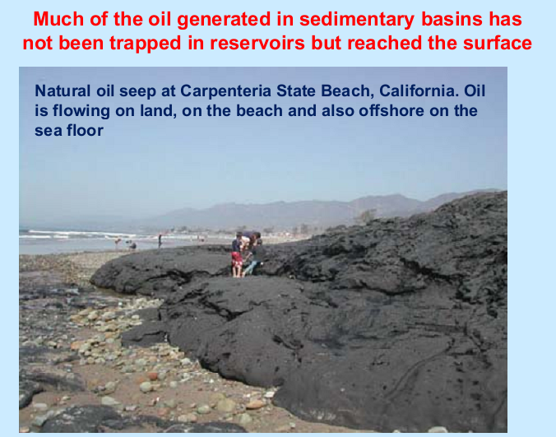

Slide 7
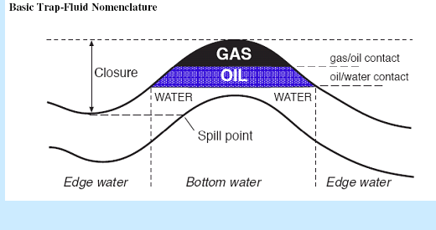

Slide 8
Formation of Shale Oil Shale
Oil is formed from organic-rich shale, which acts as both the source rock and the reservoir rock.
Step-by-Step Formation Process
Deposition of Organic Matter-Millions of years ago, microscopic plants and organisms (plankton, algae) settled at the bottom of marine or lacustrine environments. These environments were low-energy and oxygen-poor, preventing decomposition. Fine sediments (clay and silt) settled along with organic matter, forming organic-rich mud.
Burial and Compaction-Over geological time, additional sediments buried the organic-rich layers. Pressure increased, and the material compacted to form shale. Organic matter transformed into kerogen.
Thermal Maturation (Heating): With increasing depth, temperature rises due to the geothermal gradient. At temperatures of approximately: 60–120°C → Oil window >120°C → Gas window. Kerogen breaks down into liquid hydrocarbons (shale oil) and natural gas.
Retention Within Shale Unlike conventional reservoirs, shale has very low permeability. Generated hydrocarbons do not migrate far. Oil remains trapped within: Nanopores, Organic matter pores, Microfractures.
Thus, shale serves as both source rock and reservoir.

Slide 9
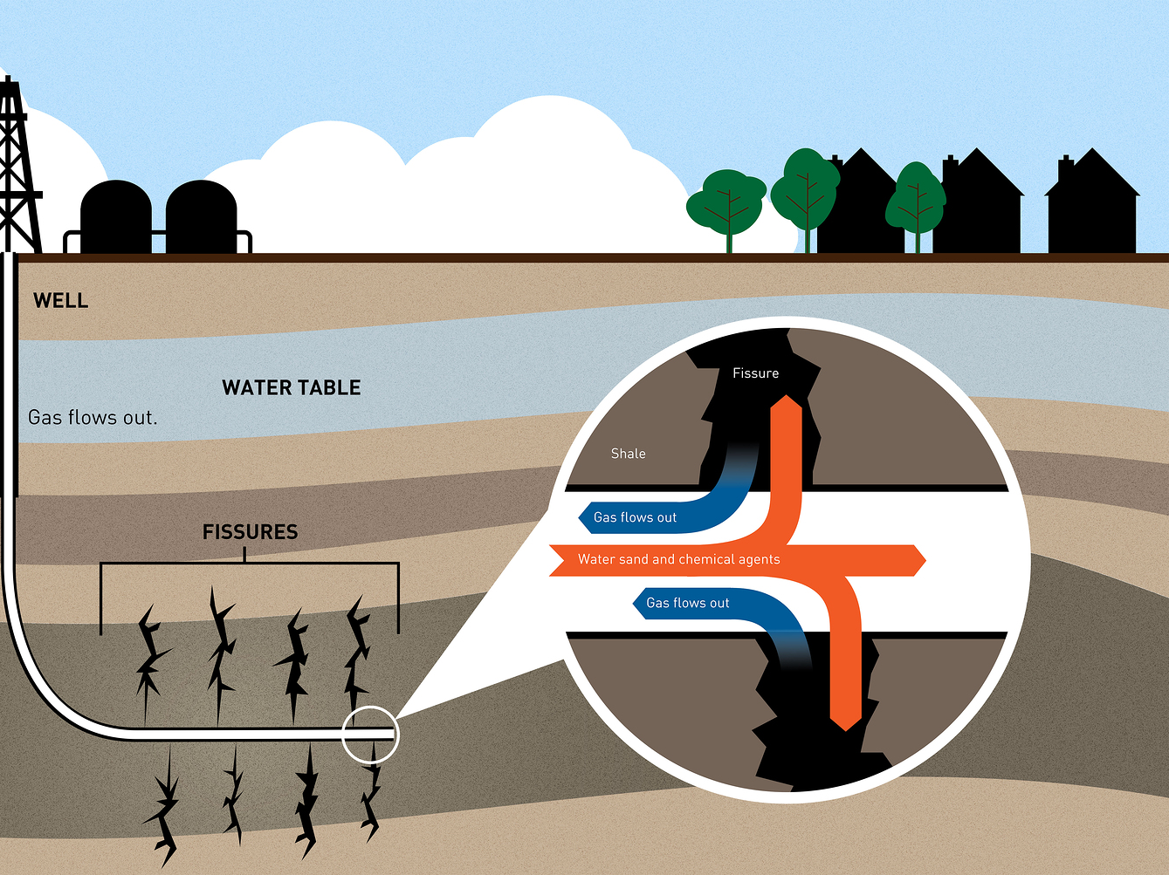
Shale oil

Slide 10
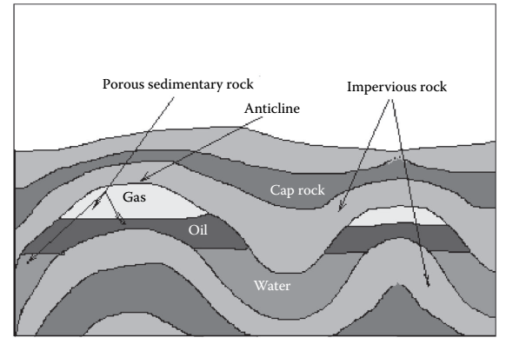

Slide 11
What are Oil and Gas?
Oil and Gas are substances found within the earth’s crust.
They are thought to come from decomposed plant and animal matter.
Scientists believe the plants and animals died long ago, and were slowly buried by thick layers of sediments. Over a long period of time, and with pressure and temperature, the organic materials were converted into the oil and gas which are found today.
(For example, we know that present day garbage dumps give off methane gas)
** On average, the temperature increases by about 25°C for every kilometer of depth

Slide 12
Petrochemicals
Petroleum chemicals or petrochemicals in short, are compound or elements recovered or derived from petroleum or natural gas.
They are the organic chemicals and got same chemical composition, structure and properties as corresponding to organic compounds derived from non-petroleum sources. For example, methyl alcohol from synthesis gas (i.e., derived from natural gas or petroleum) is exactly identical to methyl alcohol produced from destructive distillation of wood. The name petrochemical refer to the origin of the product only.

Slide 13
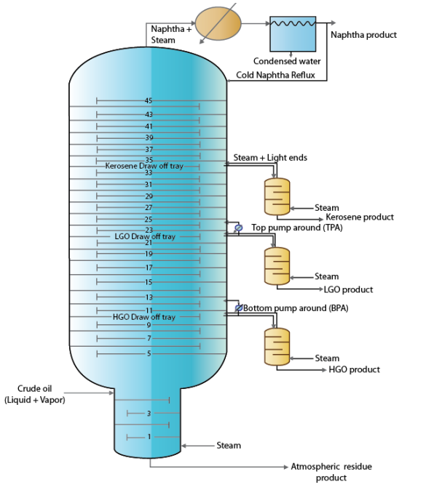
Design architecture of main and secondary columns of the ADU
32-190 °C
1.2–1.5 atm.
190-260 °C
260-320°C
320-365 °C

Slide 14
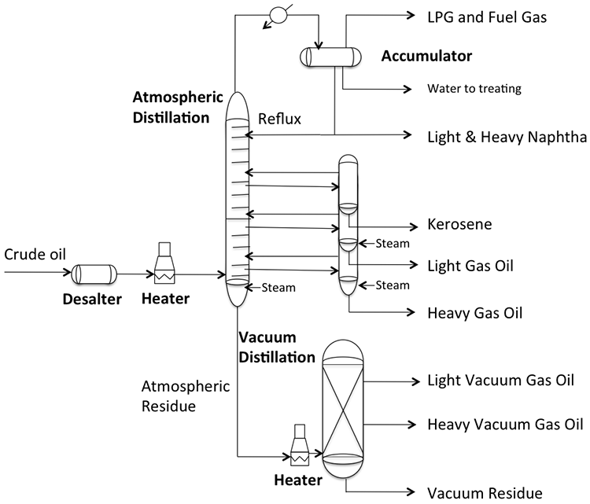

Slide 15
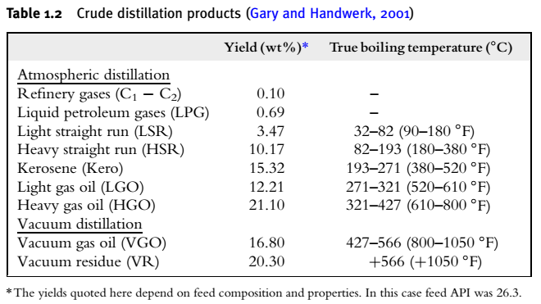

Slide 16
Boiling Ranges of Typical Crude Oil Fractions
 | ASTM °C | TBP °C
Butanes and lighter
Light straight-run naphtha (LSR) | 32-104 | 32-88
Heavy straight-run naphtha (HSR) | 82-204 | 88-193
Kerosene | 165-282 | 193-271
Light gas oil (LGO) | 215-338 | 271-321
Atmospheric gas oil (AGO) | 287-443 | 321-427
Vacuum gas oil (VGO) | 398-565 | 321-565
Vacuum reduced crude (VRC) | 565+ | 565+

Slide 17
Petrochemical resources
Distillation petroleum crude is conducted by two ways:
  Atmospheric distillation: this process produces fuel gases, LPG, light straight run naphtha, heavy straight run naphtha, kerosene, atmospheric gas oil, heavy gas oil and long residue.
  The vacuum distillation unit distillates the long residue at 40 mm Hg pressure and produces light vacuum gas oil, heavy vacuum gas oil and short residue.
Chemical from petroleum may range from basic petrochemicals such as ethylene, propylene, benzene, toluene, xylenes to finished products like plastics, rubbers, fibers,, detergents, pesticides, dyes etc.
Only 8% of world production of crude oil for manufacture of Petrochemicals
The petrochemicals are classified as 1. First generation. 2. Second generation and , 3. Third generation petrochemicals

Slide 18
First generation petrochemicals
Chemicals directly available from petroleum crude or natural gas either by fractionation, isomerization, cracking, coking, reforming, hydrocracking etc.
Represent the basic petrochemicals which are the building blocks for various chemical synthesis.
Methane, Ethane, Propane.
Ethylene, Propylene, Butylenes, Acetylene Butadiene.
Aromatics such as Benzene, Toluene, Xylenes.
These can be sub grouped as aliphatic, olefins, acetylene, dienic, naphthenic and aromatics basic petrochemicals.

Slide 19
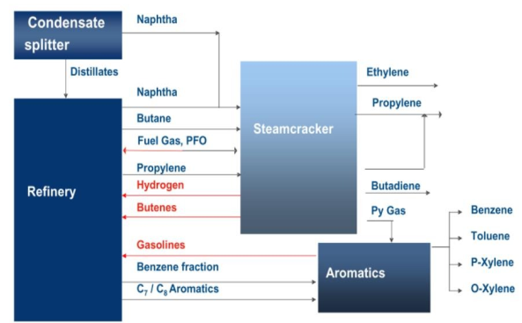

Slide 20
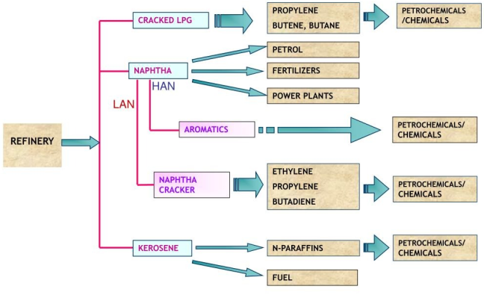

Slide 21
SECOND GENERATION PETROCHEMICALS
Not present as such as petroleum or crude oil.
They Cannot be obtained by simple operations such as reforming, cracking or hydro cracking.
These are the derivatives of first-generation petrochemicals.
Second generation petrochemicals constitute the intermediate chemicals constitute as the raw materials for consumer products like plastic, rubbers, fibers, dyes etc.
Styrene (derived from benzene and ethylene).
Dimethyl Terephthalate (derived from p-xylene)
Ethylene glycol (derived from ethylene)
Vinyl chloride monomer (derived from acetylene)
Adipic Acid (derived from benzene)
Acrylonitrile (derived from propylene)

Slide 22
Intermediates and Derivatives
Petrochemical intermediates are generally produced by chemical conversion of primary petrochemicals to form more complicated derivative products.
Petrochemical derivative products can be made in a variety of ways: Directly from primary petrochemicals; through intermediate products which still contain only carbon and hydrogen; and, through intermediates which incorporate chlorine, nitrogen or oxygen in the finished derivative. In some cases, they are finished products; in others, more steps are needed to arrive at the desired composition.
1st Generation:
Light Olefins Aromatics Synthesis Gas
• Ethylene (C₂H₄) • Benzene (C₆H₆) • CO + H₂
• Propylene (C₃H₆) • Toluene (C₇H₈) • Methanol
• Butadiene (C₄H₆) • Xylene (C₈H₁₀) • Ammonia
• Butylene (C₄H₈)

Slide 23
Second-Generation Intermediates
Ethylene Derivatives:
├ Ethylene Oxide (EO) → Ethylene Glycol (EG)
├ Ethylene Dichloride (EDC) → Vinyl Chloride (VCM)
├ Ethylbenzene (EB) → Styrene
└── Acetaldehyde → Acetic Acid
Propylene Derivatives:
├ Propylene Oxide (PO) → Polyols
├ Acrylonitrile (AN) → Acrylic Fibers
├ Cumene → Phenol/Acetone
└── Acrylic Acid → Acrylates
Aromatics Derivatives:
├ Benzene → Cyclohexane → Caprolactam/Nylon
├ Toluene → Benzene (via HDA) or TDI
└── Xylene → p-Xylene → PTA/PET

Slide 24
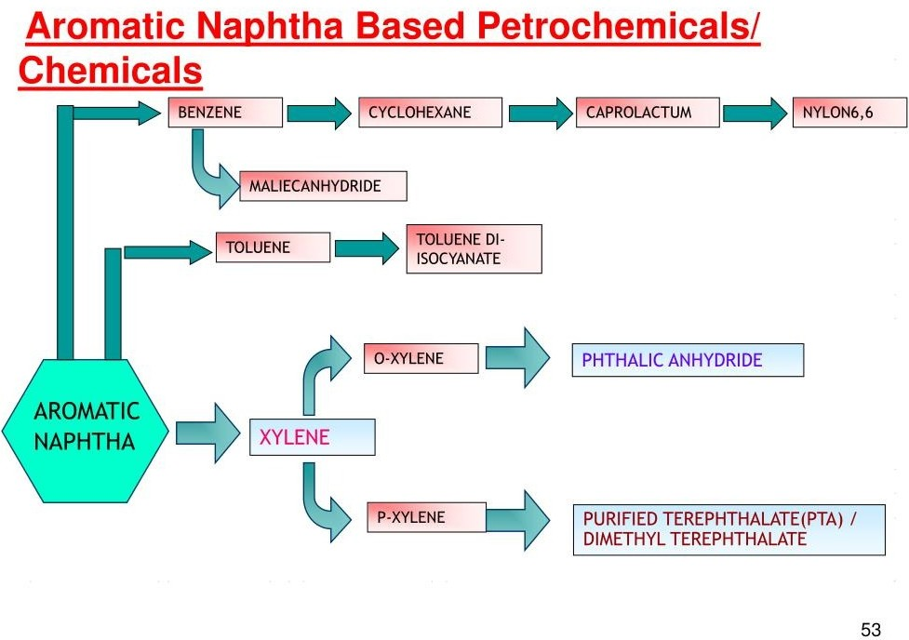

Slide 25
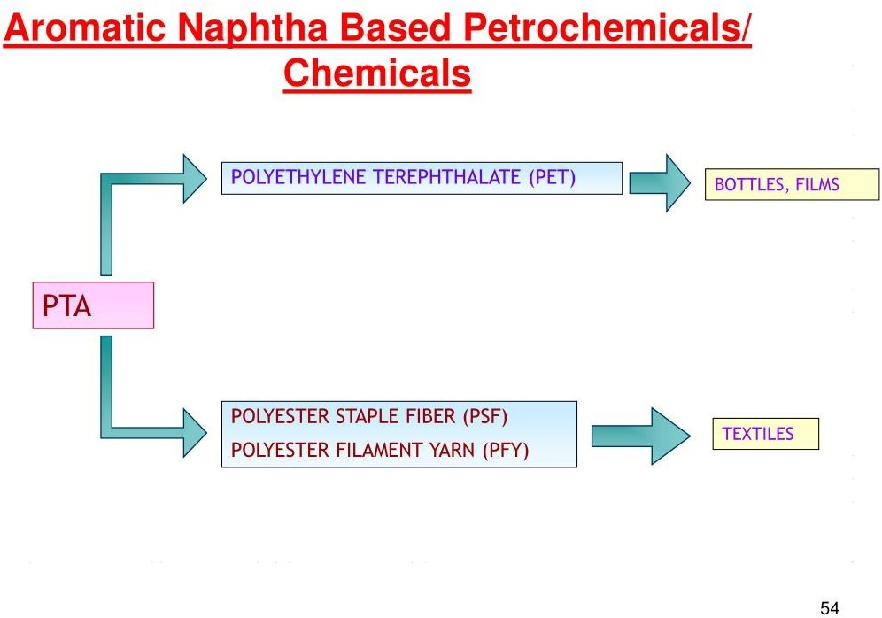

Slide 26
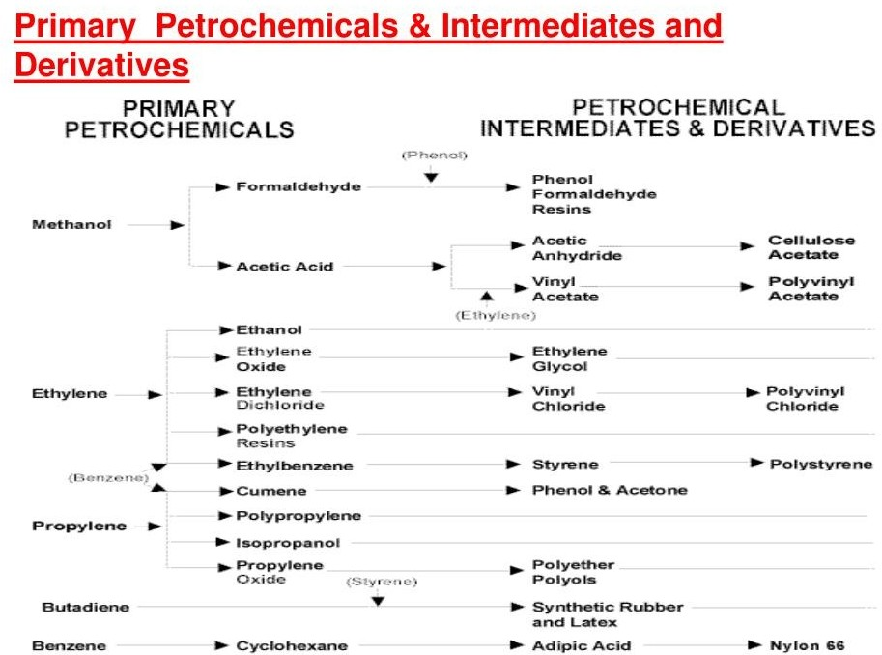

Slide 27
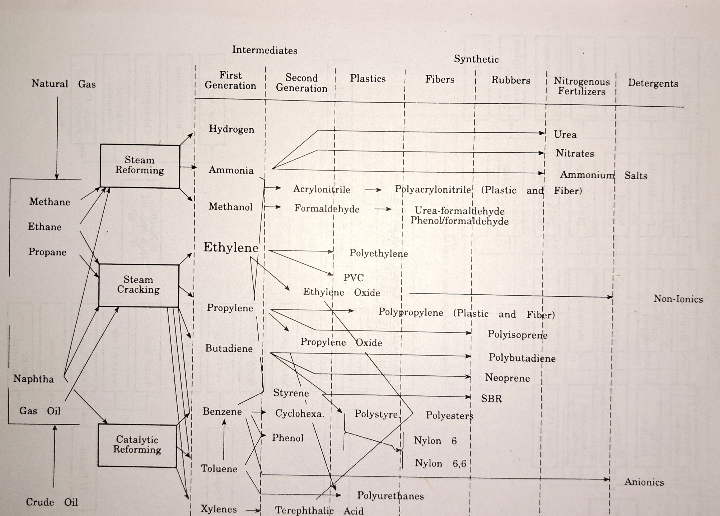
12 Jan 24

Slide 28
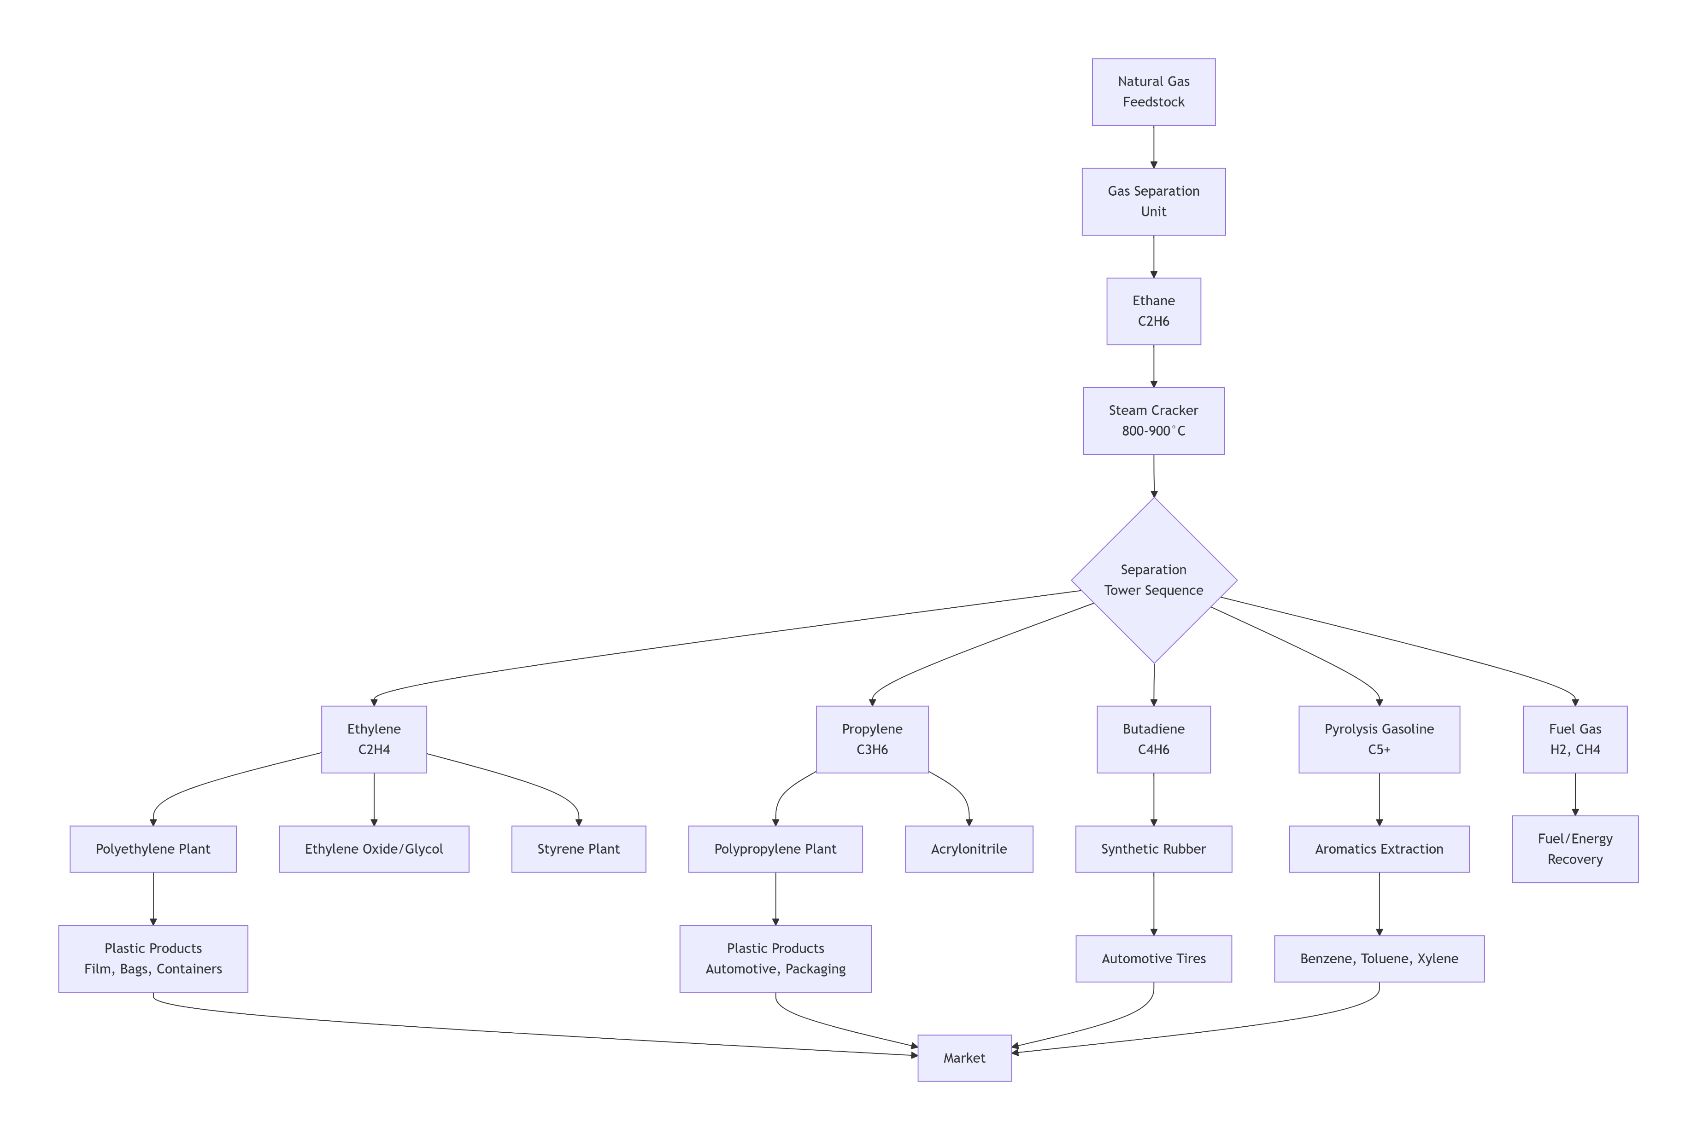

Slide 29
Third generation petrochemicals
Consumer commodities derived from second generation petrochemicals.
Represent most important commercial products such as:
Plastics, Rubbers, Fibers, Detergents etc.
Some of these may directly synthesized from first generation petrochemicals. For instance, Polybutadiene rubber is obtained by polymerizing butadiene which is a basic petrochemicals.
Polystyrene (from styrene)
Polyvinyl chloride (from vinyl chloride monomer)
DDT (from Chlorobenzene)
Azo dyes (from aniline)
Most of the plastic or rubbers are derived from second generation Petrochemicals.
Polybutadiene rubber is regarded as a 3rd generation petrochemical.

Slide 30
Thermoplastics:
├ Polyethylene (PE)
├── LDPE (Low Density)
├── LLDPE (Linear Low Density)
└── HDPE (High Density)
├ Polypropylene (PP)
├ Polyvinyl Chloride (PVC)
├ Polystyrene (PS)
├ Polyethylene Terephthalate (PET)
└── Engineering Plastics (ABS, PC, Nylon)
Thermosets:
├ Phenolic Resins
├ Epoxy Resins
├ Polyurethane (PU)
└── Unsaturated Polyesters

Slide 31
Petrochemical Configurations
Definition and major types of petrochemical configurations

Slide 32
What is Petrochemical Configuration?
Arrangement and integration of feedstocks, processing units, and product streams
Determines efficiency, product slate, and economics

Slide 33
Types of Petrochemical Configurations
1. Standalone Petrochemical Configuration
2. Refinery–Petrochemical Integrated Configuration
3. Crude-to-Chemicals (C2C)
4. Gas-to-Chemicals (GTC)

Slide 34
Standalone Petrochemical Configuration
Natural Gas / Naphtha
Steam Cracker
Ethylene / Propylene

Slide 35
Standalone Configuration – Features
Independent petrochemical plant
High purity olefins
Example: Ethane-based ethylene cracker

Slide 36
Refinery–Petrochemical Integrated Configuration
Crude Oil
Refinery
Aromatics / Naphtha Cracker

Slide 37
Refinery–Petrochemical Integration – Features
Uses refinery streams
Improved energy efficiency
Example: Refinery with BTX extraction

Slide 38
Crude-to-Chemicals (C2C) Configuration
Crude Oil
Direct Conversion Unit
Olefins & Aromatics

Slide 39
C2C Configuration – Features
Maximum chemical yield (>40%)
Minimal fuel production
High technology requirement

Slide 40
Gas-to-Chemicals (GTC) Configuration
Natural Gas
Syngas / Methanol Unit
Olefins / Polymers

Slide 41
GTC Configuration – Features
Cleaner process
Lower carbon footprint
Example: Methanol to Olefins (MTO)

Slide 42
Summary
Petrochemical configurations define plant integration
Choice depends on feedstock, market demand, and economics

Slide 43
Evolution
• Nitrocellulose to celluloid (1869)- not a petrochemical but first synthetic plastic
Bakelite or phenol-formaldehyde(1907)- first thermoset made- not a petrochemical
Prior 1919, organic chemicals manufactured from coal ,wood and agricultural raw material.
• Resources enough to meet the small demand of organic chemicals
Demand became large with progressive civilization.
• Availability of agricultural raw material like cotton, rubber, sugarcane dependent on natural phenomena.
• Inadequate supply of raw material of vegetable origin prompted search for alternative source.
• Lead to the birth of synthesis organic material as substitute for natural essential commodities.

Slide 44
Due to advantage of synthetic chemicals on natural material their demand grew.
• 1918 Petroalcohol process for making isopropyl alcohol from propylene obtained from petroleum refining was developed by Carleton Ellis in USA.
• 1925 TEL from petroleum E.I du Pont De Nemours and Co, USA invention.
• 1926 CH₃OH, CH₃CHO and HCHO synthesized from petroleum sources.
• World war II helped the Industry.
• Demands for explosives, natural rubber substitutes and other chemicals led to the development of synthetic ammonia. HNO₃
• Ammonia Nitroglycerin explosive, Toluene (TNT)
• Styrene for SBR (Known as Govt. rubber Synthetic (GRS) from petroleum.
The remarkable growth could be judged by from the following
• 1930: 10 Petrochemicals plants
• 1940: 35 Plants
• 1951: 94 Plants
• 1957: 372 Petrochemicals Plants

Slide 45
Polymers (i.e., plastics, rubber and synthetic fibers combined) constitute the second largest volume petrochemicals of today. The growth of petrochemicals and the discoveries made in the polymer field are interrelated. The advances made in the one field help open-up new vistas in the other. Thus the discovery of Ziegler catalyst for the low-pressure polymerization of olefins acts as a great stimulant for the development of ethylene production technology from petroleum hydrocarbon.
The stereospecific polymerization developed by Ziegler and Natta was responsible for synthesis of natural rubber in lab and industry as well. That in tern helped the growth of polybutadiene, and polyisoprene rubber. And the larger demand of this two dienes petrochemicals contributed to the development of petrochemical technology. Similarly the demand for polyester fibers augmented a new breakthrough in the high purity terepthalic acid directly from para xylene oxidation. The remarkable Sohio process of propylene ammoxidation to acrylonitrile is an example how the demand of a cheap monomer in the polymer industry leads to the spectacular advances in the petrochemical technology

Slide 46

Development of petrochemicals industry in India
The first polymer plant, low density polyethylene plant, was established in India by ICI UK at Rishra near Kolkata in the late fifties. Plant was based on the ethylene available from alcohol.

Slide 47
India entered the petrochemicals arena much later and primarily manufactured ethanol (produced from molasses) throughout the 1950s.
Ethanol was used as the main feedstock for producing ethylene. Ethanol-based ethylene was produced by a number of companies, including Imperial Chemicals Industries (ICI) (now AkzoNobel) for manufacturing low-density polyethylene (LDPE) in Rishra, West Bengal,
Synthetics and Chemicals Ltd for manufacturing styrene butadiene (SBR) in Barelly, Uttar Pradesh, and Chemicals and Plastics Ltd for manufacturing polyvinyl chloride (PVC) in Metturdam, Tamil Nadu.
Some of the other industrial units located in the sugar-producing states used ethanol as feedstock for manufacturing mono ethylene glycol, acetic acid, ethyl acetate, acetone, butanol, etc.
Production of ethylene from naphtha started in 1961 and was led by the establishment of the first ethylene cracker set-up by Union Carbide (now Eveready Industries India Limited) in Chembur, Mumbai.
Naphtha was then sourced from ESSO Refinery (now HPCL) in the vicinity of the cracker. In 1963, ICI set up a manufacturing facility for polyester staple fibres in Mumbai.
The petrochemical industry grew tremendously post 1970, driven by the strategic Five-Year plans led by expert committees. India’s first fully integrated petrochemical complex with six downstream units was commissioned at Vadodara, Gujarat, by Indian Petrochemicals Corporation Ltd (IPCL) in 1979, providing an impetus to the rapid growth and development of downstream process industries.
Today, India ranks sixth globally and fourth in Asia in terms of global sale of chemicals.9 More than 80,000 varieties of chemicals and petrochemicals are manufactured in the country, and the industry employs over two million people. India is known for the export of specialty chemicals and specific agrochemicals, dyes and pigments. It is the fourth largest producer of agrochemicals globally and exports about 50% of the production. India is also the second-largest manufacturer and exporter of dyes.10 The CPC industry accounted for around 9% of India’s manufacturing gross value added (GVA) and 1.3% of its national GVA in FY20. Chemical manufacturing accounted for 1.4% of the total FDI equity inflows in FY21.

Slide 48
Top Petrochemical Companies in India
Though the Indian petrochemical industry is highly dominated by only a few players, however, there are a number of petrochemical companies in India, doing their share of business. Some of the top companies can be listed as below:
Reliance Industries Ltd.
Haldia Petrochemicals Ltd.
Indian Oil Corporation
Gas Authority of India Limited
National Organic Chemical Industry Ltd.
Bongaigaon Refinery and Petrochemicals Ltd.
Manali Petrochemical Limited
I G Petrochemicals Limited
The Andhra Petrochemicals Limited
Tamilnadu Petroproducts Limited

Slide 49
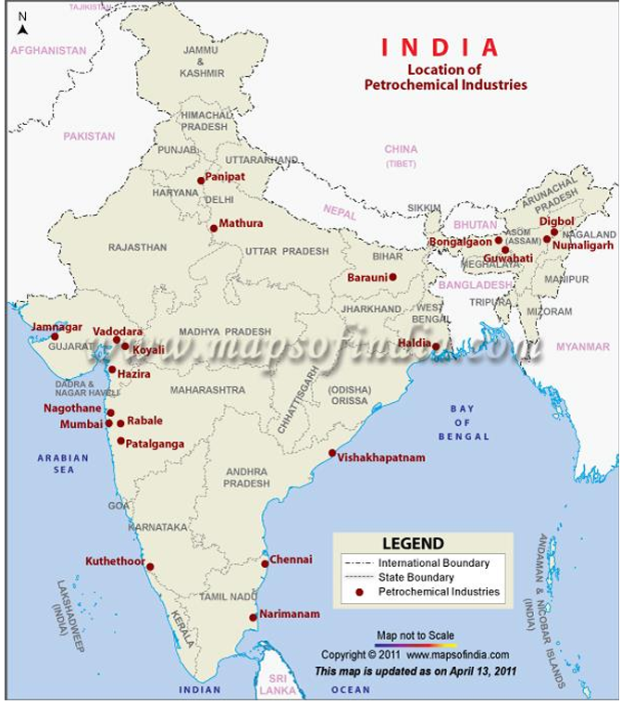

Slide 50
PPT - INTRODUCTION TO PETROCHEMICALS PowerPoint Presentation, free download - ID:6764653 (slideserve.com)
PPT - INTRODUCTION TO PETROCHEMICALS PowerPoint Presentation, free download - ID:6764653 (slideserve.com)
https://www.slideserve.com/mairead-flanagan/introduction-to-petrochemicals

Slide 51
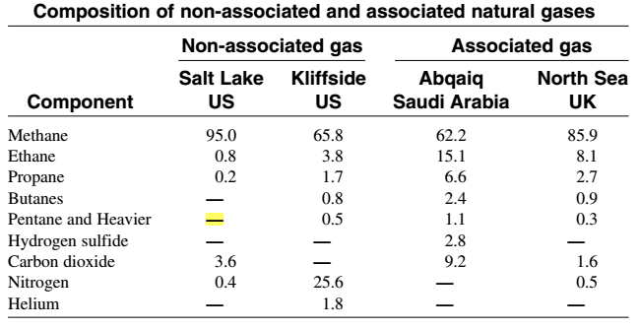
Petrochemicals resources
1. NATURAL GAS (Non-associated and Associated Natural Gases
Natural gas is a naturally occurring mixture of light hydrocarbons accompanied by some non-hydrocarbon compounds.
Non-associated natural gas is found in reservoirs containing no oil (dry wells).
Associated gas, on the other hand, is present in contact with and/or dissolved in crude oil and is coproduced with it.

Slide 52
Higher molecular weight paraffinic hydrocarbons (C2-C7) are usually present in smaller amounts with the natural gas mixture, and their ratios vary considerably from one gas field to another.
Non-associated gas normally contains a higher methane ratio than associated gas, while the latter contains a higher ratio of heavier hydrocarbons.
The non-hydrocarbon constituents in natural gas generally contains some weak acids, such as hydrogen sulfide and carbon dioxide and inerts such as nitrogen, helium and argon.
Higher molecular weight hydrocarbons present in natural gases are important fuels as well as chemical feedstocks and are normally recovered as natural gas liquids (NGL)
Ethane is separated for use as a feedstock for steam cracking for the production of ethylene.
Propane and butane are recovered from natural gas and sold as liquefied petroleum gas (LPG).

Slide 53
NATURAL GAS TREATMENT PROCESSES
Raw natural gases contain variable amounts of carbon dioxide, hydrogen sulfide, and water vapor.
The presence of hydrogen sulfide in natural gas for domestic consumption cannot be tolerated because it is poisonous. It also corrodes metallic equipment.
Carbon dioxide is undesirable, because it reduces the heating value of the gas and solidifies under the high pressure and low temperatures used for transporting natural gas.
For obtaining a sweet, dry natural gas, acid gases must be removed and water vapor reduced.
In addition, natural gas with appreciable amounts of heavy hydrocarbons should be treated for their recovery as natural gas liquids.

Slide 54
Acid Gas Treatment
Acid gases can be reduced or removed by one or more of the following methods:
1. Physical absorption using a selective absorption solvent.
2. Physical adsorption using a solid adsorbent.
3. Chemical absorption where a solvent (a chemical) capable of reacting reversibly with the acid gases is used.

Slide 55
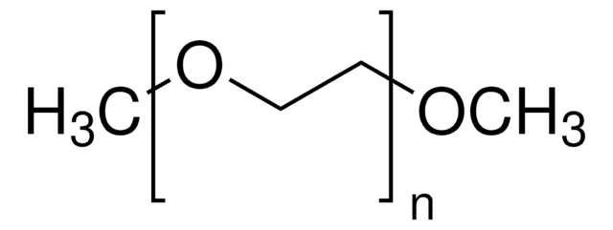
Physical Absorption
Important processes commercially used are the Selexol, the Sulfinol, and the Rectisol processes. In these processes, no chemical reaction occurs between the acid gas and the solvent.
The solvent, or absorbent, is a liquid that selectively absorbs the acid gases and leaves out the hydrocarbons.
In the Selexol process for example, the solvent is dimethyl ether of polyethylene glycol (or Poly(ethylene glycol) dimethyl ether- CH₃O(CH₂CH₂O)_{n}CH₃).
Raw natural gas passes counter-currently to the descending solvent.
When the solvent becomes saturated with the acid gases, the pressure is reduced, and hydrogen sulfide and carbon dioxide are desorbed. The solvent is then recycled to the absorption tower.

Slide 56
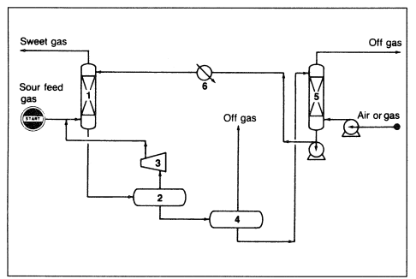
Selexol process
(1) absorber, (2) flash drum, (3) compressor, (4) low-pressure drum, (5) stripper, (6) cooler

Slide 57
Chemical Absorption (Chemisorption)
These processes are characterized by a high capability of absorbing large amounts of acid gases. They use a solution of a relatively weak base, such as monoethanolamine. The acid gas forms a weak bond with the base which can be regenerated easily. Mono- and diethanolamines are frequently used for this purpose. The amine concentration normally ranges between 15 and 30%. Natural gas is passed through the amine solution where sulfides, carbonates, and bicarbonates are formed.
Diethanolamine is a favored absorbent due to its lower corrosion rate, smaller amine loss potential, fewer utility requirements, and minimal reclaiming needs. Diethanolamine also reacts reversibly with 75% of carbonyl sulfides (COS), while the mono- reacts irreversibly with 95% of the COS and forms a degradation product that must be disposed of.
Diglycolamine (DGA), is another amine solvent used in the Econamine process. Absorption of acid gases occurs in an absorber containing an aqueous solution of DGA, and the heated rich solution (saturated with acid gases) is pumped to the regenerator. Diglycolamine solutions are characterized by low freezing points, which make them suitable for use in cold climates.

Slide 58
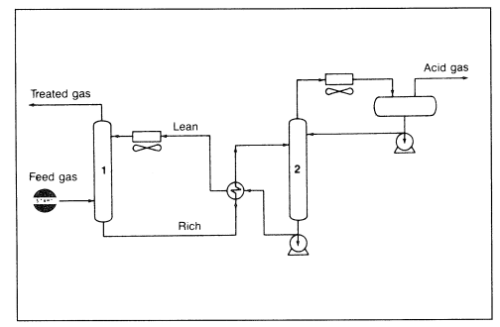
The Econamine process
(1) absorption tower, (2) regeneration tower.

Slide 59
Water Removal
Moisture must be removed from natural gas to reduce corrosion problems and to prevent hydrate formation. Hydrates are solid white compounds formed from a physical-chemical reaction between hydrocarbons and water under the high pressures and low temperatures used to transport natural gas via pipeline.
Hydrates reduce pipeline efficiency.
To prevent hydrate formation, natural gas may be treated with glycols, which dissolve water efficiently. Ethylene glycol (EG), diethylene glycol (DEG), and triethylene glycol (TEG) are typical solvents for water removal.
Triethylene glycol is preferable in vapor phase processes because of its low vapor pressure, which results in less glycol loss.

Slide 60
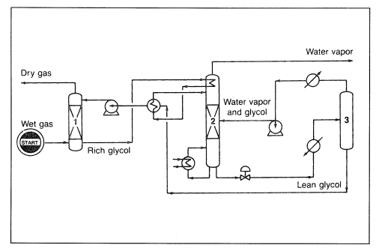
Dehydrate process
(1) absorption column, (2) glycol still, (3) vacuum drum

Slide 61
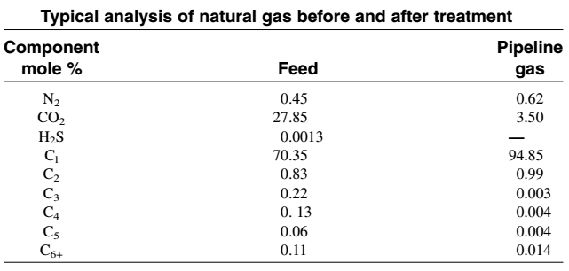
Condensable Hydrocarbon Recovery
Hydrocarbons heavier than methane that are present in natural gases are valuable raw materials and important fuels. They can be recovered by lean oil extraction. The first step in this scheme is to cool the treated gas by exchange with liquid propane. The cooled gas is then washed with a cold hydrocarbon liquid (lube oil), which dissolves most of the condensable hydrocarbons. The uncondensed gas is dry natural gas and is composed mainly of methane with small amounts of ethane and heavier hydrocarbons. The condensed hydrocarbons or natural gas liquids (NGL) are stripped from the rich solvent, which is recycled. Table below compares the analysis of natural gas before and after treatment. Dry natural gas may then be used either as a fuel or as a chemical feedstock.

Slide 62
Condensable Hydrocarbon Recov……
Another way to recover NGL is through cryogenic cooling to very low temperatures (–150 to –180°F), which are achieved primarily through adiabatic expansion of the inlet gas. The inlet gas is first treated to remove water and acid gases, then cooled via heat exchange and refrigeration. Further cooling of the gas is accomplished through turbo expanders, and the gas is sent to a demethanizer to separate methane from NGL. Improved NGL recovery could be achieved through better control strategies and use of on-line gas chromatographic analysis.

Slide 63
Petrochemicals resources
CRUDE OILS
Crude oil (petroleum) is a naturally occurring brown to black flammable liquid. Crude oils are principally found in oil reservoirs associated with sedimentary rocks beneath the earth’s surface. Although exactly how crude oils originated is not established, it is generally agreed that crude oils derived from marine animal and plant debris subjected to high temperatures and pressures. It is also suspected that the transformation may have been catalyzed by rock constituents.
Crude oils are not used directly as fuels or as feedstocks for the production of chemicals. Crude oils are refined to separate the mixture into simpler fractions that can be used as fuels, lubricants, or as intermediate feedstock to the petrochemical industries.

Slide 64
COMPOSITION OF CRUDE OILS
1. Hydrocarbon compounds (compounds made of carbon and hydrogen).
2. Non-hydrocarbon compounds.
3. Organometallic compounds and inorganic salts (metallic compounds).
Hydrocarbon Compounds: Alkanes (straight chain HC C3-C21, isoparaffins), cycloalkanes or naphthenes (cycloparaffins: methyl cyclopentane, cyclohexane etc.), aromatics (BTX).
Non-hydrocarbon Compounds:
Sulfur compounds are present in crude oil as mercaptans, mono- and disulfdes with the general formula R-SH, R-S-R1, R-S-S-R1, where R and R1 are the alkyl radicals. Mercaptans are very corrosive whereas mono- and disulfdes are not. Examples of cyclic sulfur compounds are thiophenes and benzothiophene. Hydrogen sulfide (H₂S) gas is associated with crude oil in dissolved form and is released when heated. H₂S is corrosive at high temperatures and in the presence of moisture.
The most important are the organic sulfur, nitrogen, and oxygen compounds. Traces of metallic compounds are also found in all crudes. The presence of these impurities is harmful and may cause problems to certain catalytic processes. Fuels having high sulfur and nitrogen levels cause pollution problems in addition to the corrosive nature of their oxidization products.
Sulfur in crude oils is mainly present in the form of organosulfur compounds. Hydrogen sulfide is the only important inorganic sulfur compound found in crude oil. Its presence, however, is harmful because of its corrosive nature. Organosulfur compounds may generally be classified as acidic and non-acidic. Acidic sulfur compounds are the thiols (mercaptans). Thiophene, sulfides, and disulfides are examples of non-acidic sulfur compounds found in crude fractions.

Slide 65
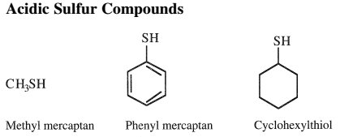
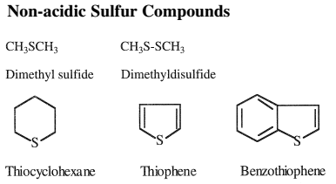

Slide 66
Sour crudes contain a high percentage of hydrogen sulfide. Because many organic sulfur compounds are not thermally stable, hydrogen sulfide is often produced during crude processing. High-sulfur crudes are less desirable because treating the different refinery streams for acidic hydrogen sulfide increases production costs. Most sulfur compounds can be removed from petroleum streams through hydrotreatment processes, where hydrogen sulfide is produced and the corresponding hydrocarbon released. Hydrogen sulfide is then absorbed in a suitable absorbent and recovered as sulfur.
In the heavier fractions of crude oil, 80%–90% of the sulfur is usually present in the complex ring structure of hydrocarbons. In this combination, the sulfur atom is very stable and non-reactive. As a result, sulfur from heavier petroleum cannot be removed without a destructive reaction, such as severe thermal or catalytic reactions.

Slide 67
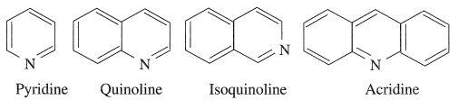

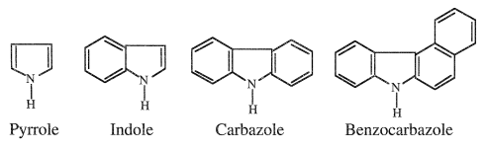
Nitrogen compounds in hydrocarbons are usually found in the heavier parts of the crude oil. These are responsible for color and color instability and poisoning of certain catalysts. Nitrogen in petroleum fuels causes the generation of oxides of nitrogen (NOx), which are also strong pollutants of the atmosphere. Nitrogen can be eliminated from petroleum products by catalytic hydrogenation. Like sulfur, nitrogen in the heavier parts of petroleum cannot be removed without severe cracking or hydrogenation reactions.
Organic nitrogen compounds occur in crude oils either in a simple heterocyclic form as in pyridine (C₅H₅N) and pyrrole (C₄H₅N), or in a complex structure as in porphyrin. The nitrogen content in most crudes is very low and does not exceed 0.1 wt%. In some heavy crudes, however, the nitrogen content may reach up to 0.9 wt %. Nitrogen compounds are more thermally stable than sulfur compounds and accordingly are concentrated in heavier petroleum fractions and residues. Light petroleum streams may contain trace amounts of nitrogen compounds, which should be removed because they poison many processing catalysts. During hydrotreatment of petroleum fractions, nitrogen compounds are hydro-denitrogenated to ammonia and the corresponding hydrocarbon.

Slide 68
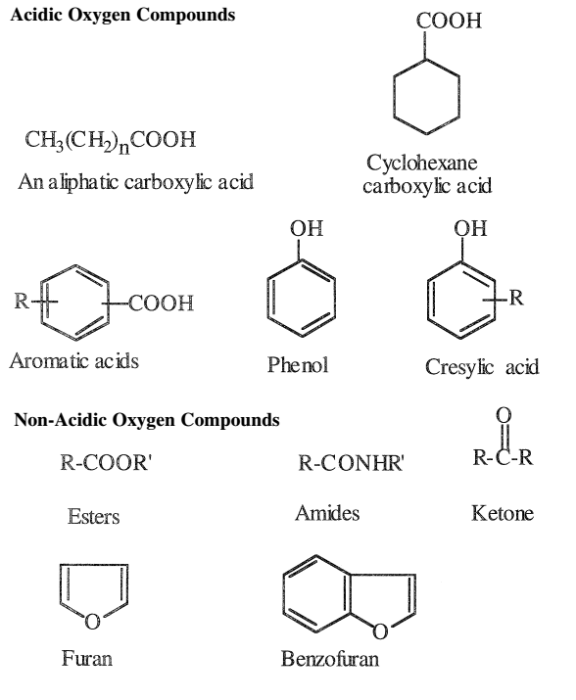
Oxygen Compounds
Oxygen compounds in crude oils are more complex than the sulfur types. However, their presence in petroleum streams is not poisonous to processing catalysts. Many of the oxygen compounds found in crude oils are weakly acidic. They are carboxylic acids, cresylic acid, phenol, and naphthenic acid. Naphthenic acids are mainly cyclopentane and cyclohexane derivatives having a carboxyalkyl side chain.
Naphthenic acids in the naphtha fraction have a special commercial importance and can be extracted by using dilute caustic solutions. The total acid content of most crudes is generally low, but may reach as much as 3%, as in some California crudes.

Slide 69
Metallic Compounds
Many metals occur in crude oils. Some of the more abundant are sodium, calcium, magnesium, aluminium, iron, vanadium, and nickel. They are present either as inorganic salts, such as sodium and magnesium chlorides, or in the form of organometallic compounds, such as those of nickel and vanadium (as in porphyrins). Calcium and magnesium can form salts or soaps with carboxylic acids. These compounds act as emulsifiers, and their presence is undesirable. Although metals in crudes are found in trace amounts, their presence is harmful and should be removed. When crude oil is processed, sodium and magnesium chlorides produce hydrochloric acid, which is very corrosive. Desalting crude oils is a necessary step to reduce these salts.
Vanadium and nickel are poisons to many catalysts and should be reduced to very low levels. Most of the vanadium and nickel compounds are concentrated in the heavy residues. Solvent extraction processes are used to reduce the concentration of heavy metals in petroleum residues.

Slide 70
Petrochemicals are chemicals derived from petroleum products. Examples of petrochemicals are plastics, rubbers, fibers, paints, solvents, and detergents. In fact, petroleum products are mixtures of hydrocarbons, whereas the raw materials for petrochemicals are pure hydrocarbons separated and converted to desirable products, such as polymers, solvents, and surfactants, usually in several stages and may be grouped as (1) feedstocks (first-generation petrochemicals), (2) intermediates (second-generation petrochemicals), and (3) finished products (third-generation petrochemicals).
Products similar to petrochemicals derived from non-petroleum sources are not strictly petrochemicals. For example, cellulose, natural rubber, natural resins, nylon 11, and ethanol of plant origin are strictly non-petrochemicals.
Coal distillation is also a source of varieties of coal chemicals, e.g., benzene, toluene, xylene, and naphthalene. In fact, before petroleum sources were known, coal chemicals were used to produce a variety of products.
Non-hydrocarbons obtained from petroleum, e.g., hydrogen, carbon monoxide, carbon dioxide, sulfur, and carbon, are also loosely called petrochemicals.
Hydrogen, nitrogen and oxides of carbon manufactured from steam reforming and partial oxidation of naphtha are also petrochemicals. These are used for production of ammonia,
urea, melamine, fertilizer, etc.

Slide 71
Petrochemical feedstocks
Typical feedstocks to petrochemical processes include:
  C1 Compounds: Methane & Synthesis gas
  C2 Compounds: Ethylene and Acetylene
  C3 Compounds: Propylene
  C4 Compounds: Butanes and Butenes
  Aromatic Compounds: Benzene
Petrochemicals are produced from simple compounds such as methane, ethylene and acetylene but not multicomponent products such as naphtha, gas oil etc.

Slide 72
Feedstocks
Feedstocks are the raw hydrocarbons obtained from crude oil refining by distillation and thermal and catalytic processes. For instance, hydrocarbon gases and naphtha are available from atmospheric distillation of crude oil; similarly, benzene, toluene, and xylene, obtained by catalytic reforming and catalytic cracking processes, are the major raw materials for the manufacture of second-generation petrochemicals. Benzene, toluene, xylene, and heavier aromatics are also generated as by-products from petrochemical plants. Thus, the feedstocks for petrochemical plants are either directly obtained from refineries or are further processed to generate them in the petrochemical plant itself.
Natural gas and refinery products are the major source of feedstocks for petrochemicals.
Thermal cracking of ethane, propane, butane, and naphtha produces cracked gases or
olefins (ethylene, propylene, butylenes, acetylene, etc.) and liquids (benzene, toluene, xylene, etc.). Olefins are the starting material (monomers) for polyolefin plants. Olefins are also reacted with other hydrocarbons or non-hydrocarbon chemicals to generate vinyl chloride, ethylene glycol, neoprene, ethylene oxide, etc., and these are used as the starting materials (monomers) for the manufacture of a variety of polymers.

Slide 73
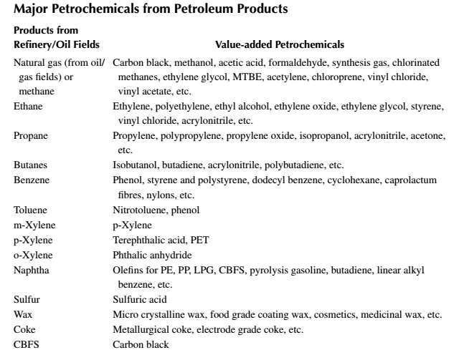

Slide 74
Petrochemical Industry in India: Survey
Petrochemical Industry in India Petrochemicals play a vital role in the functioning of virtually all key sectors of economy which includes agriculture, infrastructure, healthcare, textiles and consumer durables. Polymers provide critical inputs which enable other sector to grow. Petrochemical products cover the entire spectrum of daily use items ranging from clothing, housing, construction, furniture, automobiles, household items, toys, agriculture, horticulture, irrigation, and packaging to medical appliances. Per capita consumption of polymer has reached saturation level in US. India has the advantage of high population and expected to maintain high economic growth. This should propel India's polymer consumption to new levels in coming year.
Petrochemical markets ended 2017 on a firm note with prices of most products moving up during the year. The ICIS petrochemical index (IPEX) was on average 17% higher in 2017 than in 2016. The IPEX values represent the movement in monthly prices for 12 commodity petrochemicals and polyolefins. Among the petrochemical building blocks, Asian spot ethylene prices rose by 15% during 2017 with markets running at a two-year high towards the end of the year marking a sharp recovery from the lows seen at mid-year. Markets had come under selling pressure in the first half due to plentiful supply from both Asian and non-Asian sellers.

Slide 75
Naphtha cracking

Slide 76
Major plastics are manufactured from olefins, which are available either by cracking of gases (gas-based petrochemicals), such as methane, ethane, propane and butane, or from naphtha (naphtha-base petrochemicals).
Due to the larger availability of naphtha and the low energy requirement for cracking as compared to gases, naphtha cracking is widely accepted for the manufacture of olefins. Naphtha is a mixture of hydrocarbons boiling in the range of the lowest boiling component (C5) to 190°C, which contains paraffins, naphthenes, and aromatics in various proportions.
It is found that paraffins, i.e., straight chain hydrocarbons, yield olefins when heated at a high temperature. The branched chain and aromatic hydrocarbons, on the other hand, become heavier or decomposed to carbon.
It is also a fact that the yield of olefins decreases with the increasing molecular weight (hence with boiling point) of the hydrocarbons. For example, if ethane is thermally cracked, it will yield 80% ethylene, while from propane, butane, naphtha, and gas oil as feedstocks, if cracked separately the yields will be 45%, 37%, 30%, and 25%, respectively. Hence, the desirable feedstock naphtha should have a very high content of paraffins and be in the lower boiling range. A suitable boiling range for feedstock naphtha for olefin production is below 100°C and should have a paraffin content of more than 75%.
Usually, naphtha in the boiling range of 90°C−190°C is catalytically reformed in a refinery either to produce gasoline or aromatics.
Hence, in the refinery, C5−90°C cut is separated in the naphtha redistillation unit and is sold to the petrochemical industry. C5–90 °C contains pentanes, hexanes, and small amounts of lighter C7 isomers (and possibly benzene), all boiling below 90 °C. Naphtha cracking is carried out in a tube-still furnace at a temperature above 800°C. Due to thermal cracking, the following cracking endothermic reaction takes place

Slide 77

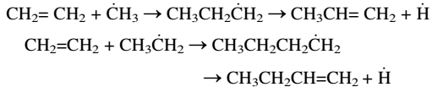

Naphtha cracking
The reaction involved

Slide 78
Reaction
C_{x}H_{y} + H₂O + O₂ C₂H₄ + C₂H₆ + C₂H₂ + H₂ + CO + CO₂ + CH₄ + C₃H₆ + C₃H₈ + C₄H₁₀ + C₄H₈ + C₆H₆ + C+ Heavy oils
Reaction temperature is about 700 – 800ºC (Vapor phase reaction).
Endothermic reaction
Further increase in temperature produces ethylene. Also result in coke formation.
Steam is used to increase the partial pressure and also to decoke the carbon inside the reactor.
Tubular reactor with short residence time (0.1-0.3 seconds)
Steam to naphtha ratio= 0.4-0.6 is maintained.

Slide 79
Light hydrocarbons obtained from the initial cracking reactions further crack into lighter olefins and propagate until the reaction temperature is brought down (quenched).
If the reaction is continued indefinitely, branched and cyclized heavy hydrocarbons will be produced, and coke will be generated as the ultimate product.
Therefore, the cracking reaction is carried out in a very short residence time, i.e., the naphtha feed passes the heater tubes at very high speed to avoid undesirable heavy end products and coke. Usually, residence time is maintained between 0.5-1.2 sec in the traditional cracker furnaces, and it is of the order of a few milliseconds in the modern millisecond furnaces.
Since a coke layer develops inside the tube surface, the heat transfer rate is rapidly reduced, causing reduced cracking and poor olefins yield.
Steam is introduced with the feed to remove the coke layer on the tube surface by converting coke into carbon monoxide and hydrogen by water gas reaction
However, coke cannot be removed completely by steam and the thickness grows during the operating period of the furnace. When the coke layer reaches the point at which cracking operation shows poor yield, the furnace is taken out of service and decoking is carried out with air and steam to remove coke to the maximum extent. Thus, a cracker furnace operates cyclically between the cracking and decoking operations.
Excess steam may also partially convert some of the hydrocarbons or naphtha components to carbon monoxide and hydrogen and reduce the yield of olefins.

Slide 80
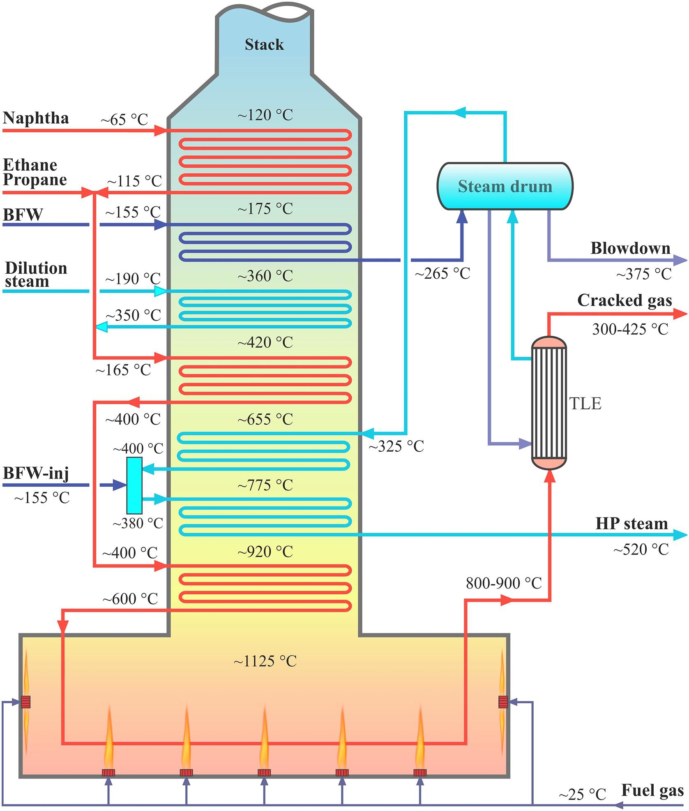
Naphtha Cracker- Main reactor
Transfer Line Exchanger
Thermal/catalytic cracking of hydrocarbons for the production of olefins; a state-of-the-art review III: Process modeling and simulation, Mohammad Fakhroleslam⁎, Seyed Mojtaba Sadrameli, Fuel(252), 2019, 553-566

Slide 81
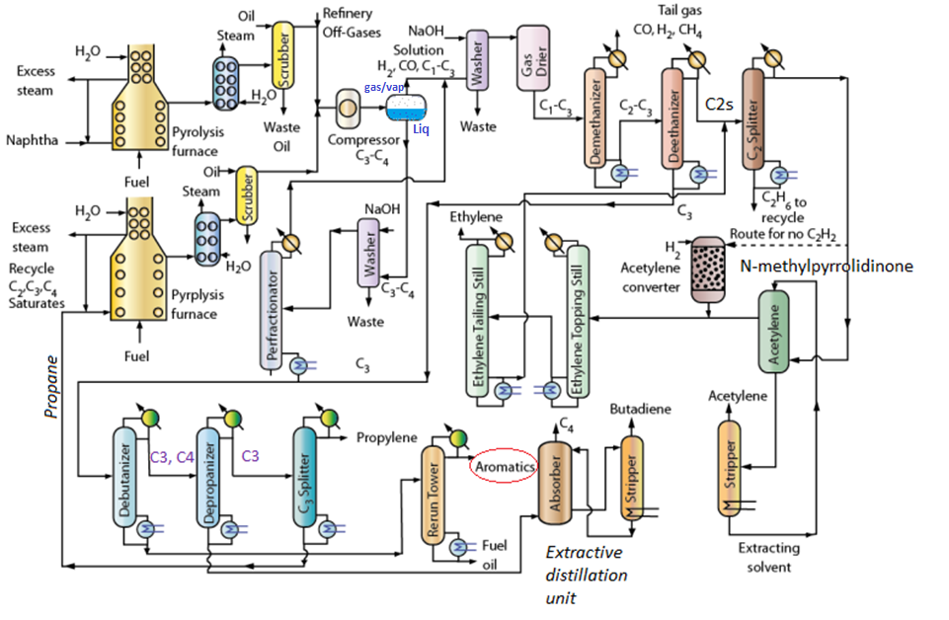
Steam cracking of naphtha Olefins and Aromatics (BTX from pyrolysis gasoline)
300–425 °C
700–800 °C
Dimethyl formamide

Slide 83
Column | Main Function | Temperature Range | Pressure Range
Demethanizer | Removes methane and hydrogen from heavier hydrocarbons | −95 to −100 °C (top), −30 to −40 °C (bottom) | 25–35 bar
Deethanizer | Separates C₂ components from C₃+ hydrocarbons | −20 to −30 °C (top), 50–80 °C (bottom) | 15–25 bar
C₂ Splitter (Ethylene/Ethane splitter) | Separates ethylene from ethane | −10 to 10 °C (top), 70–90 °C (bottom) | 15–25 bar
Depropanizer | Separates C₃ hydrocarbons from C₄+ | 30–40 °C (top), 100–120 °C (bottom) | 10–18 bar
Debutanizer / Debutenizer | Separates C₄ components from heavier hydrocarbons | 40–60 °C (top), 120–150 °C (bottom) | 5–12 bar
C₃ Splitter (Propylene/Propane splitter) | Separates propylene from propane | 35–45 °C (top), 120–150 °C (bottom) | 16–22 bar

Slide 84
Cracking furnaces
Cracking furnaces are considered to be as a heart of the olefin plant due to their importance in the production of the raw materials for the downstream processes. Each furnace is divided into three sections; radiation section or firebox, convection section and a stack as illustrated in Fig. 3. The radically chemical reactions which take place in a fraction of second (0.4–1 s) in the tubular reactors (millisecond reactors) suspended in the firebox of the cracking furnaces are highly endothermic. The required heat of the reaction is provided via several burners which are located mainly on the side walls facing the tubular reactors, and also on the floor of the firebox to provide the temperature uniformity around the reactor tubes. The required fuel gas for the firing system is recycled from the top of demethanizer in the separation section and is mixed with a design excess air of approximately 10% in the burners. An induced draft fan on the stack provides the draft to the firebox. Dilution Steam (DS) with a ratio of 0.3–1.0 kg/kg of hydrocarbon depending on the type of feedstock (0.3 for ethane and 1.0 for gasoil) is added to the feed to increase its temperature and also to lower the hydrocarbon partial pressure and dilute the feed especially for the heavier hydrocarbons. The hot flue gases leaving the radiant section of the furnace are routed to the convection section where the flue gas heat is transferred to the feed/steam streams as well as high pressure steam and Boiler Feed Water (BFW).

Slide 85
Reactor type |  |  | Industrial reactor
Reactor length (m) |  |  | 10 – 100
Tube diameter (m) |  |  | 3.10⁻² –1.510⁻¹
Flow rate (kg/s) |  |  | 10⁻² –1
Pressure drop (MPa) |  |  | 0.07 – 0.15
Coil Outlet Temp. (K) |  |  | 1000–1200
Residence time (s) |  |  | 0.1–1
Re |  |  | 1.10⁵–5.10⁵

Slide 86
The naphtha cracker reactor-millisecond reactors
Tube diameter: 50–100 mm, Tube length: 15–35 m
Material: HP alloy steel (e.g., 25Cr–35Ni–Nb)
Furnace duty: 50–300 MW (depending on plant size)

Slide 87
Process description
Naphtha/LPG saturates is mixed with superheated steam and fed to a furnace (fuel gas + fuel oil) as fuels to generate heat). The superheated steam is generated from the furnace itself using heat recovery boiler concept.
The C2-C4 saturates are fed to a separate furnace fed with fuel gas + fuel oil as fuels to generate heat.
In the furnace, apart from the steam cracking, steam is also generated. This is by using waste heat recovery concept where the combustion gases in the furnace.
After pyrolysis reaction, the products from the furnace are sent to another heat recovery steam boiler to cool the product streams (from about 700 – 800°C) and generate steam from water.
After this operation, the product vapours enter a scrubber that is fed with gas oil as absorbent (direct quench). The gas oil removes solids and heavy hydrocarbons.
Separate set of waste heat recovery boiler and scrubbers are used for the LPG furnace and Naphtha steam cracking furnaces.
After scrubbing, both product gases from the scrubbers are mixed and fed to a compressor. The compressor increases the system pressure to 35 atms.
The compressed vapour is fed to a phase separation that separates the feed into two stream namely the vapour phase stream and liquid phase stream. The vapour phase stream consists of H₂, CO, CO₂,C1-C3+ components in excess. The liquid phase stream consists of C3 and C4 compounds in excess.
Subsequently, the vapour phase and liquid phase streams are subjected to separate processing.

Slide 88
Gas stream processing:
CO₂ in the vapour phase stream is removed using NaOH scrubber. Subsequently gas is dried to consist of only H₂, CO, C1-C3 components only. This stream is then sent to a demethanizer which separates tail gas (CO + H₂ + CH₄) from a mixture of C1-C3 components. The C2-C3+ components enter a dethanizer which separates C2 from C3 components.
Here C2 components refer to all kinds of C2s namely ethylene, acetylene etc. Similarly, C3 the excess of propylene, and propane.
The C2 components then enter a C2 splitter which separates ethane from ethylene and acetylene.
The ethylene and acetylene gas mixture is fed to absorption unit which is fed with an extracting solvent (such as N-methylpyrrolidinone) to extract Acetylene from a mixture of acetylene and ethylene.
The extractant then goes to a stripper that generates acetylene by stripping. The regenerated solvent is fed back to the absorber.
The ethylene stream is fed to a topping (removes lighter components (H₂, CH₄, small C₂ impurities) from ethylene) and tailing still (removes heavier components (C₂H₆, C₃H₆, C₄’s) from ethylene) to obtain high purity ethylene and a mixture of ethylene and acetylene as the top and bottom products.
The mixture of ethylene and acetylene is sent back to the C2 splitter unit as its composition matches to that of the C2 splitter feed.

Slide 89
Liquid stream processing
The liquid stream consists of C3,C4, aromatics and other heavy oil components is fed to a NaOH scrubber to remove CO₂.
Eventually it is fed to a pre-fractionator. The pre-fractionator separates lighter components from the heavy components. The lighter components are mixed with the vapor phase stream and sent to the NaOH vapour phase scrubber unit.
The pre-fractionator bottom product is mixed with the deethanizer bottom product.
Eventually the liquid mixture enters a debutanizer that separates C3, C4 components from aromatics and fuel oil mixture. The bottom product eventually enters a distillation tower that separates aromatics and fuel oil as top and bottom products respectively.
The top product then enters a depropanizer that separates C3s from C4 components.
The C4 components then enter an extractive distillation unit that separates butane + butylenes from butadiene. The extractive distillation unit consists of a distillation column coupled to a solvent stripper. The solvent stripper produces butadiene and pure solvent (Acetonitrile (CH₃CN), Dimethylformamide (DMF, HCON(CH₃)₂), NMP) which is sent to the distillation column.
The C3 components enter a C3 splitter that separates propylene from propane + butane mixture. The saturates mixture is recycled to the saturates cracking furnace as a feed stream.

Slide 90
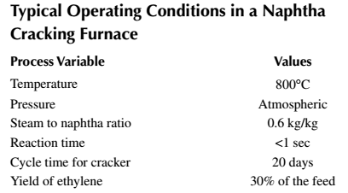
By-products of cracking are propylene, butylene, butadiene, and aromatics, such as benzene, toluene, xylene, isomeric paraffins, naphthenic components, and polynuclear aromatics.
Products from the cracking furnace are quenched by hot oil and cooled before they are sent to the separation units. The product mixture then ﬂows through a series of separators, e.g., mechanizer, de-ethanizer, depolarizer, and debutanizer units, which are multiplated distillation columns.

Slide 91
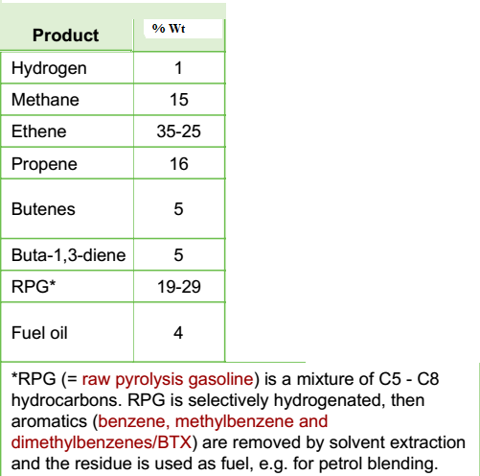
Typical yield of steam cracking of Naphtha

Slide 92
What is Raw PyGas? Explain how is it produced and separated?
Raw PyGas (Raw Pyrolysis Gasoline) is the unstable, untreated liquid by-product from high-temperature naphtha cracking in ethylene plants. It is highly reactive but rich in valuable BTX aromatics (benzene, toluene, xylenes). Raw Pyrolysis Gasoline (RPG) is the unhydrogenated form of pygas. It is a naphtha-range hydrocarbon mixture (C5 to C12) with the following characteristics.
Raw PyGas is produced as a by-product during high-temperature steam cracking in olefin plants .
Feedstock Preparation: Naphtha, butane, or gasoil is fed into the cracker furnace.
Steam Cracking: The feedstock is mixed with steam and heated to 800-875°C. This breaks long hydrocarbon chains into smaller, valuable molecules like ethylene and propylene.
By-Product Formation: The cracking process also produces heavier liquid hydrocarbons in the C5-C12 range. This liquid stream, condensed and separated from the gaseous products, is the Raw PyGas .
Raw Product: This raw stream leaves the primary fractionator and contains a complex mixture of aromatics (including benzene, toluene, xylenes), diolefins, and other unsaturated compounds.
Raw PyGas Separated and Refined: Because Raw PyGas is unstable (unsaturated compounds cause gum formation), it cannot be used directly. It undergoes a multi-step separation and purification process, typically in a Pygas Hydrogenation Unit (PHU)
Stage 1: Primary Fractionation (Rerun column)
Two-Stage Hydrogenation-Raw PyGas must be hydrotreated to remove unstable compounds and impurities. This is typically done in two stages :
First Stage (Diolefin Saturation): Diolefins and styrenes are selectively hydrogenated to mono-olefins using a catalyst (e.g., nickel/palladium). This prevents gum formation and polymerization in downstream equipment .
Second Stage (Hydrodesulfurization): Olefins are saturated, and sulfur compounds are removed as H₂S. This produces Hydrogenated Pyrolysis Gasoline (HPG) , a stable feedstock suitable for BTX extraction.

