Slide 1
CL321 PRE Module 5

Slide 2
Alkylation

Slide 3
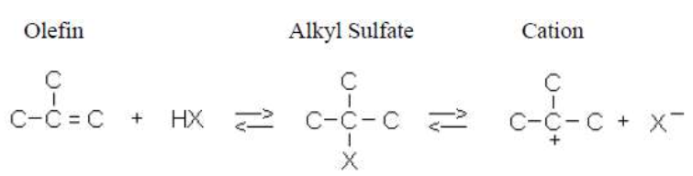
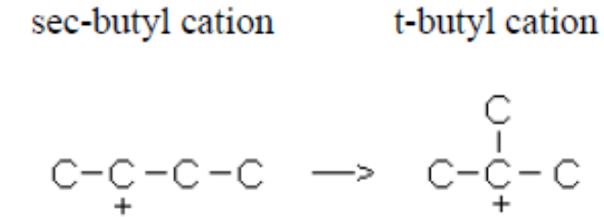
Alkylation

Slide 4
Alkylation (acid catalyzed conversion of C3–C5 olefins with isobutane into highly branched C5–C12 isoparaffins)
In petroleum refining alkylation means the reaction of low molecular weight olefins with an isoparaffin to form higher molecular weight isoparaffins
Alkylation can take place at high temperatures and pressures without catalysts, but alkylation is conducted in the presence of either sulfuric or hydrofluoric acid as catalyst at a low temperature
With sulfuric acid it is necessary to carry out the reactions at 40 to 70°F (5 to 21°C) or lower because the sulfuric acid is much more sensitive to temperature. Also it produces tar and SO₂
For anhydrous hydrofluoric acid catalyst, the temperature is usually limited to 100°F (38°C) or below.

Slide 5
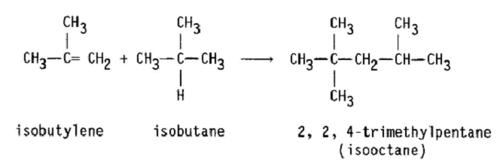
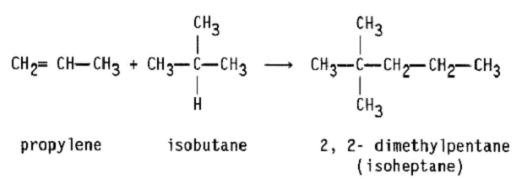
Alkylation reactions

Slide 6
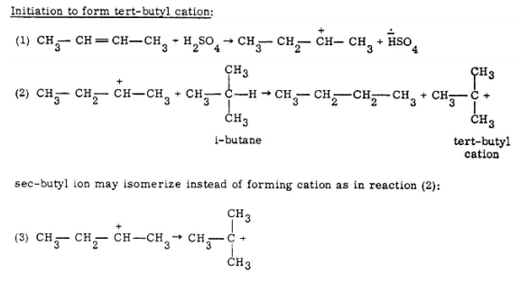
Alkylation chemistry

Slide 7
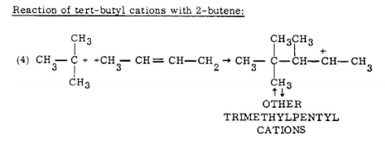
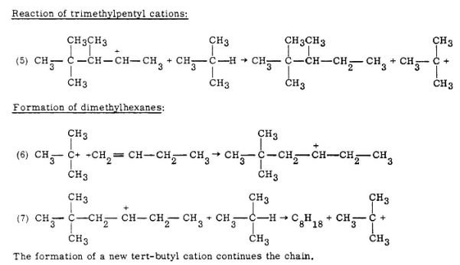

Slide 8


Slide 9
ALKYLATION FEEDSTOCKS
Olefins and isobutane are used as alkylation unit feedstocks.
Butenes and propene are the most common olefins used
The chief sources of olefins are catalytic cracking and coking operations
Hydrocrackers, catalytic crackers, catalytic reformers, crude distillation, and natural gas processing are sources of isoparaffins.

Slide 10
ALKYLATION PRODUCTS
1. LPG grade propane liquid
2. Normal butane liquid
3. C₅+ alkylate
4. Tar

Slide 11
CATALYST
88% by weight H₂SO₄, or HF
Sulfuric acid containing free SO₃ also causes undesired side reactions and concentrations greater than 99.3% H₂SO₄ are not generally used

Slide 12
Important factors of the process
1. Reaction temperature
2. Acid strength
3. Isobutane concentration
4. Olefin space velocity

Slide 13
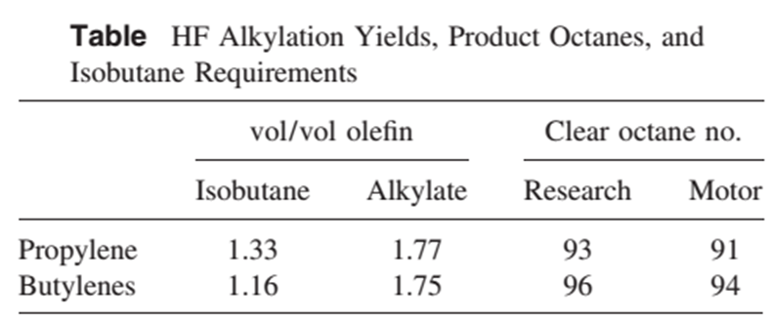

Slide 14
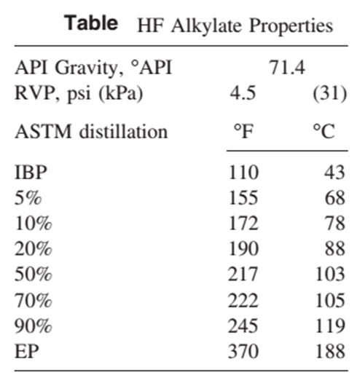

Slide 15
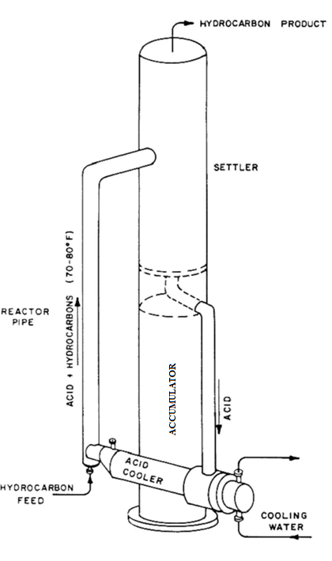
Phillips HF reactor

Slide 16
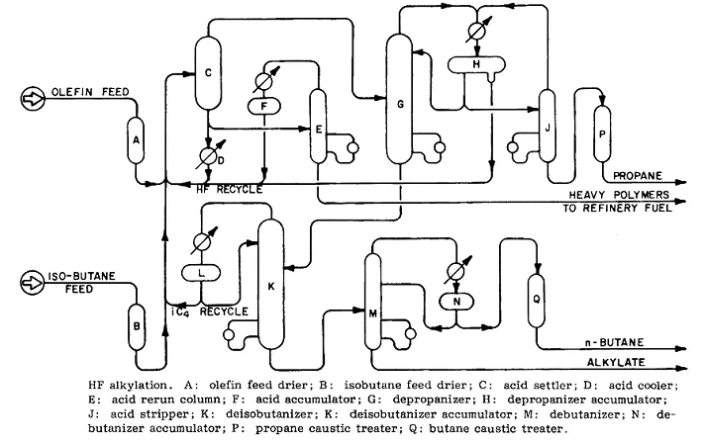
HF alkylation process flow diagram
Phillips hydrofluoric acid alkylation unit

Slide 17
Process description
Both the olefin and isobutane feeds are dehydrated by passing the feedstocks through a solid bed desiccant unit.
After dehydration the olefin and isobutane feeds are mixed with hydrofluoric acid at sufficient pressure to maintain all components in the liquid phase.
The reaction mixture is allowed to settle into two liquid layers. The acid has a higher density than the hydrocarbon mixture and is withdrawn from the bottom of the settler and passed through a cooler to remove the heat gained from the exothermic reaction. The acid is then recycled and mixed with more fresh feed, thus completing the acid circuit.
A small slip-stream of acid is withdrawn from the settler and fed to an acid rerun column to remove dissolved water and polymerized hydrocarbons. The acid rerun column contains about five trays and operates at 150 psig (1034 kPa).
The overhead product from the rerun column is clear hydrofluoric acid which is condensed and returned to the system.

Slide 18
The bottom product from the rerun column is a mixture of tar and an HF– water azeotrope. These components are separated in a tar settler (not shown on the flow diagram). The tar is used for fuel and the HF–water mixture is neutralized with lime or caustic.
The hydrocarbon layer removed from the top of the acid settler is a mixture of propane, isobutane, normal butane, and alkylate along with small amounts of hydrofluoric acid.
These components are separated by fractionation and the isobutane is recycled to the feed. Propane and normal butane products are passed through caustic treaters to remove trace quantities and hydrofluoric acid.
Although the flow sheet shows the fractionation of propane, isobutane, normal butane, and alkylate to require three separate fractionators, many alkylation plants have a single tower where propane is taken off overhead, a partially purified isobutane recycle is withdrawn as a liquid several trays above the feed tray, a normal butane product is taken off as a vapor several trays below the feed tray and the alkylate is removed from the bottom.

Slide 19
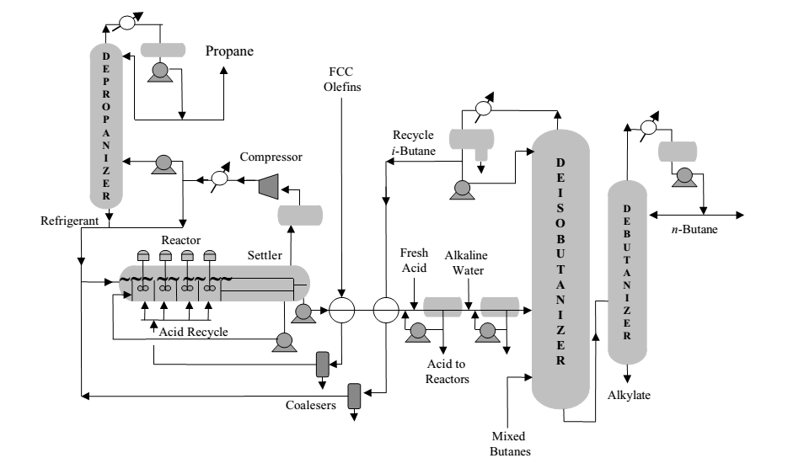
H₂SO₄ alkylation process flow diagram Cascade process licensed by Exxon Mobil (AUTOREFRIGERATION)

Slide 20
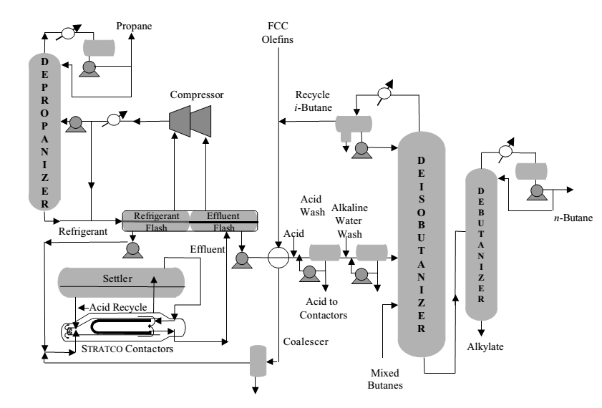
H₂SO₄ catalyzed Stratco effluent refrigerated alkylation process

Slide 21
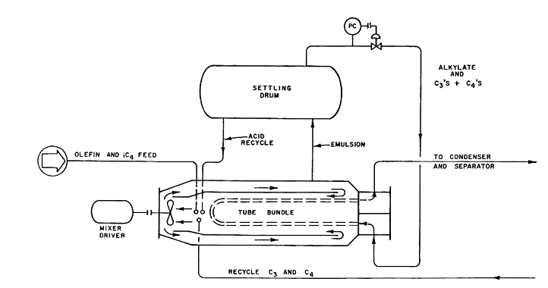

Slide 22
HYDROGEN PRODUCTION AND PURIFICATION

Slide 23
HYDROGEN PRODUCTION AND PURIFICATION
Refineries produce sufficient quantities of hydrogen for hydrotreating from their naphtha-fed platinum catalyst reforming operations.
Some of the more modern plants with extensive hydrotreating and hydrocracking operations, however, require more hydrogen than is produced by their catalytic reforming units.
This supplemental hydrogen requirement can be provided by one of two processes: partial oxidation of heavy hydrocarbons such as fuel oil, or steam reforming of light ends such as methane (natural gas), ethane, or propane.
The steam reforming process employs catalysts, but it should not be confused with the catalytic reforming of naphtha for octane improvement.
Relative hydrogen production costs by the two processes are primarily a function of feedstock cost. Steam reforming of methane usually produces hydrogen at a lower cost than partial oxidation of fuel oil.

Slide 24
Steam reforming of light hydrocarbon
Feed pretreated to remove sulphur and halogens traces. H₂S is removed using zinc oxide. ZnO + H₂S → ZnS + H₂O. Organic sulphur removed by hydrotreating and H₂S removal from the feed. Halogens are removed using adsorption technique.
Steam reforming for hydrogen production is accomplished in four steps: 1. Reforming. This involves the catalytic reaction of methane with steam at temperatures in the range of 1400 to 1500°F (760–816°C), according to the following equation: CH₄ + H₂O → CO + 3H₂ (endothermic)
The reaction is carried out by passing the gas through catalyst-filled tubes in a furnace. The catalyst usually is in the form of hollow cylindrical rings ranging up to 3/4 inch in diameter. It consists of 25 to 40% nickel oxide deposited on a low-silica refractory base. The steam to hydrocarbon ratio varies and is about 2.5 – 3.5.

Slide 25
2. Shift conversion. More steam is added to convert the CO from step 1 to an equivalent amount of hydrogen by the following reaction:
CO + H₂O → CO₂ + H₂ (exothermic)
The reaction and is conducted in a fixed-bed catalytic reactor at about 650°F (343°C). Multiple catalyst beds in one reactor with external cooling between beds are commonly employed to prevent the temperature from getting too high, as this would adversely affect the equilibrium conversion. The catalyst used is a mixture of chromium and iron oxide. It is interesting to note that these reactors operate at low temperatures. Therefore, cooling is carried out for the furnace reactor product and steam is generated. Similarly, steam is generated after the high temperature shift reactor also.

Slide 26
3. Gas purification. The third step is removal of carbon dioxide by absorption in a circulating amine or hot potassium carbonate solution. Several other treating solutions are in use. The treating solution contacts the hydrogen and carbon dioxide gas in an absorber containing about 24 trays, or the equivalent amount of packing. Carbon dioxide is absorbed in the solution, which is then sent to a still for regeneration of solvent.
4. Methanation. In this step, the remaining small quantities of carbon
monoxide and carbon dioxide are converted to methane by the following reactions:
CO + 3H₂ → CH₄ + H₂O
CO₂ + 4H₂ → CH₄ + 2H₂O
This step is also conducted in a fixed-bed catalytic reactor at temperatures of about 700 to 800°F (427°C). Both reactions are exothermic and, if the feed concentration of CO and CO₂ is more than 3%, it is necessary to recycle some of the cooled exit gas to dissipate the heat of reaction. The catalyst contains 10 to 20% nickel on a refractory base. The product from methanation reaction consists of 97 % H₂.

Slide 27
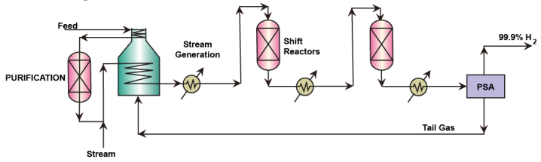
Alternatively, in some modern refineries, the low temperature shift reactor product is fed to a pressure swing adsorption (PSA) unit which produces 99.9 % hydrogen as a main product.
The PSA also produces a tail gas which is used as a fuel in the furnace used in the reformer process.
PSA technology also is incapable for CO and CO₂ removal as the adsorbents
are not competent enough to separate these components to a large extent. But they can effectively do separation when hydrocarbons are present but not
oxides in the hydrogen rich stream. Therefore, from PSA perspective as well
it is important to remove CO₂ bulk with amine scrubbing followed with
methanation reaction for both CO and CO₂ conversion. Activated carbon is used as the adsorbent.

Slide 28
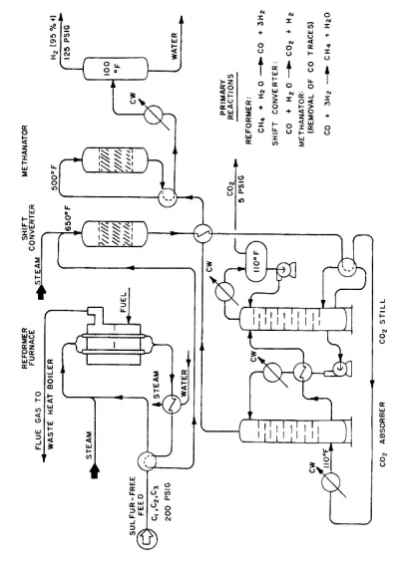

Slide 29
Polymerization
Polymerization to get high octane number polymer gasoline

Slide 30
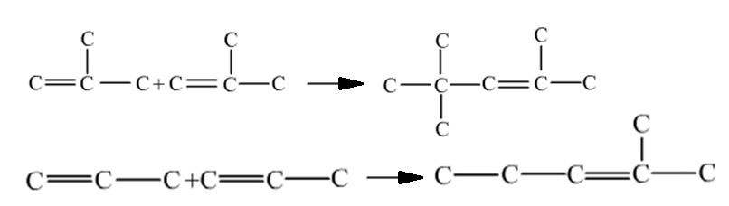
Catalytic Polymerization
Feed : product from FCC, Visbreaking, coking.
Feed washed with alkanolamine and caustic soda to remove H₂S and mercaptans respectively, followed by water wash. Dried with silica gel. Finally 350–400 ppm water is added to promote the ionization of catalyst.
Poor octane no due to presence of olefinic bond. Polymer gasoline may be hydrotreated for final blending with MS
Exothermic: 1550 kcal/kg
Temp:150-200 °C
Pressure:35-70 bar
Catalyst: Solid phosphoric acid supported on kieselguhr clay
The propane and butane in the feed act as diluents

Slide 31
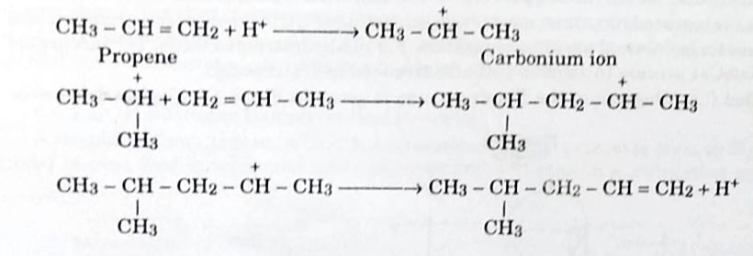
Polymerization mechanism

Slide 32
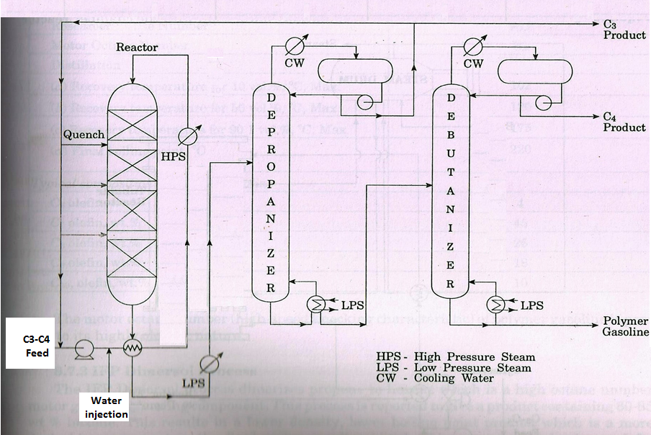
Polymerization process flow diagram (UOP)

Slide 33
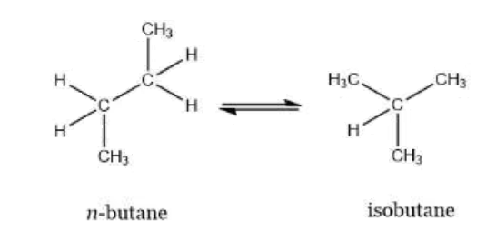
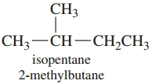
Catalytic Isomerization
H₃C-CH₂-CH₂-CH₂-CH₃

Slide 34
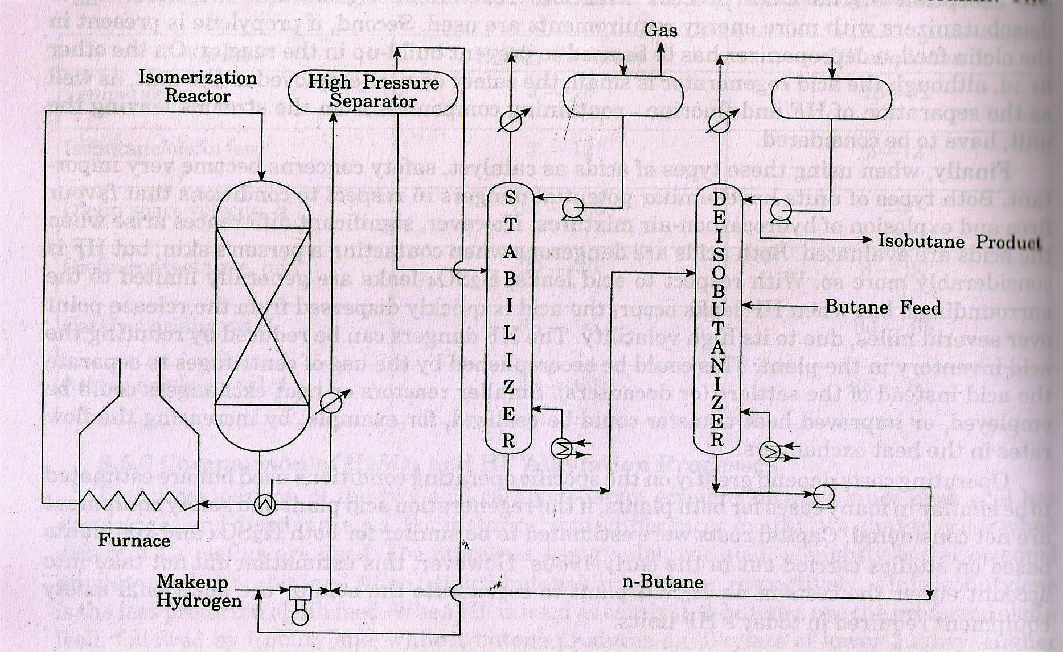
Isomerization of n-butane to iso-butane (feed for alkylation)
Pt catalyst

Slide 35
Lubricating Oil (LOBS)
Lube Oil Base Stocks
Lube base oils are Heavy Hydrocarbon Oils suitable for producing specific Lube oils in combination with additives.
Additives impart special characteristics to the final Lube oil Product
Lube Base Oils + Additives Lube Oils
Additives – Anti Oxidants/ anti wear/ anti rust/ color etc.
Base Oil constitutes > 90-95 % of the total composition.
Synthetic base oils, such as polyalphaolefns, alkylated aromatics, polybutenes, and aliphatic diesters, are also used as base oils

Slide 36
Introduction
Vacuum distillates (SO, IO, HO) and also the deasphalted oil from the residue (bright stock) are suitable for the production of LOBS, which are the main ingredients of finished lubes.
Usually, the temperature of an engine rises rapidly during the start up and continues at that temperature during motion. Such a wide and sudden change in temperature demands that the lubricant should have a high VI. In addition to temperature ﬂuctuations, lubricants are prone to oxidation and cracking, leading to the formation of cokes, carbons, and gummy substances, which may ultimately deposit on the engine, causing irreparable damage. In addition to engine oils, different lubricants are applicable for other parts of the vehicle, such as the gears, brake, clutch, and bearings. Gear boxes contain the gears immersed in lubricating oil having low viscosity to reduce friction at high speed. The brake and clutch require lubricating oils of low viscosity. Bearings are used in various parts of the automobile from engine to wheels and require low to high viscous lubricants. At low temperatures and high load, bearings at wheels are lubricated by grease. Since materials of construction and type of engines vary with the make, appropriate lubricants are selected and prescribed by the manufacturers. No single lubricant is therefore applicable for all makes.

Slide 37
Additives blended with the base oil
Detergents: These are surfactants to cleanse the harmful carbon and sludge deposits on the surface of the metals in contact. Sodium or calcium sulfonates or organic sulfonates are excellent detergent agents in lube oils.
Dispersants: These are used to disperse the oil-insoluble products of oxidation and other formations in the oil phase and does not allow these to deposit on the metallic surfaces of bearing or rolling or sliding metals. Examples of dispersants are succinimides, esters of polysuccinic acid or succinate ester, and hydroxyethyl imide.
Antioxidants and stabilizers: These agents prevent auto-oxidation of hydrocarbon base oils present in the lubricant. This chemical reaction is in three stages: initiation, propagation, and termination, similar to a polymerization reaction forming resinous layers. Copper soaps are an excellent retardant of such auto-oxidation. Aromatic amines and phenols are examples of antioxidants.

Slide 38
Additives
Viscosity index improvers: Polymethacrylates and polyisobutylene are excellent viscosity index (VI) improvers. These agents keep the viscosity of oil nearly unchanged over a wide range of temperature ﬂuctuations.
Friction modifiers: These agents modify the coefficient of friction by adhering to the metallic surface. Examples are amines, amides, their derivatives, carboxylic acids, phosphoric acids and their salts.
Pour point depressants: Polymethacrylates, polyacrylates, and di-tetra paraffn-phenol-phthalate act as the pour point suppressants.

Slide 39
Additives
Demulsifiers: Acidic gases, moisture, carbon particles and other products may form at high temperatures, especially in engines, and form an emulsion with the lubricant oils. Sulfonates, alkylated phenolic resins, polyethylene oxide, etc., are good demulsifers.
Anti-foaming agents: Gases and moisture are responsible for foam formation with the lubricating oil. The most widely used anti-foaming agent is polydimethylsiloxane.
Corrosion inhibitors: Ingress of oxygen and the presence of moisture cause oxide corrosion, and acidic chemicals and mercaptans may cause chemical corrosion aided by high temperatures. Esters or amides of dodecyl-succinic acid, thiophosphates, etc., act as corrosion inhibitors. Anti-oxidants also prevent oxide corrosion.
Thickeners: Sodium or calcium soaps act as thickeners, which are required to retain the film of lubricant over the metallic surfaces in contact and do not allow the metallic surfaces to come in direct contact without the lubricant film within them.

Slide 40
Key Properties of Base Oils
Viscosity- As per Lube Oil Grades
Viscosity Index- Desired High
Pour point- Desired Low
Colour- Desired bright and Clear
Flash point- Desired High
Volatility- Desired low
Oxidative & Thermal Stability- Desired High

Slide 41
Lube Composition and Properties
VI
KV
n - Paraffins
i - Paraffins
mono - Naphthenes
di & higher Naphthenes
mono - Aromatics
di - Aromatics
tri & higher- Aromatics
VI
Molecular weight
Pour Point

Slide 42

Lube Processing
Pour Point
Properties controlled by Process Units
VI, CCR
Gas
KV,
Flash Point
Colour &
Stability
Atmospheric distillation
Naphtha
VGO
Vacuum Distillates
Waxy Raffinates
De-waxed oils
Lube Base Oils
Kero
Diesel
Vacuum distillation
Solvent Extraction
Solvent De-waxing or
Catalytic De-waxing
Hydrofinishing
150N
500N
Crude oil
HN
BN/150BS
VR
DAO
RCO
Propane
De-Asphalting

Slide 43
API Base Oil Characterization Groups
 | VI | SATURATES % | SULPHER %
GROUP I | 80-120 | <90 | >0.03
GROUP II | 80-120 | >90 | <0.03
GROUP III | >120 | >90 | <0.03

Slide 44
Lube Base Oil Product Qualities
 | Grade | KV (cSt) | VI (min.) | Pour Point (max)
GR I | 150N | 28-32 (40ºC) | 100 | -9
 | 500N | 10 (100ºC) | 95 | -6
 | HN | 13.5 (100ºC) | 92 | -3
 | BN | 32 (100ºC) | 92 | -3
GR II | 70N | 9.5-15.5 (40ºC) | 100 | -21
 | 150N | 28.8-32 (40ºC) | 105 | -15
 | 500N | 90-105 (40ºC) | 95 (105) | -15
 | 150BS | 30 (100ºC) | 95 | -6

Slide 45
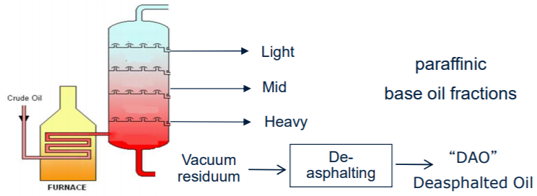
Lube Base Oil Production- Step-1
Production of Vacuum Gas oils of suitable viscosity Grades
Cuts obtained in the vacuum distillation unit as VGOs
These VGOs have high flash points and thus very low volatility
They consists of Waxy Paraffins, Aromatics and Naphthenic Oils.
VI of aromatics very low, they need to be separated.

Slide 46
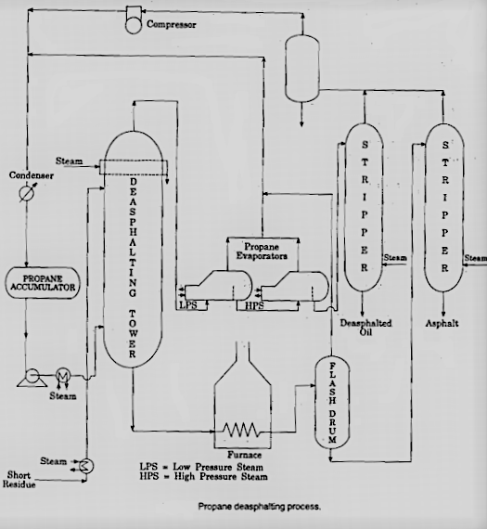

Oil with 85% propane
Rotating disc contactor
Extractor
40-90°C
Residue with
30-50% propane

Slide 47
Lube Base Oil Production- Step-2
Separation of Aromatics from the Vacuum Gas Oil Distillates
Aromatics Extraction by using solvents like Furfural / NMP (n-methyl Pyrollidone)
The process is a liquid-liquid extraction process.
The solvent have relatively more solubility for the Aromatics and this 2 phases are created in the extractor column
Low in Aromatics, Have High VI and high Pour Point
Raffinate Mix
Dry Solvent
Furfural/ NMP
Extractor Column
VGO Feed Stock
Free of Moisture
Rich in Aromatics,
Have very low VI
Extract Mix

Slide 48
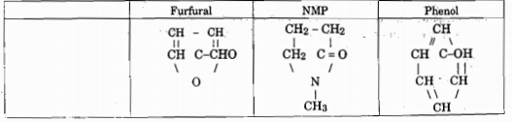
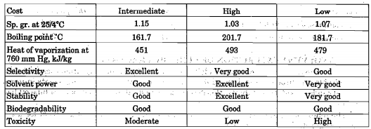
Aromatic extraction solvents

Slide 49
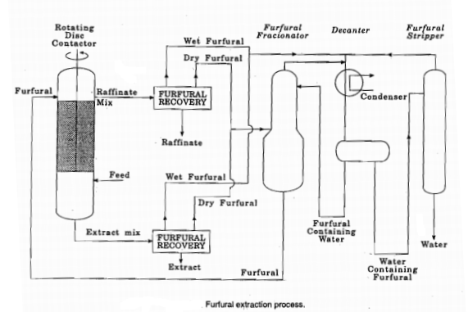


Slide 50
Lube Base Oil Production- Step-2
Solvent recovery and drying columns
Raffinate Mix
Heater
Raffinate

Slide 51
Lube Base Oil Production- Step-2
Solvent recovery and drying columns
Extract Mix
Heater
Extract
Solvent with water makes an azeotropic mixture and thus drying operation requires an azeotropic distillation column. Steam is used as a ternary solvent.

Slide 52
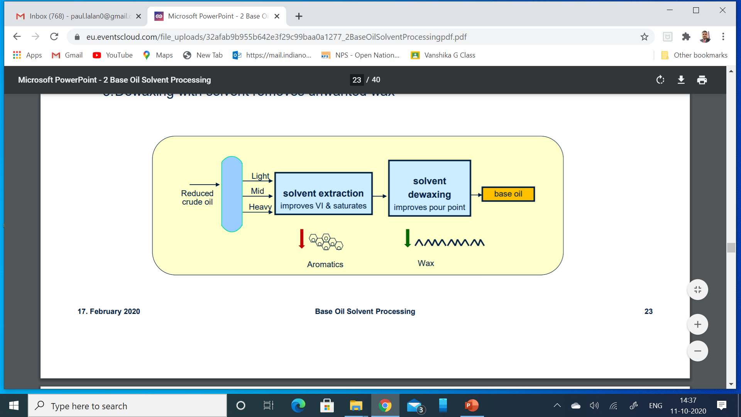
Lube Base Oil Production- Step-3
De-waxing of the Raffinates to lower the pour point
There are two methods.
1. Solvent De-waxing (SDU)
Involves physical separation of the wax molecules from the Raffinate
Employs operations like solvent extraction, crystallization and filtration
Solvents used are Methyl-Ethyl Ketone (MEK), Toluene, Methyl Isobutyl Ketone (MIBK) etc.

Slide 53
Lube Base Oil Production- Step-3
De-waxing of the Raffinates to lower the pour point
There are two methods.
2. Catalytic De-Waxing (CDWU)
Involves conversion of the wax molecules to low pour oil.
It is a catalytic process where n-paraffinc molecules are converted to their branched chain isomers.
Catalytic Iso-merization
Normal chain paraffins
Branched chain paraffins
Waxy in nature
Non-Waxy in nature
Catalytic De-waxing
Pour Point Reduction
Base Oils

Slide 54
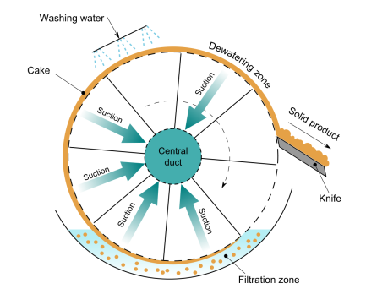
Solvent De-waxing
Ammonia Chillers
Rotary Drum Vacuum Filters
Chillers
Raffinate Mix
Solvent
-5 to -8 Deg C
-15 to -20 Deg C
Wax Mix
To Wax and solvent recovery
(Flash and Stripper Columns followed by drying)
Wax
Filtrate Mix
To Filtrate and solvent recovery
(Flash and Stripper Columns followed by drying)
Lube Base Oils

Slide 55
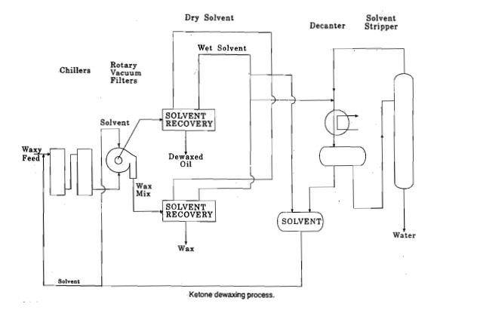


Slide 56

Catalytic De-waxing
Recycle Hydrogen Gas
Compressor
Heater
Heater
Separator
Raffinate Mix
Feed Hydro-treatment
De-waxing
Hydro-finishing
Light Distillates
Light Lubes
Heavy Lubes

Slide 57
Catalytic De-waxing
Feed Hydro-treatment is necessary to remove contaminants in the feed like Sulfur, Nitrogen which are poisons to the De-waxing catalyst
Hydrotreatment is done in Hydrogen rich atmosphere at high temperature and pressure conditions.
The reactions are highly exothermic and requires introduction of Hydrogen Quench gas in between the reactor beds to control the reactor temperature profile.
Multipoint thermocouple are installed in the catalyst beds for monitoring. Average Bed temperatures are the controlled parameters
Weighted average bed temperature is the average reactor temperature

Slide 58
Catalytic De-waxing
H₂S and NH₃ generated in the system are removed from the Recycle Gas stream in Amine Absorption Columns. The Sweet gas is again recycled back into the unit.
De-Waxing reactions (Isomeraization) are also highly exothermic. Quench hydrogen is introduced in between the beds.
Hydro-finishing reactor improves the colour and stabilizes the products by improved saturation.
Fractionation section separates the lighter hydrocarbons produced during the catalytic reactions.
Minor quantities of Naphtha and Diesel is also produced as a result of side reactions.
Pour Point of the product ranges from -15 to -21 Deg C.
VI of the product is >110

Slide 59
Lube Base Oil Production- Step-4
Hydro-finishing of the Lube Base Oil from SDU
The purpose is to improve the color and increase stability.
The operation is carried out in Hydrogen atmosphere and mild saturation occurs.
The Process is very similar to Hydro-treatment with similar equipment configuration. However the catalyst is different.
Catalyst- oxides of Co-Mo, Ni-Mo, Ni-Co-Mo

