Slide 1
CL321 PRE Module 4

Slide 2
CATALYTIC CRACKING

Slide 3
Introduction
Catalytic cracking process has almost completely replaced thermal cracking because in this process more gasoline with higher octane no. and less heavy fuel oils and light gases are produced. The light gases produced by catalytic cracking also contain more olefins than those produced by thermal cracking. Operating temperature is also low here (480– 540°C ). Residence time of gas inside the riser 2-3 s.
Catalytic cracking is the most important and widely used refinery process for converting heavy gas oils, vacuum distillates into more valuable gasoline, LPG, cycle oil, decant oil, olefins.
Catalytic cracking processes mainly are of two classes, either moving-bed or fluidized-bed units.
Thermafor catalytic cracking process (TCC) is representative of the moving-bed units and the fluid catalytic cracker (FCC) of the fluidized-bed units. There are very few TCC units in operation today and the FCC unit has taken over the field.

Slide 4
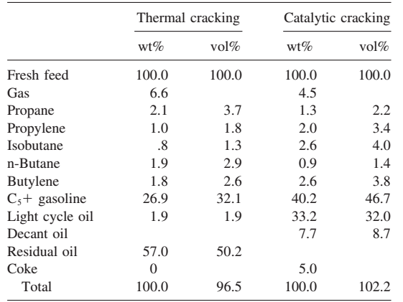
Thermal Versus Catalytic Cracking Yields on Similar Topped Crude Feed

Slide 5
Light cycle oil (LCO) is a diesel boiling range product from fluid catalytic cracking units. However, LCO is a poor diesel fuel blending component without further processing. There are various ways of economically upgrading LCO, which include hydrotreating, high pressure hydrocracking for full conversion of LCO into naphtha and a more optimized partial conversion hydrocracking process. The optimized partial conversion hydrocracking process provides an effective and flexible process to process LCO into desired products such as very low sulphur diesel and high-octane high-aromatics naphtha. Cycle oil is a light lubricating oil suited for use on bicycles and similar devices.
Decant oil is a high-boiling cat cracked aromatic process oil used in the manufacture of carbon black, burning fuel or in the blending of heavy fuel oils (bunker fuel oil).

Slide 6
Intro…..
The hot oil feed is contacted with the catalyst in either the feed riser line or the reactor. As the cracking reaction progresses, the catalyst is progressively deactivated by the formation of coke on the surface of the catalyst. The catalyst and hydrocarbon vapors are separated mechanically, and oil remaining on the catalyst is removed by steam stripping before the catalyst enters the regenerator (620-845°C). The oil vapors are taken overhead to a fractionation tower for separation into streams having the desired boiling ranges.
The spent catalyst flows into the regenerator and is reactivated by burning off the coke deposits with air. Regenerator temperatures are carefully controlled to prevent catalyst deactivation by overheating and to provide the desired amount of carbon burn-off. This is done by controlling the air flow to give a desired CO₂/CO ratio in the exit flue gases or the desired temperature in the regenerator.
The flue gas and catalyst are separated by cyclone separators and electrostatic precipitators. The catalyst in some units is steam-stripped as it leaves the regenerator to remove adsorbed oxygen before the catalyst is contacted with the oil feed.
The fluidized catalyst is circulated continuously between the reaction zone and the regeneration zone and acts as a vehicle to transfer heat from the regenerator to the oil feed and reactor. Two basic types of FCC units in use today are the ‘‘side-by-side’’ type, where the reactor and regenerator are separate vessels adjacent to each other, and the Orthoflow, or stacked type, where the reactor is mounted on top of the regenerator.
Until about 1965, most units were designed with a discrete dense-phase fluidized-catalyst bed in the reactor vessel. It was assumed most of the cracking occurred in the reactor bed. But observation shows cracking occurred in the riser feeding the reactor because the catalyst activity and temperature were at their highest.

Slide 7
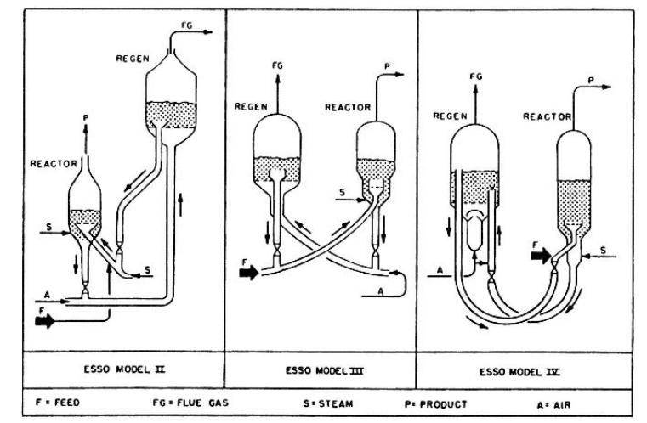
Older fluid catalytic-cracking (FCC) unit configurations

Slide 8
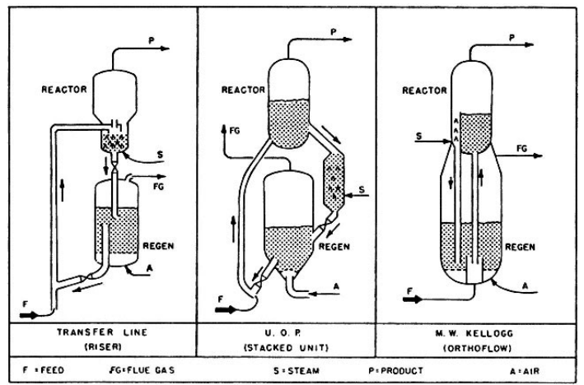
Older fluid catalytic-cracking (FCC) unit configurations

Slide 9
Process description-CATALYTIC CRACKING
The fresh feed is preheated in heat exchanger and then heated up to about 390°C in a fired heater. The heavy cycle oil and slurry decant oil from the fractionator are mixed with the preheated feed before it enters the riser of the reactor. The hot regenerated catalyst( ̴600 °C) from regenerator mixes with combined feed stream at the bottom of the riser. The hydrocarbons are vaporized and begins to crack at the riser. The catalyst and vapors rise as a dilute phase to the reactor. The catalyst rate is adjusted by a slide valve to give desired reactor temperature. Disengage of the catalyst takes place in the reactor as the vapor rise and leave the reactor through cyclone separator.
Cracking of the hydrocarbons produces coke which is deposited on the catalyst. Coke consists of hydrocarbons with a very low hydrogen to carbon ratio (6-8 wt% hydrogen. This spent catalyst in then subjected to steam stripping for removing the light hydrocarbon deposited on the catalyst surface. The spent catalyst containing coke is then sent to a regenerator through a slide valve which controls the catalyst inventory in the reactor. The catalyst is continuously regenerated in the regenerator by combusting the coke deposited on catalyst. The heat produced on combustion supplies the energy necessary for balancing the heat required to operate the reactor. Flue gas exists the regenerator through cyclone that separates the fine catalyst from gas. It contains considerable energy in the form of sensible heat and carbon monoxide. Waste heat boiler can utilize the heat in flue gases and produce steam.
Hydrocarbon vapors leaving the reactor at temperature 480-540 °C are sent to the main fractionator. The products withdrawn as gas (light gas and olefin), gasoline, light and heavy cycle oil, and slurry decant oil.
Some part of the heavy cycle oil and slurry oil are recycled with fresh feed to the reactor for further cracking.

Slide 10
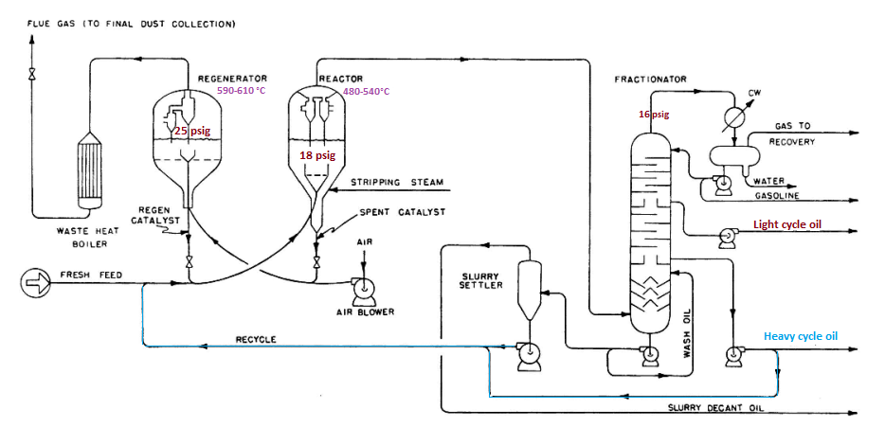
FCC PFD

Slide 11
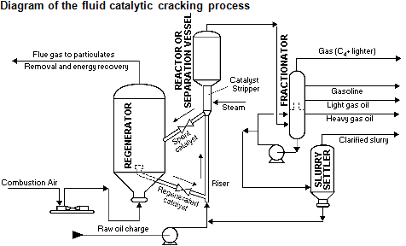
FCC

Slide 12


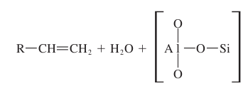

CRACKING REACTIONS
Primary reactions are involving the initial carbon–carbon bond scission and the immediate neutralization of the carbonium ion [24]. The primary reactions can be represented as follows:
carbonium ions are formed initially by a small amount of thermal cracking of n-paraffins to form olefins. These olefins add a proton from the catalyst to form large carbonium ions which decompose according to the beta rule (carbon–carbon bond scission takes place at the carbon in the position beta to the carbonium ions and olefins) to form small carbonium ions and olefins. The small carbonium ions propagate the chain reaction by transferring a hydrogen ion from a n-paraffin to form a small paraffin molecule and a new large carbonium ion

Slide 13

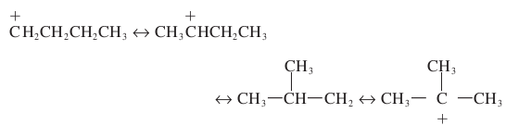
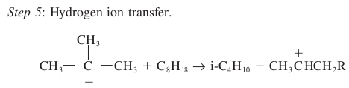
CRACKING REACTIONS

Slide 14
CRACKING CATALYSTS
Cracking catalysts can be divided into three classes: (1) acid-treated natural aluminosilicates (10-140μm), (2) synthetic amorphous silica-alumina combinations, and (3) crystalline synthetic silica-alumina catalysts called zeolites or molecular sieves.
The synthetic amorphous catalyst has been developed as an outgrowth of the earlier natural catalyst which was prepared by acid treating of certain alloys. The synthetic amorphous catalyst is formed by the precipitation of silica to form highly porous structure. On this porous structure alumina is added as a surface coating. Active sites which are acidic in nature are formed at the silica-alumina interface and reaction takes place at these sites with the available hydrogen.
Zeolite catalyst are used in catalytic cracking since mid-1960’s. They are formed through the reaction of reactive forms of alumina and silica. The reaction conditions are controlled so that the product of the reaction will be cage like crystalline structure. Depending on SiO₂ and Al₂O₃ ratio, the zeolite catalyst are divided into:
x- type (SiO₂/A₂lO₃=3 , with 27% rare earth)
y-type (SiO₂/A₂lO₃= 3 to 6, with 16% rare earth)
After the reaction, sodium ions remain in the large cages. Rare earth ions are exchanged for the sodium ions which lead to the acidity of the site thus formed, and consequently its activity.
Most catalysts used in commercial units today are either class 3 or mixtures of classes 2 and 3 catalysts.

Slide 15
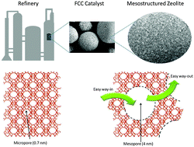
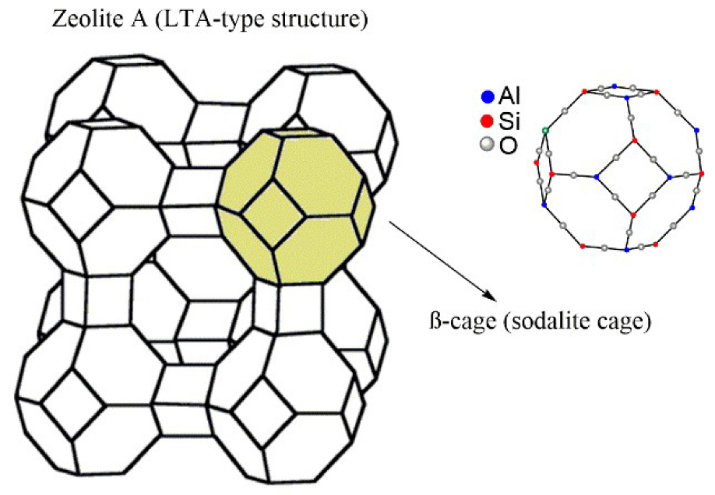
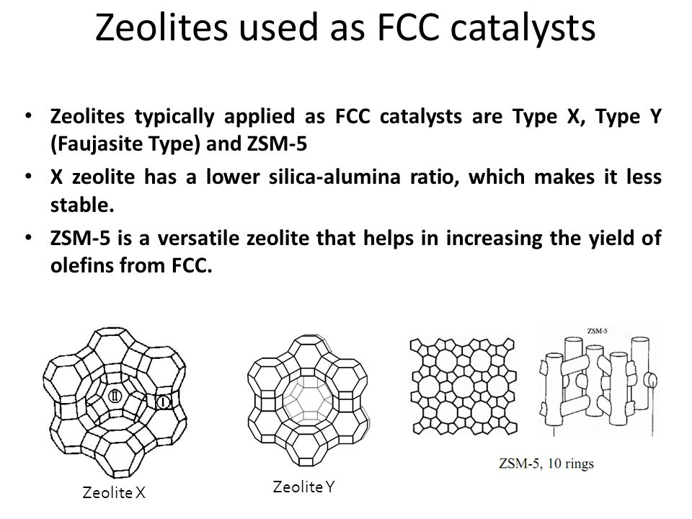
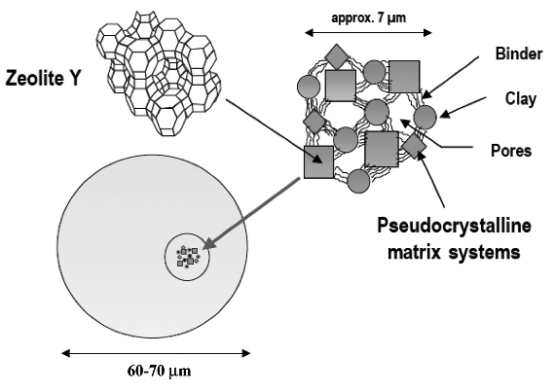
Zeolite catalyst

Slide 16
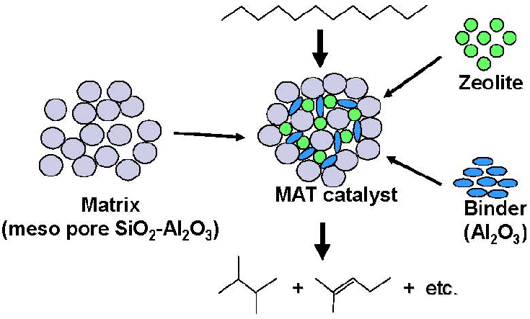
Zeolite catalyst used in FCC process

Slide 17
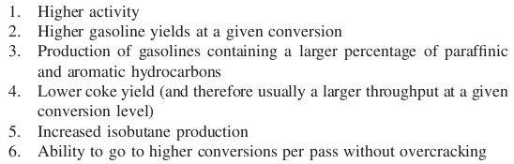
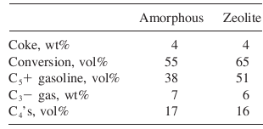
Comparison of Amorphous and Zeolite Catalysts
The advantages of the zeolite catalysts over the natural and synthetic amorphous catalysts are:

Slide 18
Catalyst poison
Nitrogen compounds, iron, nickel, vanadium, and copper in the oil act as poisons to cracking catalysts . The nitrogen reacts with the acid centers on the catalyst and lowers the catalyst activity.
The metals deposit and accumulate on the catalyst and cause a reduction in throughput by increasing coke formation and decreasing the amount of coke burn-off per unit of air by catalyzing coke combustion to CO₂ rather than to CO.
Nickel and vanadium reduces catalyst activity by occupying active catalytic sites, the major effects are to promote the formation of gas and coke and reduce the gasoline yield at a given conversion level.

Slide 19
PROCESS VARIABLES
The major operating variables effecting the conversion and product distribution are the cracking temperature, catalyst/oil ratio, space velocity, catalyst type and activity, and recycle ratio. For a better understanding of the process, several terms should be defined.
Activity: Ability to crack a gas oil to lower boiling fractions.
Catalyst/oil ratio(C/O): kg catalyst/kg feed.
Conversion: 100 (volume of feed - volume of cycle stock)/volume of feed.
Cycle stock: Portion of catalytic-cracker effluent not converted to naphtha and lighter products [generally the material boiling above 220 °C]
Efficiency: (% gasoline) × conversion.
Recycle ratio : Volume recycle/volume fresh feed.
Selectivity: The ratio of the yield of desirable products to the yield of undesirable products (coke and gas).
Space velocity : Space velocity may be defined on either a volume (LHSV) or a weight (WHSV) basis. In a fluidized-bed reactor, the LHSV has little meaning because it is difficult to establish the volume of the bed.
The weight of the catalyst in the reactor can be easily determined or calculated from the residence time and C/O ratio.
LHSV Liquid hour space velocity in volume feed/(volume catalyst) (hr).
WHSV (Weight hour space velocity in lb feed)/(lb catalyst) (hr). If t is the catalyst residence time in hours, then WHSV= 1/(t)(C/O).

Slide 20
Within the limits of normal operations, increasing
1. Reaction temperature
2. Catalyst/oil ratio
3. Catalyst activity
4. Contact time
results in an increase in conversion, while a decrease in space velocity increases conversion. It should be noted that an increase in conversion does not necessarily mean an increase in gasoline yield

Slide 21
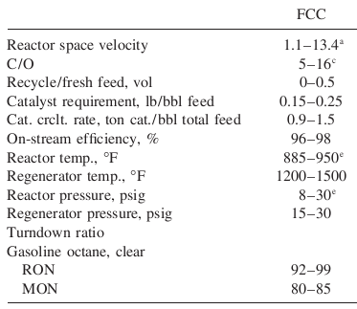

FCC- process condition and gasoline yield

Slide 22
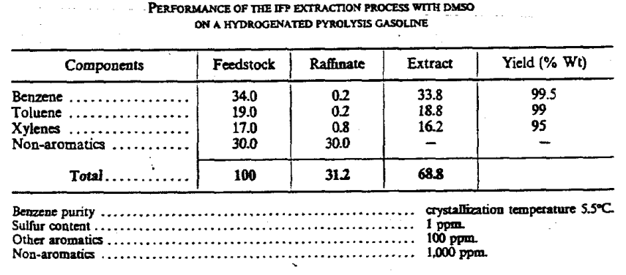

Slide 23
Assignment/Quiz 2
CL321 Petroleum Refining Engineering and Petrochemicals
F.M. 20: Time 1 hr
Why is visbreaking operation conducted in refinery? What are various types of visbreaking process? Compare their yield pattern. Briefly describe the soaker visbreaking process with process flow diagram, feed, and reaction conditions. [1+1+1+5]
Why is delayed coking preferred over other coking process? What is the reason for using two coker drums? [1+2]
Why the pressure in regenerator is kept higher than that of reactor in catalytic cracking process? Briefly describe the catalytic fluid cracking process with flow diagram. [1+5]
What are objectives of conducting catalytic reforming process? Write down the various reactions involved in reforming. [1+2]

Slide 24
Catalytic Hydrocracking
The hydrocracking process was commercially developed by I. G. Farben Industrie in 1927 for converting lignite into gasoline
Some of the advantages of hydrocracking are: 1. Better balance of gasoline and distillate production 2. Greater gasoline yield 3. Improved gasoline pool octane quality and sensitivity 4. Production of relatively high amounts of isobutane in the butane fraction.
5. Supplementing of fluid catalytic cracking to upgrade heavy cracking stocks, aromatics, cycle oils, and coker oils to gasoline, jet fuels, and light fuel oils

Slide 25
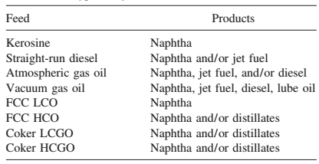
Typical Hydrocracker Feedstocks

Slide 26
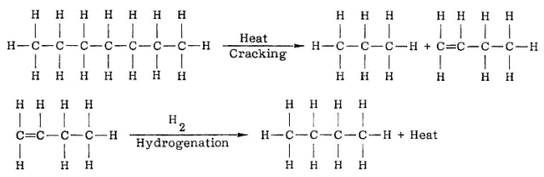
HYDROCRACKING REACTIONS
Scission of a carbon–carbon single bond, and hydrogenation is the addition of hydrogen to a carbon–carbon double bond.

Slide 27
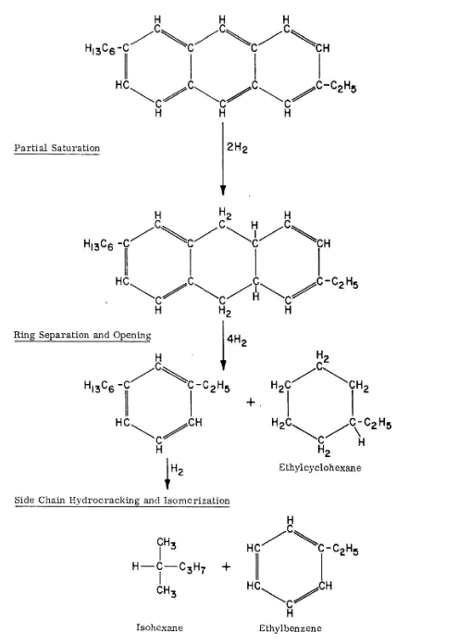

Slide 28
FEED PREPARATION
Hydrocracking catalyst is susceptible to poisoning by metallic salts, oxygen, organic nitrogen compounds, and sulfur in the feedstocks.
The feedstock is hydrotreated to saturate the olefins and remove sulfur, nitrogen, and oxygen compounds. Molecules containing metals are cracked and the metals are retained on the catalyst. The nitrogen and sulfur compounds are removed by conversion to ammonia and hydrogen sulfide.
Although organic nitrogen compounds are thought to act as permanent poisons to the catalyst, the ammonia produced by reaction of the organic nitrogen compounds with hydrogen does not affect the catalyst permanently.
For some types of hydrocracking catalysts, the presence of hydrogen sulfide in low concentrations acts as a catalyst to inhibit the saturation of aromatic rings. This is a beneficial effect when maximizing gasoline production as it conserves hydrogen and produces a higher octane product.

Slide 29
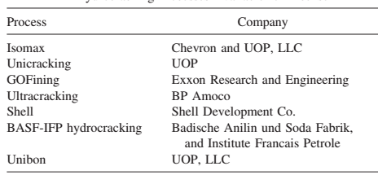
Hydrocracking processes developed

Slide 30
Process description
The GOFining process is a fixed-bed regenerative process employing a molecular-sieve catalyst impregnated with a rare-earth metal. The process employs either single-stage or two-stage hydrocracking with typical operating conditions ranging from 660 to 785°F and from 1000 to 2000 psig (350–420°C and 6900–13,800 kPa).
The temperature and pressure vary with the age of the catalyst, the product desired, and the properties of the feedstock.

Slide 31
The fresh feed is mixed with makeup hydrogen and recycle gas (high in hydrogen content) and passed through a heater to the first reactor.
If the feed has not been hydrotreated, there is a guard reactor before the first hydrocracking reactor. The guard reactor usually has a modified hydrotreating catalyst such as cobalt-molybdenum on silica-alumina to convert organic sulfur and nitrogen compounds to hydrogen sulfide, ammonia, and hydrocarbons to protect the precious metals catalyst in the following reactors.
The hydrocracking reactor(s) is operated at a sufficiently high temperature to convert 40 to 50 vol% of the reactor effluent to material boiling below 400°F (205°C).
The reactor effluent goes through heat exchangers to a high-pressure separator where the hydrogen-rich gases are separated and recycled to the first stage for mixing both makeup hydrogen and fresh feed.
The liquid product from the separator is sent to a distillation column where the C4 and lighter gases are taken off overhead, and the light and heavy naphtha, jet fuel, and diesel fuel boiling range streams are removed as liquid sidestreams. The fractionator bottoms are used as feed to the second-stage reactor system.
The unit can be operated to produce all gasoline and lighter products or to maximize jet fuel or diesel fuel products.

Slide 32
The bottoms stream from the fractionator is mixed with recycle hydrogen from the second stage and sent through a furnace to the second-stage reactor. Here the temperature is maintained to bring the total conversion of the unconverted oil from the first-stage and second-stage recycle to 50 to 70 vol% per pass.
The second-stage product is combined with the first-stage product prior to fractionation.
Both the first- and second-stage reactors contain several beds of catalysts. The major reason for having separate beds is to provide locations for injecting cold recycled hydrogen into the reactors for temperature control.
In addition, redistribution of the feed and hydrogen between the beds helps to maintain a more uniform utilization of the catalyst.
When operating hydrocrackers for total conversion of distillate feeds to gasoline, the butane-and-heavier liquid yields are generally from 120 to 125 vol% of fresh feed

Slide 33
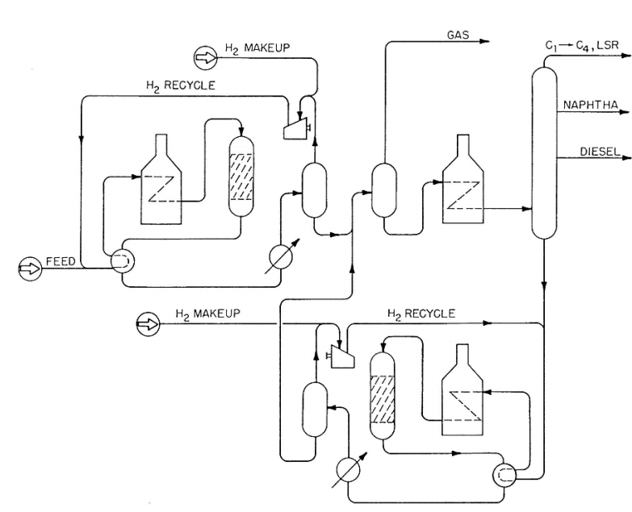
GOFining hydrocraking-PFD

Slide 34
Catalyst
Most of the hydrocracking catalysts consist of a crystalline mixture of silica-alumina with a small uniformly distributed amount of rare earths contained within the crystalline lattice. The silica-alumina portion of the catalyst provides cracking activity while the rare-earth metals promote hydrogenation.
Almost all hydrocracking catalysts use silica-alumina as the cracking base but the rare-earth metals vary according to the manufacturer. Those in most common use are platinum, palladium, tungsten, and nickel.

Slide 35
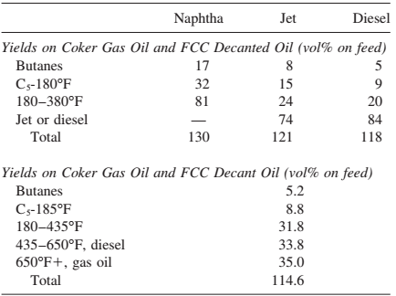
Hydrocracking Yields

