Slide 1
CL321 PRE
MODULE 3

Slide 2
Visbreaking
Visbreaking or viscosity breaking is a mild thermal cracking unit that produces low viscosity fuel oil from a high viscosity oil stock.
Long paraffinic side chains attached to aromatic rings are the primary cause of high pour points and viscosities for paraffinic base residua. Visbreaking is carried out at conditions to optimize the breaking off of these long side chains and their subsequent cracking to shorter molecules with lower viscosities and pour points.
In this method, the feedstock is usually a mixture of heavy vacuum distillates and residues, even asphalt, heated in a furnace at a cracking temperature (above 400°C) at a pressure above atmosphere for a short time and quickly quenched and ﬂashed in a plated column.
Sufficient steam is used to separate the cracked light hydrocarbons.
Products include gases, gasoline (VB gasoline or naphtha), gas oil (VB gas oil), and low viscous fuel oil or furnace oil as the major product.
There are two types of visbreaker operations, coil and furnace cracking and soaker cracking.
Coil cracking uses higher furnace outlet temperatures (460–520°C) and reaction times (1-3 minutes), while soaker cracking uses lower furnace outlet temperatures (427–443°C) and longer reaction times (5-8 mins).
The product yields and properties are similar, but the soaker operation with its lower furnace outlet temperatures has the advantages of lower energy consumption and longer run times before having to shut down to remove coke from the furnace tubes.
Run times of 3–6 months are common for furnace vis-breakers and 6–18 months for soaker visbreakers.

Slide 3
The principal reactions which occur during the visbreaking operation
1. Cracking of the side chains attached to cycloparaffin and aromatic rings at or close to the ring, so the chains are either removed or shortened to methyl or ethyl groups.
2. Cracking of resins to light hydrocarbons (primarily olefins) and compounds which convert to asphaltenes.
3. At temperatures above 480 °C, some cracking of naphthene rings. There is little cracking of naphthenic rings below 480 °C.

Slide 4
Coil and Furnace visbreaking
Heavy viscous vacuum oils, residue from the vacuum distillation unit, and asphalt from a propane deasphalting unit are the feedstocks, which are preheated by hot products followed by heating in a tube-still furnace and quenched as it exits the furnace with gas oil or tower bottoms to stop the cracking reaction. Then it is ﬂashed in a distillation column.
Top vapors/liquid mixture enter a stabilizer column to separate the gases and VB naphtha components.
Gases from stabilizer are further scrubbed in an absorber tower by VB gas oil from the main distillation column.
Gases leaving the absorber tower are used as fuel gas and the rich gas oil stream containing scrubbed hydrocarbons from the gases is recycled back to the main fractionator column. The bottom of the main fractionator column is the VB tar (black oil) which is the cheapest and major fuel for the industrial furnaces.
The by-products are VB gas oil and VB naphtha. VB gas oil is mixed with the straight run, vacuum, light cycle gas oils, etc., for HSD as the final product. VB naphtha has medium octane number and is blended with high octane components like cat cracked gasoline and reformate. Since the products from this unit contain much mercaptans and unsaturated hydrocarbons, meroxing or desulfurizing is essential. Catalytic hydrodesulfurization may be beneficial as far as the removal of sulfur and olefins/di-olefins is concerned, but at the cost of an octane number.

Slide 5
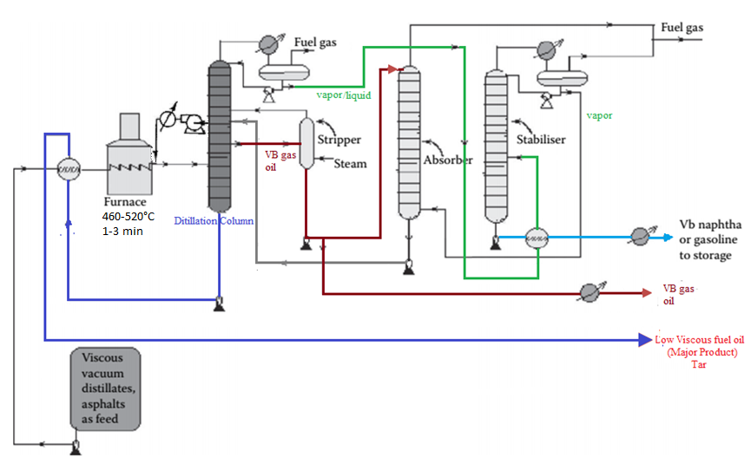
PFD-Coil and Furnace visbreaking
Dissolved gas/vapor
22 kg/cm²
Quench

Slide 6
Soaker visbreaking
Feed is preheated by hot products followed by heating in a furnace (temperature between 427 and 438 °C) and then allowed to pass through a soaking drum, which provides the additional reaction time.
Pressure is an important design and operating parameter with units being designed for pressures as high as 750 psig (5170 kPa) for liquid-phase visbreaking and as low as 100–300 psig (690–2070 kPa) for 20–40% vaporization at the furnace outlet.
For furnace cracking, fuel consumption accounts for about 80% of the operating cost with a net fuel consumption equivalent of 1–1.5 wt% on feed. Fuel requirements for soaker visbreaking are about 30–35% lower
Smaller furnace, less capital expenditure (10—15%), lower pressure drop through furnace

Slide 7
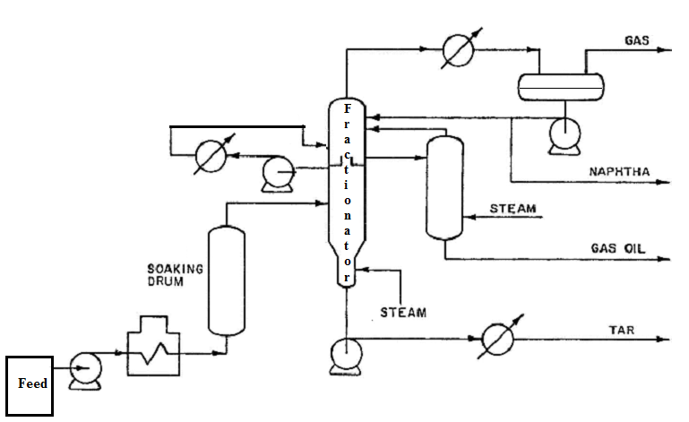
PFD-Soaker visbreaking
Pump around

Slide 8
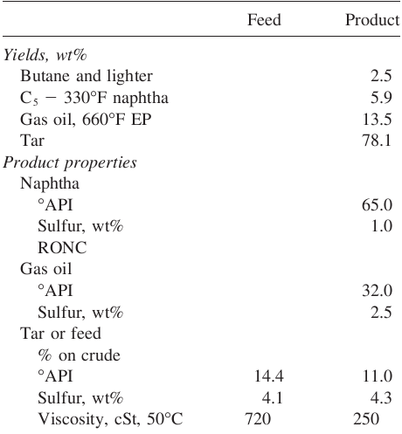
Visbreaking Results, Kuwait Long Resid

Slide 9
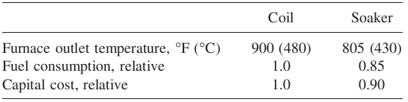
Coil and Soaker Visbreaking comparison

Slide 10
Soaker visbreaking versus coil visbreaking
From the standpoint of yield, there is little or nothing to choose between the two approaches. However, each offers significant advantages in particular situations:
De-coking: The cracking reaction forms petroleum coke as a byproduct. In coil visbreaking, this deposits in the tubes of the furnace and will eventually lead to fouling or blocking of the tubes. The same will occur in the drum of a soaker visbreaker, though the lower temperatures used in the soaker drum lead to fouling at a much slower rate. Coil visbreakers therefore require frequent de-coking. This is quite labour-intensive, but can be developed into a routine where tubes are de-coked sequentially without the need to shut down the visbreaking operation. Soaker drums require far less frequent attention but their being taken out of service normally requires a complete halt to the operation. Which is the more disruptive activity will vary from refinery to refinery.
Fuel Economy: The lower temperatures used in the soaker approach mean that these units use less fuel. In cases where a refinery buys fuel to support process operations, any savings in fuel consumption could be extremely valuable. In such cases, soaker visbreaking may be advantageous.

Slide 11
Coking
Coking
The coking unit of a refinery yields petroleum coke, which is heavily condensed hydrocarbon with more than 90% carbon. Non-lube bearing crude oil yields large residual masses and asphalts with minimum metal and sulfur content, which are suitable for the production of petroleum coke.
Coking is a severe thermal cracking process in which one of the end products is carbon (i.e., petroleum coke).
Actually the coke formed contains some volatile matter or high-boiling hydrocarbons. The modern theory held by some authors that the coke is actually a polymer.
To eliminate essentially all volatile matter from petroleum coke it must be calcined at approximately 2000 to 2300°F (1095 to 1260 °C). Minor amounts of hydrogen remain in the coke even after calcining.
Coking was used primarily to pretreat vacuum residuals to prepare coker gas oil streams suitable for feed to a catalytic cracker. This reduced coke formation on the cracker catalyst.
All cokes, produced from the coker, are called ‘‘green’’ cokes and contain some high-molecular-weight hydrocarbons. These volatile matters has been left after coking process due to incomplete carbonization.
Fuel grade cokes are sold as green coke, but coke used to make anodes electrode for aluminum production (from alumina) or electrodes for steel production must be calcined at temperatures from 1800 to 2400 °F (980 to 1315°C) to complete the carbonization reactions and reduce the volatiles to a very low level.

Slide 12
Coking
There are two different mechanisms of petroleum coke formation.
  Very high molecular weight compounds, such as asphaltenes and resins, tend to dealkylate straight-chain compounds and CH₂ groups when subjected to high temperature. This leads to a residue of carbon with a highly disordered, cross-linked structure, or with many small graphite crystals in a matrix of amorphous carbon plus asphalt. Due to cross-linkage, as well as the residual straight-chain radicals, the platelets loose mobility. Graphitization is difficult to accomplish even at high temperatures.
  The second mechanism depends upon the dehydrogenation of heavy oils. The subsequent polymerization or condensation of free radicals forms high molecular weight compounds with high carbon to hydrogen ratios which proceed eventually to coke. The coke formed by this mechanism should have some crystalline disorder and cross-linkage but it is superior to that formed by dealkyllation process.

Slide 13
Types of coking
There are 3 main types of coking
  Delayed coking
  Fluid coking
  Flexicoking

Slide 14
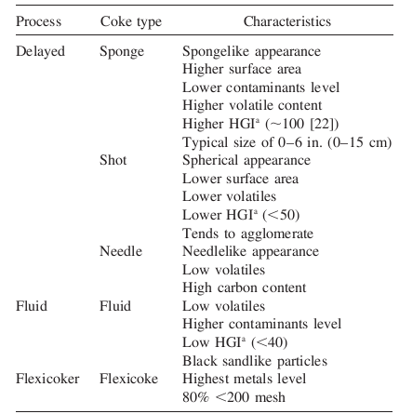
Petroleum Coke Characteristics
HGI-
Hardgrove grindability index

Slide 15
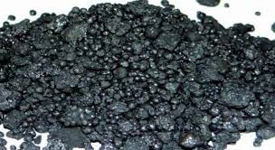
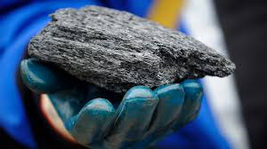
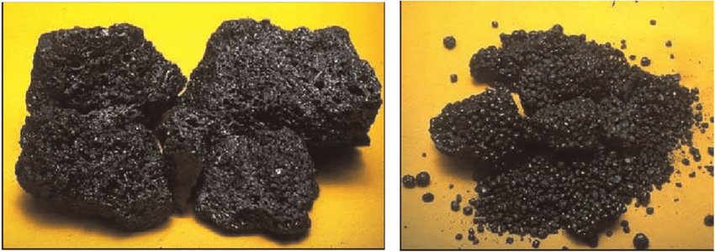
Sponge coke
Needle coke
Sponge coke
Short coke

Slide 16
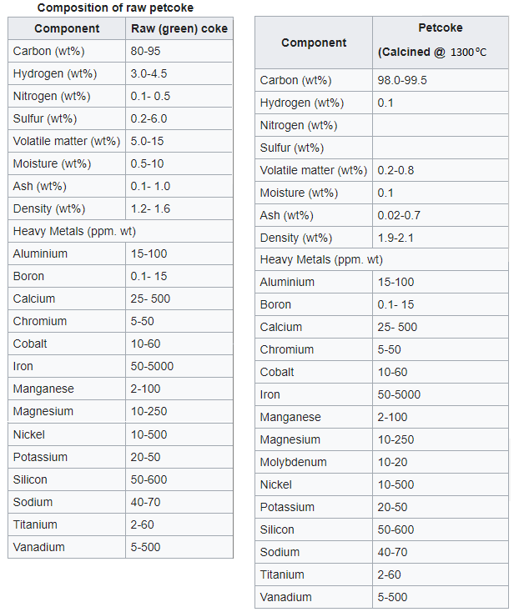

Slide 17
Delayed coking
The delayed coking process was developed to minimize yields of residual fuel oil by severe thermal cracking of stocks such as vacuum residuals, aromatic gas oils, and thermal tars.
The severe thermal cracking of such stocks resulted in unwanted deposition of coke in the heaters. By gradual evolution of the art it was found that heaters could be designed to raise residual stock temperatures above the coking point without significant coke formation in the heaters. This required high velocities (minimum retention time) in the heaters.
Providing an insulated surge drum on heater effluent allowed sufficient time for the coking to take place before subsequent processing, hence the term ‘‘delayed coking’’.
Typically furnace outlet temperatures range from 480–515 °C. The higher the outlet temperature, the greater the tendency to produce shot coke and the shorter the time before the furnace tubes have to be decoked. Usually furnace tubes have to be decoked every three to five months.

Slide 18
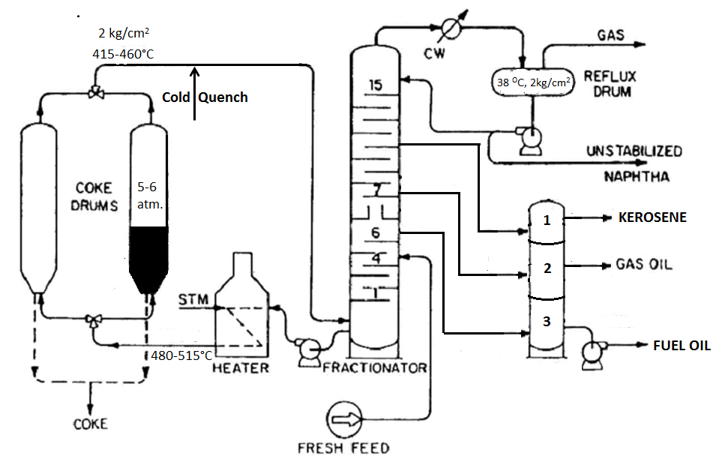
PFD-Delayed coking

Slide 19
Delayed coking-process description
Fresh feed (vacuum residuals, aromatic gas oils, and thermal tars) is charged to the lower portion of the main fractionator, where it contacts the heated vapors from the coke drum and light components are flashed off from the feed. Prior to entering the fractionator, the feed is preheated by heat exchanger with Coker distillates.
The heavy residue from the bottom of the fractionator is passed through a furnace where it is heated to temperature in the range of 480-515°C and charged to one of the two coke drum.
For a continuous operation, the process needs at least two coke drums: one in operation for coke accumulating and the other out of the for hydraulic decoking. Coke drums typically range in diameter from 4.5 to 8.5 meter and in height from 25 to 35m.
The material fed to the coke drum is thermally decomposed. As the cracking reactions are endothermic, the temperature in coke drum is lower than the furnace outlet and usually is in range of 415-460 °C. Pressure in the coke drum varies from 25-30 psig.
In the coke drum sufficient residence time is allowed so that the reaction proceeds to form coke which is settled in coke drum.
Lighter cracked products from drum are returned to fractionator. Petroleum coke formed remains as a solid in the coke drum. In the fractionator gas, naphtha, kerosene and gas oil are separated from heavier materials which is recycled with fresh feed to the furnace for re-cracking.
When the drum builds up to predetermined level, the flow is diverted to another coke drum. A two day cycle is preferred most-one day filling and one day decoking.
At the end of each cycle the coke drum is depressurized and steamed out to strip uncondensed vapors. The full coke drum isolated, cooled by filling with water, opened, drained, and the coke removed.

Slide 20
De-coking of the drum
The decoking operation is accomplished in some plants by a mechanical drill or reamer, however most plants use a hydraulic system. The hydraulic system is simply a number of high pressure [2,000 to 4,500 psig (13,800 to 31,000kPa)] water jets which are lowered into the coke bed on a rotating drill stem. A small diameter hole [18 to 24 in. (45 to 60 cm) in diameter] called a ‘‘rat hole’’ is first cut all the way through the bed from top to bottom using a special jet. This is done to allow the main drill stem to enter and permit movement of coke and water through the bed.
The main bulk of coke is then cut from the drum, usually beginning at the bottom. Some operators prefer to begin at the top of drum to avoid the chance of dropping large pieces of coke which can trap the drill stem or cause problems in subsequent coke handling facilities. Today some operators use a technique referred to as ‘chipping’’ the coke out of the drum. In this technique, the cutting bit is repeatedly transferred back and forth from top to bottom as the hydraulic bit rotates, and the coke is cut from the center to the wall. This reduces cutting time, produces fewer fines, and eliminates the problem of the bit being trapped.
The coke which falls from the drum is often collected directly in railroad cars. Alternatively, it is sluiced or pumped as a water slurry to a stockpile or conveyed by belt.

Slide 21
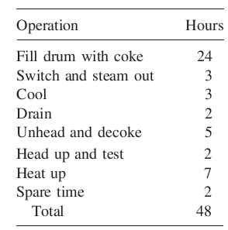
Time Cycle-delayed coking

Slide 22
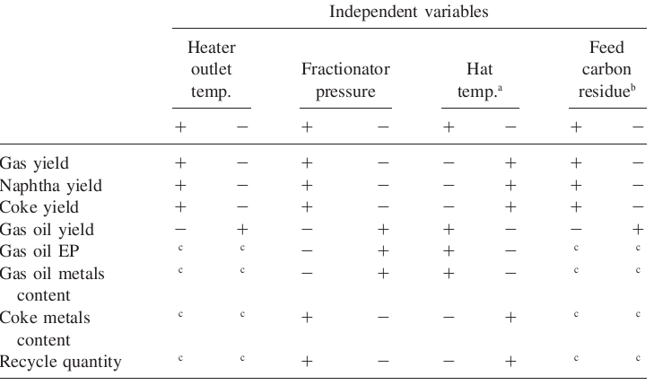

Relation of Operating Variables in Delayed Coking
High heater outlet temperatures increase the cracking and coking reactions, thus increasing yields of gas, naphtha, and coke and decreasing the yield of gas oil.

Slide 23
Typical yield from delayed coker
 | I | II | III | IV | V | VI
Feed
°API | 7.4 | -1.1 | 7.4 | 12.0 | 12.5 | 12.3
Sulphur, wt% | 0.48 | 0.56 | 2.76 | 1.6 | 0.6 | 0.38
Conradson carbon, wt% | 5.6 | 8.6 | 19.6 | 9.6 | 14.8 | 11.3
Yields
Gas | 13.2 | 18.1 | 5.6 | 12.0 | 6.4 | 11.8
Naphtha | 11.1 | 0.9 | 17.8 | 15.7 | 21.6 | 29.0
Light gas oil | 31.4 | 21.1 | 20.0 | 35.2 | 46.0 | 30.3
Heavy gas oil (343°C) | - | - | 23.7 | 15.5 | - | -
Coke | 44.3 | 59.9 | 32.6 | 21.6 | 26.0 | 28.9
Sulphur in coke,wt% | 0.57 | 0.65 | 4.2 | 1.2 | 2.2 | 0.63

Slide 24
Fluid coking
Fluid coking uses two vessels, a reactor, and a burner, both the vessels contain fluidized beds with coke particles circulating between the two vessels by fluidized solids techniques. Coke particles are circulated to transfer heat to the reactor.
Feed can be any heavy oil such as vacuum resid, coal tar, shale oil, or tar sand bitumen.
The fresh feed is introduced into the different section of reactor, where it is thermally cracked to form vaporizing products and coke. The volume of the vapors increases progressively up through the bed due to formation of cracked products. Vapor products leave the bed and passed through cyclones which remove most of the entrained coke. They then discharge into bottom of the scrubber. There the remaining coke dust is scrubbed out and the products cooled to condense out the heavy tar. The resulting slurry is recycled to the reactor..
The slurry recycled to the reactor from the scrubber amounts to 20-40% on resid feed. The scrubber overhead is sent to the fractionator for recovery of the gas, naphtha, and light/heavy gas oils. Material boiling above a typical cut can be recycled to the reactor. A typical recycle cut point may be 520°C. The coke produced in the reactor is deposited on the fluid coke particles and they flow down through the vessel into the stripping zone where stripping steam displaces product vapors between the particles. The coke then flows down a standpipe through a slide valve that controls the reactor bed level. A riser then carries the coke to the burner, with steam being added to induce upward flow.
In the burner vessel sufficient coke is burned to supply the heat of reaction needed in the reactor to sustain the thermal cracking. Typically the coke burned amounts to 6-7 wt% on resid feed. The average bed temperature in the burner is 590-620 °C. Air for the combustion is added through blower as needed. The hot coke particles from the burner is then returned to the reactor through a standpipe, slide valve and riser.
The flue gases from the burner bed pass through internally mounted cyclone and then discharge to a stack through a variable orifice which controls burner pressure. The net product coke leaves the burner vessel through a smaller elutriator vessel.
The coke formed mainly used as boiler fuel or sale.

Slide 25
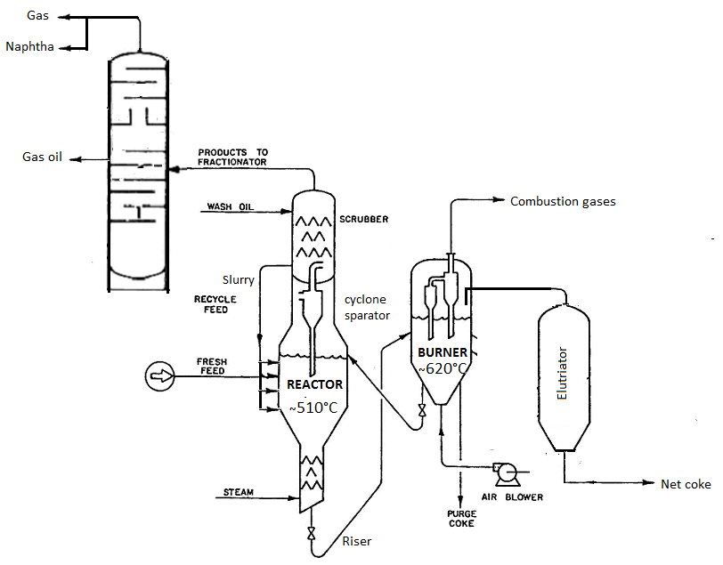
PFD-Fluid coking

Slide 26
Typical operating condition of fluid coking
 | Reactor | Burner
Temperature, °C | 510 | 620
Pressure, kPa | 170 | 176
Velocity, m/s | 0.3-0.9 | 0.6-0.9
Bed depth m | 9-15 | 3-4.5

Slide 27
Typical yield-fluid coking
Feed characteristics | Tia Juana-565°C residue
CCR, wt% | 22.20
°API | 6.8
Sulfur, wt% | 2.9
Nitrogen, wt% | 0.35
Product | Yield, wt%
H2, H2S | 0.9
C1-C4 | 11.5
C5-132°C | 7.0
132-221 °C | 8.2
221-343°C | 13.5
343 °C+ | 31.1
Coke gross,/Coke net | 27.8/20.0
sulfur | 4.05

Slide 28
Flexicoking
Flexicoking process integrates conventional fluid coking with coke gasification. The gasification is effected by addition of air and steam to a third fluidized bed vessel.
The gasification reactions are as follow:
C + O₂ CO, CO₂
CO + 0.5O₂ CO₂
C + CO₂ 2CO
C + H₂O CO + H₂
CO + H₂O CO₂ + H₂

Slide 29
Flexi coking-Process description
The feed is preheated to about 315 to 370°C and sprayed into the reactor where it contacts a hot fluidized bed of coke. This hot coke is recycled to the reactor from the coke heater at a rate which is sufficient to maintain the reactor fluid bed temperature between 510 to 540°C). The coke recycle from the coke heater thus provides sensible heat and heat of vaporization for the feed and the endothermic heat for the cracking reactions.
The cracked vapor products pass through cyclone separators in the top of the reactor to separate most of the entrained coke particles (cyclone separators are efficient down to particle sizes about 7 microns, but the efficiency falls off rapidly as the particles become smaller) and are then quenched in the scrubber vessel located at the top of the reactor. Some of the high-boiling (495°C +)] cracked vapors are condensed in the scrubber and recycled to the reactor. The balance of the cracked vapors flow to the coker fractionator where the various cuts are separated. Wash oil circulated over baffles in the scrubber provides quench cooling and also serves to reduce further the amount of entrained fine coke particles.
The coke produced by cracking is deposited as thin films on the surface of the existing coke particles in the reactor fluidized bed. The coke is stripped with steam in a baffled section at the bottom of the reactor to prevent reaction products, other than coke, from being entrained with the coke leaving the reactor.

Slide 30
Flexi coking-Process descript……
Coke flows from the reactor to the heater where it is reheated to about 593°C. The coke heater is also a fluidized bed and its primary function is to transfer heat from the gasifier to the reactor.
Coke flows from the coke heater to a third fluidized bed in the gasifier where it is reacted with air and steam to produce a fuel gas product consisting of CO, H₂, CO₂, and N₂. Sulfur in the coke is converted primarily to H₂S, plus a small amount of COS, and nitrogen in the coke is converted to NH₃ and N₂.
This gas flows from the top of the gasifier to the bottom of the heater where it serves to fluidize the heater bed and provide the heat needed in the reactor. The reactor heat requirement is supplied by recirculating hot coke from the gasifier to the heater.
The system can be designed and operated to gasify about 60 to 97% of the coke product in the reactor. The overall coke inventory in the system is maintained by withdrawing a stream of purge coke from the heater.
The coke gas leaving the heater is cooled in a waste heat steam generator before passing through external cyclones and a venturi-type wet scrubber. The coke fines collected in the venturi scrubber.
After removal of entrained coke fines the coke gas is treated for removal of hydrogen sulfide in a Stretford unit and then used for refinery fuel. The treated fuel gas has a much lower heating value than natural gas (100 to 130 Btu/scf vs. 900 to 1000 Btu/scf) and therefore modifications of boilers and furnaces may be required for efficient combustion of this gas.

Slide 31
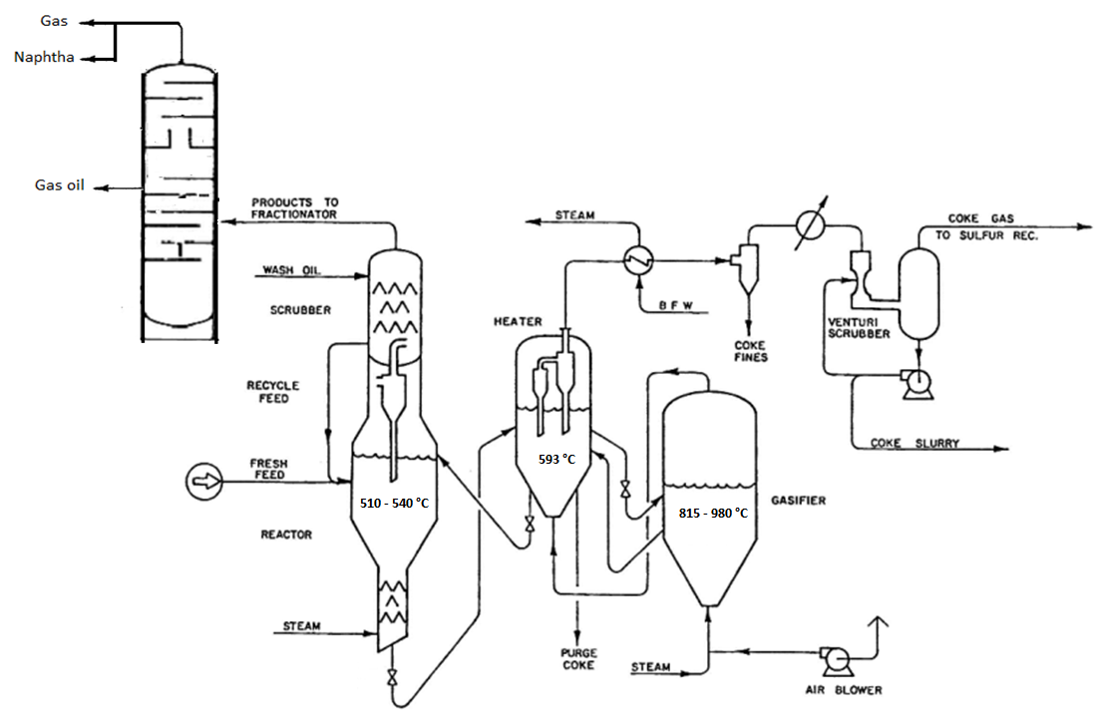
PFD-Flexicoking

Slide 32
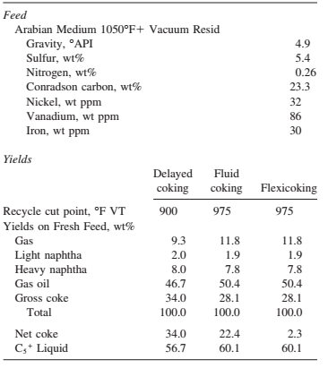
Comparison of Coking Yields

Slide 33
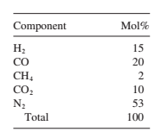
Flexicoker produces coke gas of the following approximate composition after H₂S removal (dry basis):

Slide 34
Finishing Processes
Hydrotreating

Slide 35
Hydrotreating
Objectives: Hydrotreating is a process to catalytically stabilize petroleum products and/ or remove objectionable elements from products or feedstocks by reacting them with hydrogen. Stabilization usually involves converting unsaturated hydrocarbons such as olefins and gum-forming unstable diolefins to paraffins. Objectionable elements removed by hydrotreating include sulfur, nitrogen, oxygen, halides, and trace metals. Hydrotreating is applied to a wide range of feedstocks, from naphtha to reduced crude. When the process is employed specifically for sulfur removal it is usually called hydrodesulfurization, or HDS.
The oil feed is mixed with hydrogen-rich gas either before or after it is preheated to the proper reactor inlet temperature. Most hydrotreating reactions are carried out below 800°F (427°C) to minimize cracking, and the feed is usually heated to between 500 and 800°F (260–427°C). The oil feed combined with the hydrogen-rich gas enters the top of the fixed-bed reactor. In the presence of the metal-oxide catalyst, the hydrogen reacts with the oil to produce hydrogen sulfide, ammonia, saturated hydrocarbons, and free metals. The metals remain on the surface of the catalyst and other products leave the reactor with the oil–hydrogen stream. The reactor effluent is cooled before separating the oil from the hydrogen rich gas. The oil is stripped of any remaining hydrogen sulfide and light ends in a stripper.

Slide 36
CATALYTIC HYDROTREATING
Catalytic hydrotreating is a hydrogenation process used to remove about 90% of contaminants such as nitrogen, sulfur and oxygen from liquid petroleum fractions. These contaminants, if not removed from the petroleum fractions as they travel through the refinery processing units, can have detrimental effects on the equipment, the catalysts, and the quality of the finished product. Typically, hydrotreating is done prior to processes such as catalytic reforming so that the catalyst is not contaminated by untreated feedstock. Hydrotreating is also used prior to catalytic cracking to reduce sulfur and improve product yields, and to upgrade middle-distillate petroleum fractions into finished kerosene, diesel fuel, and heating fuel oils. In addition, hydrotreating converts olefins and aromatics to saturated compounds.
Catalytic Hydrodesulfurization Process
Hydrotreating for sulfur removal is called hydrodesulfurization. In a typical catalytic hydrodesulfurization unit, the feedstock is deaerated and mixed with hydrogen, preheated in a fired heater (600°-800° F) and then charged under pressure (up to 1,000 psi) through a fixed-bed catalytic reactor. In the reactor, the sulfur and nitrogen compounds in the feedstock are converted into H₂S and NH₃. The reaction products leave the reactor and after cooling to a low temperature enter a liquid/gas separator. The hydrogen-rich gas from the high-pressure separation is recycled to combine with the feedstock, and the low-pressure gas stream rich in H₂S is sent to a gas treating unit where H₂S is removed. The clean gas is then suitable as fuel for the refinery furnaces. The liquid stream is the product from hydrotreating and is normally sent to a stripping column for removal of H₂S and other undesirable components. In cases where steam is used for stripping, the product is sent to a vacuum drier for removal of water. Hydrodesulfurized products are blended or used as catalytic reforming feedstock.

Slide 37
HYDROTREATING CATALYSTS
Catalysts developed for hydrotreating include cobalt and molybdenum oxides on alumina, nickel oxide, nickel thiomolybdate, tungsten and nickel sulfides, and vanadium oxide. The cobalt and molybdenum oxides on alumina catalysts are in most general use today because they have proven to be highly selective, easy to regenerate, and resistant to poisons. They must be activated by converting the hydrogenation metals from the oxide to the sulfide form.
If the removal of nitrogen is a significant consideration, catalysts composed of nickel–cobalt–molybdenum or nickel–molybdenum compounds supported on alumina are more efficient.
Cobalt–molybdenum catalysts are selective for sulfur removal and nickel–molybdenum catalysts are selective for nitrogen removal, although both catalysts will remove both sulfur and nitrogen
Nickel–molybdenum catalysts have a higher hydrogenation activity than cobalt–molybdenum which results, at the same operating conditions, in a greater saturation of aromatic rings.
Reactions taking place in the hydrotreating of gas oils [400–1050°F (200–566°C)]
Catalyst consumption varies from 0.001 to 0.007 lb/bbl (0.003 to 0.02
kg/m3) feed depending upon the severity of operation and the gravity and metals content of the feed.

Slide 38
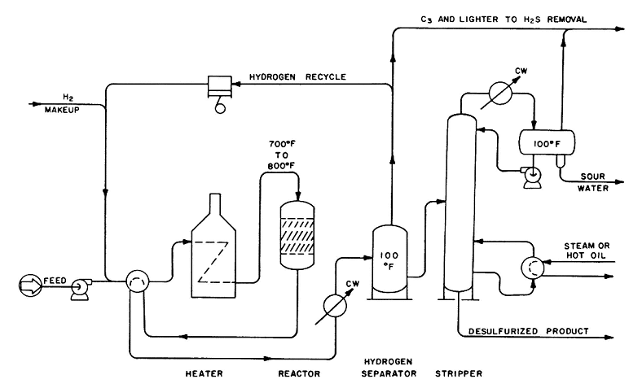
Catalytic hydro-desulfurizer

Slide 39
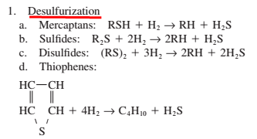
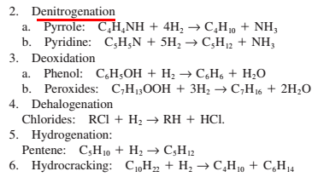
HYDROTREATING : REACTIONS
The main hydrotreating reaction is that of desulfurization but many others take place

Slide 40
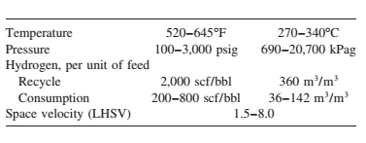
PROCESS VARIABLES
The principal operating variables are temperature, hydrogen partial pressure, and space velocity
Increasing temperature and hydrogen partial pressure increases sulfur and nitrogen removal and hydrogen consumption.
Increasing pressure also increases hydrogen saturation and reduces coke formation.
Increasing space velocity reduces conversion, hydrogen consumption, and coke formation.
Although increasing temperature improves sulfur and nitrogen removal, excessive temperatures must be avoided because of the increased coke formation.
Liquid hourly space velocity (LHSV)

Slide 41
Hydrodesulfurization (HDS)
The process chemistry
Hydrogenation is a class of chemical reactions in which the net result is the addition of hydrogen (H). Hydrogenolysis is a type of hydrogenation and results in the cleavage of the C-X chemical bond, where C is a carbon atom and X is a sulfur, nitrogen (N) or oxygen (O) atom. The net result of a hydrogenolysis reaction is the formation of C-H and H-X chemical bonds. Thus, hydrodesulfurization is a hydrogenolysis reaction. Using ethanethiol (C₂H₅SH), a sulfur compound present in some petroleum products, as an example, the hydrodesulfurization reaction can be simply expressed as:
C₂H₅SH + H₂ → C₂H₆ + H₂S
Hydrodenitrogenation
The hydrogenolysis reaction is also used to reduce the nitrogen content of a petroleum stream in a process referred to as hydrodenitrogenation (HDN). The process flow is the same as that for an HDS unit. Using pyridine (C₅H₅N), a nitrogen compound present in some petroleum fractionation products, as an example, the hydrodenitrogenation reaction has been postulated as occurring in three steps:
Many HDS units for desulfurizing naphthas within petroleum refineries are actually simultaneously denitrogenating to some extent as well.

Slide 42
Saturation of olefins
The hydrogenolysis reaction may also be used to saturate or convert olefins (alkenes) into paraffins (alkanes). The process used is the same as for an HDS unit.
Pentene + Hydrogen → Pentane
C₅H₁₀ + H₂ → C₅H₁₂
Some hydrogenolysis units within a petroleum refinery or a petrochemical plant may be used solely for the saturation of olefins or they may be used for simultaneously desulfurizing as well as denitrogenating and saturating olefins to some extent.

