Slide 1
CL321 PRE
MODULE 2

Slide 2
Typical yield
S.No. | Composition(%) | Products | No of carbon atom with Average value
1 | 25 | Gasoline | C6-C12(C8)
2 | 45-60 | Diesel & Kerosene | C₁₂-C22 (C14)
3 | 15-20 | Naphtha | C8-C30(C18)
4 | 8-10 | Fuel Oil | C30 –C80 (C40)
5 | 2-5 | Asphalt | C50-C100 (C60)

Slide 3
Boiling Ranges of Typical Crude Oil Fractions
 | ASTM °C | TBP °C
Butanes and lighter
Light straight-run naphtha (LSR) | 32-104 | 32-88
Heavy straight-run naphtha (HSR) | 82-204 | 88-193
Kerosene | 165-282 | 193-271
Light gas oil (LGO) | 215-338 | 271-321
Atmospheric gas oil (AGO) | 287-443 | 321-427
Vacuum gas oil (VGO) | 398-565 | 321-565
Vacuum reduced crude (VRC) | 565+ | 565+

Slide 4
Major Processes in Petroleum Refinery
Desalting
Crude distillation unit (CDU/ADU)
Vacuum distillation unit (VDU)
Thermal cracker
Hydrotreaters
Fluidized catalytic cracker
Separators
Naphtha splitter
Reformer
Alkylation and isomerization
Gas treating
Blending pools
Stream splitters

Slide 5
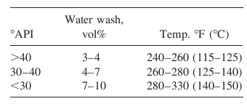
Desalting of Crude Oil
Crude oil received in a refinery contains much water, salts, clay, and sand, which do not settle in the tank and are desalter at the beginning of the refining operations
The presence of salts of magnesium, sodium, alkaline earth metals in crude oil varies from crude to crude. These salts are dissolved in water associated and entrained with crude oil from the drilling fluids or wash water from the crude-carrying vessels.
Salts in the presence of water are responsible for corrosion. For example, chloride salts of magnesium generate hydrochloric acid at a temperature above 150°C and may cause severe corrosion both in the liquid and vapour phases.
If the salt content of the crude oil is greater than 10 lb/1000 bbl (expressed as NaCl), the crude requires desalting to minimize fouling and corrosion caused by salt deposition on heat transfer surfaces and acids formed by decomposition of the chloride salts.
In addition, some metals in inorganic compounds dissolved in water emulsified with the crude oil, which can cause catalyst deactivation in catalytic processing units
Desalting is carried out by mixing the crude oil with from 3 to 10 vol% water at temperatures from 90 to 150°C.

Slide 6
Desalting process
The modern method of electrical desalting removes water and the dissolved salts simultaneously from crude oil. In an electric desalter crude oil enters the bottom of a horizontal vessel provided with two flat electrodes supplied with a very high voltage (20–33 kV AC).
Crude containing salt and water is mixed with fresh demineralized water (DM water) through a mixing valve at the bottom portion of the vessel in order to dissolve salts to the aqueous phase. The optimum temperature for solubilizing the salts to the aqueous phase is 120°C–130°C, hence crude must be preheated to this temperature before it enters the desalter.
Crude, water, and salt travel upward as an emulsified mixture and are brought in contact with the flat electrodes.
Drops of water are ionized by electric charge and coalesce to form bigger drops of water, which then fall by gravity toward the bottom of the vessel. Thus, emulsion is broken as long as the crude–water mixture is in contact with the electrodes.
De-emulsifying agents are also injected in small amounts to break the unbroken emulsion. The practice of electric desalting can reduce the salt content by 90%–98%.
Pressure in the drum is usually maintained at a pressure slightly above the vapour pressure of mixed hydrocarbon gases, usually 8–10 kg/cm², to maintain the liquid phase.
Formation of hydrochloric acid from chloride salts and the presence of organic acids in crude oil may cause severe corrosion in the desalter drum. Hence, a caustic solution is injected with the incoming crude and the pH of the aqueous phase is monitored and controlled to maintain a pH near 7.
The water level in the desalter is controlled such that the water level should not reach the electrodes, which may cause a short circuit between them as water is a good conductor of electricity. The water level in the desalter is controlled such that the water level should not reach the electrodes, which may cause a short circuit between them as water is a good conductor of electricity.

Slide 7
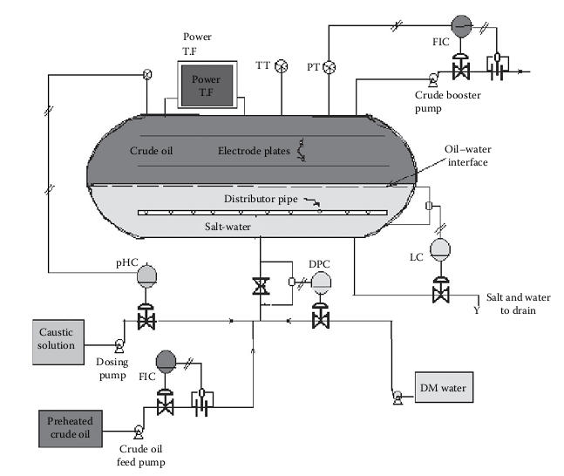
A typical crude oil desalting unit

Slide 8
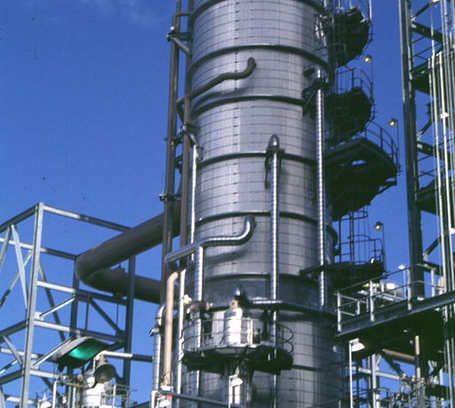
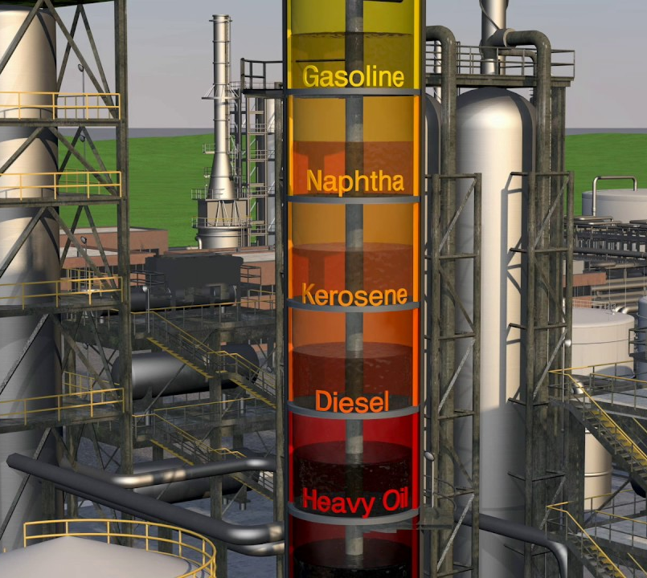
Crude Distillation unit

Slide 9
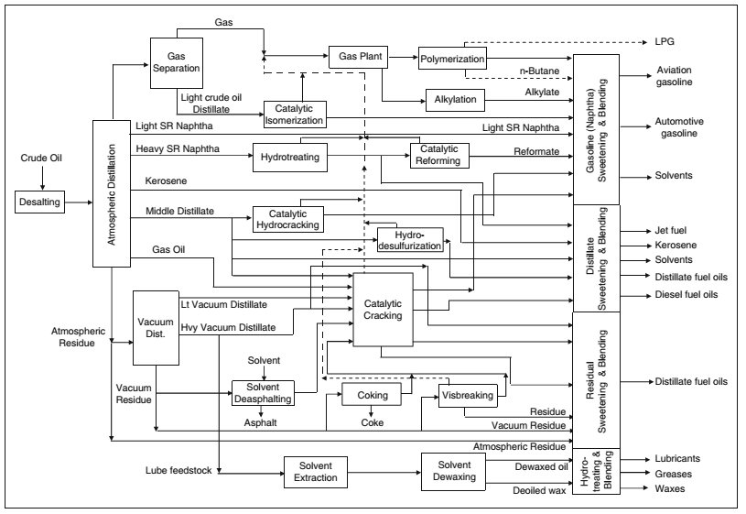
Modern Refinery Unit

Slide 10
Overall Refinery Flow
The crude oil is heated in a furnace and charged to an atmospheric distillation tower.
Butanes and lighter wet gas, unstabilized, light naphtha, heavy naphtha, kerosine, atmospheric gas oil, and topped (reduced) crude (ARC or RCO) are separated.
The topped crude is sent to the vacuum distillation tower.
Vacuum gas oil stream and vacuum reduced crude bottoms (VRC or SR) are separated.
The VRC is thermally cracked in a delayed coker to produce wet gas, coker gasoline, coker gas oil, and coke.

Slide 11
OVERALL REFINERY flo…..
The atmospheric and vacuum crude unit gas oils and coker gas oil are cracked in catalytic cracking or hydrocracking units- Products: gasoline and distillate fuel. Any unsaturated product is treated with hydrogen (hydrotreating) to get saturated components.
The light naphtha streams from the crude tower, coker and cracking units are sent to an isomerization unit to convert straight-chain paraffins into isomers that have higher octane numbers.
The heavy naphtha streams from the crude tower, coker, and cracking units are fed to the catalytic reformer to improve their octane numbers. The products from the catalytic reformer are blended into regular and premium gasolines for sale.

Slide 12
OVERALL REFINERY Flo…..
The wet gas streams from the crude unit, coker, and cracking units are separated in the vapor recovery section (gas plant) into fuel gas, liquefied petroleum gas (LPG), unsaturated hydrocarbons (propylene, butylenes, and pentenes), normal butane, and isobutane.
The fuel gas is burned as a fuel in refinery furnaces.
normal butane is blended into gasoline or LPG.
The unsaturated hydrocarbons and isobutane are sent to the alkylation unit for processing. The alkylation unit uses either sulfuric or hydrofluoric acid as catalyst to react olefins with isobutane to form isoparaffins boiling in the gasoline range. The alkylate product is a high-octane product blended into premium motor gasoline and aviation gasoline.

Slide 13
OVERALL REFINERY Flo…..
The middle distillates from the crude unit, coker, and cracking units are blended into diesel and jet fuels and furnace oils.
In some refineries, the heavy vacuum gas oil and reduced crude from paraffinic or naphthenic base crude oils are processed into lubricating oils.

Slide 14
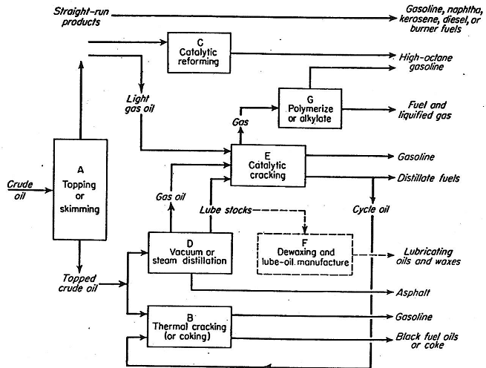
Basic crude refinery operations

Slide 15
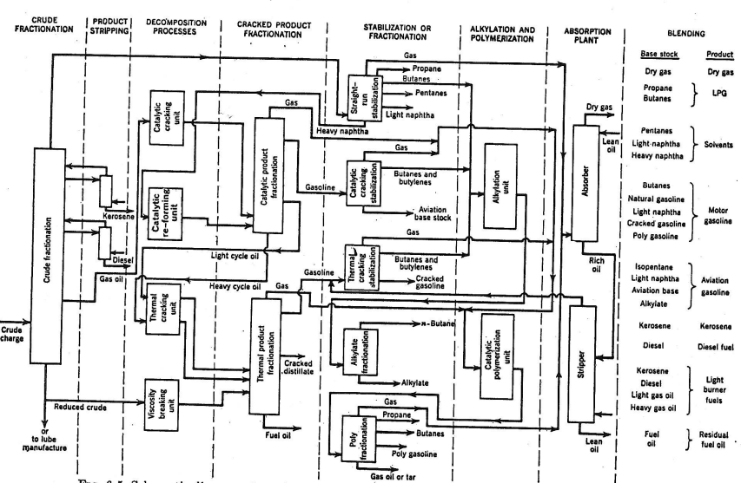

Slide 16

Maximum reflux and fractionation is obtained by removing all heat at the top of the tower, but this results in an inverted cone-type liquid loading which requires a very large diameter at the top of the tower.
To reduce the top diameter of the tower and even the liquid loading over the length of the tower, intermediate heat-removal streams are used to generate reflux below the sidestream removal points. To accomplish this, liquid is removed from the tower, cooled by a heat exchanger, and returned to the tower or, alternatively, a portion of the cooled sidestream may be returned to the tower. This cold stream condenses more of the vapors coming up the lower and thereby increases the reflux below that point.

Slide 17
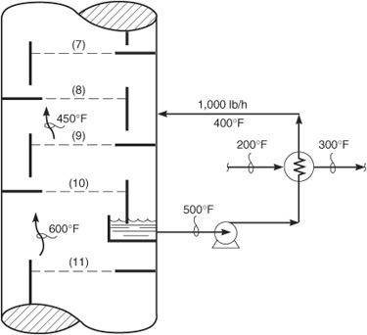
Different type of reflux
TOP TRAY REFLUX
PUMP BACK REFLUX
PUMP AROUND REFLUX
The pump back reflux is adopted to reduce the liquid load in the top section hence avoid the inverted cone shape column.
The purpose of pump around reflux is to cool and partially condense the up flowing vapors. It also supplies the liquid in the dry tray below the side withdrawal trays.

Slide 18
Pump around and pump back reflux
The purpose of pump around is to remove hot liquid from the tower and pumps it to a cooler. The cool liquid is then re-introduced at higher level in the tower. A pump around help controls temperature of the internal reflux. Also, it condenses more vapor coming from bottom.
The purpose of pump back reflux is to reduce the liquid load at the upper plates. It also helps in temperature control in the distillation tower

Slide 19
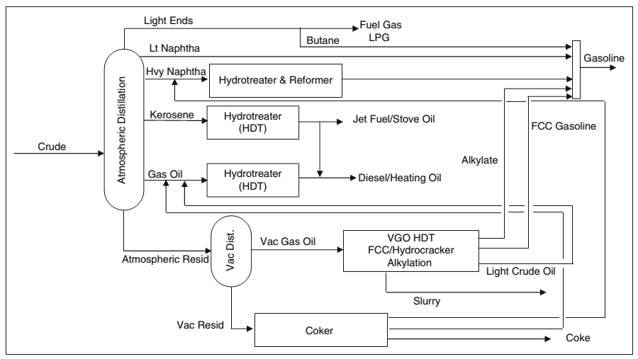
Crude distillation and subsequent processes

Slide 20
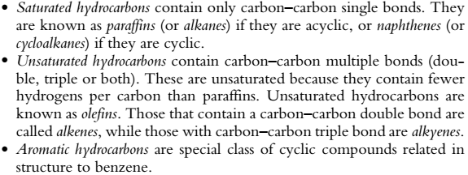
CRUDE COMPONENTS

Slide 21
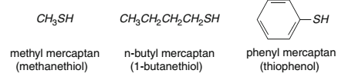


Paraffins
Olefins
Naphthenes (cycloalkanes)
Aromatics
Sulphur Compounds
Oxygen Compounds
Nitrogen Compounds
Asphaltenes and Resins
Metallic Compounds

Slide 22
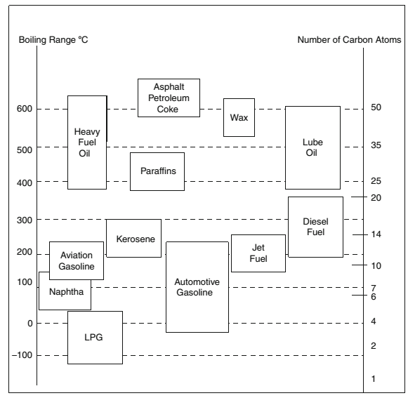
Products Composition

Slide 23
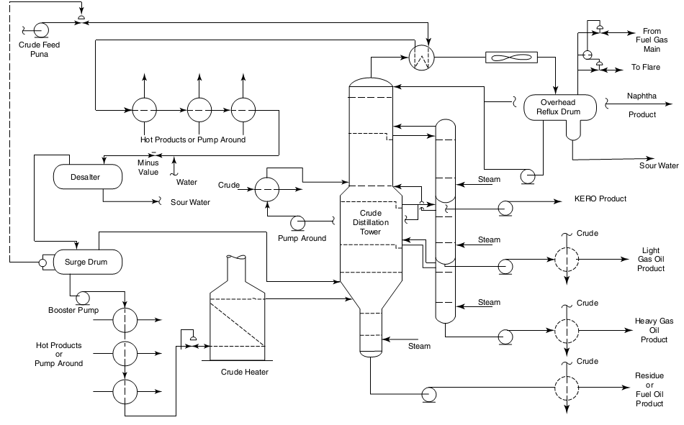
ADU
LPG/
343-399°C
50 psig

Slide 24
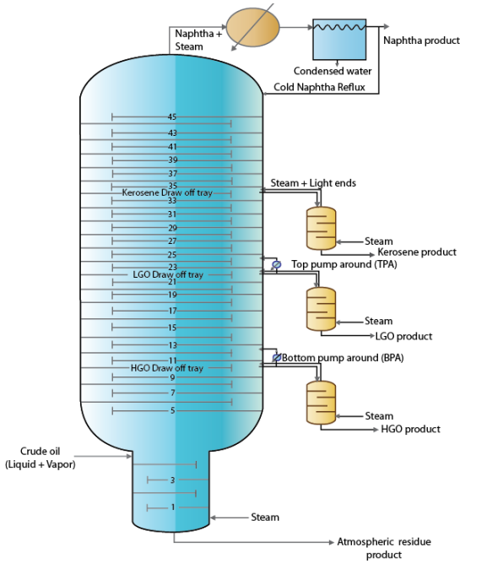
Design architecture of main and secondary columns of the ADU
32-190 °C
1.2–1.5 atm.
190-260 °C
260-320°C
320-365 °C

Slide 25
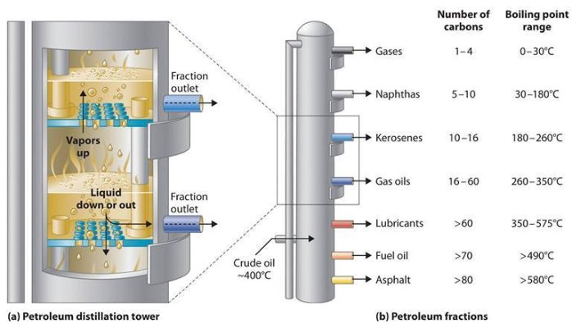
Comprehensive petroleum products

Slide 26
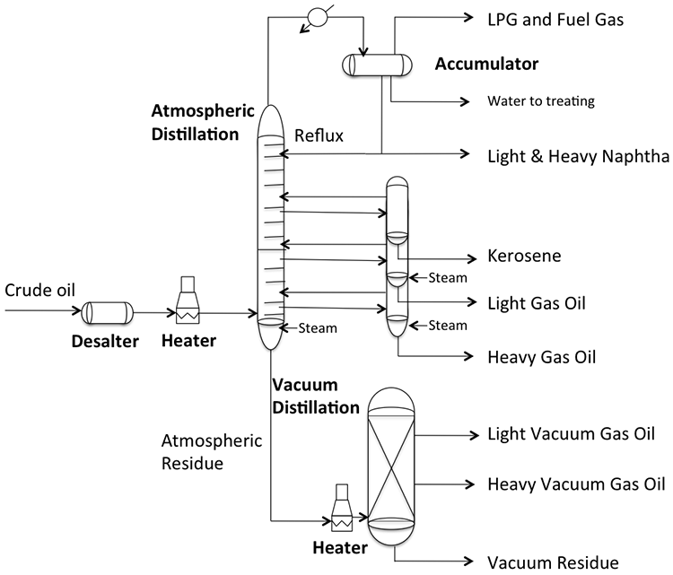

Slide 27
STABILIZATION
The top product from the atmospheric distillation column (IBP–190°C cut) is a mixture of hydrocarbon gases, e.g., methane, ethane, propane, butane, and naphtha vapors.
Methane, ethane, propane, and butane exist in gaseous form, whereas naphtha vapors liquify at ambient temperature and atmospheric pressure.
If the overhead product is kept at atmospheric pressure, these valuable liquefiable fuel gases will be lost to the atmosphere. The initial boiling point (IBP) of this mixture will vary due to the relative presence of these gases. These gases are easily separated from naphtha by distillation in a multiplated column where the top product is the mixture of gases containing methane to butanes and the bottom product is stabilized naphtha boiling in the range of C5–190°C.

Slide 28
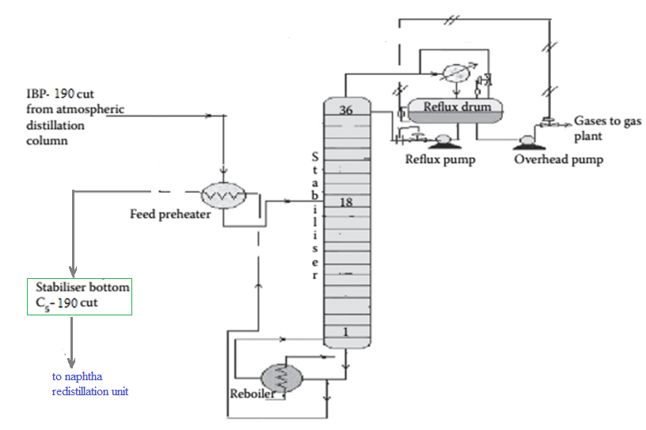
A typical stabilization column
(To amine wash)
(From ADU top product)
(To naphtha splitter)

Slide 29
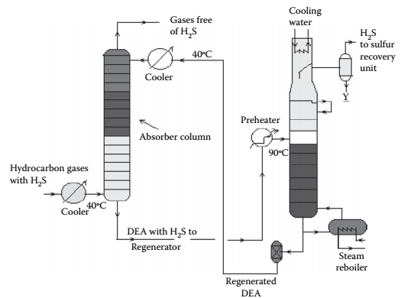
AMINE ABSORPTION
Gases from the stabilizer go to a gas plant where hydrogen sulfide associated with hydrocarbons is removed by solvent extraction, usually by diethyl amine (DEA) solution. In a plated tower, the solvent ﬂows down and the gases ﬂow up the column counter currently. Used amine solvent containing hydrogen sulfide emerges from the bottom of the tower and the top of the column produces hydrocarbon gases free of hydrogen sulfide. The amine solution containing hydrogen sulfide is regenerated in a separate steam stripper.

Slide 30
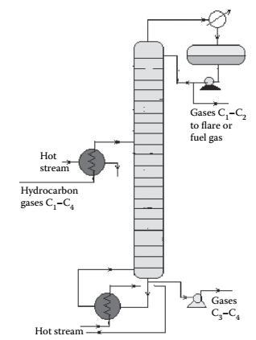
DE-ETHANIZER
Liquified Gas mixture at pressure 17 kPag from the amine wash column enters a de-ethanizer column where methane and ethane are separated from the propane and butanes by distillation. This is a distillation column where a preheated feed gas mixture is introduced in the tower, reboiled by a heater at the bottom of the column, and reﬂuxed by the top product from the reﬂux drum located at the top of the tower to separate the methane and ethane gases from the rest. The top product from this column is sent to a fuel gas system for the furnaces used in the refinery. However, top gases may also be used as a source of petrochemicals and hydrogen. The bottom product is a mixture of propane and butanes that are sent to a meroxing unit for the removal of mercaptans.
17 kPag

Slide 31
MEROXING AND CAUSTIC WASH
Meroxing is usually done for liquefied petroleum gas (LPG), kerosene, and gasoline.
Merox is an abbreviation of the word “mercaptan oxidation,” which is done catalytically in a packed bed reactor.
Mercaptans are a sulfur compound of hydrocarbons and are designated as RSH. Mercaptans are highly corrosive, and not desirable. Mercaptans can be extracted by a caustic solution, a process known as extractive merox.
Mercaptans can also be catalytically converted to disulfides (cobalt salt in the form of a chelate compound as the catalyst containing in a charcoal packed bed). Disulfide RSSR are not corrosive as mercaptans and remain with the product. This type of treatment is called sweetening merox. The following reaction takes place in a caustic solution
NaOH + RSH = NaSR + H₂O (Extractor)
Sodium mercaptide “NaSR” formed is further oxidized to disulfide in the presence of air and the catalyst as
NaSR + RSH + 1/2O₂ = NaOH + (RS)₂

Slide 32
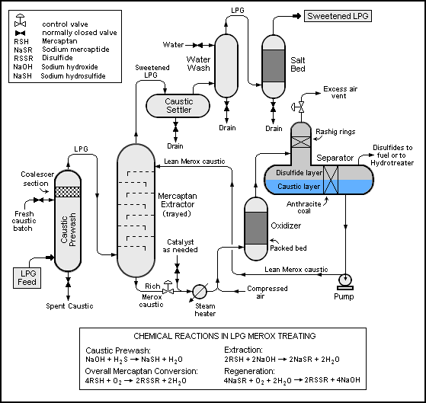

Slide 33
NAPHTHA REDISTILLATION/NAPHTHA SPLITTER
Naphtha stream is obtained from the stabilizer bottom, which is normally liquid boiled in the range of C5–190°C
This is further separated into two fractions in a column where the top is the lighter fraction, C5–90°C, and the bottom is 90°C–190°C.
This lighter fraction is suitable for petrochemical plants in the production of olefins and hydrogen because of the presence of paraffinic hydrocarbons
the heavier naphtha is suitable for the production of high-octane gasoline and valuable petrochemicals like benzene (B), toluene (T), and xylenes (X)

Slide 34
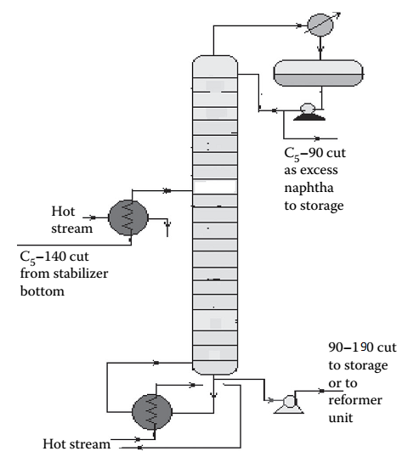
Naphtha Redistillation unit

Slide 35
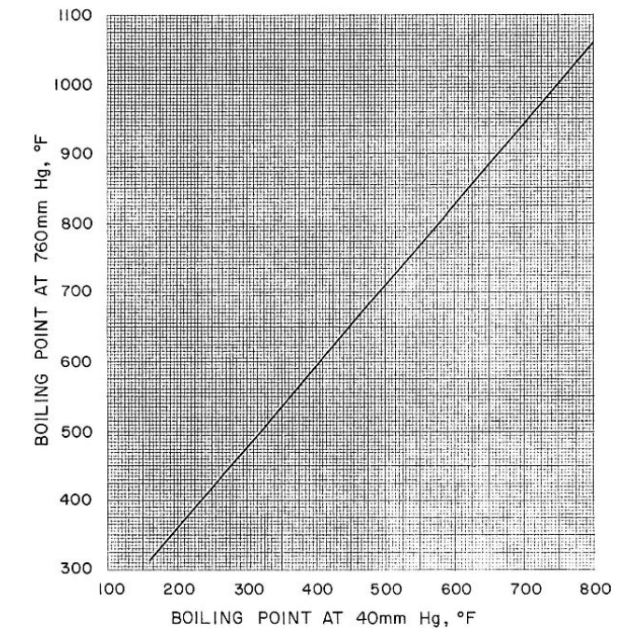
Boiling point at 760 mmHg versus boiling point at 40 mmHg.

Slide 36
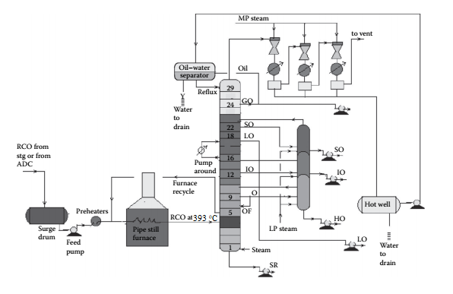
Vacuum distillation unit
H

Slide 37
Vacuum Distillation
In vacuum distillation of the atmospheric residue yields additional and valuable distillates, which could otherwise be thermally destroyed if further distillation was attempted at atmospheric pressure and above.
Hot RCO either from the steam-heated storage tank or from the bottom of the atmospheric distillation column is pumped through a series of preheaters (heat exchanger train) followed by heating in a pipe-still heater to raise the temperature to 393°C. This hot stream is then ﬂashed in a multiplated distillation column where vacuum (below atmospheric pressure) is maintained by steam ejectors by medium pressure superheated steam as the motive ﬂuid that entrains the top hydrocarbon vapours, which are condensed by water coolers. Usually, three numbers of ejectors are used; the first stage sends the uncondensed vapour to the second stage followed by condensation.
The uncondensed vapour then enters the third stage followed by condensation and the uncondensed vapour from the third stage is vented out through a ﬂare or stack. A vacuum of 30–40 mm of mercury is maintained at the top of the column and 100–120 mm at the bottom. Condensates from these ejectors are collected in a drum, known as a hot well. The oily layer is then sent to an oil–water separator vessel from which oil is drawn as vacuum gas oil (VGO), part of which is sent to the column as the reﬂux and the rest to storage. Condensates from the hot well and the separator drum are drained to the sewer or water collection system. A few plates below the top plate of the column, an additional VGO is drawn and sent to the diesel/gas oil pool.

Slide 38
SO (spindle oil) is the next vacuum distillate, which is drawn a few plates below the gas oil draw plate. Similarly, the other vacuum distillates drawn from the plates below are light oil (LO), intermediate oil (IO), and heavy oil (HO) in this sequence. LO is sent to the vis-breaking unit for the production of low viscous fuel oils, whereas SO, IO, and HO distillates are further stripped in a side stripper by steam to remove the lighter components to adjust the ﬂ ash points.
The bottom residue from the tower is called the short residue (SR), which is stripped by the bottom steam followed by cooling through a steam generator and sent for storage in the deasphalting unit. A portion of the hot vacuum distillate is drawn from the column and returned back after cooling to control the heat load of the column. This stream is called the pump around. Unlike circulating reﬂuxes in the atmospheric column, pump around is only one stream in the vacuum column. To aid washing of the HO fraction, 4%–5% of the feed RCO is overﬂashed. It is to be mentioned that SO, IO, and HO are the lube oil base stocks (LOBS), which are the main ingredients of lubricating oils in the market. Valuable lube oil stock, known as bright stock, is obtained from the SR by solvent deasphalting.

Slide 39
CATALYTIC REFORMING

Slide 40
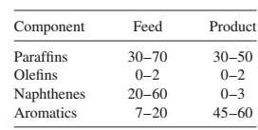
Objective of catalytic reforming
In catalytic reforming, the change in the boiling point of the stock passed through the unit is relatively small as the hydrocarbon molecular structures are rearranged to form higher-octane aromatics with only a minor amount of cracking. Thus, catalytic reforming primarily increases the octane of motor gasoline rather than increasing its yield. The yield slightly decreases due to hydrocracking reaction.

Slide 41
CATALYTIC REFORMING
In catalytic reforming the hydrocarbon molecular structures are rearranged to form higher-octane aromatics with only a minor amount of cracking.
feedstocks to catalytic reformers are heavy straight-run (HSR) gasolines and naphthas [180–375°F (82–190°C)] and heavy hydrocracker naphthas.
four major hydrocarbon groups: paraffins, olefins, naphthenes, and aromatics (PONA).
Component Feed (vol%) Product (vol%) Paraffins 30–70 30–50 Olefins 0–2 0–2 Naphthenes 20–60 0–3 Aromatics 7–20 45–60

Slide 42
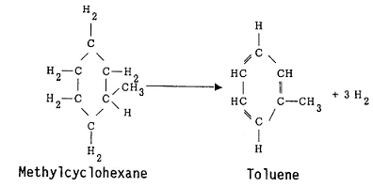
REACTIONS involved in catalytic reforming
Dehydrogenation Reactions (endothermic) Dehydrogenation of alkylcyclohexanes to aromatics

Slide 43
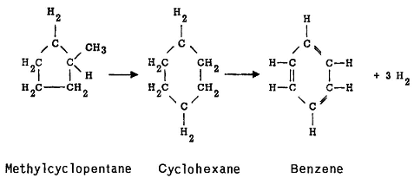
Dehydroisomerization of alkylcyclopentanes to aromatics

Slide 44
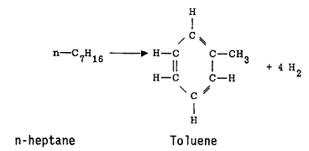
Dehydrocyclization of paraffins to aromatics

Slide 45
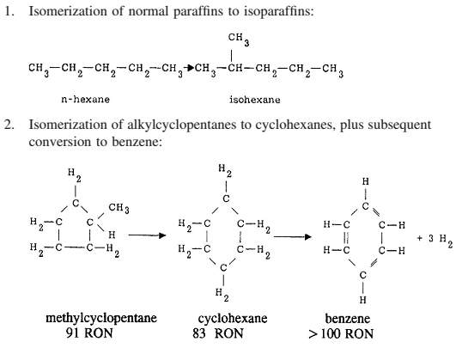

Slide 46
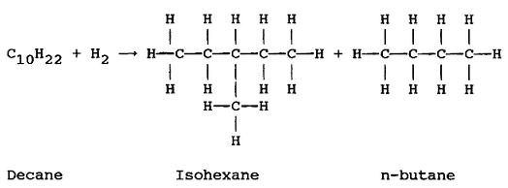
The hydrocracking reactions are exothermic and result in the production of lighter liquid and gas products

Slide 47
FEED PREPARATION
The active material in most catalytic reforming catalysts in platinum. Other metals, hydrogen sulfide, ammonia, and organic nitrogen and sulfur compounds will deactivate the catalyst
Hydrotreating is usually employed to remove these materials
Hydrotreater employs a cobalt–molybdenum catalyst to convert organic sulfur and nitrogen compounds to hydrogen sulfide and ammonia, which then are removed from the system with the unreacted hydrogen.

Slide 48
Regeneration of catalyst
(a) Removing a carbon containing deposit from the reforming catalyst,
(b) Contacting the reforming catalyst with oxygen under catalyst rejuvenation conditions to provide a rejuvenated catalyst,
(c) Purging a portion of the oxygen from the rejuvenated catalyst such that residual oxygen is retained within the reactor, and
(d) Introducing hydrogen into the reactor at a rate to provide a reactor temperature increase in the range from 25 to 45° F.
https://patentimages.storage.googleapis.com/82/a2/72/fb5e45489e96d9/US8815201.pdf

Slide 49
Reforming process
Continuous- continuous in-situ regeneration of part of the catalyst in a special regenerator, and by continuous addition of the regenerated catalyst to the operating reactors.
Semi-regenerative- catalyst is regenerated in situ during routine catalyst regeneration shutdowns which occur approximately once each 6 to 24 months.
Cyclic- catalytic reforming units have an extra spare or swing reactor and each reactor can be individually isolated so that any one reactor can be undergoing in situ regeneration while the other reactors are in operation.

Slide 50
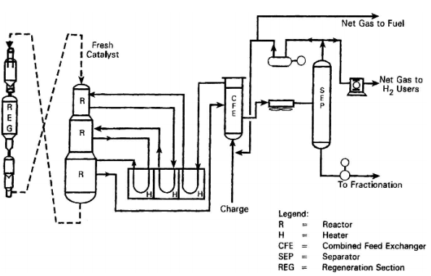

Slide 51
Semi regenerative process
The pretreated feed and recycle hydrogen are heated to 498–524°C before entering the first reactor.
In the first reactor, the major reaction is the dehydrogenation of naphthenes to aromatics and, as this is strongly endothermic, a large drop in temperature occurs
The gases are reheated before being passed over the catalyst in the second reactor
Usually, three or four reactors are sufficient to provide the desired degree of reaction and heaters are needed before each reactor to bring the mixture up to reaction temperature.
The reaction mixture from the last reactor is cooled and the liquid products condensed. The hydrogen-rich gases are separated from the liquid phase in a drum separator, and the liquid from the separator is sent to a fractionator to be debutanized
The hydrogen-rich gas stream is splitted into a hydrogen recycle stream and a net hydrogen by-product which is used in hydrotreating or hydrocracking operations or as fuel
Operating pressure from 50 to 350 psig (345–2415 kPa)
Hydrogen charge ratios of 3–8 mol H₂/mol feed

Slide 52
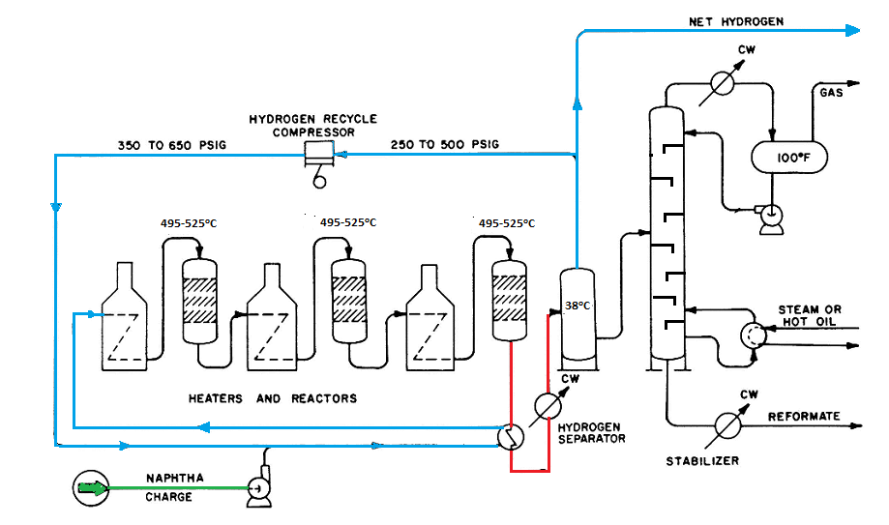

PFD-catalytic reforming

Slide 53
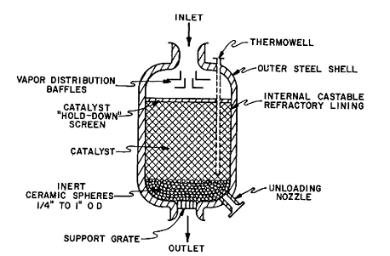
The reactor

Slide 54
Reforming catalyst
Platinum supported on chlorinated alumina base
Rhenium is combined with platinum to form more stable catalyst which permits operation at lower pressures
Platinum is thought to serve as a catalytic site for hydrogenation and dehydrogenation reactions and chlorinated alumina provides an acid site for isomerization, cyclization, and hydrocracking reactions

Slide 55
Isomerization of LSR naphtha Characteristics
Process to improve the octane numbers of the LSR naphtha [ (C₅-82°C)] e.g., n-pentane (ON 67.1) to isopentane (ON 92.3)
Reaction temperatures of about 200–400°F (95–205°C)
Reactor pressure is made at 17-27 bar.
Catalysts used:
organic chlorides.
catalysts used for isomerization contain platinum on various bases
molecular sieve base
platinum supported on a novel metal oxide base
atmosphere of hydrogen is used to minimize carbon deposits on the catalyst but hydrogen consumption is negligible

Slide 56
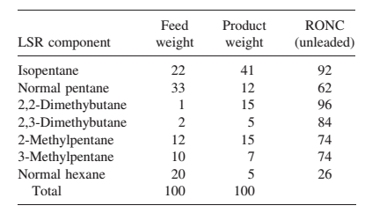
Isomerization : feed and product

Slide 57
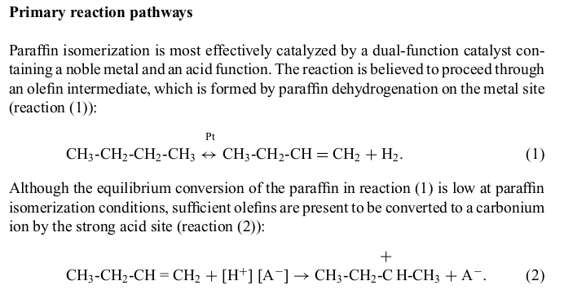

Slide 58
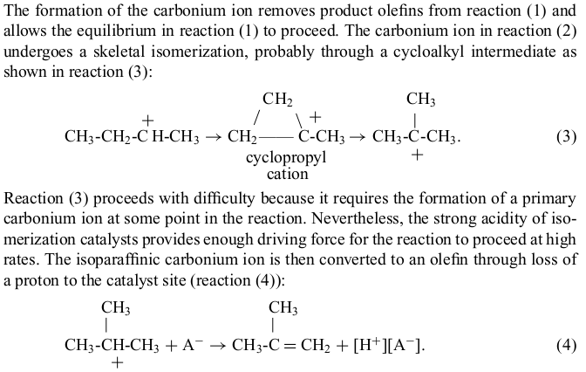

Slide 59
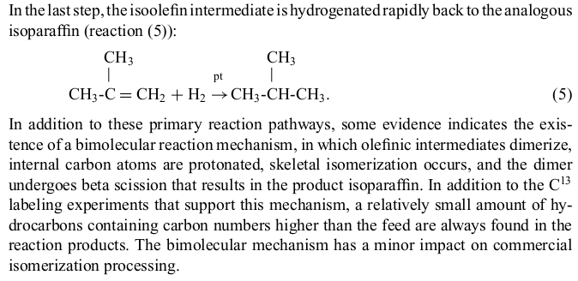

Slide 60
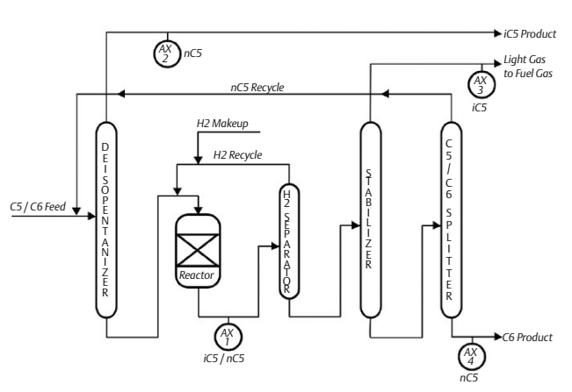
Isomerization of LSR feed

Slide 61
Finishing process
These are the secondary refining processes, are necessary to make the petroleum products suitable for use with respect to performance, corrosivity, odor, storage stability etc.
H₂S removal process
Sweetening process
Solvent extraction process
Hydrotreating process

