Slide 1
CL215-Mass Transfer Operation-I
Module 1

Slide 2
What is chemical engineering?
Chemical engineering is the field of engineering that deals with industrial processes in which raw materials are converted or separated into final useful products.
Who is the chemical Engineer?
The function of a qualified chemical engineer is to apply chemistry of a particular industrial process through the use of coordinated scientific and engineering principles. Also develop the laboratory results of chemists into economical chemical plants, he must develop, design and engineer both the complete industrial process and the equipment used in it. Then his duties can be stated as:
1- He must choose the raw material.
2- He must design and operate the plant efficiently, safely, and economically.
3- He must know that his products meet the requirements set by the customers.
4- When science does not give him a complete answer, he must use experience & judgment
to combine all sources of information to reach particular solution to processing problems.

Slide 3
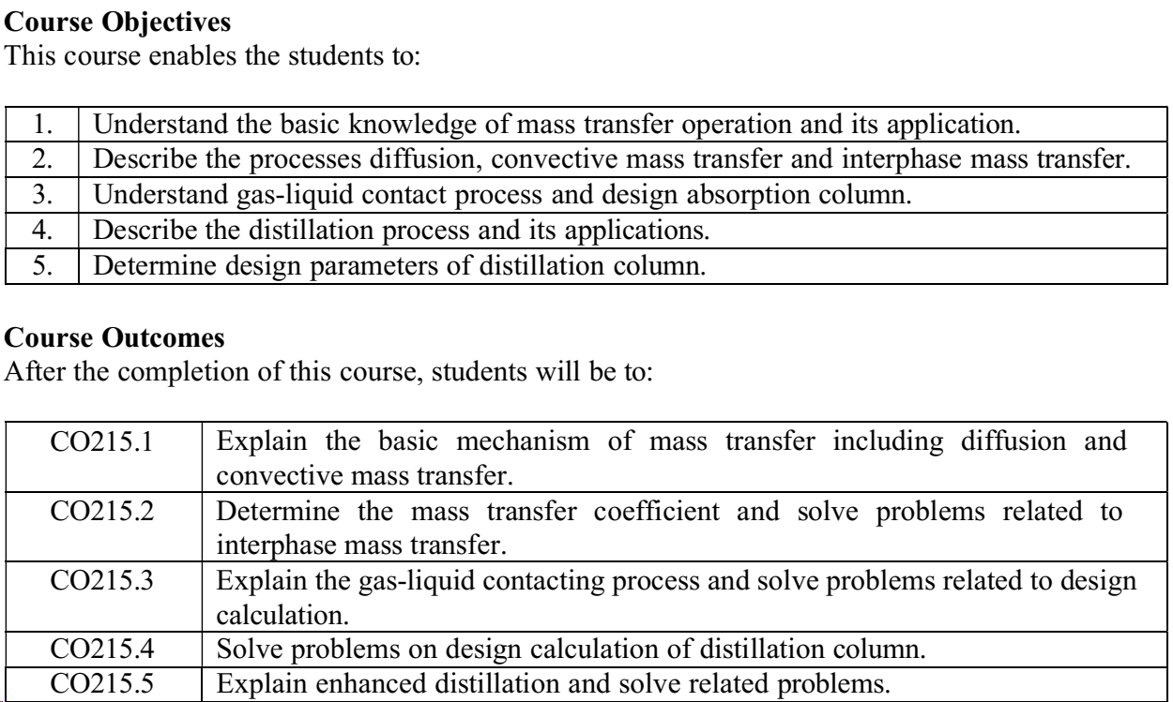
CL215: Mass Transfer Operations-I

Slide 4
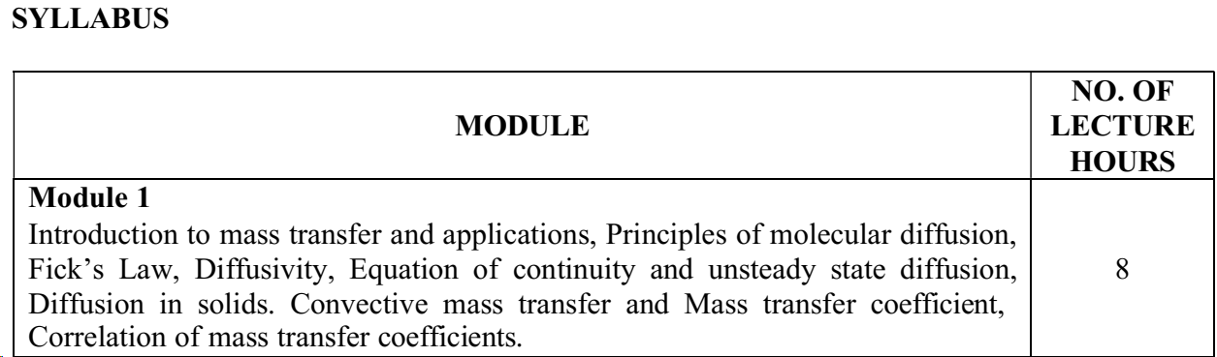
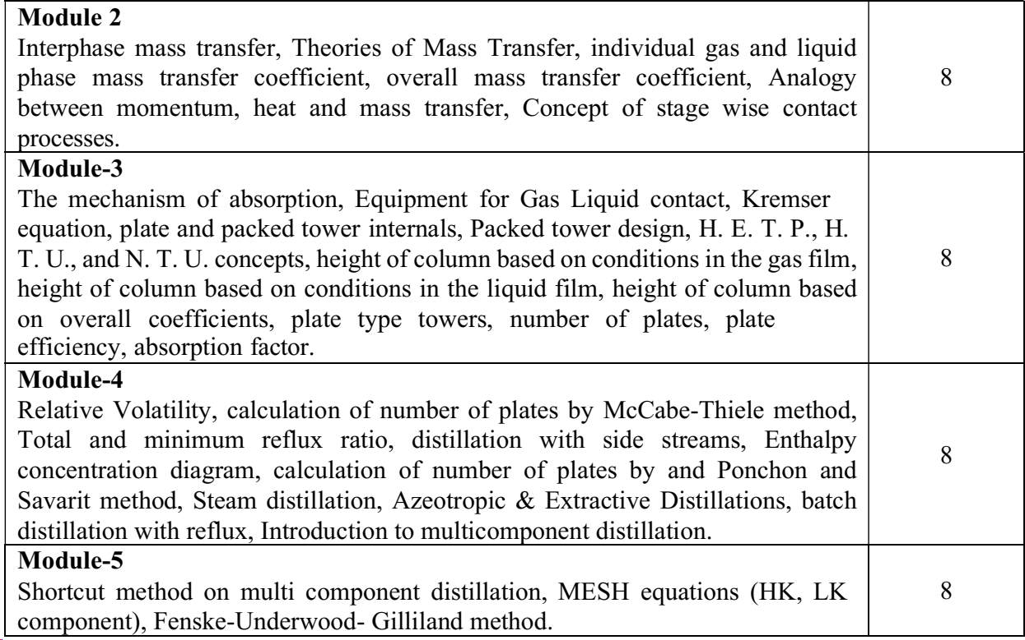

Slide 5
Intensive vs. Extensive Variables (with Examples)
In thermodynamics and physics, intensive and extensive variables classify properties based on their dependence on the size or quantity of a system.
1. Intensive Variables (Independent of system size)
These remain unchanged even if the system is divided.
Examples:
Temperature (T) – A cup of water at 25°C and a swimming pool at 25°C have the same temperature.
Pressure (P) – The air pressure inside a balloon is the same whether the balloon is small or large.
Density (ρ) – 1 kg of gold has the same density as 100 kg of gold.
Concentration (Molarity, Molality) – A sugar solution’s concentration doesn’t change if you take half of it.
Refractive Index – A diamond’s refractive index is the same for a small or large piece.
Specific Heat Capacity – Water’s specific heat (~4.18 J/g°C) is the same for a drop or an ocean.
Chemical Potential (μ) – Depends on composition, not quantity.
Boiling/Melting Point – Water boils at 100°C regardless of volume.

Slide 6
2. Extensive Variables (Dependent on system size)
These scale with the amount of matter in the system.
Examples:
Mass (m) – 2 kg of iron has twice the mass of 1 kg of iron.
Volume (V) – A 2L bottle has twice the volume of a 1L bottle.
Internal Energy (U) – More molecules mean higher total energy.
Entropy (S) – A larger system has more possible microstates.
Enthalpy (H) – Depends on the quantity of substance.
Number of Moles (n) – Directly proportional to system size.
Electric Charge (Q) – A system with more electrons has more charge.
Heat Capacity (C) – A bigger object requires more heat to raise its temperature.

Slide 7
Mass transfer operations
Diffusion: molecular diffusion and eddy diffusion
Convective mass transfer
Interphase mass transfer
Absorption/stripping-gas-liquid contact process
Distillation-vapor-liquid system
Extraction-liquid-liquid system, solid-liquid system
Adsorption-solid-liquid or solid-gas system
Drying/humidification
Leaching-solid-liquid extraction
Crystallization
Membrane separation

Slide 8
Mass density, molar concentration, mole fraction, mole ratio
The molecular diffusion is intimately connected with molecular velocity, conc. difference and the flux
Mass Density (ρ)
Definition: The mass of a substance per unit volume.
Formula: ρ=m/V
  m: Mass of the substance (e.g., in kilograms or grams).
  V: Volume of the substance (e.g., in cubic meters or liters).
Units: kg/m³
Molar Concentration (Molarity, C)
Definition: The number of moles of solute per unit volume of solution.
Formula: C=n/V
  n: Number of moles of solute.
  V: Volume of solution (in liters).
Units: Moles per liter

Slide 9
Mole Fraction (x)
Definition: The ratio of the number of moles of a particular component to the total number of moles in a mixture.
Formula: x_{i}=n_{i}/n_{total}
Mole Ratio (X)
Definition: The ratio of the moles of one substance to the moles of another substance in a mixture or reaction.
Formula:
Mole Ratio of A =n_{A}/n_{other}
  n_{A}​: Moles of one component.
  n_{other}​: Moles of other components.

Slide 10
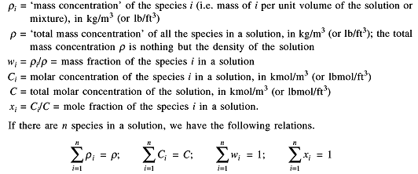
Concentration, Average Velocity
Concentration
Mass density, molar concentration, mole fraction, mole ratio etc..

Slide 11


Velocity of species
The molecular diffusion is intimately connected with molecular velocity, conc. difference and the flux.
In a liquid solution or in a gaseous mixture, the various components move with different velocities. By velocity we mean the molecular velocity in the microscopic scale and the bulk motion. By bulk motion we mean the motion in a fluid caused by a pressure difference. A diffusing species moves with a velocity greater than the average velocity of the medium. Two types of average velocities with respect to a stationary observer have been defined below:
Mass average velocity:
Molar average velocity:
where u_{i} is the linear velocity of i^{th} species in the concerned direction

Slide 12
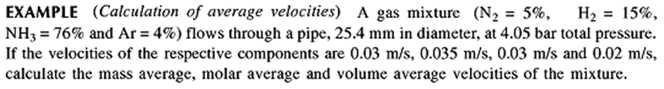
Tutorial

Slide 13
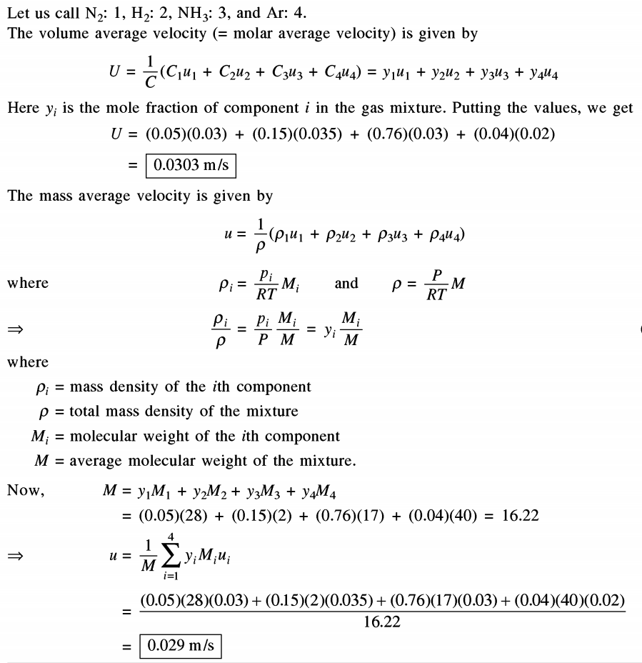

Slide 14
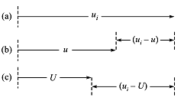
FRAME OF REFERENCE
Stationary frame of Reference:
Velocity u_{i} of the i th species
Observer moves with mass average velocity u,
will note a velocity (u_{i}-u) of the species i
Observer moves with molar average velocity U,
will note a velocity (u_{i}-U) of the species i

Slide 15
FLUX
(kg/m²s or kmol/m²s)
Mass flux
Relative to a stationary observer, n_{i} = ρ_{i}u_{i}
Relative to an observer moving with mass average velocity, i_{i} = ρ_{i}(u_{i}-u)
Relative to an observer moving with molar average velocity, j_{i} = ρ_{i}(u_{i}-U)
Molar flux
Relative to a stationary observer, N_{i} = C_{i}u_{i}
Relative to an observer moving with mass average velocity, I_{i} = C_{i}(u_{i}-u)
Relative to an observer moving with molar average velocity, J_{i} = C_{i}(u_{i}-U)

Slide 16
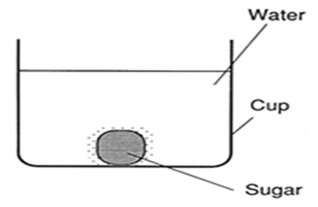
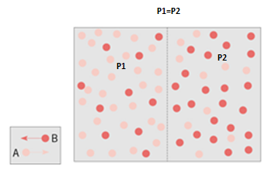





Molecular Diffusion in binary system
Fick’s law

Slide 17
Molecular diffusion and Eddy diffusion
Molecular diffusion by random and spontaneous microscopic movement of individual molecules in a gas, liquid, or solid as a result of thermal motion.
Eddy (turbulent) diffusion by random macroscopic fluid motion.
Eddy diffusion Refers to the turbulent mixing of particles (mass or heat) in a fluid due to the chaotic, irregular motion of eddies (turbulent swirls). It is a mechanism of transfer driven by turbulence in the absence of a bulk flow force. Caused by turbulence within the fluid, characterized by the mixing of fluid particles without a net flow. Governed by the eddy diffusivity (𝐷_{𝑒}), which depends on turbulence intensity and fluid properties. Caused by Mixing in stirred tanks or reactors without forced flow.
Molecular diffusion is extremely slow, whereas eddy diffusion, when it occurs, is orders of magnitude more rapid.

Slide 18
0.99 gm/cc NaCl
Pure water
1.5 m
1gm/cc NaCl soln
0.75 m
1.5 m
To reach 87.5% of 1gm/cc concentration it needs 10 years by pure molecular diffusion
To reach 99% of 1 gm/cc concentration it needs 28 years by pure diffusion
Using a stirrer with speed 22 rpm it requires only 60 s to get uniform concentration

Slide 19
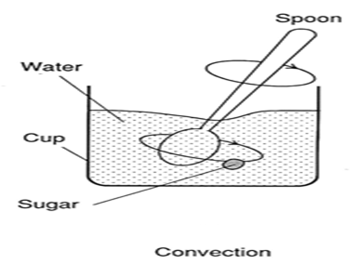
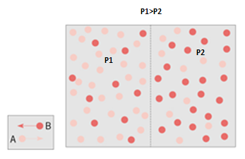
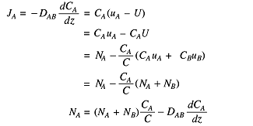
Diffusion associated with Convection

Slide 20
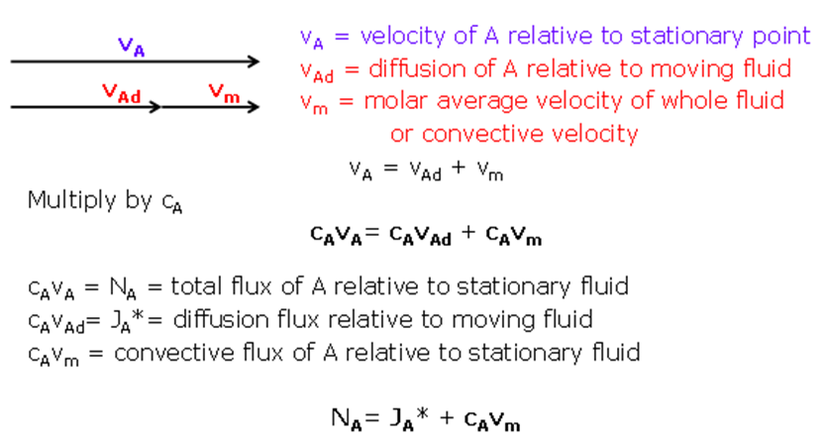





Slide 21




Problem
Prove that for an ideal gas mixture:
D_{AB} = D_{BA}
Adding
We know
hence

Slide 22
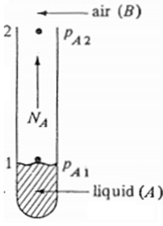
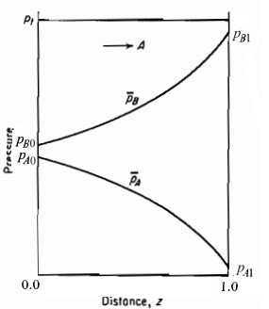






Diffusion of A through non diffusing B
N_{B}=0

Slide 23
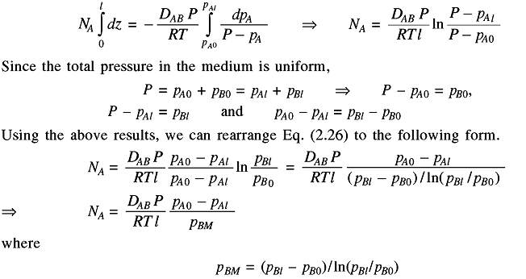

Slide 24

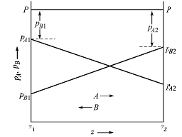



Equimolar counter diffusion
C + O₂→CO₂
(Diffusion of 1 mol O₂ and 1 mol CO₂ in counter direction through the air film on carbon surface)
N_{A}= - N_{B}

Slide 25
Non-Equimolar counter diffusion
2C + O₂→ 2CO
Diffusion of 1 mol O₂ and 2 mol CO in counter direction through the air film on carbon surface
N_{A}= - N_{B} /2

Slide 26
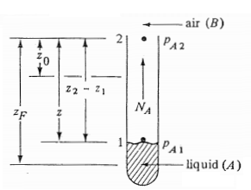
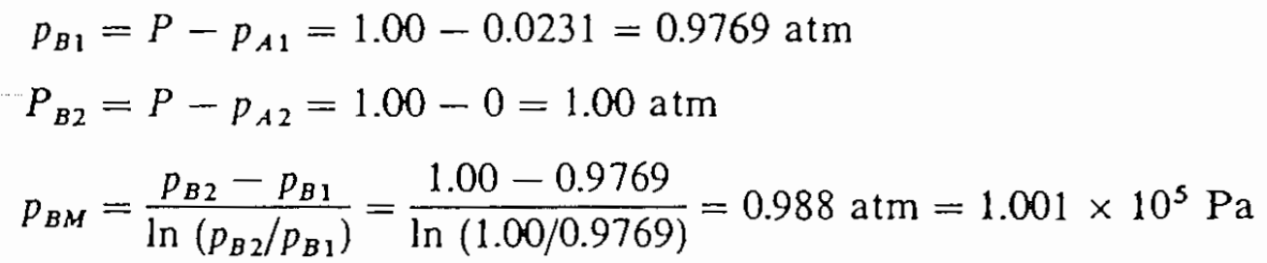
Tutorial
Water in the bottom of a narrow metal tube is held at a constant temperature of 293 Kelvin. The total pressure of air (assumed dry) is 1.01325 ×10⁵ Pascal and the temperature is 293 Kelvin. Water evaporates and diffuses through the air in the tube and the diffusion path is 0.1524 meter long . Calculate the flux of evaporation at steady state in kmol/ m² s. The diffusivity of water vapor at 293 Kelvin and one atmospheric pressure is 2.5× 10 ⁻⁵ m²/s. The vapor pressure of water at 20°C is 17.54 mm Hg.

Slide 27

Universal Gas Constant
R = 8.3145 J/(mol·K)
1.9872 cal/(mol·K)
8.3145 L·kPa/(mol·K)
0.0821 L·atm/(mol·K)

Slide 28
Problem
Tutorial
In an oxygen-nitrogen gas mixture at 1 atm. and 25°C, the concentration of oxygen in planes 3mm apart are 10 and 20 volume% respectively. Calculate the diffusional flux of oxygen in kmol oxygen/m²s for the case of equimolar counter diffusion of the two gases. The diffusivity for the system is 0.206 cm²/s.

Slide 29
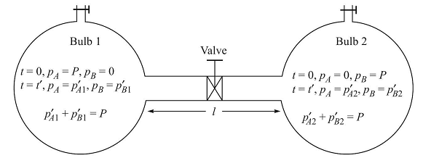


Experimental Determination of GAS PHASE DIFFUSIVITY: Equimolar counter diffusion: Twin bulb method

Slide 30


Determine D_{AB}

Slide 31
Pseudo-steady state in diffusion
In the context of diffusion, substances move from an area of higher concentration to an area of lower concentration until equilibrium is reached. In a true steady state, the concentration profile does not change with time. However, in some cases, a system may exhibit a pseudo-steady state, which is a transient condition that gives the appearance of steadiness over a certain timeframe.
This phenomenon often occurs in situations where the rate of change in concentration is much slower than the timescale over which observations are made. In other words, the concentration profile may seem relatively constant over a short period, leading to the assumption of a pseudo-steady state. The term "pseudo" here means "false" or "not genuine." So, in pseudo steady state diffusion, the concentration gradient might be changing, but it changes slowly enough that for practical purposes, it appears as if the system is at a steady state.
It's important to note that the term "pseudo-steady state" is used to describe a simplification or approximation and does not imply a true equilibrium. The system may eventually reach a true steady state, or it may continue to evolve over time.
Researchers and scientists use this concept to analyze and understand the behavior of systems undergoing diffusion, recognizing that the assumption of pseudo-steady state is a simplification that may have limitations.

Slide 32
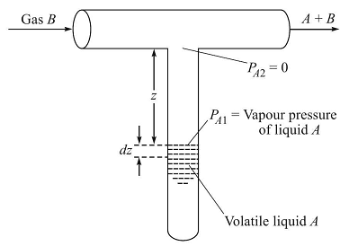




Experimental Determination of GAS PHASE DIFFUSIVITY: Stefan tube method (A diffusing through non diffusing B)
z₀
z’

Slide 33

Predictive Equations for Gas phase diffusivity

Slide 34
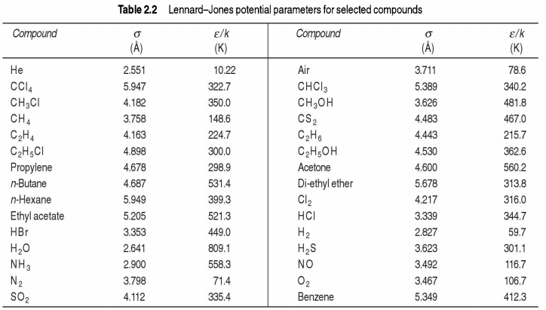

Slide 35
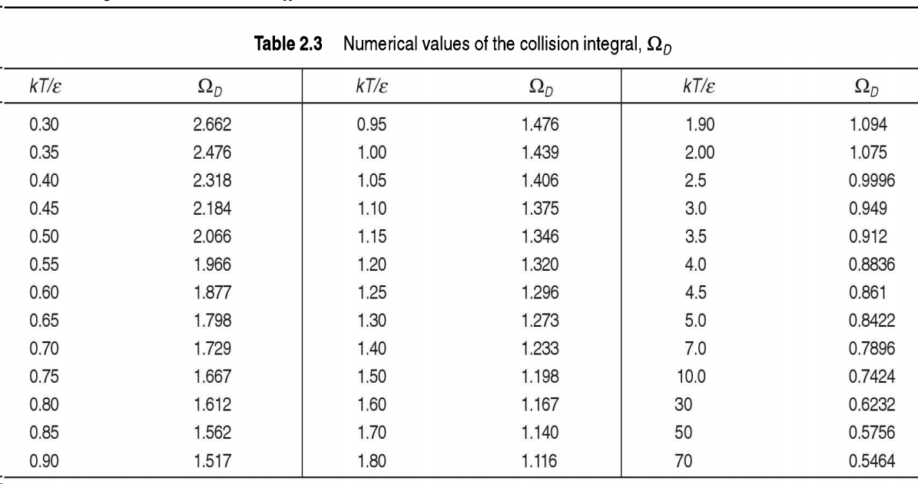

Slide 36
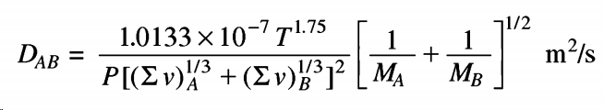
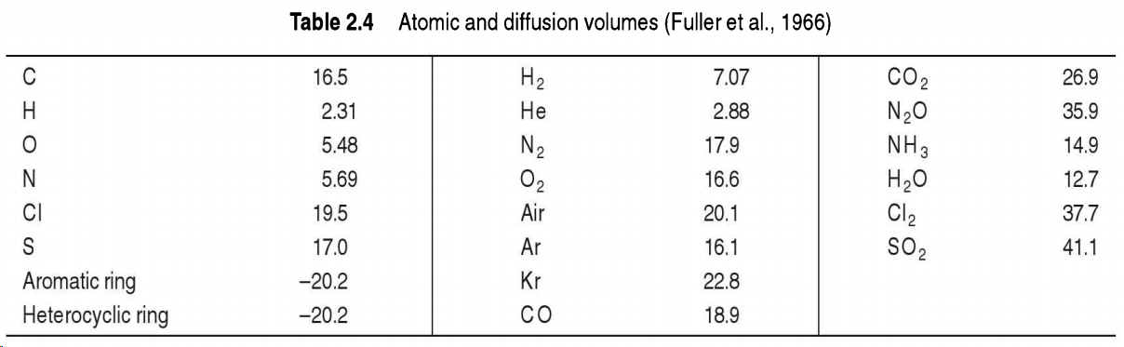
Fullers, Schettler and Giddings (1966) equation
Atomic diffusion volume

Slide 37




Molecular Diffusion in liquid
Diffusion of solutes in liquid phase is important in many industrial processes like liquid-liquid extraction, gas absorption, distillation, oxygenation of rivers and lakes by air and diffusion salts in blood.
(Here x_{A} and y_{A} both indicate the mole fraction)

Slide 38
Tutorial
Calculate the rate of diffusion of acetic acid (A) across a film of non-diffusing water (B) solution 1 mm thick at 17 °C when the concentrations on opposite sides of film are, 9 wt% and 3 wt% respectively. The diffusivity of acetic acid in the solution is 0.65×10⁻⁹ m²/s. M_{A} = 60.03, M_{B}=18.02. The density of 9% and 3% solution at 17°C are 1012 kg/m³ and 1003.2 kg/m³.

Slide 39



Slide 40


Predictive Equation for Liquid phase diffusivity

Slide 41
Diffusion through a variable area
So far, we have derived the diffusivity in systems where it occurs through a constant cross-sectional area. There are various examples of molecular diffusion that are occurring through variable cross-sectional area also. For example: diffusion of water vapor from a spherical drop of water, diffusion of naphthalene from a naphthalene ball etc.
Let us evaluate the diffusivity in various cross-sectional area.

Slide 42
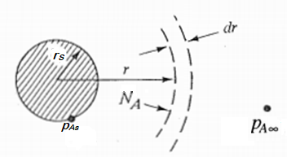




Diffusion from a sphere
A naphthalene sphere with radius r1 is in the infinite gas medium. The component A has the partial pressure p_{A1} at the diffusing surface and partial pressure p_{A2} at the stagnant medium is equal to zero
From the above figure we can write rate of mass transfer, W = 4πr² N_{A}
Since this is diffusion of type ‘ A diffusing through non diffusing B’ we can write

Slide 43





This equation can be integrated between r =r_{s} (surface of the sphere, p_{A} = p_{As}) and r = ∞ where p_{A} = p_{A∞}
The rate of mole transfer can be found from the loss of mass of a sphere for time t
From eqn (i) and (ii)

Slide 44

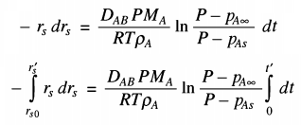


The change in the drop size in considerable time can be determined by integrating the above equation considering the pseudo-steady state.
Integrating the equation for at t=0, r =r_{S0} and at t= t’, r_{s}=r_{s}’
The time required to complete evaporation of the sphere can be determined when r_{s}’ = 0

Slide 45
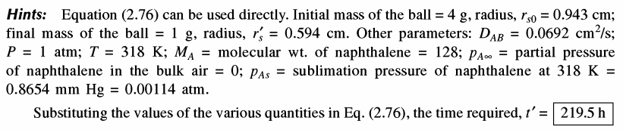
Diffusion from a sphere
Tutorial
Calculate the time required for the sublimation of 3 gm of naphthalene from a naphthalene ball of 4 gm kept suspended in a large volume of stagnant air at 45°C and 1 atm pressure. Diffusivity of naphthalene in air under the given condition is 6.92×10⁻⁶ m²/s, its density is 1140 kg/m³ and its sublimation pressure at 45°C is 0.8654 mm Hg.

Slide 46
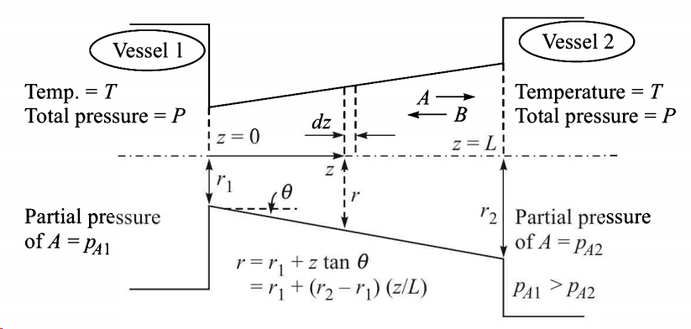
Diffusion through a tapered tube

Slide 47


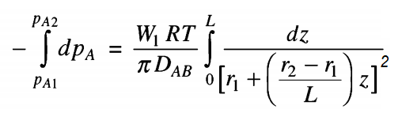


The product of flux and the cross-sectional area is constant which gives the rate of mole transfer
W₁ = πr² N_{A}
For equimolar counter diffusion we can write
r can be substituted from the geometry as
To integrate put

Slide 48
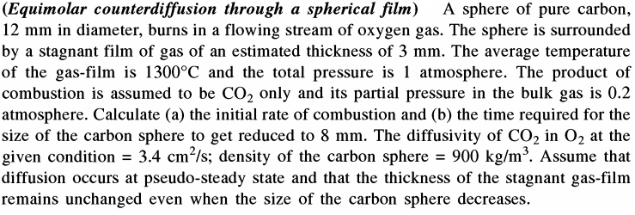
Tutorial

Slide 49



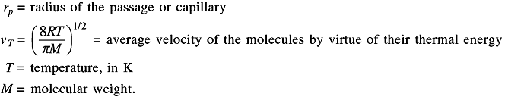
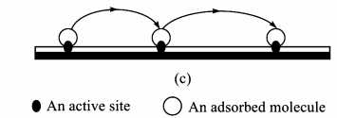

Knudsen Diffusion
Surface Diffusion
Self Diffusion: self study

Slide 50
Diffusivity dependency on temperature and pressure
Homework
Ref: Mass transfer operations – R. E. Treybal
Gas phase diffusivity:
Pressure dependence of diffusivity is given by D_{AB}∝ 1/𝑃
Temperature dependency is according to D_{AB}∝ 𝑇^{3/2}
Liquid phase diffusivity:
Temperature dependency is according to D_{AB}∝ T

Slide 51

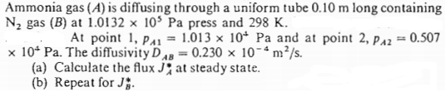
Problems
Tutorial

Slide 52
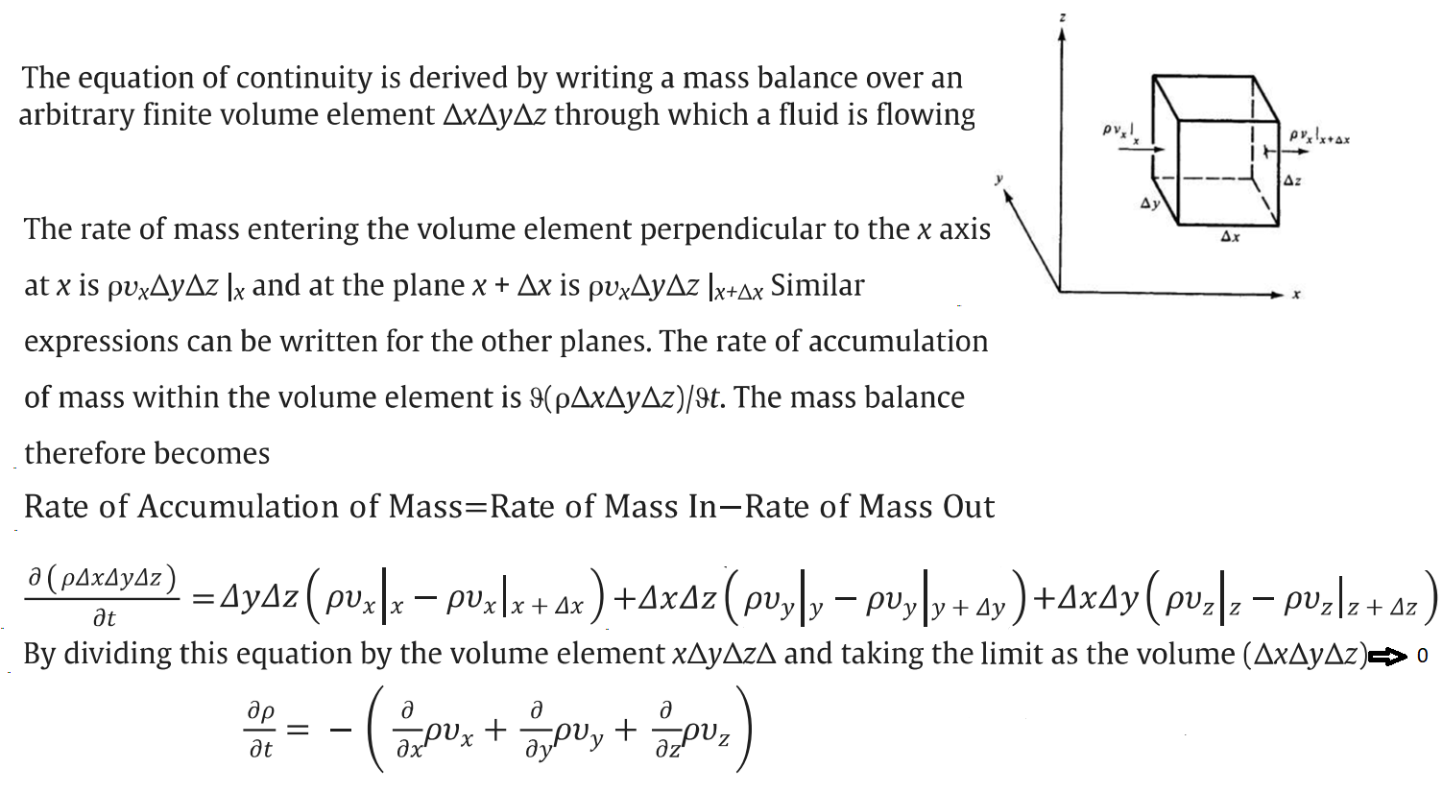
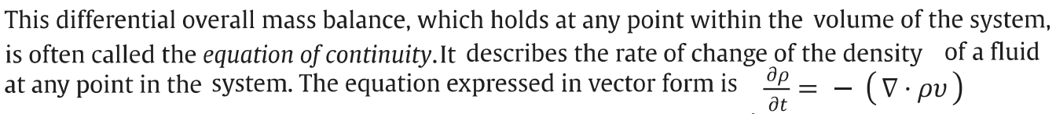
Equation of continuity

Slide 53
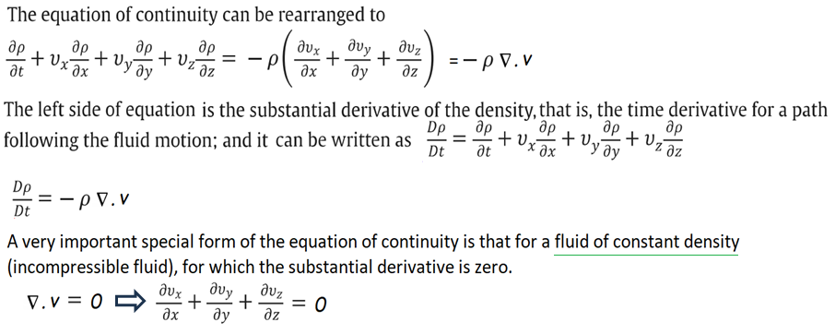

Slide 54
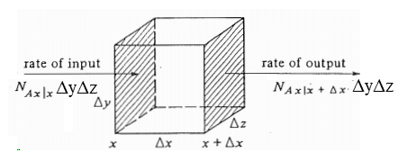
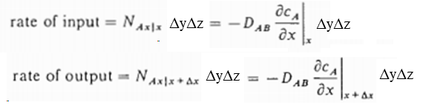




Unsteady state diffusion
rate of generation = R_{A} ΔxΔyΔz
Now, Adding the equations and divide LHS and RHS by ΔxΔyΔz
0
when Δx → 0
When D_{AB} is variable

Slide 55
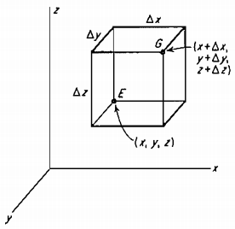


Unsteady State Equation-3-dimensional form
The more general form for three-dimensional rectangular coordinates is
This is Fick’s 2nd law of diffusion

Slide 56

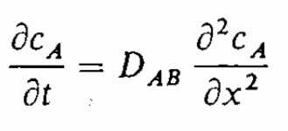
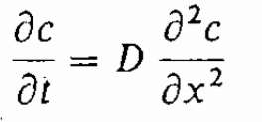
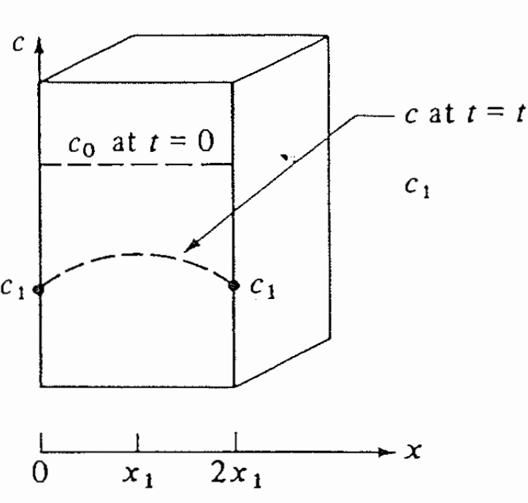

Slide 57
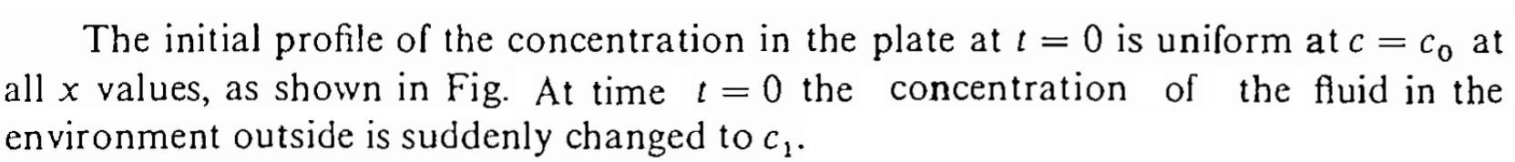
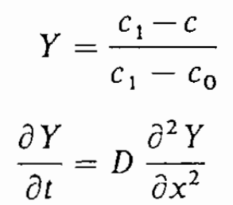
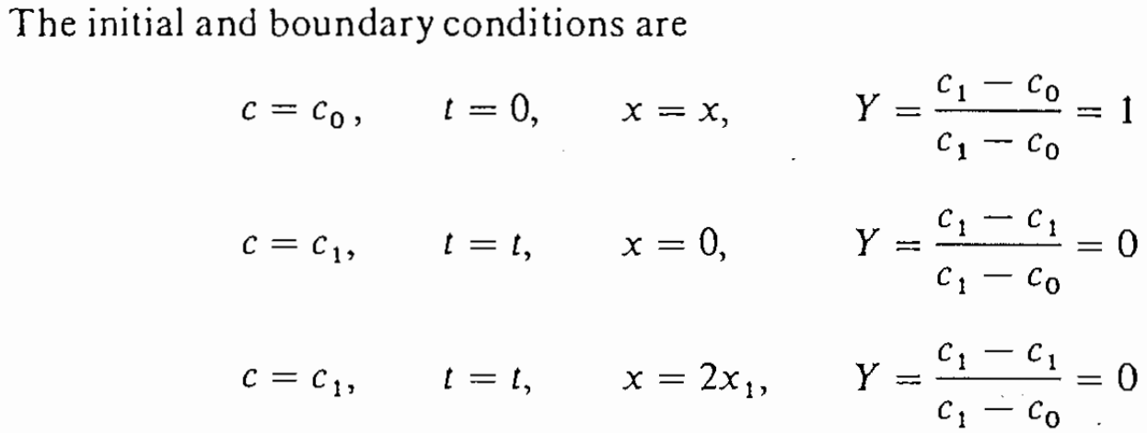

Slide 58
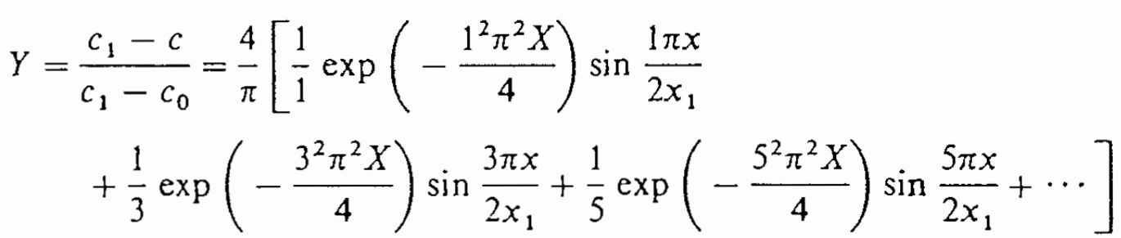
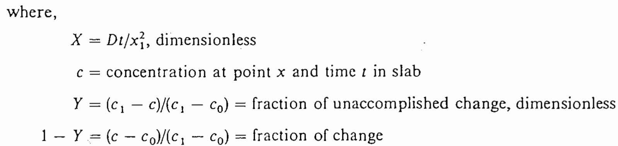

Slide 59
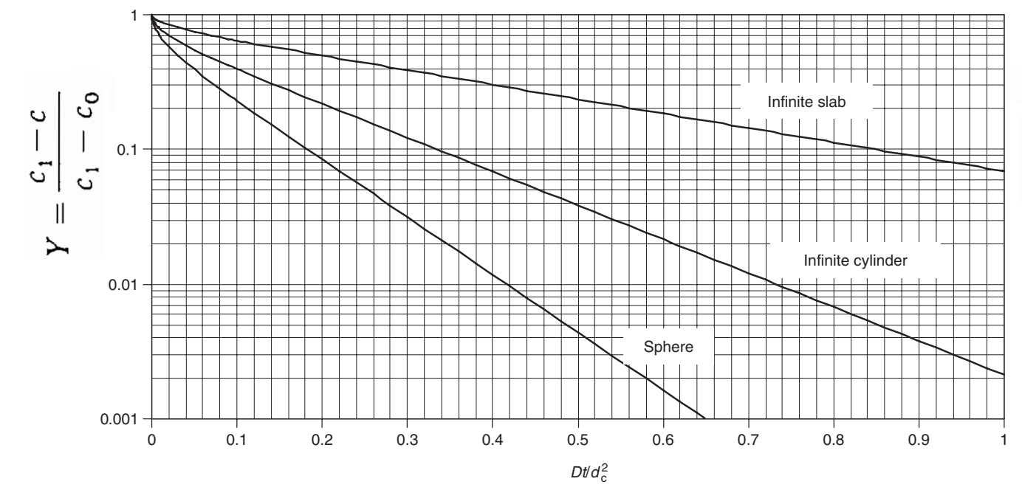

Slide 60
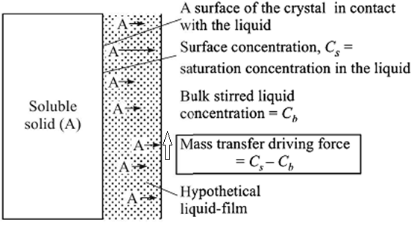

Convective mass transfer and MASS TRANSFER COEFFICIENT
When a solid is dissolving in a fluid in motion, there will always be a stagnant film over the solid-liquid interface.
The mass flux can not be determined by simple diffusion equation because the film thickness and characteristics of flow field are unknown.

Slide 61

Mass transfer from a solid surface to an adjacent liquid
Viscous sub-layer film
Buffer zone
Turbulent zone

Slide 62



Turbulent or Eddy diffusion
Turbulent or eddy diffusivity depends on the intensity of the local turbulence.

Slide 63





Slide 64






Where,
Another correlation

Slide 65



Types of mass transfer coefficients
=
=

Slide 66
Buckingham method for mass transfer coefficient
The mass transfer coefficient (k_{c}​) depends on several physical quantities.
k_{c}​: Mass transfer coefficient (L/T).
D: Diffusion coefficient (L²/T).
ρ: Fluid density (M/L³).
Μ: Dynamic viscosity (M/(LT).
v: Fluid velocity (L/T).
L: Characteristic length (L).

Slide 67
Total Variables and Fundamental Dimensions
Number of variables (n) = 6.
Fundamental dimensions (m) = 3 (M,L,T).
The number of dimensionless groups (π terms) is:
π=n−m=6−3=3
We expect to derive three dimensionless groups.

Slide 68
Repeating variables that:
Represent all fundamental dimensions (M,L,TM, L, TM,L,T).
Are dimensionally independent.
Let’s choose:
ρ: (M/L³): Represents mass.
v (L/T): Represents velocity.
L: (L): Represents length.
These variables will combine with the remaining variables k_{c}​, D, and μ to form the π-terms.

Slide 69



Slide 70



Slide 71



Slide 72



Slide 73








Power law dependency of MTC on variables
…(i)
…(ii)
…(iii)
…(iv)
}
Substituting in eq. (iii)
…(v)
…(vi)
Substituting in equation (i)

Slide 74

Free convection

Slide 75

Mass transfer coefficient (MTC)
Determination of rate of mass transfer is possible to measure by knowing the flow field and mass and momentum balance equations. e.g., solid dissolution from a flat surface to the flowing fluid, rate of mass transfer in a liquid falling film. But where the flow field is complex like dissolution of solid from in stirred tank, absorption in packed bed, the rate determination is difficult. The concept of mass transfer coefficient is developed to address those problems.

Slide 76


Slide 77




Dimensionless groups in mass transfer

Slide 78




Naphthalene ball suspended in flowing air through a circular tube-Experimental determination of MTC

Slide 79







Dimensionless number in mass transfer
For liquid phase mass transfer:

Slide 80


Slide 81

Correlations for convective mass transfer coefficient
The correlations have been developed by large volume of experimental data

Slide 82


Slide 83
Problem
Tutorial
Determine the rate of water evaporated from a tray full of water. Air at a velocity of 2 m/s is ﬂowing over the tray. The temperature of water and air is 25°C. The width of the tray is 45 cm and its length along the direction of air ﬂow is 20 cm. The diﬀusivity of water vapor in air is D = 0.26 x10⁻⁴ m²/s. The relative humidity of air is 50%.
Given: Vapor pressure of water at saturation = 3.179 kPa at 25°C

Slide 84









Slide 85


Slide 86



Slide 87


Slide 88

A 0.3175 cm sphere of glucose is placed in a water stream ﬂowing at a rate of 0.15 m/s. The temperature of water is 25°C. The diﬀusivity of glucose in water is 0.69 × 10⁻⁵ cm²/s. Determine the mass transfer coefficient.

Slide 89


