Slide 1
Binary distillation
CL215 MTO-I
Module 4

Slide 2
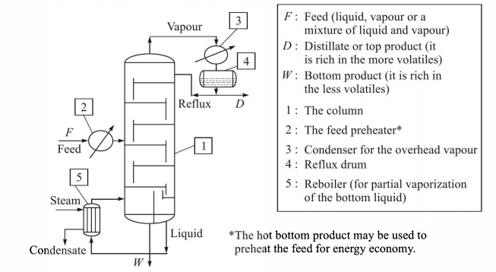
Distillation
Binary mixture

Slide 3
The phase rule
4 variables:
x_{A}
y_{A}

Slide 4
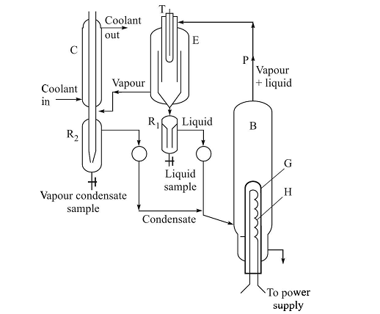
Vapor-Liquid Equilibrium (Gillespie still)

Slide 5
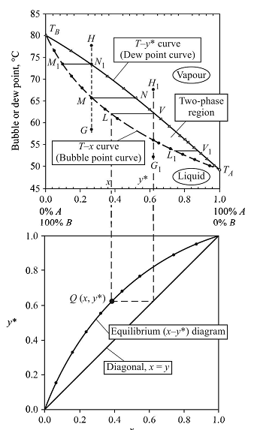

Slide 6
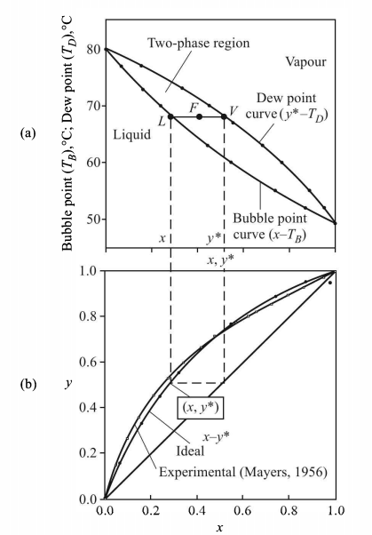
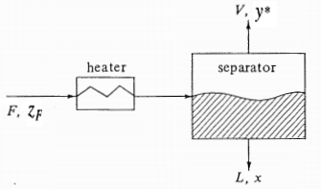
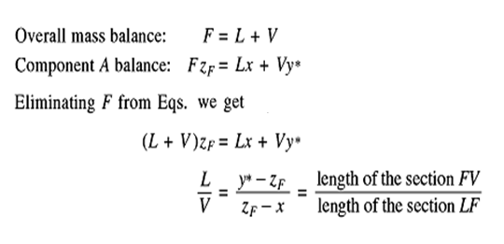

Slide 7
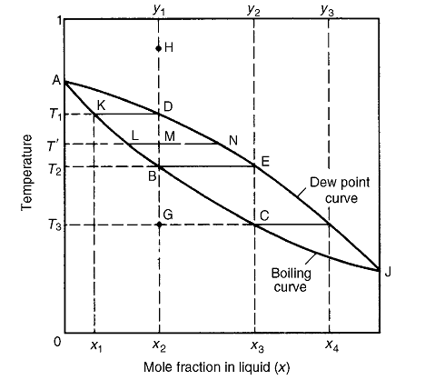
Partial vaporization and Partial condensation

Slide 8
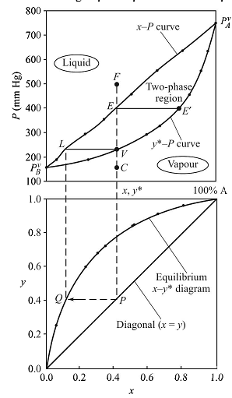
VLE curve at constant temperature

Slide 9




Raoult’s law and ideal solution
Henry’s law at low concentration of low boiler

Slide 10




Modified Raoult’s Law

Slide 11
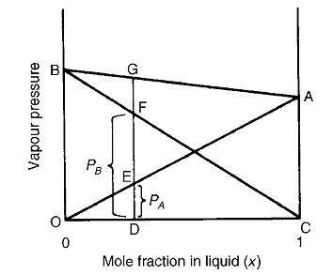
Partial Pressure of ideal mixtures

Slide 12
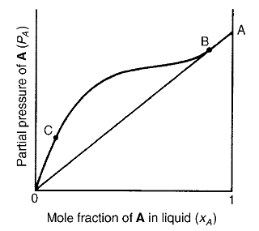
Partial Pressure of non-ideal mixtures

Slide 13
Problem

Slide 14
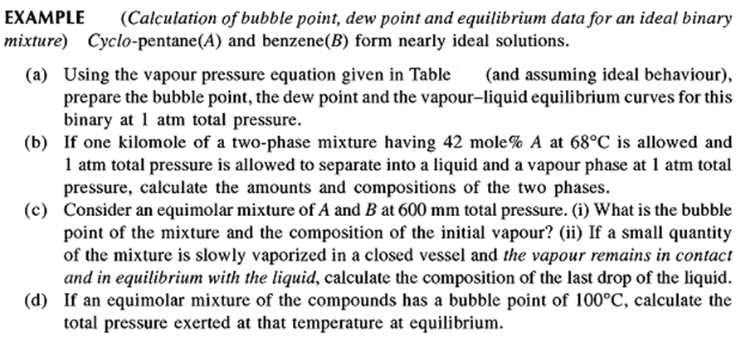


Slide 16
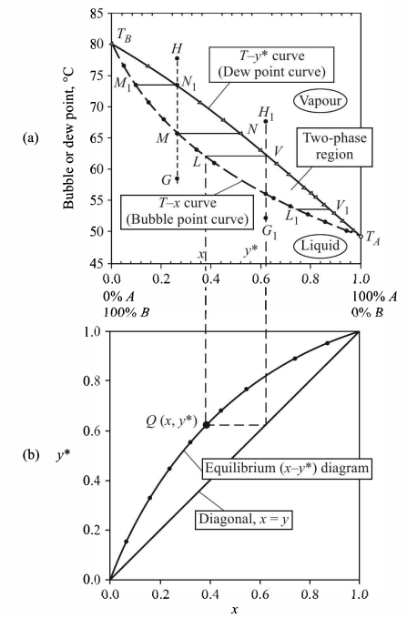


Slide 17
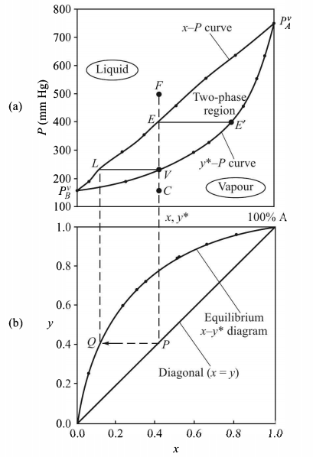


Slide 18
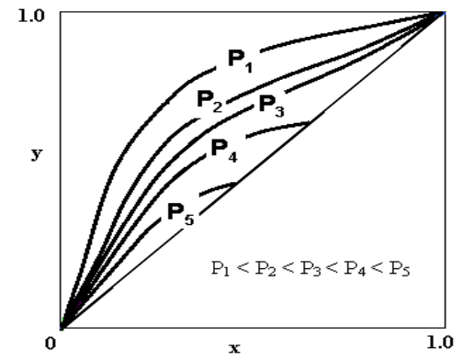
Variation of equilibrium curve with pressure

Slide 19
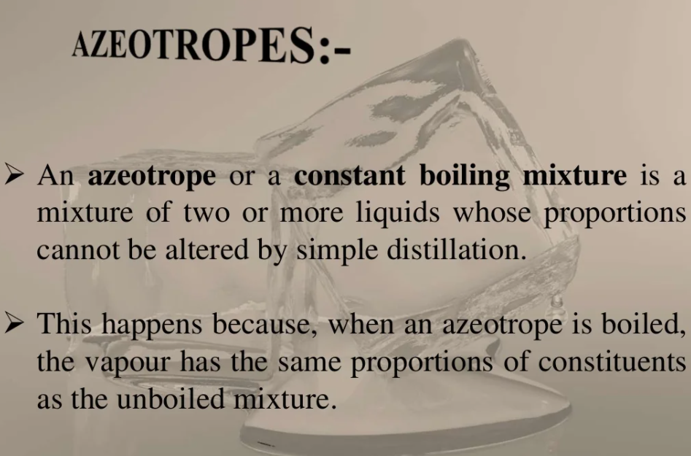

Slide 20
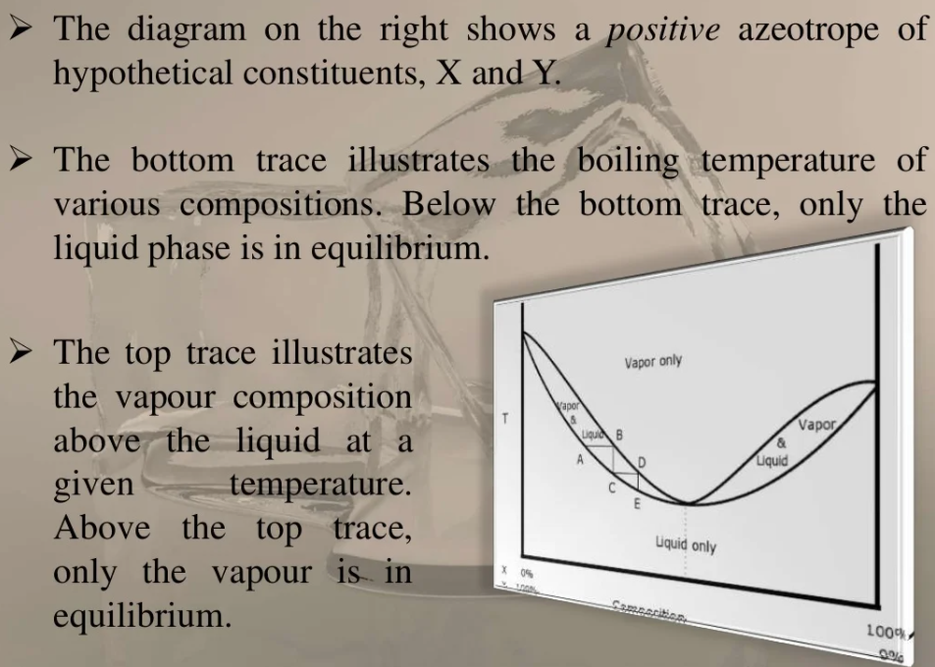
Minimum boiling Azeotrope

Slide 21
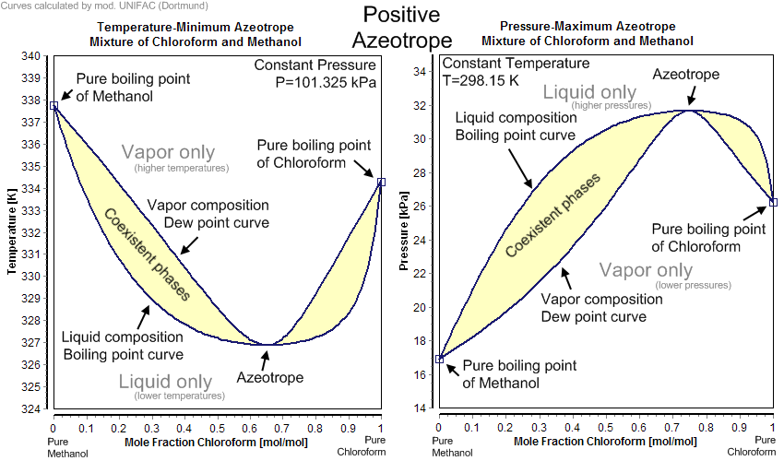

Slide 22
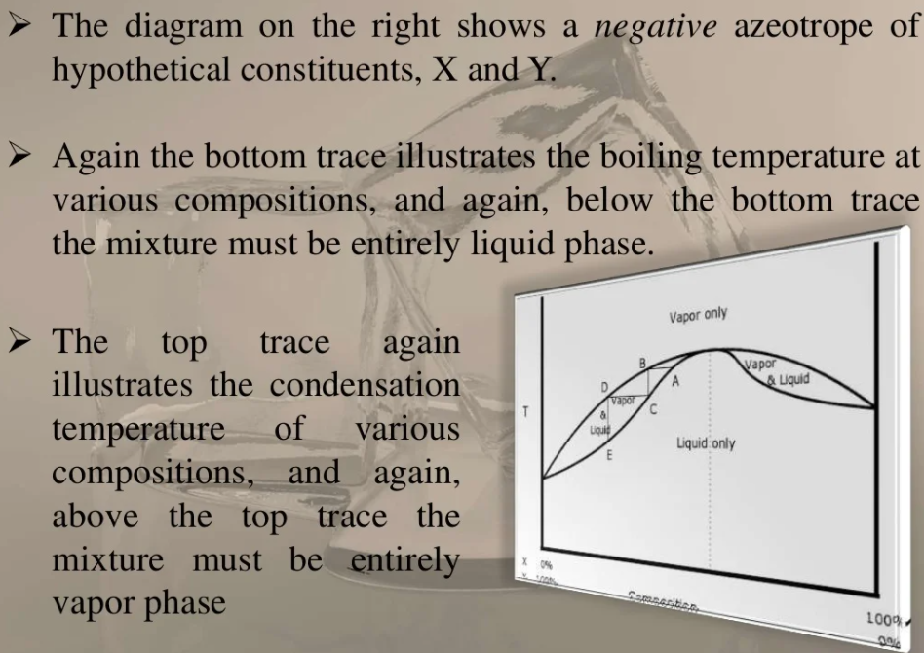
Maximum boiling Azeotrope

Slide 23
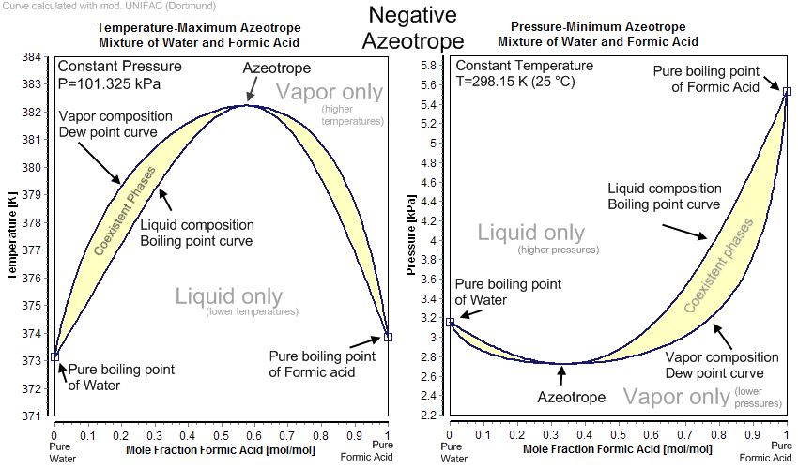

Slide 24
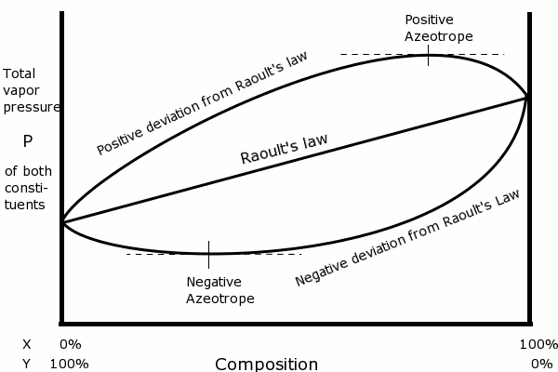

Slide 25
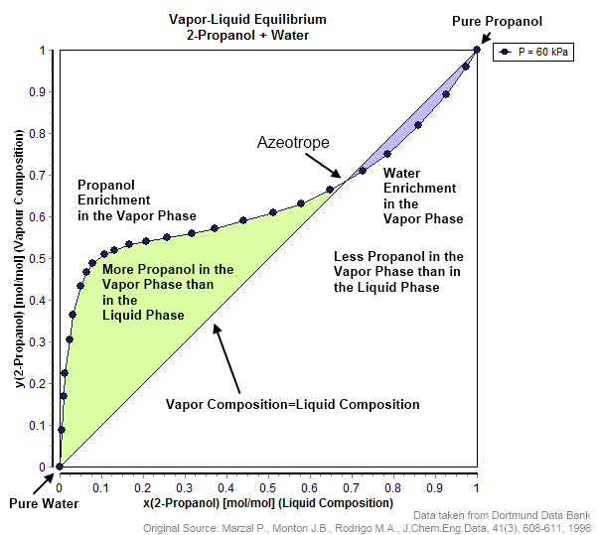

Slide 26
Azeotrope Properties (Ethanol-Water)
Minimum boiling Azeotrope
Composition: 95.6% ethanol & 4.4% water (by weight)
Boiling Point: 78.2°C (172.8°F) at 1 atm
Comparison to Pure Substances:
  Pure ethanol boils at 78.37°C
  Pure water boils at 100°C
  The azeotrope boils at a slightly lower temperature than pure ethanol

Slide 27
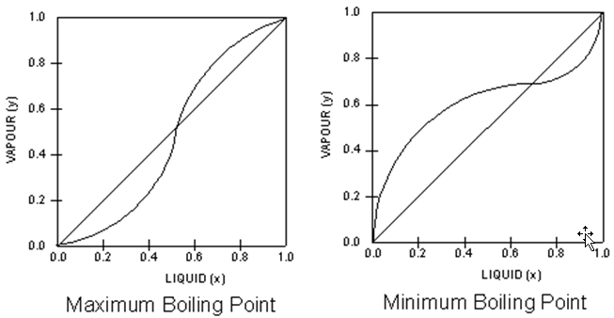

Slide 28
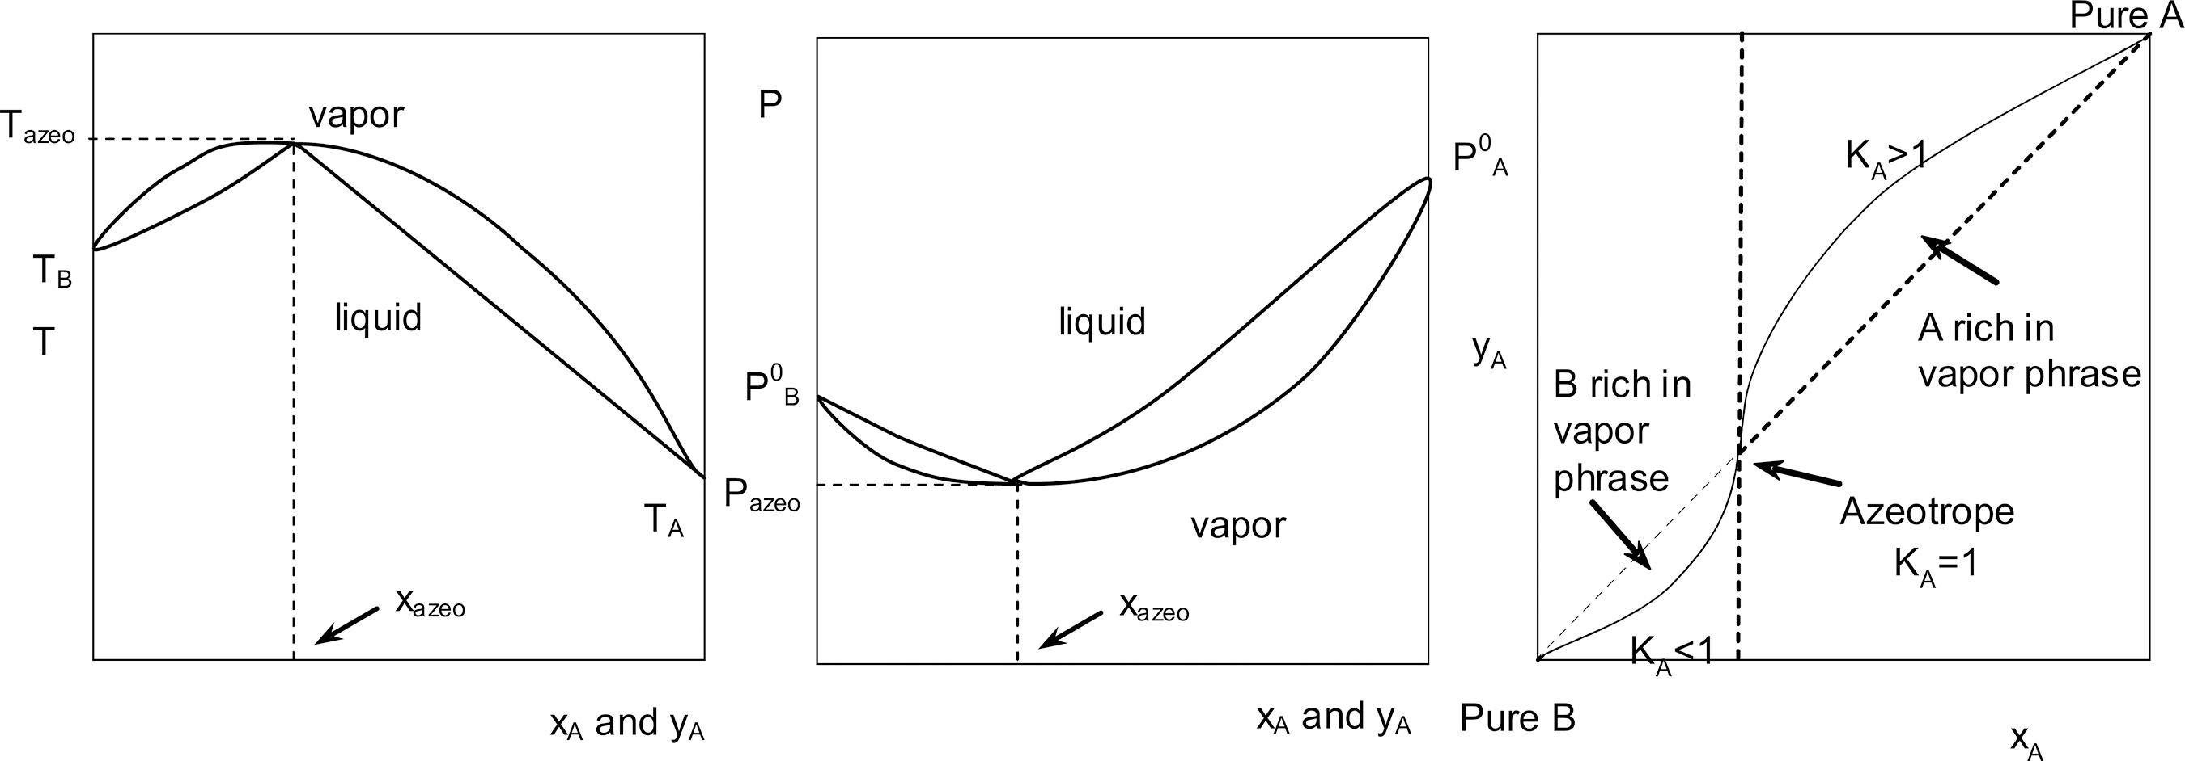
Maximum boiling azeotrope

Slide 29
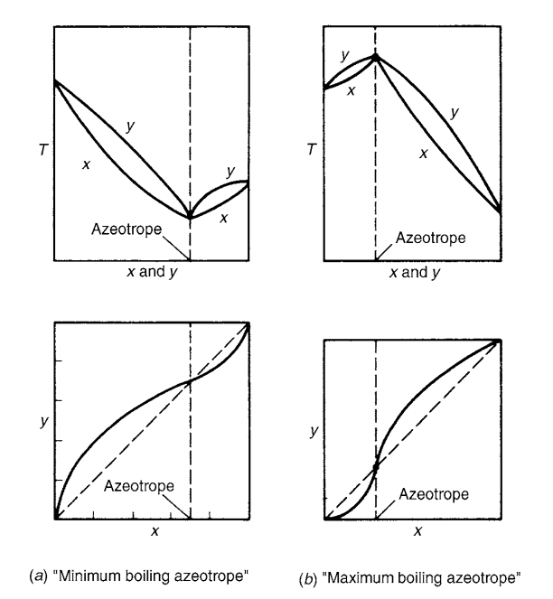

Slide 30
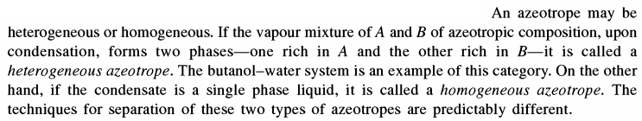
Azeotropic Distillation

Slide 31
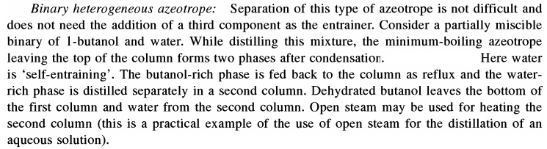

Slide 32
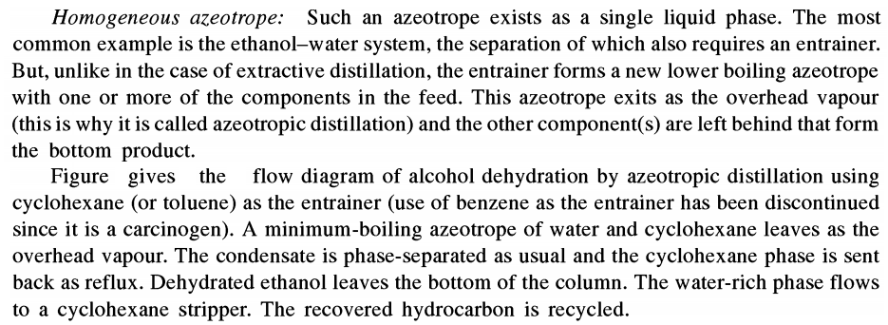
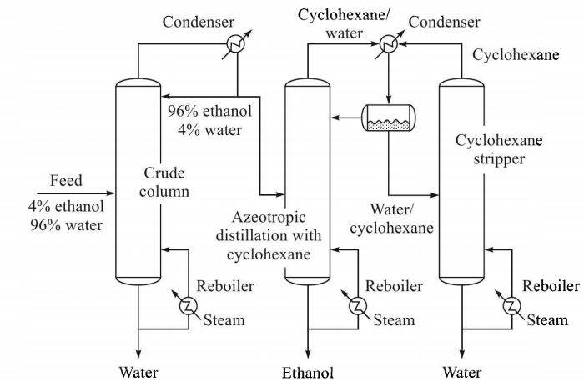

Slide 33
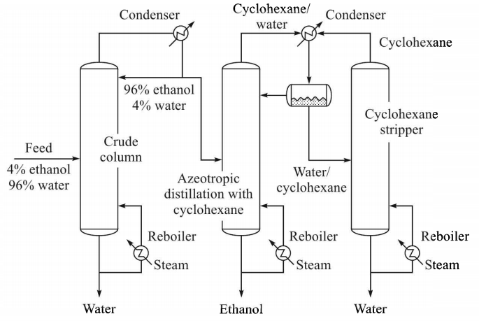

Slide 34
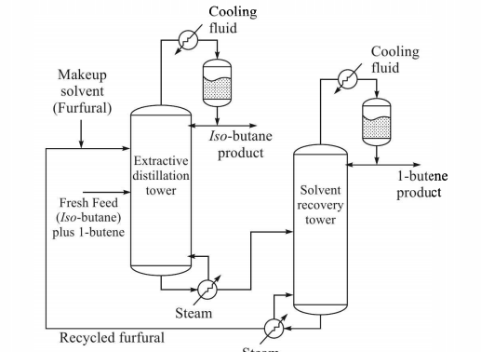
Extractive Distillation

Slide 35
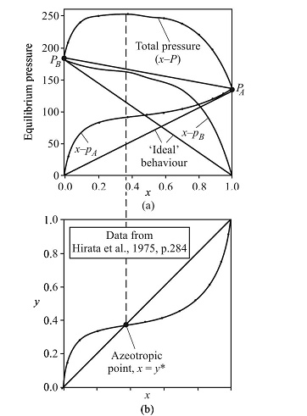
Minimum boiling azeotrope

Slide 36
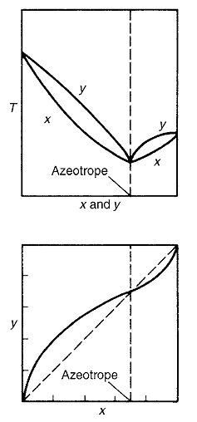

Slide 37
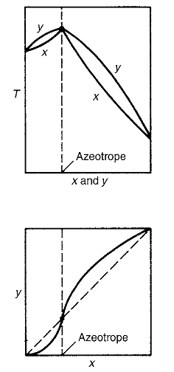
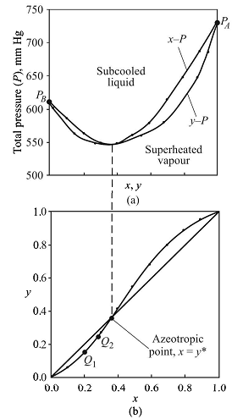
Maximum boiling azeotrope

Slide 38




Relative volatility
(concentration ratio of A to B in vapor divided by same ratio in the liquid )

Slide 39
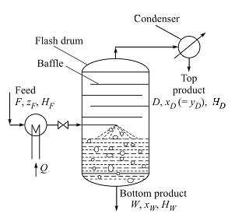
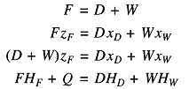


Slide 40
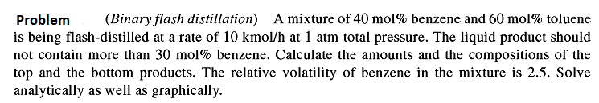

Slide 41
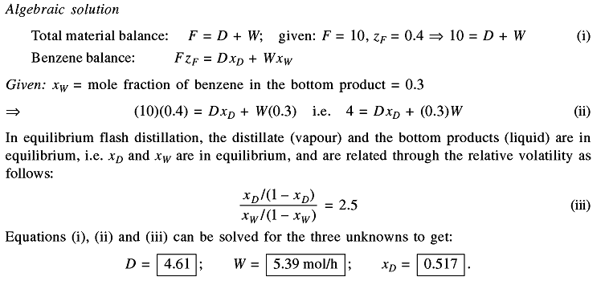

Slide 42
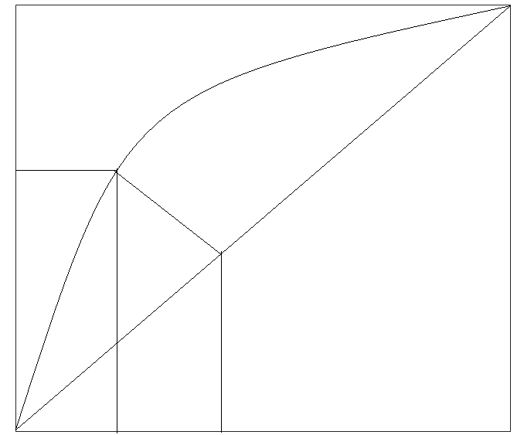
Graphical solution
Locate z_{F} and x_{W} on diagonal line,
a vertical line through x_{W}=0.3 is extended to meet the equilibrium line at P(0.3, 0.517). Join the F(0.4,0.4) and P point. Find the slope of FP line which equals to –(W/D)
x_{d}=0.517
P
-W/D
y
F(z_{F,} z_{F})
x_{W}=0.3
z_{F}=0.4
x

Slide 43
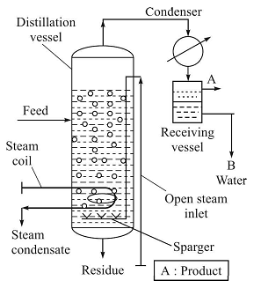


Slide 44




Slide 45
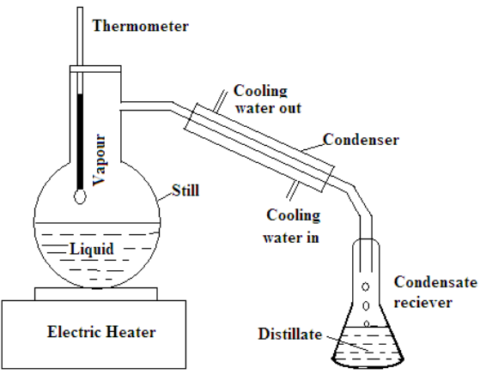

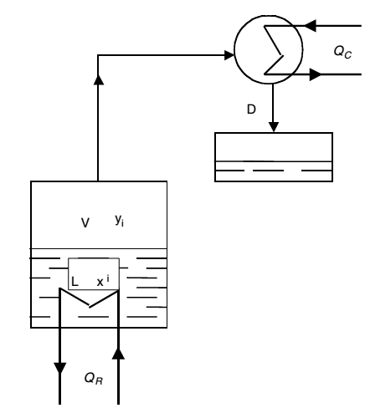




Batch distillation, Rayleigh distillation, Differential distillation
Originally, a large amount of L1 mole is present in the still. With composition x₁, Say at any time, there are L moles of liquid left in the still with composition x. Let small amount of dL is vaporized. The composition of liquid changes from x to x-dx and the amount of liquid from L to L-dL. The vapor phase composition of vapor forms is y*. The material balance gives
0

Slide 46
PROBLEM: A feed of 100 mol containing 50 mol% n-pentane and 50 mol% n-heptane is distilled under differential conditions at 101.3 kPa until 40 mol% is distilled. What is the average composition of the total vapor distilled and the composition of the liquid left? The equilibrium data for n-pentane is given as
x | 1.00 | 0.867 | 0.594 | 0.398 | 0.254 | 0.145 | 0.059 | 0
y | 1.00 | 0.984 | 0.925 | 0.836 | 0.701 | 0.521 | 0.271 | 0

Slide 47

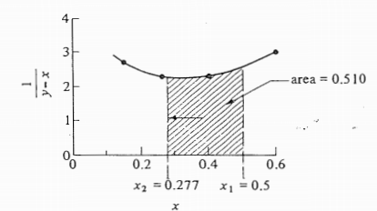

Slide 48
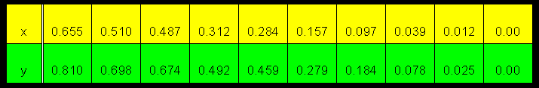
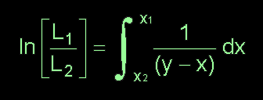
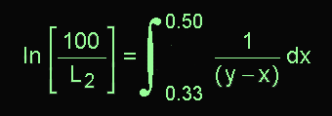
A 100-g-mole liquid mixture containing 50 mole% n-heptane and 50 mole% n-octane at 30 ºC is to be subjected to a differential distillation at atmospheric pressure.
The process is stopped when the mole fraction of MVC in the still reaches 0.33.
Determine the amount of composited distillate collected and its mole fraction, (i.e. y_{ave})
This is the problem of determining L₂ from known values (either given in the problem statement or can be calculated from the information given) of L₁ , x₁ and x₂ .
In this case, L₁ = 100 g-moles, x₁ = 0.50 (n-heptane, the MVC) and x₂ = 0.33
From the Rayleigh equation:
Putting in the known parameter, we have:

Slide 49
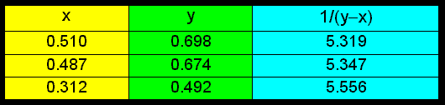
Plot the curve using the equilibrium data given: (see Note)
The RHS = the area under the curve 1/(y-x) bounded between x₁ and x₂ is 0.916. Thus, the LHS = ln (100/L₂) = 0.916.
Solving for L₂:
L₂ = 40.0 g-mole

Slide 50
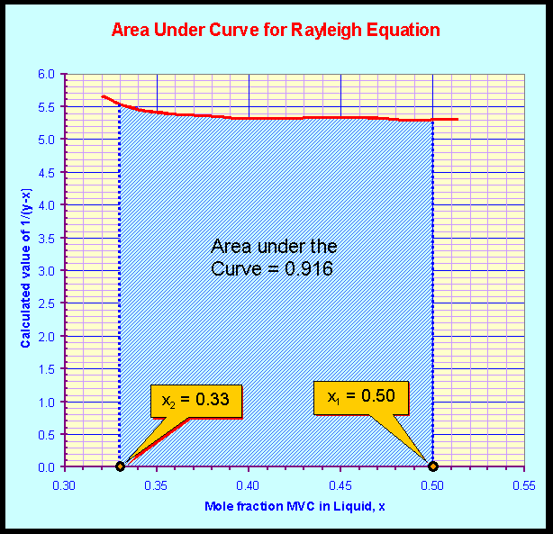

Slide 51

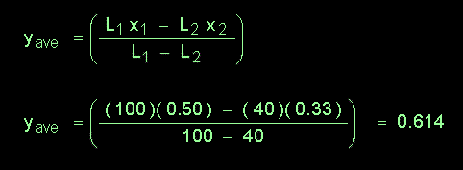
Average composition in the vapour distilled:
Putting in the numbers:

Slide 52
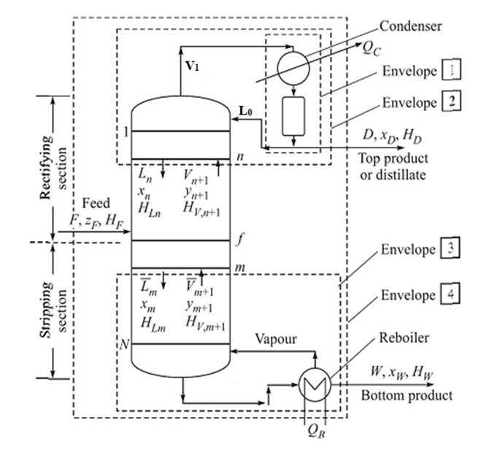
Continuous Multi-stage Fractionation of Binary Mixture

Slide 53

Enclosing the condenser and the reflux drum, Envelope 1

Slide 54

Enclosing a part of the rectifying section and the condenser, Envelope 2

Slide 55

Enclosing a part of the stripping section and the reboiler, Envelope 3

Slide 56

Enclosing the entire column, the condenser and reboiler, Envelope 4

Slide 57


Determination of no of ideal stages:
McCabe Thiele assumptions
Molar rate of overflow of liquid from one tray to another is constant in each section. By virtue of that the vapor flow rate from tray to tray will also be constant for each section

Slide 58


The Rectifying section
McCabe-Thiele assumption
This is the operating line equation of rectifying or enriching section

Slide 59




The Stripping section
For envelope 3
putting
This is the operating line equation of stripping section
Boil-up ratio =

Slide 60
The top section of a distillation column is called the rectifying section (or enriching section) because its primary function is to purify and enrich the more volatile (lighter) component in the vapor phase as it moves upward.
Vapor Enrichment in Light Component
  In the rectifying section, rising vapor interacts with descending liquid (reflux) in a series of equilibrium stages.
  Each stage allows the more volatile (low-boiling) component to concentrate further in the vapor phase.
Reflux Action
  A portion of the condensed overhead product is recycled back (reflux) into the column.
  This reflux provides a liquid flow that strips away heavier components from the vapor, ensuring only the lightest components reach the top.
Theoretical Plates Enhance Separation
  The trays/packing in this section act as equilibrium stages, progressively increasing the concentration of the desired light component.
To rectify the vapor by partial condensation of vapor and partial vaporization liquid

Slide 61
4. Final Purification Before Product Withdrawal
  By the time vapor reaches the top, it is maximally enriched in the more volatile component, ready for condensation as the distillate product.
Contrast with the Stripping Section (Bottom Part)
The stripping section (below the feed point) does the opposite: it removes light components from the liquid to enrich the less volatile (heavier) product in the bottoms.
Practical Example:
In a petroleum refinery, the rectifying section of a crude oil distillation column ensures that the lightest hydrocarbons (e.g., gasoline, naphtha) are separated and collected at the top, while heavier fractions (kerosene, diesel) are drawn from lower sections.

Slide 62
The bottom section of a distillation column is called the stripping section because its primary role is to "strip out" (remove) the remaining light (more volatile) components from the descending liquid, ensuring the bottom product is enriched in the heavy (less volatile) components.
Purpose: Removal of Light Components
  As liquid flows down the column, it interacts with rising vapor (often steam or reboiled vapor).
  Each tray or packing stage strips away traces of volatile components from the liquid, leaving behind a purer heavy product.
Reboiler’s Role
  The reboiler at the bottom heats the liquid, generating vapor that rises back up.
  This vapor carries away the last traces of light components, further purifying the bottom product.
Contrast with the Rectifying Section
  Rectifying section (top): Concentrates light components in the vapor.
  Stripping section (bottom): Concentrates heavy components in the liquid.
Industrial Example
  In a crude oil distillation column, the stripping section ensures that heavy residues (e.g., bitumen) contain minimal light hydrocarbons (e.g., methane, naphtha).
Why "Stripping"?
The term comes from the process of stripping away volatiles—like peeling off layers—until only the heaviest materials remain.
The remaining MVC will be stripped off from the liquid by partial vaporization and partial condensation

Slide 63
Role of Partial Condensation and Partial Vaporization in the Rectifying Section
The rectifying section (top part) of a distillation column relies on partial condensation and partial vaporization to achieve high-purity separation of the more volatile (lighter) component. Here’s how these processes work together:
1. Partial Condensation
As vapor rises, it cools slightly (due to heat loss or deliberate cooling). Some of the heavier components in the vapor condense into liquid.
Purpose: Enriches the remaining vapor in light components (since heavier molecules are removed as liquid). Provides reflux liquid that flows back down the column.
Example: In a methanol-water distillation, methanol (lighter) stays in the vapor phase, while water (heavier) partially condenses.
2. Partial Vaporization
The reflux liquid (from partial condensation) flows downward, contacting hot rising vapor. Heat from the vapor causes partial re-vaporization of the lightest components in the liquid.
Purpose: Strips residual heavy components from the liquid, further purifying it. Boosts the concentration of light components in the rising vapor.
Example: If the reflux contains traces of ethanol, partial vaporization recycles ethanol back into the vapor phase.

Slide 64
3.How They Work Together
The rectifying section functions as a countercurrent equilibrium cascade: Vapor rises, losing heavy components via partial condensation. Liquid descends, losing light components via partial vaporization.
Partial condensation removes heavies from vapor, enriching the distillate.
Partial vaporization removes lights from reflux, improving separation.
Together, they create a gradient of purity in the rectifying section.

Slide 65
Role of Partial Condensation and Partial Vaporization in the Stripping Section
The stripping section (bottom part) of a distillation column uses partial condensation and partial vaporization to remove residual light components from the liquid, ensuring the bottom product is enriched in the heavier components. Here's how these processes work:
1. Partial Vaporization (Primary Mechanism)
Liquid flowing down the column contacts hot vapor (from the reboiler or injected steam). Heat transfer causes light components in the liquid to partially vaporize.
Purpose: Removes traces of volatile components from the descending liquid. Ensures the bottom product contains mostly heavy components (e.g., water in ethanol-water distillation).
Example: In a crude oil column, steam strips residual naphtha (light) from heavy diesel.
2. Partial Condensation (Secondary Effect)
Rising vapor (from reboiler/steam) cools slightly as it moves up. Some heavy components in the vapor condense back into the liquid phase.
Prevents heavy components from escaping upward. Returns condensed heavies to the bottom product.
Example: In a methanol-water column, water vapor condenses back, ensuring only methanol rises to the rectifying section.

Slide 66
How They Work Together
The stripping section operates as a countercurrent purification stage:
Liquid descends, losing light components via partial vaporization.
Vapor rises, losing heavy components via partial condensation.
Result:
  Bottom liquid becomes pure in heavy components (e.g., >99% water).
  Vapor reaching the feed point is enriched in lights, ready for the rectifying section.
Key Parameters
Reboiler Duty: More heat = more vaporization = better stripping.
Steam Stripping: Injected steam lowers partial pressure, enhancing light-component removal.
Theoretical Trays: More trays improve separation efficiency.
Summary
Partial vaporization strips lights from liquid.
Partial condensation prevents heavies from rising.
Together, they ensure high-purity bottoms product.

Slide 67
Comparison with Rectifying Section
Process | Rectifying Section | Stripping Section
Goal | Purify vapor (light product) | Purify liquid (heavy product)
Main Mechanism | Partial condensation | Partial vaporization
Heat Source | Condenser (reflux) | Reboiler/steam
Key Output | Distillate (e.g., methanol) | Bottoms (e.g., water)

Slide 68

Problem

Slide 69





Slide 70





The Feed Line
Assuming enthalpy changes of streams across the feed plate is negligible

Slide 71






q is the ratio of increase in liquid due to addition of feed across the feed plate to the total feed. So, q can be termed as the feed quality or the fraction of liquid in the feed
If the point of intersection of operating lines of stripping and enriching section is say (x, y)
On adding
This is the operating line of feed line also

Slide 72






From total material balance
and divide both sides by F
Recalling the feed operating line
Divide both sides by F

Slide 73



Feed conditions

Slide 74


The bubble point of the feed 366.7 K
Tutorial

Slide 75




Slide 76


Tray Efficiency
Overall tray efficiency
Murphree Tray efficiency

Slide 77




Total Reflux

Slide 78







Fenke’s Equation for Minimum no. of Trays at Total Reflux
Because
(Related by operating line which lie on diagonal line)
Because
Here N_{m} is total no of ideal stage inside the column and there is a total reboiler which is not considered as ideal stage

Slide 79



Minimum Reflux Ratio

Slide 80


Two exceptional cases for R_{min}

Slide 81


Tutorial

Slide 82


Column with multiple feed and side stream

Slide 83


Distillation column with multiple feed and side withdrawals

Slide 84


Determine

Slide 85



Slide 86

Multistage batch distillation with reflux

Slide 87



Constant reflux
If W_{i} and W_{f} are the initial and final amount of liquid present in the still, then
In batch distillation no continuous feed is given but liquid is continuously evaporated.
So composition of W_{i} and W_{f} both will be decreasing i. e., x_{D} and x_{W}

Slide 88


Slide 89






Slide 90


Slide 91


Slide 92


Steam Distillation
Applicable for separation of component A (low volatile, immiscible with water) from
mixture of A and B, where B is slightly volatile non-volatile
When two liquids are immiscible the total pressure is the sum of vapour pressure of
individual vapor pressure of each liquid.
The bubble point of the mixture will be lower than the boiling point of both the liquids.

Slide 94

Enthalpy concentration diagram

Slide 95


Slide 96


Slide 97

Ponchon-Savarit method

Slide 98




Slide 99








The Enriching Section

Slide 100

27/3/23

Slide 101



Operating line of enriching section
Putting n=0

Slide 102


Slide 103

Put n=0

Slide 104









The Stripping Section
Where,

Slide 105



…The Stripping Section

Slide 106


Slide 107





Slide 108


Slide 109


Slide 110

Minimum Reflux Ratio

Slide 111


Slide 114


Slide 115
Reboiler energy balance:

Slide 116


Slide 119
Put n = 0

Slide 120


Slide 124


