Slide 1
CL215 MTO-I
Gas-LIQUID Contact
Module 3

Slide 2
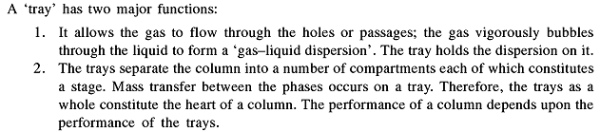
The stage and the Tray
Stage: any device or combination of devices in which two immiscible phases are brought into intimate contact in order to achieve mass transfer of one or more components from one phase to another is called ‘Stage’

Slide 3
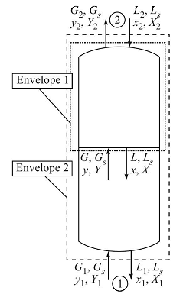
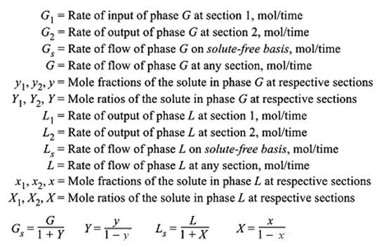
Gas liquid contact operation

Slide 4



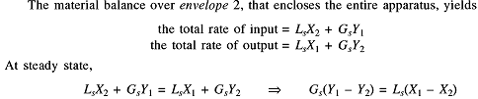

Material balance of counter current gas-liquid operation-solute free basis and mole ratio unit
Envelope 1
This is the equation of operating line

Slide 5
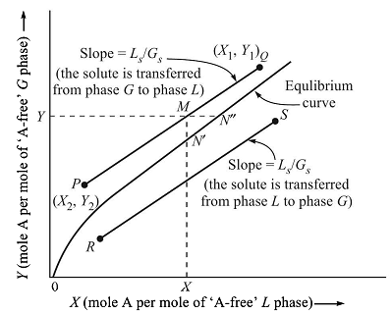

Slide 6

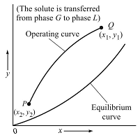
Material balance of counter current gas-liquid operation-total gas flow and mole fraction unit

Slide 7
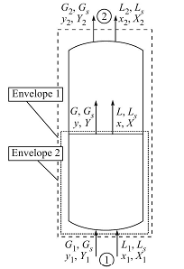
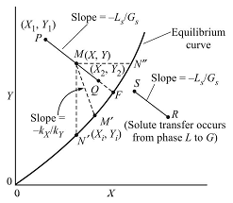
Steady state co-current process
Equilibrium line is the locus of M’

Slide 8
PROBLEM
Tutorial
It desired to absorb 90% of the acetone from a gas containing 1.0 mol% acetone in air in a counter current tray tower. The total inlet gas flow to the tower is 30.0 kmol/h, and the total inlet pure water flow to be used to absorb the acetone is 90 kmol H₂O/h. The process is to operate isothermally at 300 K and 1 atm. Pressure. The equilibrium relation for acetone in the gas-liquid is y_{A} = 2.53x_{A}. Determine the number of theoretical stages required for this separation.

Slide 9
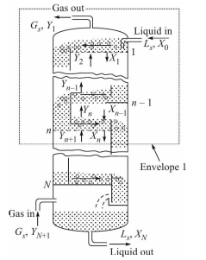
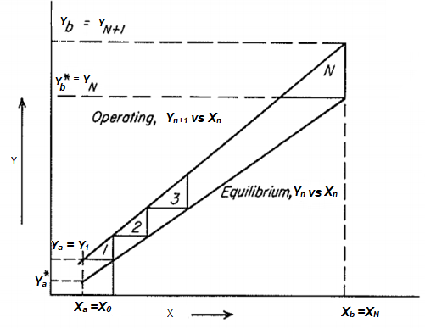

Multi stage counter-current process

Slide 10















Kremser-Brown-Souder equation

Slide 11









Slide 12
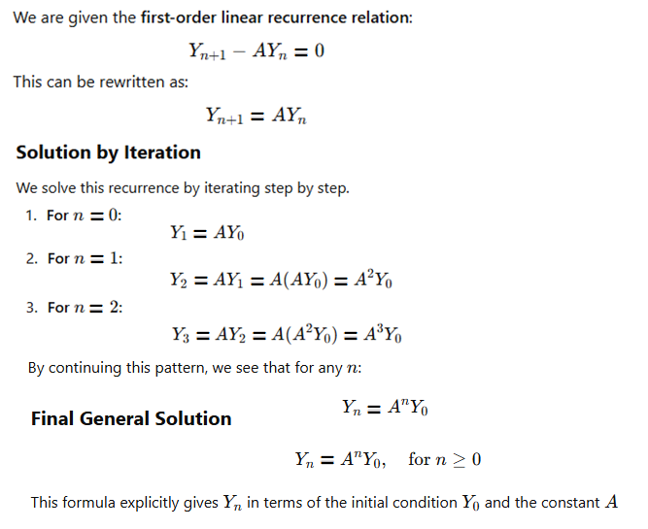

Slide 13







Slide 14




Slide 15






Slide 17
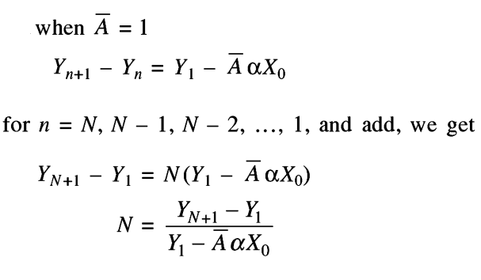
Kremser equation for the condition when operating line and equilibrium line are straight and parallel i.e., both are having same slope

Slide 18
Determination of ideal no. of stages in counter current contact

Slide 19
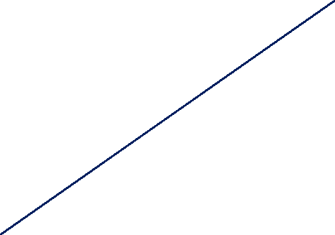
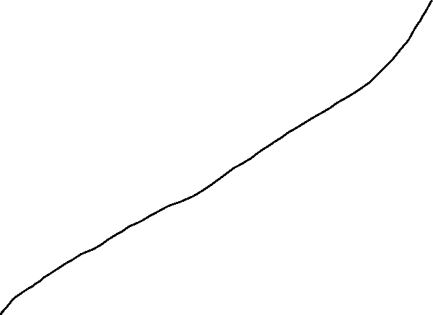
Determination of ideal no. of stages in counter current contact

Slide 20
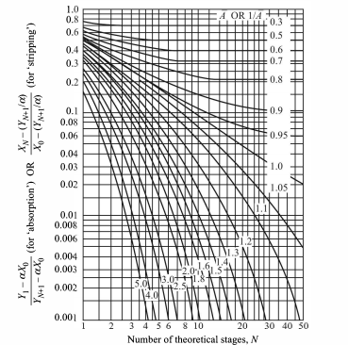
Kremser chart

Slide 21
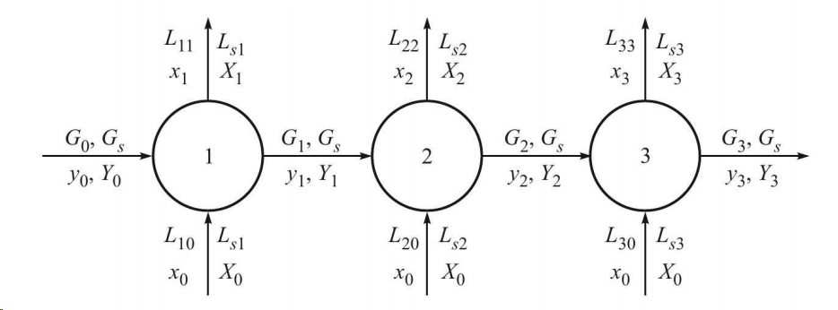
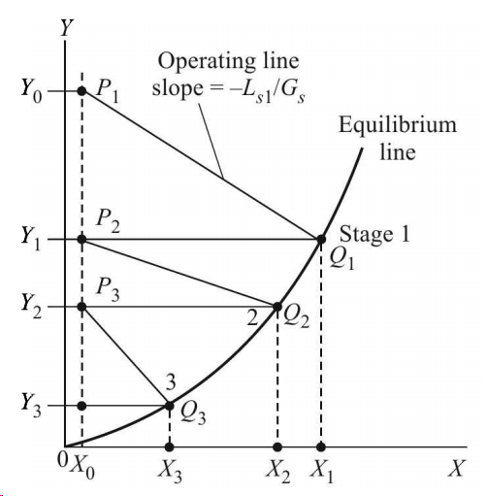
No. of ideal stage in cross-current operation

Slide 22
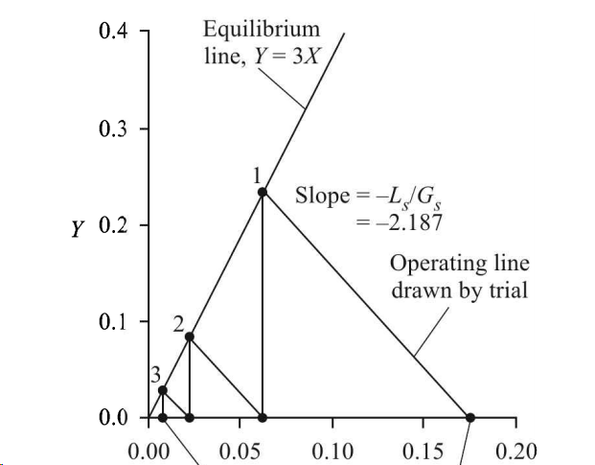
Cross-current stripping

Slide 23
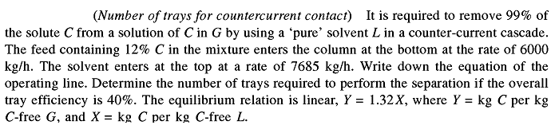
Problem

Slide 24
Selection of solvent and stripping medium
Home work/self study

Slide 25

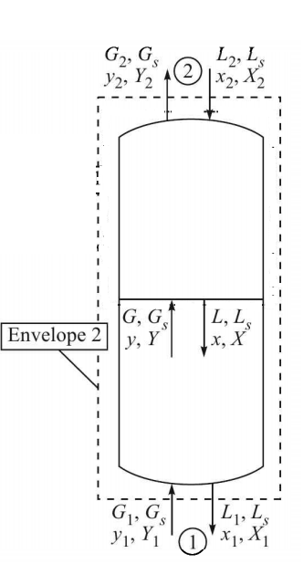
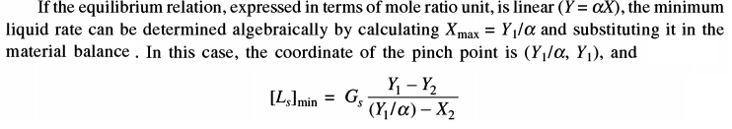
Minimum Liquid Rate for Absorption
Material balance
In designing an absorption column generally these data are given
G_{s}
Y₁
Y₂
X₂
we have two unknowns L_{s} and X₁
Actual L_{s} will be (1.2 to 2) times of the L_{smin}

Slide 26
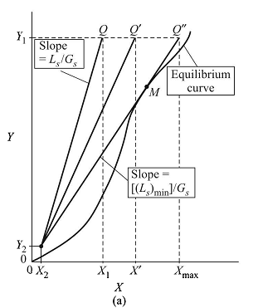
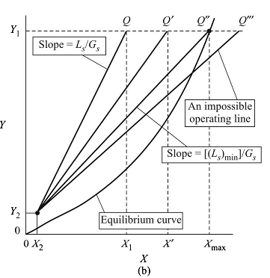

Slide 27
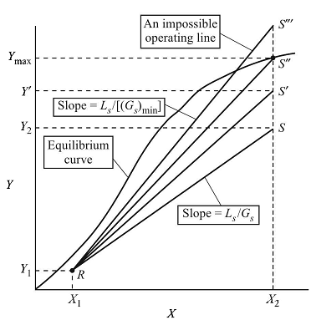
Minimum gas or steam rate for stripping operation
Unknowns are G_{s} and Y₂

Slide 28
Problem
A binary gas mixture with solute concentration of mole ratio 0.001 has to be absorbed by a fresh solvent. The final gas concentration is limited to 0.0004 mole ratio. The gas flow rate is 6 kmol/hr in solute free basis. Find the minimum liquid flow rate. If the operational liquid rate is 1.5 times of the minimum, find the no. of ideal stage for this operation. The equilibrium relation is given by
X | 0 | 0.002 | 0.004 | 0.006 | 0.008 | 0.01 | 0.012 | 0.014 | 0.015 | 0.016 | 0.018 | 0.02 | 0.022 | 0.024 | 0.025
Y | 0 | 0.000173 | 0.000327 | 0.000464 | 0.00058 | 0.00068 | 0.00076 | 0.00083 | 0.00085 | 0.00087 | 0.0009 | 0.00091 | 0.0009 | 0.00087 | 0.00085

Slide 29

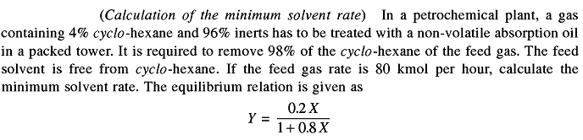

Slide 30
Problem
Tutorial
An oil containing 2.50 mole per cent of a hydrocarbon is stripped by running the oil down a column up which live steam (solute free) is passed. The feed rate is 50 kmol/h on solute free basis. Determine the number of theoretical plates required to reduce the hydrocarbon content to 1.0 mole per cent, taking actual gas rate as 1.5 times of the minimum and assuming that the oil is non-volatile. The gas–liquid equilibrium relation of the hydrocarbon in the oil is given by y = 33x, where y is the mole fraction in the gas and x the mole fraction in the liquid. The temperature is maintained constant by internal heating, so that steam does not condense in the tower.

Slide 31
GAS-LIQUID Contact
The liquid is dispersed in the form of droplets or discontinuous films in a continuous gas phase (example: spray tower , packed tower ,venturi scrubbers, etc.)
The gas is dispersed in liquid in form of bubbles (e.g. tray tower, bubble column, agitated column etc).
Sometimes both gas and liquid phases are continuous (for example, “a falling film contactor” which is used for gas-liquid reactions ).
Tray and packed columns are most widely used for gas – liquid contacting for gas absorption, stripping, distillation.
These are also used for liquid-liquid extraction

Slide 32
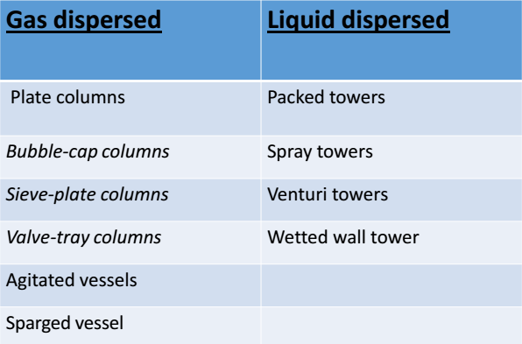

Slide 33
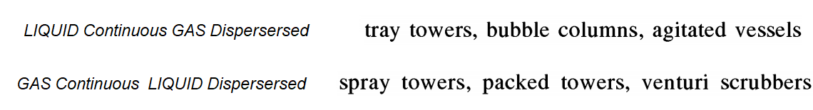
Column INTERNALS
Gas-liquid, vapor-liquid, Liquid-liquid contact etc

Slide 34
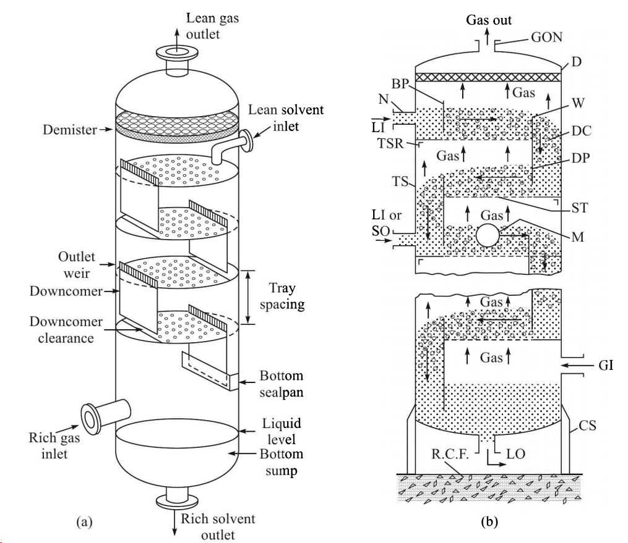
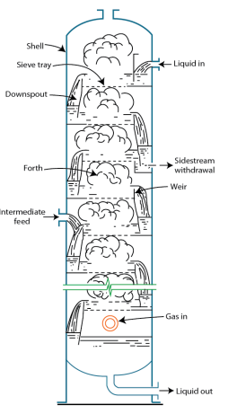
The TRAY Column
THE SHELL

Slide 35
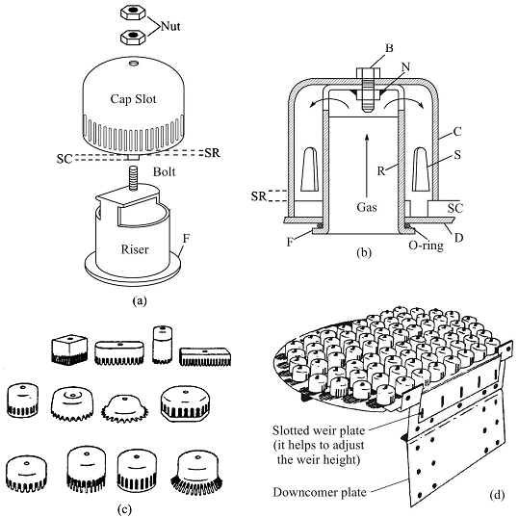
TRAY: bubble cap tray (Diameter: 1-6 inches)

Slide 36
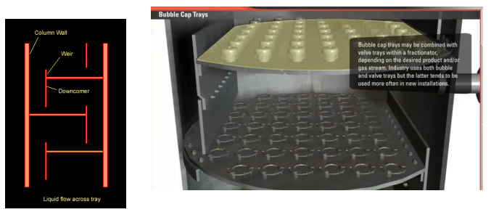
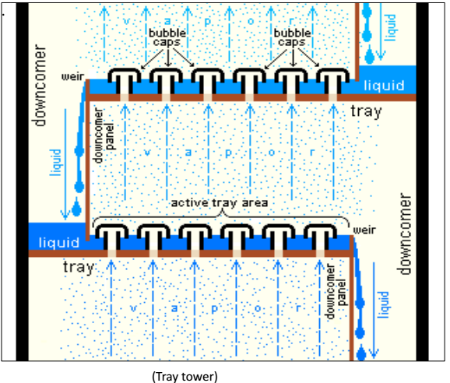
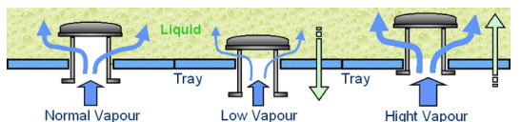

Slide 37
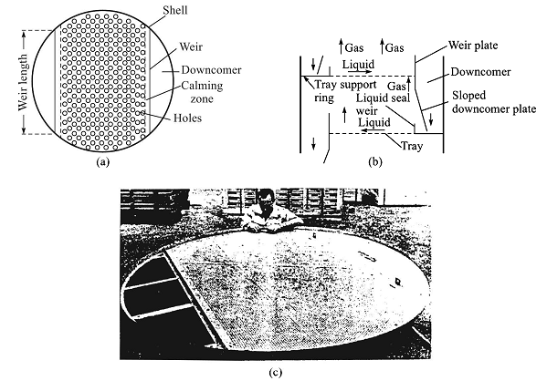
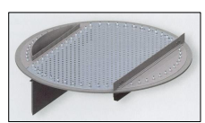
The sieve tray (Diameter: 1/8 to ½ inch )
Pitch distance= 2.5d_{H} – 5d_{H} , normally 3.8d_{H}
Free area= 6-10%
Free area= hole area/tower C/S

Slide 38
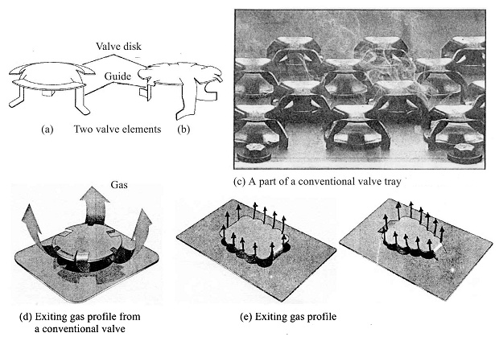
The valve tray
12 to 16 valves per ft²
Orifice: 1.5 and 2 inch
Disk rise 3/16 to 7/16 inch
10-15 % active tray area

Slide 39
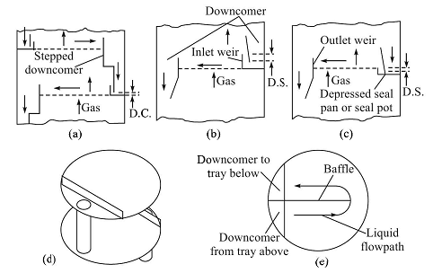
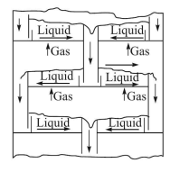
Downcomers and Weirs

Slide 40
Weir
❑ The function of a weir is to maintain a desired liquid level on the tray.
❑ Typical weir height is between 2 to 4 inch. Low weirs are frequently used in low pressure column.
❑ Notched weir are commonly used for low liquid loads.
❑ The higher the liquid level, the higher the tray pressure drop. Higher liquid level also imply more liquid hold up on the tray, which may be undesirable if the liquid is toxic or hazardous.
❑ The weir length may vary from 60 to 80% of the tower diameter.

Slide 41
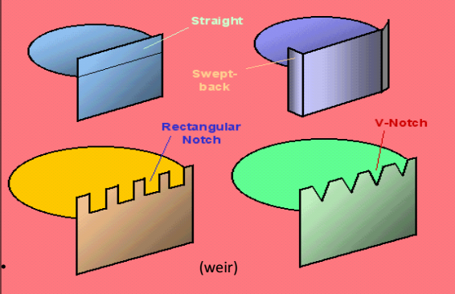

Slide 42
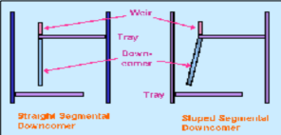
Downcomer
Downcomer are used to guide liquid flow from an upper tray to a lower tray.
The liquid, along with some dispersed gas or vapour bubbles, overflows the weir and enters the downcomer.
The Downcomer must provide sufficient residence time for gas-liquid disengagement.
The ‘clear liquid’ velocity in the downcomer normally ranges between 0.3 to 0.5 ft/s.
The downcomer plate may be straight or inclined

Slide 43
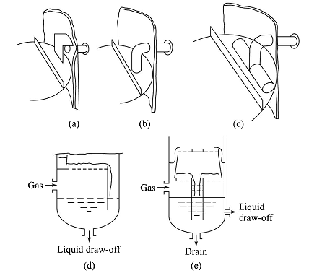

Slide 44

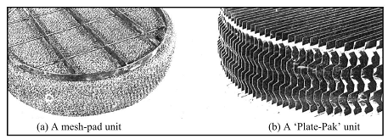
MIST ELEMINATOR

Slide 45
Problems related to tray tower:
Entrainment:
❑ When a gas bubbles through the liquid pool vigorously, droplets of liquid are formed in the vapour space by quite a few mechanisms including shearing action of the gas jet of the liquid film as a gas bubble bursts.
❑ Depending upon the size of a droplet, its velocity of projection and the drag force action on it due to the gas velocity, the droplet may descend back into the liquid on the tray or may be carried into the tray above.
❑ The phenomenon of carry over of the suspended droplets into the upper tray is called ‘ entrainment’.
Flooding:
❑ When the liquid flowrate is very high, in comparison with gas flowrate the liquid fills the downcomer as well as an entire tray space and eventually the entire column. This phenomenon is called ‘ flooding’.

Slide 46
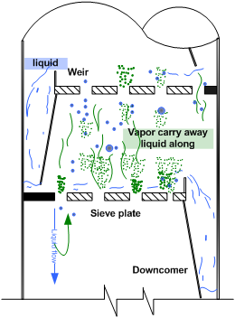
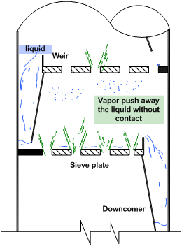
Priming:
Priming is an exaggerated condition of liquid entrainment. Due to high gas flowrate, liquid from the bottom trays are carried away along with the gas to the top tray. This phenomenon is called ‘priming’.
Coning:
❑ Coning in a tray tower occurs due to low liquid flowrate when compared to gas which results in pushing of the liquid away from the tray opening.

Slide 47
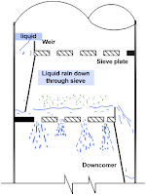
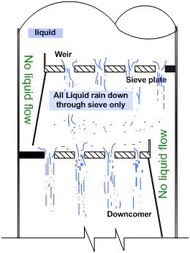
Weeping:
❑ If a very small fraction of the liquid flows from a tray to lower one through perforation or openings of the tray, the phenomenon is called ‘ weeping’.
❑ Weeping causes some reduction of the tray efficiency. Weeping occurs at low gas flowrate compared to liquid flowrate.
Dumping:
When the gas flow rate is very low, in comparison to liquid flow rate, liquid flows from a tray opening without entering into downcomer. This phenomenon is called ‘ dumping’.

Slide 48
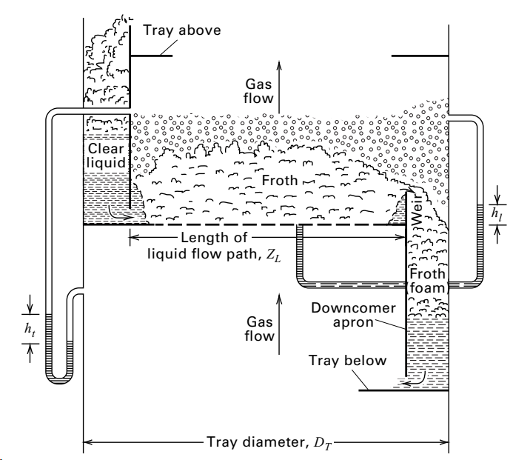
OPERATIONAL FEATURES OF A TRAY COLUMN
As vapor passes up through a column, its pressure decreases. Vapor pressure drop in a tower is from 0.05 to 0.15 psi/tray (0.35 to 1.03 kPa/tray).
The total pressure drop (head loss), h_{t}, for a sieve tray is due to: (1) friction for vapor flow through dry tray perforations, h_{d}; (2) holdup of
equivalent clear liquid on the tray, h_{l} (= ℎ_{𝑤𝑐} + ℎ_{𝑤} ); and (3) a loss due to surface tension, h_{r}
ℎ_{𝑡} = ℎ_{𝑑} + ℎ_{𝑤𝑐} + ℎ_{𝑤} + ℎ_{𝑟}
Where, ℎ_{𝑑} =dry plate pressure drop, mm
ℎ_{𝑤𝑐} =height of liquid over weir (weir crest), mm ℎ_{𝑤} =weir height, mm ℎ_{𝑟}=residual head, mm

Slide 49
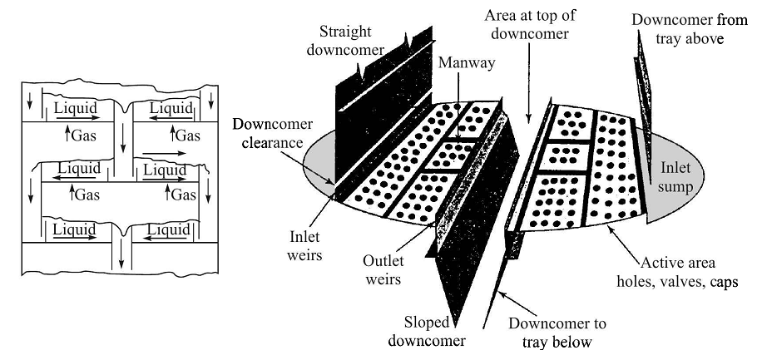

Slide 50

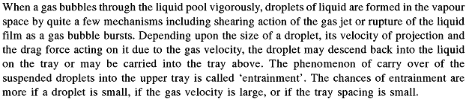


Slide 51
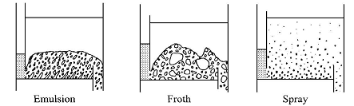



Slide 52




Slide 53


Slide 54



Slide 55


Slide 56



Slide 57

The Packed Tower
The Shell

Slide 58


Packings

Slide 59


Slide 60


Slide 61



Slide 63
SELF STUDY

Slide 64




Slide 65

Packed column diameter

Slide 67


Slide 68


Design of a Packed Tower
Steps
Items and variable to be known

Slide 69


Material balance in packed tower
G՜ and L՜ are having unit total mol/time area
The rate of flow of the solute (including carrier gas) = G՜y mol/time.area
The change in the solute flow rate over the section= d(G՜y)
If N_{A} be the local flux and k_{y} is the individual gas-phase mass tr. coefficient
The interfacial area of contact for mass transfer in the differential section = ($\overline{\text{a}}$)(1)(dh)
Rate of mass transfer of the solute = ($\overline{\text{a}}$)(1)(dh)(N_{A})
mass balance over the section with thickness dh
= ($\overline{\text{a}}$)(1)(dh)(N_{A}) = - d(G՜y) = - G՜dy - y dG՜
Since the carrier gas is insoluble, the change in the total gas flow rate will be,
-dG՜ = ($\overline{\text{a}}$)(dh)(N_{A})

Slide 70





Design method based on gas phase Mass transfer coefficient
Alternative forms
We can find the height of the packed bed column by following method discussed in next page

Slide 71


a) Draw the equilibrium line using mole fraction unit, x-y plane
(b) Convert the mole ratio data on the opearting line to mole fraction data and draw the curved operating line on x-y plane. Use the given material balance equation:

Slide 72


(B. K Dutta)

Slide 73

ASSIGNEMNT- Problem on design of packed bed
MTO Book BK Dutta pp. 271

Slide 74




Design method based on Overall Mass transfer coefficient
Putting N_{A} in terms of overall gas –phase mass transfer coefficient

Slide 75






Design method based on Height of a Transfer unit and Number of transfer unit

Slide 76

HTU and NTU with various Driving Force

Slide 77



Slide 78



Simplified Design Procedure for Dilute Gases

Slide 79




Slide 80

Design equation for Concentrated Gases

Slide 81
HETP
Total height of Packing = HETP × No. of Theoretical Plate

Slide 82








