Slide 1
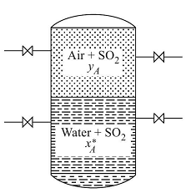
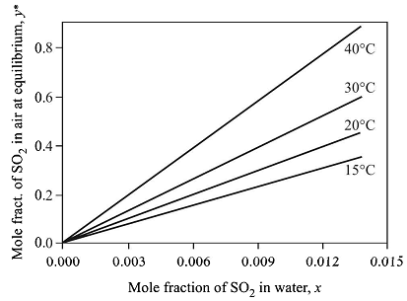
CL215 MTO-I Module 2 Interphase mass transfer
Drying of air by conc. sulfuric acid in sulfuric acid plant
Extraction of aromatics by sulfolane solvent
Aeration of pool of water in aquarium
Equilibrium between phases

Slide 2


Phase rule for gas liquid contact
F= C-P + 2 = 3-2+2= 3
Temp, pressure, y_{A} and x_{A} are the four variable of this system. Define any three the 4th one will be automatically fixed.
Raoult’s law: for ideal gas-liquid mixture
Henry’s law: for non-ideal gas-liq. mixture at low concentration

Slide 3
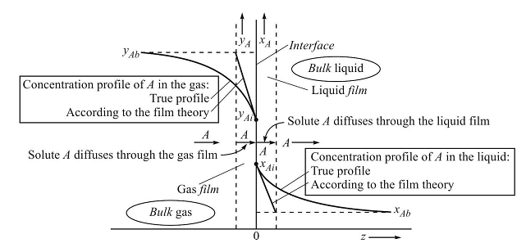
Concentration profile

Slide 4


Slide 5
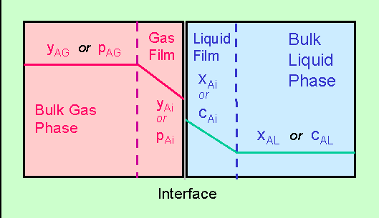
Two film theory

Slide 6
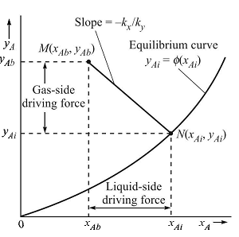

Determination of interfacial concentrations

Slide 7
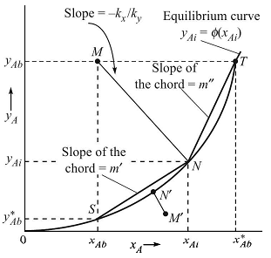



Overall mass transfer coefficient

Slide 8
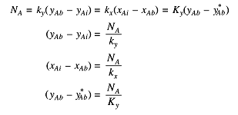

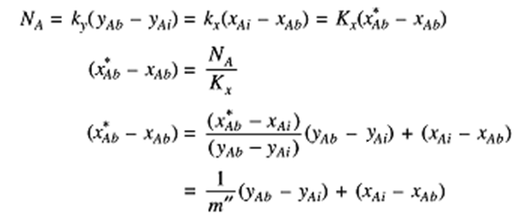

Slide 9
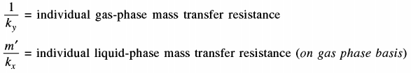

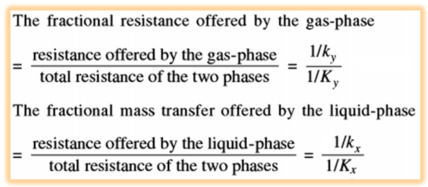

Slide 10
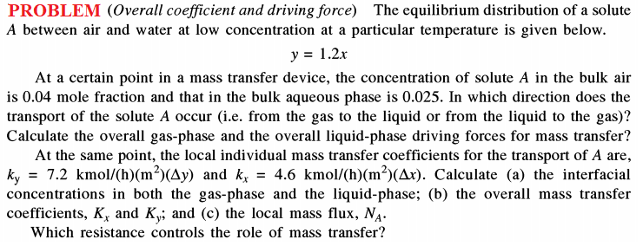
Tutorial

Slide 11
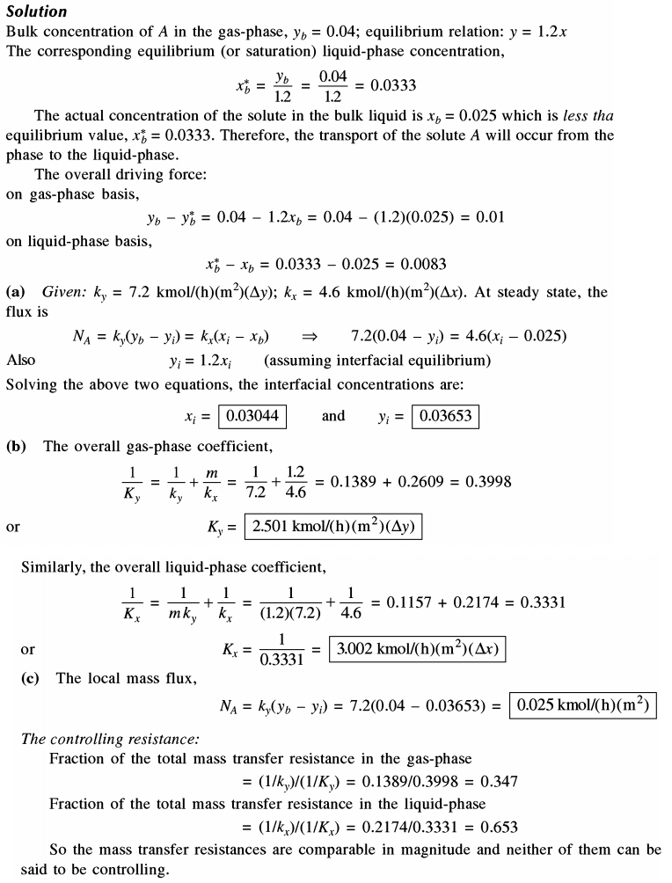

Slide 12
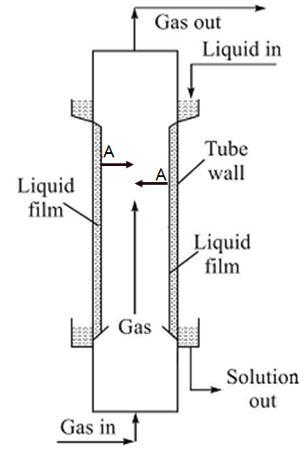

Mass transfer coefficient: Wetted Wall Column
Mass transfer from flowing gas to falling liquid film is common in gas absorption in a packed tower. A wetted wall column is essentially a vertical tube with means of admitting liquid at the top and causing it to flow downwards along the inside wall of the tube, under the influence of gravity and the gas is to flow through the inside of the tube, where it flows through the tower in contact with the liquid. In absence of ripple formation at the liquid surface, the interfacial area, A, is known and the form drag is absent.
The correlation for wetted wall column mass tr. coefficient

Slide 13
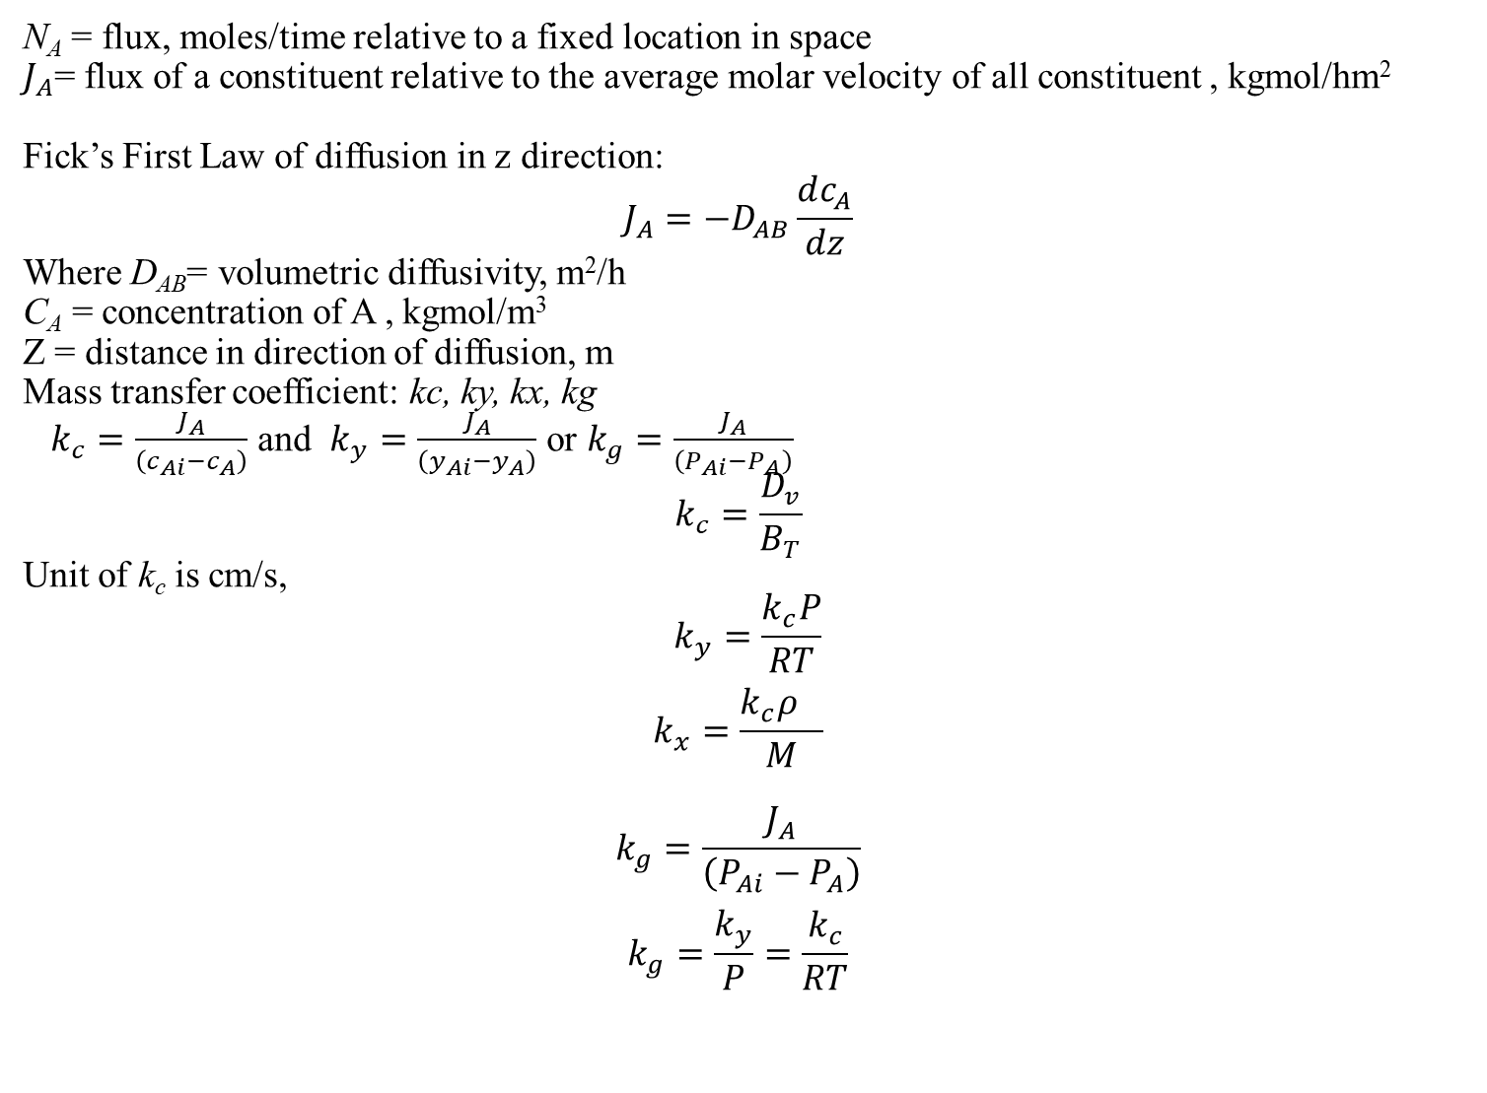
N_{A} = flux, moles/time relative to a fixed location in space
$J_{A}$= flux of a constituent relative to the average molar velocity of all constituent , kgmol/hm²
Fick’s First Law of diffusion in z direction:
$$J_{A}=−D_{AB}\frac{dc_{A}}{dz}$$
Where D_{AB}= volumetric diffusivity, m²/h
C_{A} = concentration of A , kgmol/m³
Z = distance in direction of diffusion, m
Mass transfer coefficient: kc, ky, kx, kg
$k_{c}=\frac{J_{A}}{\left(c_{Ai}−c_{A}\right)}$ and $k_{y}=\frac{J_{A}}{\left(y_{Ai}−y_{A}\right)}$ or $k_{g}=\frac{J_{A}}{\left(P_{Ai}−P_{A}\right)}$
$$k_{c}=\frac{D_{v}}{B_{T}}$$
Unit of k_{c} is cm/s,
$$k_{y}=\frac{k_{c}P}{RT}$$
$$k_{x}=\frac{k_{c}ρ_{}}{M}$$
$$k_{g}=\frac{J_{A}}{\left(P_{Ai}−P_{A}\right)}$$
$$k_{g}=\frac{k_{y}}{P}=\frac{k_{c}}{RT}$$

Slide 14
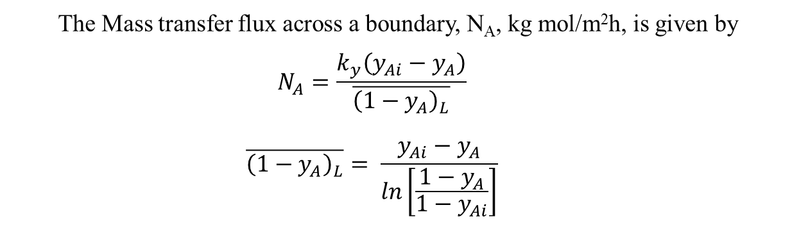

Let , a = humidity at inlet b = humidity at outlet.
Mass transfer area, $A=πdL$
$$N_{A}=\frac{Mass flowrate of air×(b−a)}{18 x A}$$
Determination of Average y_{Ai}
Determine Vapour pressure of water at inlet and outlet temperatures, T₁ and T₂ as P₁ and P₂ $y_{\begin{aligned}Ai \\ \end{aligned}}=\frac{P_{1}+P_{2}}{2P_{total}}$
$$y_{A inlet}=\frac{a/{18}}{a/{18}+1/{29}}$$
$y_{A outlet}=\frac{b/{18}}{b/{18}+1/{29}}$
The Mass transfer flux across a boundary, N_{A}, kg mol/m²h, is given by $$N_{A}=\frac{k_{y}\left(y_{Ai}−y_{A}\right)}{\overline{{\left(1−y_{A}\right)}_{L}}}$$
$$\overline{{\left(1−y_{A}\right)}_{L}}= \frac{y_{Ai}−y_{A}}{ln\left[\frac{1−y_{A}}{1−y_{Ai}}\right]}$$

Slide 15
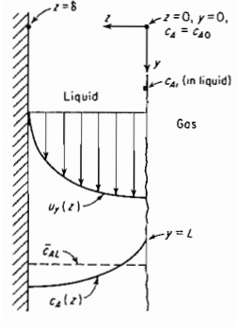

Slide 16
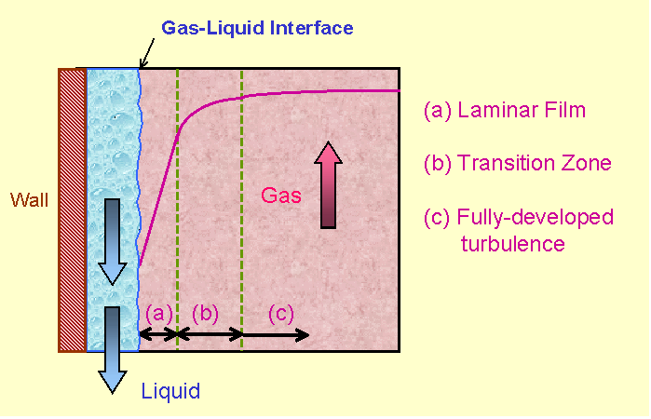
Film theory

Slide 17
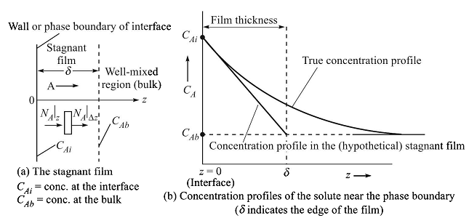
Film theory (Whitman, 1923)
Mass transfer occurs by pure molecular diffusion through a stagnant fluid layer at the phase boundary (the wall). Beyond this film, the fluid is well-mixed having a concentration which is the same as that of the bulk fluid i.e., C_{AB}.
Mass transfer through the film occurs at steady state.
The bulk flow term (N_{A} + N_{B})C_{A}/C in Fick’s 1st law is small. So, the flux can be written as N_{A} = -D_{AB}(dC_{A}/dz). This is valid for the low flux and the mass transfer occurs at lower concentration.

Slide 18
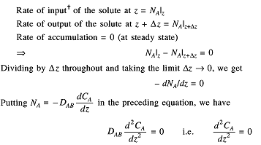


The film theory predicts the linear relation of mass tr. Coefficient with diffusivity but in reality, for a turbulent fluid, k_{L} varies as (D_{AB})^{n} where n varies from 0 to 0.8.
This theory is unable to deduce mass tr. coefficient because film thickness can not be determined experimentally. This theory has been extremely useful in the analysis of mass transfer accompanied by a chemical reaction.

Slide 19
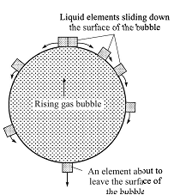
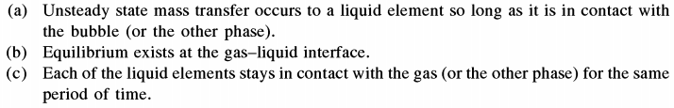
The penetration theory (Higbie, 1935)

Slide 20






Fresh liquid element coming from the bulk and just attached to the bubble
Equilibrium at the interphase
Infinite thickness of the element
Solving the equation using similarity variable, η

Slide 21

Surface renewal theory, Danckwarts, 1951
Danckwarts’s assumptions includes the distribution of age of liquid elements present at the interphase at any time
The model parameter of this theory is the fractional rate of surface renewal, s which is expressed as the fraction of the surface area renewed in unit time

Slide 22
Theory | Assumption | Mass Transfer Mechanism | Key Limitation
Film Theory (Whitman 1923) | Stationary film at interface | Steady-state diffusion | Ignores turbulence effects
Penetration Theory (Higbie, 1935) | Elements exposed for fixed time | Unsteady-state diffusion | Does not consider varying exposure times
Surface Renewal Theory (Danckwerts, 1951) | Random renewal of surface elements | Diffusion + surface turbulence | Requires knowledge of renewal rate (λ\lambda)

Slide 23
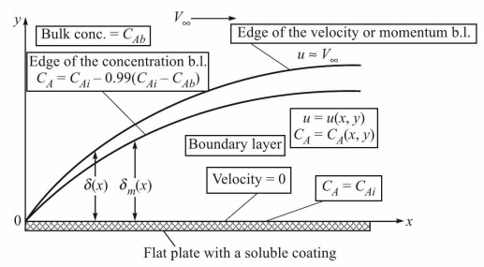


The Boundary Layer Theory
= 3×10⁵
Local Sherwood no.
Average Sherwood no.

Slide 24
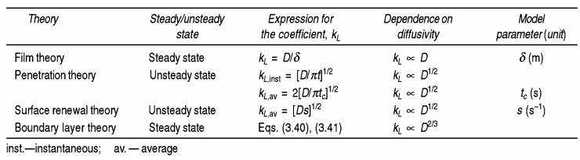

Slide 25
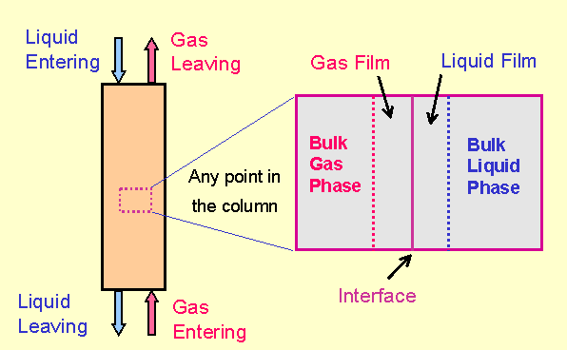

Slide 26











Analogy b/w Momentum, Heat and Mass transfer

Slide 27
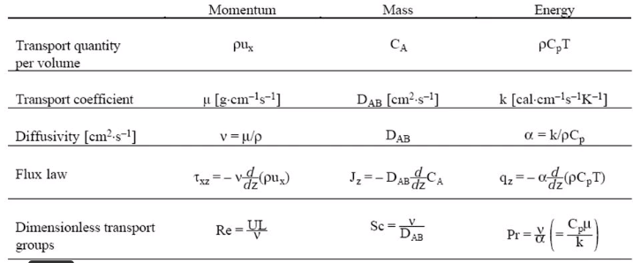
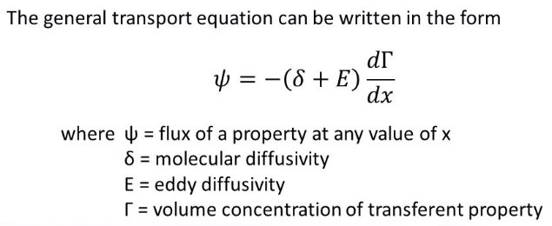

Slide 28
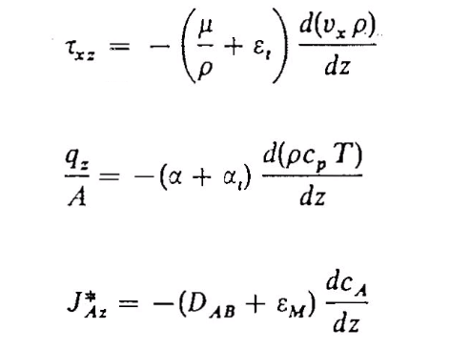
Turbulent transport equations

Slide 29













Slide 30




















Slide 31











Slide 32






Slide 33




Slide 34


Slide 35






















Slide 36
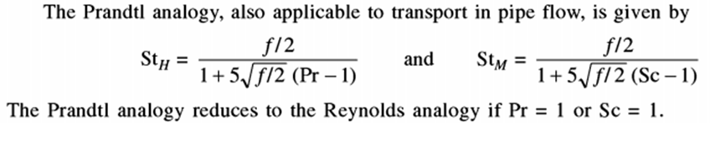
Prandtl analogy

Slide 37


Colburn analogy
This is the analogy based on experimental data for gases and liquids for turbulent and
laminar flow. It is also valid for flow past a flat plate.
For flow past a flat plate or flow in a pipe where no form drag is present, then f/2 = j_{H}= j_{D}
When form drag is present as flow in packed bed, then f/2 > j_{H} or j_{D} and j_{H} and j_{D} are close.
If HTC is known for a system in a given condition characterized by Reynold’s no. then MTC for the same system with same Re can be derived by putting j_{H}= j_{D}

Slide 38
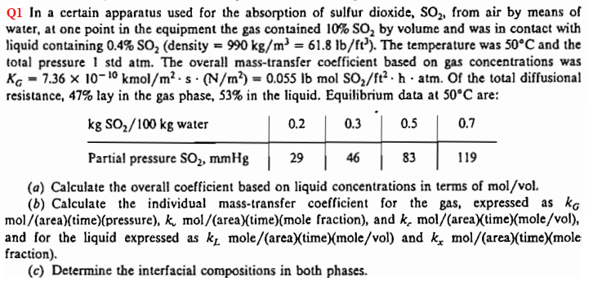
In a certain apparatus used for the absorption of sulfur dioxide, SO2 from air by means of
water, at one point in the equipment the gas contained 10% SO2 by volume and was in contact with liquid containing 0.4% SO2( density 990kg/m³). The temperature was 50°C and the total pressure 1 std atm. The overall mass transfer coefficient based on gas phase concentration was K_{G}=7.36×10⁻¹⁰kmol/m²s Pa. Of the total diffusional resistance, 47% lay in the gas phase, 53% in the liquid. Equilibrium data at 50°C are

Slide 39
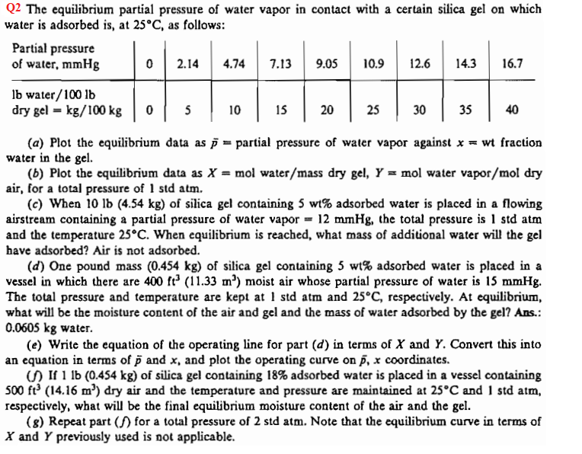

Slide 40
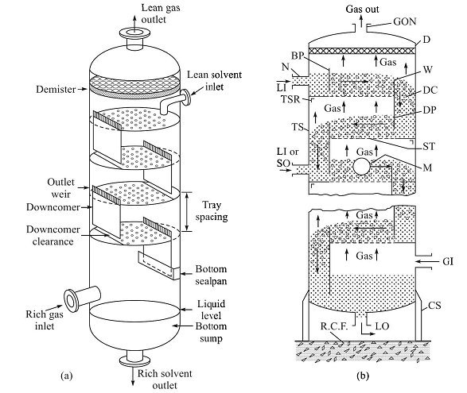
Column internals:Plate tower

Slide 41
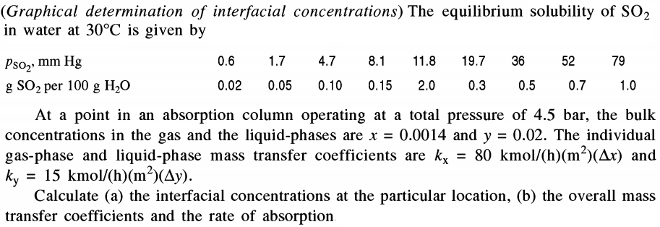

Slide 42
