Slide 1
CL 355 Petrochemicals technology
Module 2
AROMATIC COMPLEXES

Slide 2
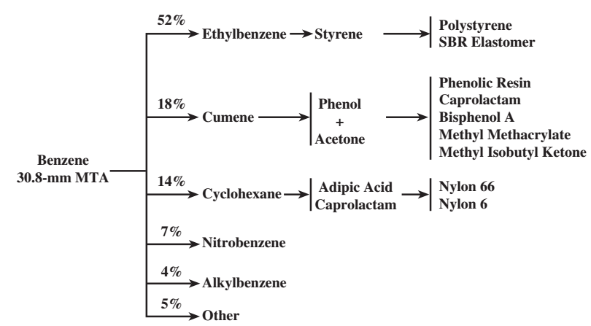
Benzene block
An aromatics complex is a combination of process units that can be used to convert petroleum naphtha and pyrolysis gasoline (pygas) into the basic petrochemical intermediates: benzene, toluene, and xylenes (BTX). Benzene is a versatile petrochemical building block used in the production of more than 250 different products. The most important benzene derivatives are ethylbenzene, cumene, and cyclohexane
aniline production, leading to dyes
Used mainly in detergents.

Slide 3
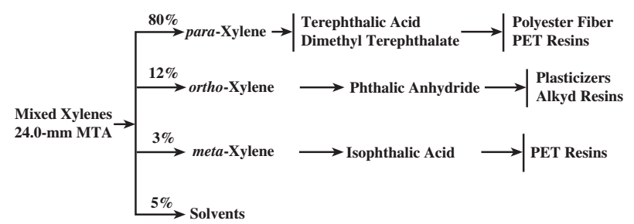
Xylene block

Slide 4
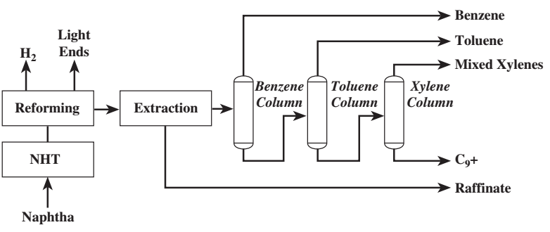
Aromatics from naphtha
NHT- naphtha hydrotreating

Slide 5
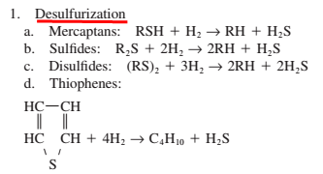
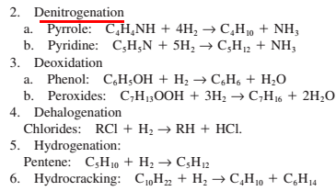
HYDROTREATING : REACTIONS
The main hydrotreating reaction is that of desulfurization but many others take place

Slide 6
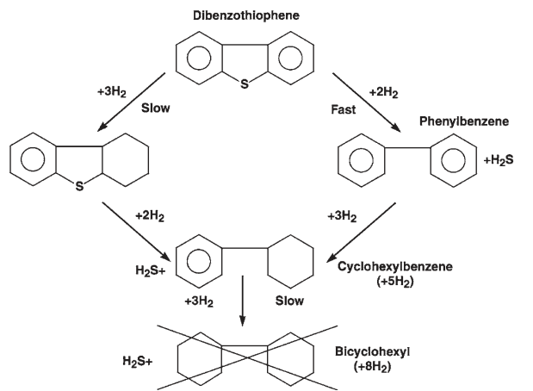
Hydrotreating reactions

Slide 7
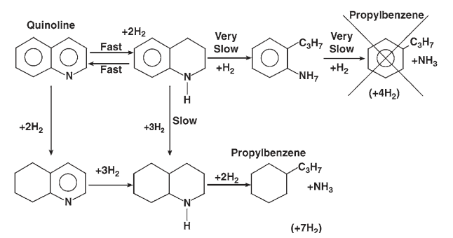

Slide 8
CATALYTIC REFORMING

Slide 9
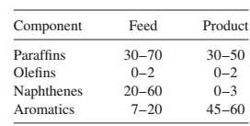
Objective of catalytic reforming
In catalytic reforming, the change in the boiling point of the stock passed through the unit is relatively small as the hydrocarbon molecular structures are rearranged to form higher-octane aromatics with only a minor amount of cracking. Thus, catalytic reforming primarily increases the octane of motor gasoline rather than increasing its yield. The yield slightly decreases due to hydrocracking reaction.

Slide 10
CATALYTIC REFORMING
In catalytic reforming the hydrocarbon molecular structures are rearranged to form higher-octane aromatics with only a minor amount of cracking.
feedstocks to catalytic reformers are heavy straight-run (HSR) gasolines and naphthas [180–375°F (82–190°C)] and heavy hydrocracker naphthas.
four major hydrocarbon groups: paraffins, olefins, naphthenes, and aromatics (PONA).
Component Feed (vol%) Product (vol%)
Paraffins 30–70 30–50
Olefins 0–2 0–2
Naphthenes 20–60 0–3
Aromatics 7–20 45–60

Slide 11
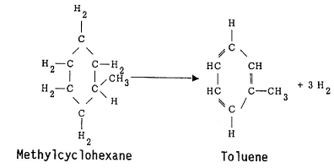
REACTIONS involved in catalytic reforming
Dehydrogenation Reactions (endothermic)
Dehydrogenation of alkylcyclohexanes to aromatics

Slide 12
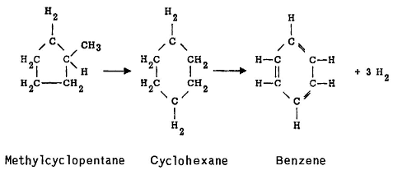
Dehydroisomerization of alkylcyclopentanes to aromatics

Slide 13
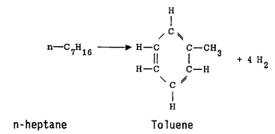
Dehydrocyclization of paraffins to aromatics

Slide 14
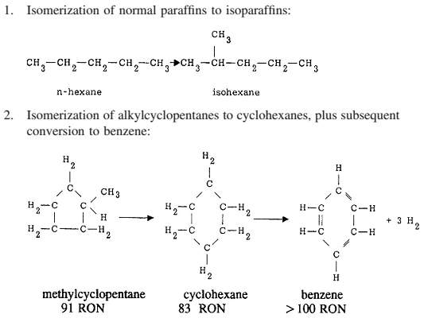

Slide 15
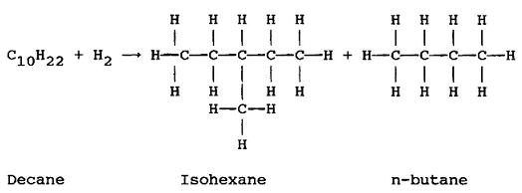
The hydrocracking reactions are exothermic and result in the production of lighter
liquid and gas products

Slide 16
Feed and Product Compositions
The Platforming naphtha charge typically contains C6 through C11 paraffins, naphthenes, and aromatics. The primary purpose of the Platforming process is to produce aromatics from the paraffins and naphthenes. The product stream is a premium-quality gasoline blending component because of the high-octane values of the aromatics. Alternatively, the aromatics-rich product stream can be fed to a petrochemical complex where valuable aromatic products such as benzene, toluene, and xylene (BTX) can be recovered. In motor fuel applications, the feedstock generally contains the full range of C6 through C11 components to maximize gasoline production from the associated crude run. In petrochemical applications, the feedstock may be adjusted to contain a more-select range of hydrocarbons (C6 to C7, C6 to C8, C7 to C8, and so forth) to tailor the composition of the reformate product to the desired aromatics components. For either naphtha application, the basic Platforming reactions are the same.

Slide 17
Primary Metal:
Platinum (Pt) → 0.3–0.7 wt%
Role:
Dehydrogenation of naphthenes → aromatics
Dehydrocyclization of paraffins → aromatics
Hydrogenation of intermediates
Suppresses coke formation

Slide 18
Promoter | Purpose
Rhenium (Re) | Improves stability & coke resistance
Tin (Sn) | Improves selectivity
Iridium (Ir) | Improves activity
Germanium (Ge) | Enhances stability

Slide 19
2. Support (Acid Function)
Gamma Alumina (γ-Al₂O₃)
Surface area: 150–250 m²/g
Provides acidity
Provides mechanical strength
Allows chlorination for acidity control

Slide 20
3. Halogen Component
Chlorine (Cl) → 0.8–1.5 wt%
Role:
Increases acidity of alumina
Enhances isomerization & cyclization
Improves catalyst performance
Maintained by:
Injecting small amount of HCl in feed

Slide 21
Component | Weight %
Platinum | 0.3–0.6%
Rhenium (if present) | 0.2–0.4%
Chlorine | 0.8–1.2%
Alumina | Balance (~98%)

Slide 22
Function | Provided By
Dehydrogenation | Platinum
Isomerization | Acidic Alumina + Chlorine
Cyclization | Metal + Acid sites
Hydrocracking | Acid sites

Slide 23
Common catalysts:
Pt/Al₂O₃ (semi-regenerative reformer)
Pt–Re/Al₂O₃ (high severity reforming)
Pt–Sn/Al₂O₃ (CCR reformer)

Slide 24
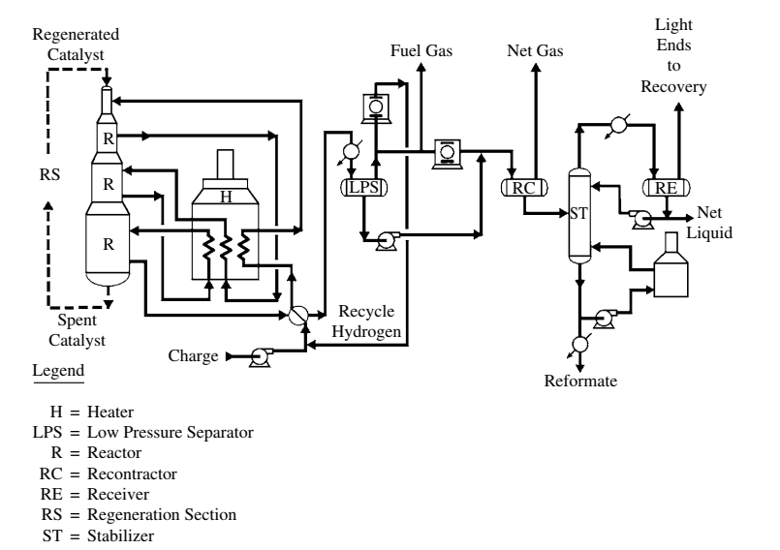

Slide 25
Product Yield (Reformate)
Product | Typical Yield (wt% of feed)
Reformate (C5+) | 80 – 88 wt%
C1–C4 gases | 5 – 10 wt%
Hydrogen (H₂) | 3 – 6 wt% equivalent
Higher severity → Higher aromatics → Slightly lower liquid yield
Lower pressure → Higher octane but more gas make
Aromatics Yield in Reformate
Component | Typical Yield (wt% of feed)
Total Aromatics | 55 – 75 wt% (in reformate)
BTX | 25 – 45 wt% of feed (can be higher in high severity)

Slide 26
Composition After BT Separation
(Feed to PX recovery / Parex / Isomerization section)
C8 Aromatics Fraction (Typical wt% or vol%)
Component | % in C8 Aromatics
m-Xylene | 45 – 55 %
p-Xylene | 20 – 25 %
o-Xylene | 15 – 20 %
Ethylbenzene (EB) | 15 – 25 %

Slide 27
Integrated UOP aromatics complex
UOP Naphtha Hydrotreating Process - Removes sulfur and nitrogen contaminants in the naphtha.
CCR Platforming ProcessTM - Selectively reforms naphtha to aromatics (BTX) and high purity hydrogen.
Sulfolane Process - Extracts benzene and toluene from the reformate, Sulfolane extractive distillation can also be applied.
TatorayTM Process - Disproportionates toluene and transalkylates toluene plus C9 aromatics to benzene and xylenes.
UOP THDA** Process - Thermal dealkylation of toluene and heavier aromatics to benzene.
ParexTM Process - Separates high purity para-xylene from mixed C8 aromatics isomers.
IsomarTM Process - Re-establishes an equilibrium mixture of isomers via xylene isomerization and conversion of ethyl benzene to benzene or xylenes.
**The choice between the THDA and Tatoray processes depends upon whether the principal product is benzene or para-xylene and their relative values. The incorporation of a Tatoray unit into the complex can more than double the yield of para-xylene from a given feedstock. THDA is used when benzene is the principal product.
UOP = Universal Oil Products, CCR Platforming = Continuous Catalyst Regeneration Platforming
https://www.academia.edu/9478499/UOP_Aromatics_Complex

Slide 28
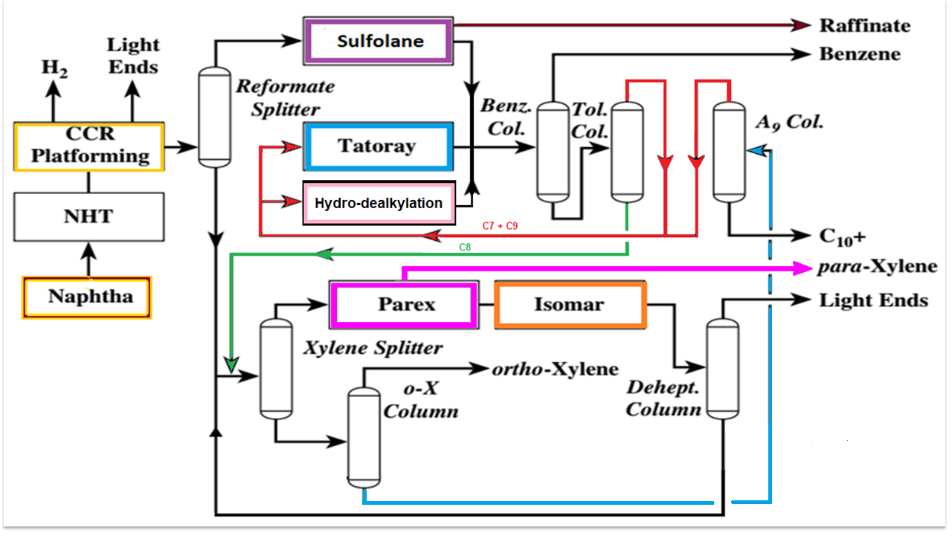
C7
C9
Integrated UOP aromatics complex
Integrated UOP aromatics complex

Slide 29
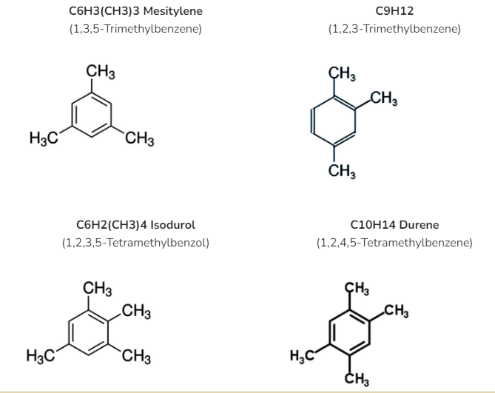
Aromatic components in reformate
C6- benzene
C7- toluene
C8-xylenes and ethyl benzene
A9= C9 & C10

Slide 30
Process Description
The principal products from the aromatics complex are benzene, para-xylene, and ortho-xylene. If desired, a fraction of the toluene and C₉ aromatics may be taken as products, or some of the reformate may be used as a high-octane gasoline blending component.
The naphtha is first hydrotreated to remove sulfur and nitrogen compounds and then sent to a CCR Platforming unit, where paraffins and naphthenes are converted to aromatics. This unit is the only one in the complex that actually creates aromatic rings. The other units in the complex separate the various aromatic components into individual products and convert undesired aromatics into additional high-value products.
The CCR Platforming unit is designed to run at high severity, 104 to 106 research octane number, clear (RONC), to maximize the production of aromatics. This high-severity operation also extinguishes virtually all nonaromatic impurities in the C8 fraction of the reformate, thus eliminating the need for extraction of the C8 and C9 aromatics. The reformate product from the CCR Platforming unit is sent to a debutanizer column within the Platforming unit to strip off the light ends.
The reformate from the CCR Platforming unit is sent to a reformate splitter column.
Severity: Any catalytic process is subjected to both high and low severity operations depending on requirement. High Severity operations facilitates both the wanted and unwanted reactions to proceed faster. For example in catalytic Reforming, during high severity of operations you operate the reformer with high conversions to produce wanted products like Benzene, Toluene and Xylenes for Aromatic production and high Octane numbers for octane boosting. Since both Wanted reactions like BTX production and octane boost are enhanced, we obtain high conversions. At the same time unwanted reactions like coke formation is also enhanced due to high severity, the catalyst thus gets coked fast and shortens the cycle lengths and overall life of the catalyst.
At low severities both the wanted and unwanted reactions proceeds with Low rates hence low production of wanted products like BTX and low octane boost. At low severities less coke formation, hence high cycle length and high ultimate life of the catalyst.
The severities are a function of operating parameters and the process environment.

Slide 31
The C₆ +C₇ fraction from the overhead is sent to the Sulfolane unit for extraction of benzene and toluene. The C₈₊ fraction from the bottom of the reformate splitter is clay-treated and then sent directly to the xylene recovery section of the complex.
The Sulfolane unit extracts the aromatics from the reformate splitter overhead and rejects a paraffinic raffinate stream. The aromatic extract is clay-treated to remove trace olefins. Then individual high-purity benzene and toluene products are recovered in the benzene-toluene (BT) fractionation section of the complex.
The C8 material from the bottom of the toluene column is sent to the xylene recovery section.
The raffinate from the Sulfolane unit may be further refined into paraffinic solvents, blended into gasoline, used as feedstock for an ethylene plant, or converted to additional benzene by an RZ-100 (UOP trademark) Platforming unit.
Toluene is usually blended with C9 and C10 aromatics (A9) from the overhead of the A₉₊ column and charged to a Tatoray unit for the production of additional xylenes and benzene. (Toluene to Xyenes)
The effluent from the Tatoray unit is sent to a stripper column within the Tatoray unit to remove light ends. After the effluent is clay-treated, it is sent to the BT fractionation section, where the benzene product is recovered and the xylenes are fractionated out and sent to the xylene recovery section.
The overhead material from the Tatoray stripper or THDA(Thermal dealkylation of toluene and heavier aromatics to benzene) stripper column is separated into gas and liquid products. The overhead gas is exported to the fuel gas system, and the overhead liquid is normally recycled to the CCR Platforming debutanizer for recovery of residual benzene.

Slide 32
The clay removes:
 | Benzene | toluene | Ethyl benzene | o-xylene | m-xylene | p-xylene
Molecular wt | 78 | 92 | 106 | 106 | 106 | 106
Colour and state | Colorless liquid | Colorless liquid | Colorless liquid | Colorless liquid | Colorless liquid | Colorless liquid
Melting point, °C | 5.5 | -95 | -95 | -25.2 | -47.8 | 13.3
Boiling point, °C | 80 | 111 | 137.2 | 144.4 | 139.1 | 138.4
Density, gm/cc | 0.88 | 0.87 | 0.88 | 0.88 | 0.87 | 0.86
Trace olefins
Sulfur compounds
Nitrogen compounds
Color bodies
Peroxides
Gum-forming impurities

Slide 33
Parameter | Pentane | Hexane | Heptane | Isooctane | Benzene | Toluene | o-Xylene
MW (g/mol) | 72.15 | 86.18 | 100.21 | 114.23 | 78.11 | 92.14 | 106.17
C% by mass | 83.2% | 83.6% | 83.9% | 84.1% | 92.3% | 91.2% | 90.5%
H% by mass | 16.8% | 16.4% | 16.1% | 15.9% | 7.7% | 8.8% | 9.5%
ΔH_comb (kJ/mol) | -3509 | -4163 | -4817 | -5471 | -3268 | -3910 | -4553
MJ/kg (HHV) | 49.0 | 48.8 | 48.6 | 48.3 | 41.9 | 42.5 | 43.0
MJ/L | 30.7 | 32.1 | 33.2 | 33.4 | 36.8 | 36.8 | 37.8
Stoich A/F ratio | 15.4 | 15.2 | 15.1 | 15.0 | 13.2 | 13.5 | 13.8
RON | 62 | 25 | 0 | 100 | >100 | 120 | 115

Slide 34
The C₈₊ fraction from the bottom of the reformate splitter is clay-treated and then charged to a xylene splitter column. The xylene splitter is designed to rerun the mixed xylenes feed to the Parex unit down to very low levels of A9 concentration.
The A9 builds up in the desorbent circulation loop within the Parex unit, and removing this material upstream in the xylene splitter is more efficient. The overhead from the xylene splitter is charged directly to the Parex unit. The bottoms are sent to the A9 column, where the A9 fraction is rerun and then recycled to the Tatoray or THDA unit. If the complex has no Tatoray or THDA unit, the A9 material is usually blended into gasoline or fuel oil.
If ortho-xylene is to be produced in the complex, the xylene splitter is designed to make a split between meta- and ortho-xylene and drop a targeted amount of ortho-xylene to the bottoms. The xylene splitter bottoms are then sent to an o-X column where high-purity ortho-xylene product is recovered overhead. The bottoms from the o-X column are then sent to the A9 column.
The xylene splitter overhead is sent directly to the Parex unit, where 99.9 wt % pure paraxylene is recovered by adsorptive separation at 97 wt % recovery per pass. Any residual toluene in the Parex feed is extracted along with the para-xylene, fractionated out in the finishing column within the Parex unit, and then recycled to the Tatoray or THDA unit.

Slide 35
The raffinate from the Parex unit is almost entirely depleted of para-xylene, to a level of less than 1 wt %. The raffinate is sent to the Isomar unit, where additional para-xylene is produced by reestablishing an equilibrium distribution of xylene isomers. Any ethylbenzene in the Parex raffinate is either converted to additional xylenes or dealkylated to benzene, depending on the type of Isomar catalyst used. The effluent from the Isomar unit is sent to a deheptanizer column. The bottoms from the deheptanizer are clay-treated and recycled back to the xylene splitter. In this way, all the C8 aromatics are continually recycled within the xylene recovery section of the complex until they exit the aromatics complex as para-xylene, ortho-xylene, or benzene.
The overhead from the deheptanizer is split into gas and liquid products. The overhead gas is exported to the fuel gas system, and the overhead liquid is normally recycled to the CCR Platforming debutanizer for recovery of residual benzene.

Slide 36
The UOP Extractive Distillation (ED) Sulfolane process
This uses Sulfolane solvent for the recovery of high purity benzene and toluene products from reformate splitter overhead. It is a simplified, low capital investment alternative (as much as 80% less) to the traditional Sulfolane process. The process offers:
99.9 wt% purity benzene (ASTM Refined Benzene)
High purity toluene with less than 1000 wt-ppm non-aromatics.
Benzene and toluene recovery greater than 99.5%
Low solvent consumption
Maximum energy efficiency

Slide 37
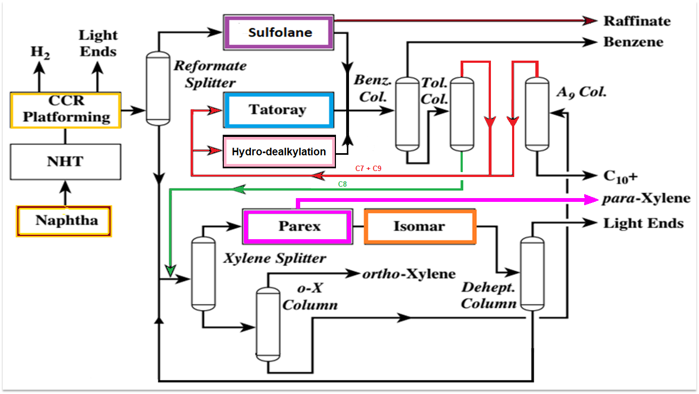
UOP-Sulfolane process

Slide 38
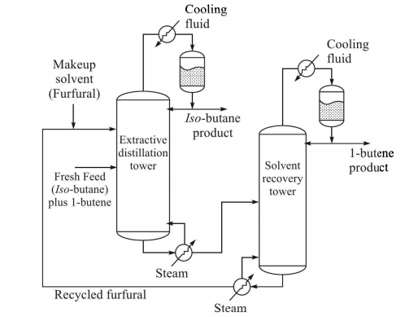
Extractive Distillation (Review)

Slide 39
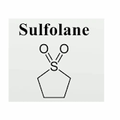
UOP-SULFOLANE process
Tetrahydrothiophene 1,1- dioxide
B.P. 287°C
The UOP Sulfolane process is used to recover high-purity aromatics from hydrocarbon mixtures, such as reformed petroleum naphtha (reformate), pyrolysis gasoline (pygas), or coke-oven light oil.
The Sulfolane process takes its name from the solvent used: tetrahydrothiophene 1,1-dioxide, or Sulfolane. Sulfolane was developed as a solvent by Shell in the early 1960s and is still the most efficient solvent available for the recovery of aromatics. Since 1965, UOP has been the exclusive licensing agent for the Sulfolane process.
The Sulfolane process can be applied as a combination of liquid-liquid extraction (LLE) and extractive distillation (ED) or, with an appropriate feed, ED alone. The application of extractive distillation is favored when the Sulfolane feed is rich in aromatics. In such a case, there is less raffinate to boil overhead in the extractive distillation column, which consumes energy.
The C6-C7 fraction from the overhead of the reformate splitter is fed to the Sulfolane unit. The aromatic extract from the Sulfolane unit is clay-treated to remove trace olefins, and individual benzene and toluene products are recovered by simple fractionation. The paraffinic raffinate from the Sulfolane unit is usually blended into the gasoline pool or used in aliphatic solvents.
The Sulfolane process can also be an attractive way to reduce the benzene concentration in a refinery’s gasoline pool so that it meets new reformulated gasoline requirements.

Slide 40
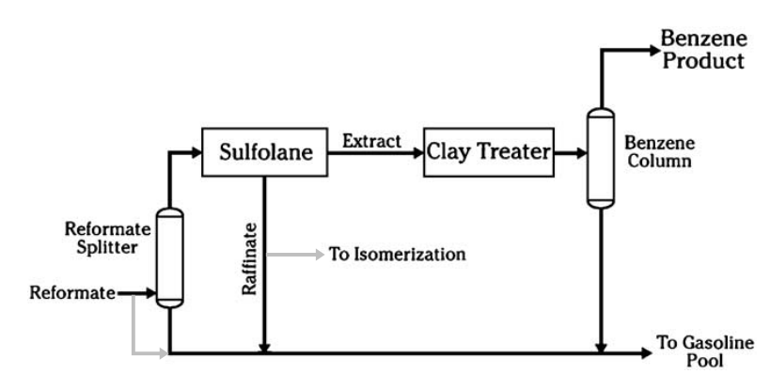
Benzene-reduction application (Gasoline blend)
In a typical benzene-reduction application, a portion of the debutanized reformate is sent to a reformate splitter column. The amount of reformate sent to the splitter is determined by the degree of benzene reduction required.
Bypassing some reformate around the splitter and recombining it with splitter bottoms provide control of the final benzene concentration.
The benzene-rich splitter overhead is sent to the Sulfolane unit, which produces a high-purity benzene product that can be sold to the petrochemical market. The raffinate from the Sulfolane unit can be blended back into the gasoline pool or upgraded in an isomerization unit.

Slide 41
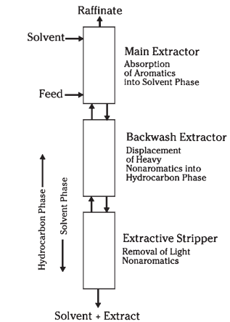
Lean solvent is introduced at the top of the main extractor and flows downward. The hydrocarbon feed is introduced at the bottom and flows upward, countercurrent to the solvent phase. As the solvent phase flows downward, it is broken up into fine droplets and redispersed into the hydrocarbon phase by each successive tray. The solvent selectively absorbs the aromatic components from the feed. However, because the separation is not ideal, some of the non-aromatic impurities are also absorbed. The bulk of the nonaromatic hydrocarbons remain in the hydrocarbon phase and are rejected from the main extractor as raffinate.
The solvent phase, which is rich in aromatics, flows downward from the main extractor into the backwash extractor. There the solvent phase is contacted with a stream of light non-aromatic hydrocarbons from the top of the extractive stripper. The light non-aromatics displace the heavy non-aromatic impurities from the solvent phase. The heavy non-aromatics then reenter the hydrocarbon phase and leave the extractor with the raffinate.
The rich solvent from the bottom of the backwash extractor, containing only light nonaromatic impurities, is then sent to the extractive stripper for final purification of the aromatic product. The light non-aromatic impurities are removed overhead in the extractive stripper and recycled to the backwash extractor. A purified stream of aromatics, or extract, is withdrawn in the solvent phase from the bottom of the extractive stripper. The solvent phase is then sent on to the solvent recovery column, where the extract product is separated from the solvent by distillation.
Steam

Slide 42
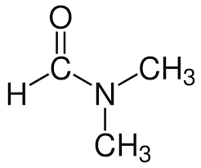
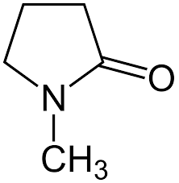
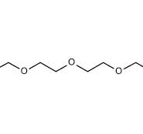

Extraction solvents
Sulfolane
N-methyl pyrrolidinone
N-formyl morpholine
Dimethyl formamide
Tetra ethylene glycol

Slide 43
Solvent Selection
The suitability of a solvent for aromatics extraction involves the relationship between the capacity of the solvent to absorb aromatics (solubility) and the ability of the solvent to differentiate between aromatics and nonaromatics (selectivity). A study of the common polar solvents used for aromatic extraction reveals the following qualitative similarities:
When hydrocarbons containing the same number of carbon atoms are compared, solubilities decrease in this order: aromatics>naphthenes>olefins>paraffins.
When hydrocarbons in the same homologous series are compared, solubility decreases as molecular weight increases.
The selectivity of a solvent decreases as the hydrocarbon content, or loading, of the solvent phase increases.
High specific gravity (1.26). High specific gravity allows the aromatic capacity of Sulfolane to be fully exploited while maintaining a large density difference between the hydrocarbon and solvent phases in the extractor. This large difference in densities minimizes the required extractor diameter. The high density of the liquid phase in the extractive distillation section also minimizes the size of the equipment required there.
Low specific heat—0.4 cal/(g°C) [0.4 Btu/(lb°F)]. The low specific heat of Sulfolane solvent reduces heat loads in the fractionators and minimizes the duty on solvent heat exchangers.
High boiling point [287°C (549°F)]. The boiling point of Sulfolane is significantly higher than that of the heaviest aromatic hydrocarbon to be recovered, facilitating the separation of solvent from the aromatic extract.

Slide 44
SULFOLANE process: introduction
The Sulfolane process combines both liquid-liquid extraction and extractive distillation in the same process unit. This mode of operation has particular advantages for aromatic recovery:
In liquid-liquid extraction systems, light nonaromatic components are more soluble in the solvent than heavy nonaromatics are. Thus, liquid-liquid extraction is more effective in separating aromatics from the heavy contaminants than from the light ones.
In extractive distillation, light nonaromatic components are more readily stripped from the solvent than heavy nonaromatics. Thus, extractive distillation is more effective in separating aromatics from the light contaminants than from the heavy ones.
Contaminants that are the most difficult to eliminate in one section are the easiest to remove in the other. This combination of techniques permits effective treatment of feedstocks with much broader boiling range than would be possible by either technique alone.

Slide 45
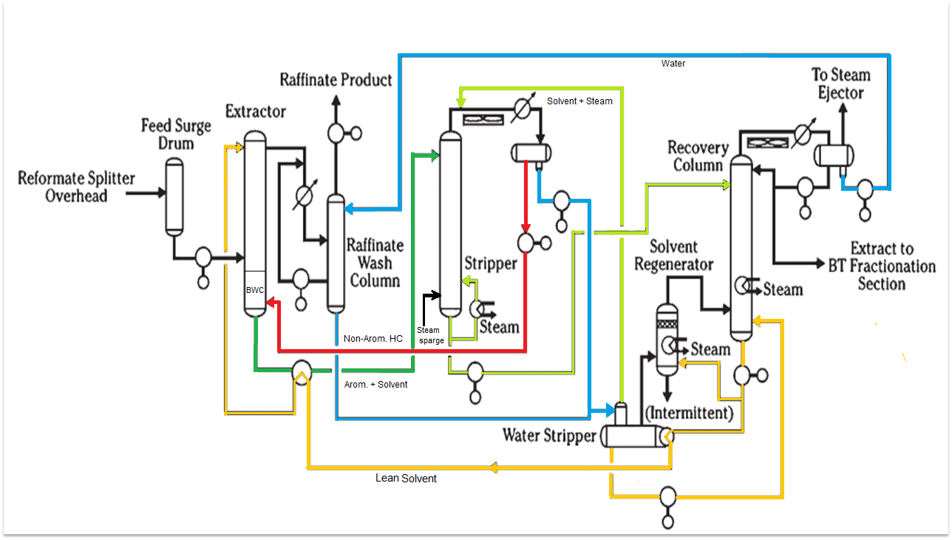
SULFOLANE process flow diagram

Slide 46
Sulfolane solvent process uses a combination of liquid–liquid extraction and extractive stripping to separate the aromatics from the other hydrocarbons because of the characteristics of polar solvents. As the concentration of aromatics in the solvent increases, the solubility of the nonaromatic hydrocarbons in the extract phase also increases. This results in a decrease in the selectivity of the solvent and a carryover of some of the nonaromatic hydrocarbons with the extract phase to an extractive stripper. In the extractive stripper an extractive distillation occurs and the nonaromatic hydrocarbons are stripped from the aromatic–solvent mixture and returned as reflux to the extraction column. The solvent is then recovered from the nonaromatic hydrocarbon-free extract stream leaving an extract which contains less than 1000 ppm ( 0.1%) aliphatics.
Aromatics recoveries are typically equal to or better than 99.9, 99.0, and 97.0% for benzene, toluene, and xylenes, respectively. Because of the high affinity of the polar solvents for water and the low solubilities in the nonaromatic hydrocarbon raffinate phase, the solvent is recovered from the raffinate phase by washing with water. The water is returned to extract recovery column (Sulfolane) for recovery of the solvent.
The water content of the solvents is carefully controlled and used to increase the selectivity of the solvents. The water content of the polyglycols is kept in the range of 2 to 10 wt% and that of sulfolane is maintained at about 1.5 wt%.
The solvent quality is maintained in the Sulfolane process by withdrawing a slip stream from the main solvent recirculation stream and processing it in a solvent reclaiming tower to remove any high-boiling contaminants that accumulated.
The solvent quality is maintained by using a combination of filtration and adsorption to remove accumulated impurities.

Slide 47
Process description
Fresh feed is fed into the extractor, where it rises and flows against the flow of lean solvent. Aromatic materials are dissolved in the solvent in a targeted manner as the feed passes through the extractor. An extremely low-aromatic-content raffinate stream is removed from the extractor's top. The aromatic-rich, rich solvent emerges from the extractor's bottom and goes into the stripper. Through extractive distillation, the non-aromatic components with volatilities greater than benzene's are entirely extracted from the solvent and removed overhead, along with a small amount of aromatics.
This overhead stream is recycled to the extractor, where the heavy nonaromatics from the solvent phase exiting the bottom of the extractor are replaced by the light nonaromatics. After being largely free of nonaromatic contaminants, the bottom stream from the stripper is sent to the recovery column, where the solvent and aromatic product are separated. This separation is easily completed with little energy input due to the significant difference in boiling points between the heaviest aromatic component and the sulfolane solvent. To minimize solvent temperatures, the recovery column is operated under vacuum.
Lean solvent from the bottom of the recovery column is returned to the extractor. The extract is recovered overhead and sent on to distillation columns downstream for recovery of the individual benzene and toluene products.
The raffinate stream exits the top of the extractor and is directed to the raffinate wash column. In the wash column, the raffinate is contacted with water to remove dissolved solvent. The solvent-rich water is vaporized in the water stripper by exchange with hot circulating solvent and then used as stripping steam in the recovery column. Accumulated solvent from the bottom of the water strip-per is pumped back to the recovery column. The raffinate product exits the top of the raffinate wash column. The amount of Sulfolane solvent retained in the raffinate is negligible.

Slide 48
There is very little oxidative degradation of the sulfolane solvent under typical operating conditions. A small solvent regenerator is included in the design of the unit as a safeguard against the possibility of air leaking into the unit. A tiny slip-stream of circulating solvent is sent to the solvent regenerator during regular operation in order to remove oxidized solvent.
The extract product from a Sulfolane unit may contain trace amounts of olefins and other impurities which would adversely affect the acid wash color tests of the final benzene and toluene products. To eliminate these trace impurities, the extract is clay treated prior to fractionation. Clay treating is done at very mild conditions and clay consumption is minimal.
After treatment, the extract is sent to the aromatics fractionation section, which recovers high-purity toluene, benzene, and occasionally mixed xylenes. The design of the aromatics fractionation section varies depending on the particular processing requirements of the customer. The design of the aromatics fractionation section varies depending on the particular processing requirements of the refiner.
The toluene product is often recycled to a UOP Tatoray unit for conversion into benzene and xylenes.
In order to separate mixed xylenes into para-, ortho-, and meta-xylene products, they can be sent straight to the xylene recovery section. Any heavy aromatics in the feed are yielded as a bottoms product from the fractionation section. The C9 aromatics are typically recovered and recycled to a UOP Tatoray unit in order to produce more xylenes. The heavy aromatics can also be sold as a high-octane blending component or mixed back into the gasoline pool at the refinery.

Slide 49
UOP Thermal Hydrodealkylation (THDA) Process

Slide 50
UOP Thermal Hydrodealkylation (THDA) Process
Main reaction: C₇H₈ + H₂ ------------> C₆H₆ + CH₄
Side reaction: 2 Benzene --------------> Diphenyl + H₂
Benzene is the fundamental component used in the direct or indirect production of more than 250 different products or product categories.
The main uses of benzene have been in the manufacturing of cyclohexane (used in nylon), cumene (used in phenol and acetone), and ethylbenzene (used in polystyrene). A significant amount of benzene is also used in the production of maleic anhydride, aniline, and detergent alkylate.
The majority of the petroleum-derived petrochemical benzene is supplied by catalytic reforming. Nevertheless, the reforming process yields more toluene than benzene, and in many regions, the low market demand for toluene may render dealkylation an economically viable way to convert it to benzene. The toluene dealkylation process yields about 13% of the global petrochemical benzene produced.
High-purity benzene can be efficiently produced from alkylbenzenes using the thermal hydrodealkylation (THDA) process. Apart from yielding benzene, the THDA method can be used profitably to produce high-grade naphthalene from appropriate feedstocks.

Slide 51
The UOP THDA PROCESS DESCRIPTION
Alkylbenzenes and alkylnaphthalenes are converted to their respective aromatic rings, benzene and naphthalene, by the UOP THDA process. The relationship between operating severity and product distribution is such that the conversion per pass of fresh feed is maintained at 95–98% per pass for both benzene and naphthalene operations.
The conversion of the alkyl-group side chains of the alkyl-aromatic feed and any potential non-aromatics in the unit feed results in a light paraffinic coproduct gas that is primarily composed of methane.
The basic hydrodealkylation reaction enables the process to produce a high-purity benzene or naphthalene product without applying extraction or super-fractionation techniques, even when charging a mixture of alkyl aromatics and nonaromatic hydrocarbons.
Hydrogen consumption is greatly increased for presence of excessive nonaromatics in the charge.
The benzene yield from toluene approximates 99 percent on a molal basis, and product yields are close to stoichiometric. A small amount of heavy-aromatic material consisting of
biphenyl-type compounds is coproduced.

Slide 52
The UOP THDA PROCESS DESCRIPTION
In a benzene unit, fresh toluene feedstock, recycled toluene, and fresh hydrogen gases are combined. The mixture is heated through exchange in a fired heater before being charged into the reactor.
Alkyl aromatics are hydrodealkylated to benzene and nonaromatics, and paraffins and naphthalenes are hydrocracked.
Reactor effluent is cooled and sent to a product separator, where it splits into a gas phase and a liquid phase.
The separator liquid is fed to a stripper to remove light ends, and the hydrogen-rich gas phase is recycled back into the reactor.
Stripper bottoms are percolated through a clay treater to the fractionation section, where high-purity benzene is obtained as an upper sidecut from a benzene fractionation column.
The lower sidecut of the benzene column is recycled into the reactor with unconverted toluene. The heavy-aromatic byproduct is removed and stored at the bottom of the column.
A naphthalene THDA unit's reactor-section process flow is comparable to the benzene unit's described process flow. Recycled hydrogen, makeup, and unconverted alkyl aromatics are combined with fresh feed. After that, the mixture is heated and added to the reactor. Materials in the feedstock materials that boil close to naphthalene would make the recovery of high-purity product either impossible or uneconomic if they remain unconverted. In order to produce products that are easily separated by fractionation, the process conditions are adjusted to ensure that these materials are either dealkylated or hydrocracked, or both.

Slide 53
The UOP THDA Process…
In the case of naphthalene, the aromatic-splitter bottoms are charged to a naphthalene splitter, where the small amount of heavy-aromatic coproduct is rejected as a bottoms product. Naphthalene splitter overhead is directed to the naphthalene fractionator, where high-purity naphthalene is recovered as an overhead product. Naphthalene fractionator bottoms are recycled to the reactor section. In both benzene and naphthalene THDA units, clay treating of the product is generally required to meet the usual acid-wash color specifications.
To preserve hydrogen purity, coproduct light ends—mainly methane—must be eliminated from the reaction section. It is also necessary to take into account the removal of C3 and heavier nonaromatic hydrocarbons from the makeup gas when the supply of makeup hydrogen is restricted. These materials hydrocrack and significantly increase the amount of hydrogen consumed if they are present. In the process of designing hydrodealkylation units, the availability and consumption of hydrogen in relation to the overall operation of the refinery must be carefully considered.
Depending on the application, THDA units can process a wide variety of feedstocks. For the production of benzene, feedstocks could include extracted light alkylbenzene, suitably treated coke-oven light oil, and pyrolysis coproducts. Feedstocks to produce naphthalene could include heavy reformate, extracted cycle oils from the fluid catalytic cracking (FCC) process, and coal-tar-derived materials. Benzene produced from commercial THDA units typically has a freeze point of 5.5°C, which exceeds the ASTM Benzene-545 benzene specifications.

Slide 54
THDA reactor
Parameter | Typical Value
Tubular Plug Flow Reactor Vertical furnace-fired tubes (Non-catalytic) Temperature | 650–750°C
Pressure | 30–40 atm
H₂ / Hydrocarbon Ratio | 4 : 1 to 10 : 1
Residence Time | 1–5 seconds

Slide 55
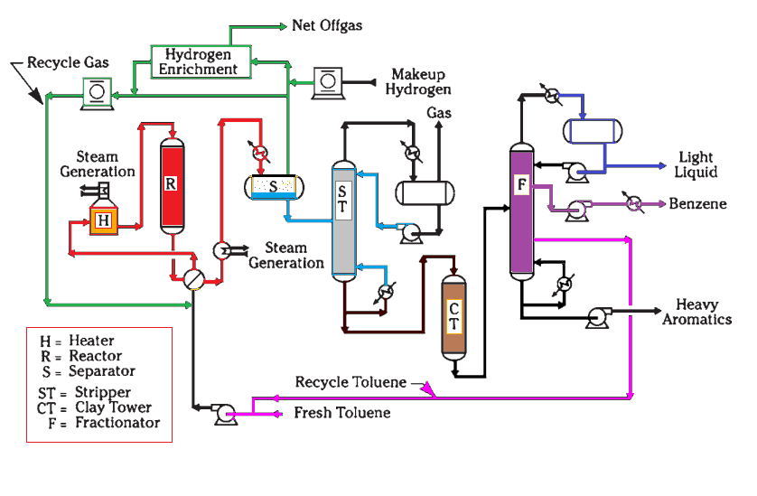
The UOP THDA Process Flow Diagram
H₂ (major) CH₄, C2, C3 gases, Traces H₂S
600-660°C, 35-40 bar, 70% conv.
Tubular Plug Flow Reactor
32.8 bar, 38 °C
B-T, Heavy arom.
150-170° C

Slide 56
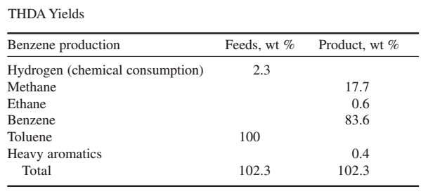

Slide 57
UOP TATORAY PROCESS

Slide 58
Tatoray: the rationale
An aromatics complex is a set of units used in the pyrolysis of gasoline and petroleum naphtha to produce the three main petrochemical intermediates: xylenes, toluene, and benzene.
UOP's Tatoray process is a fully integrated contemporary complex intended to produce benzene, paraxylene (PX), and occasionally ortho-xylene. The plant's xylene recovery and aromatics extraction divisions are linked with the Tatoray process. Instead of being sold for use as a solvent or mixed into the gasoline pool, toluene (A7) is fed into the Tatoray machine. Alternatively, the C9 aromatic (A9) by-product can be supplied to the Tatoray unit instead of being blended into the gasoline pool in order to optimize the complex's PX output. Low-value toluene and heavy aromatics can be converted into additional mixed xylenes in an optimal manner using the Tatoray process.
Approximately 45% of xylene originates from the reformate, and 5% is derived via C8 aromatic isomerization, which converts ethylbenzenes to xylenes. An example of this process is the Isomar process. About half of the xylenes in an aromatics complex containing transalkylation originate from the Tatoray process, or the transalkylation reaction.
An equilibrium mixture of xylenes + ethylbenzene is produced by the Tatoray procedure. While ethylbenzene can also be transformed to xylenes, the xylenes are recovered and isomerized to PX. The output of PX from naphtha feedstock can be more than doubled by adding a Tatoray unit to an aromatics complex.

Slide 59
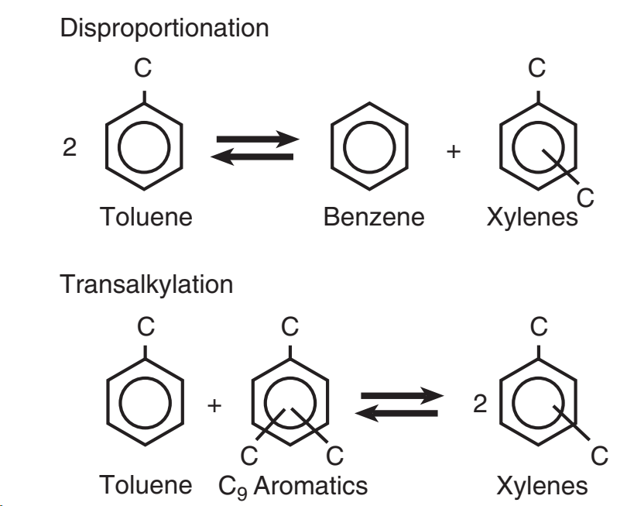
PROCESS CHEMISTRY

Slide 60
DESCRIPTION OF THE PROCESS FLOW
The Tatoray process consists mainly of a fixed-bed reactor containing TA-5 zeolite catalyst and a product separation unit, forming a very simple process layout.
The hydrogen-rich recycle gas is first mixed with the fresh feed to the Tatoray unit, heated by exchange with the hot reactor effluent, and heated in a fired heater to reaction temperature(430°C and 35 bar.). Following that, the combined feed vapor is delivered to the reactor, where it is treated downflow over a fixed catalyst bed. The reactor effluent is then routed to a product separator after being exchanged with the combined feed and cooled by a product condenser.
Gas rich in hydrogen is removed from the separator's top, and some of it is purified there to get rid of accumulated light ends in the recycle gas loop. After that, it's recycled back into the reactor along with makeup gas. The separator's bottom liquid is sent toward a stripper column.
After cooling, the stripper's overhead is divided into liquid and gaseous products. To the fuel gas system is exported the stripper overhead gas. To enable any benzene in this stream to be recovered to the extraction or BT separation portion of the aromatics complex, the overhead liquid is recycled to the Platforming unit debutanizer column.
The benzene and xylene products, together with the unreacted toluene and C9 aromatics, are taken from the bottom of the stripper and recycled to the BT fractionation section of the aromatics complex.
In the Tatoray method, even though no net hydrogen is consumed in the transalkylation processes, the reactor section is kept in a hydrogen atmosphere due to the dealkylation reaction pathway. Because to the dealkylation side reactions, in actual practice, a little quantity of hydrogen is always consumed.
Hydrogen consumption increases for heavier feedstocks since these generally contain heavier alkyl groups, typically C3 and C4.

Slide 61
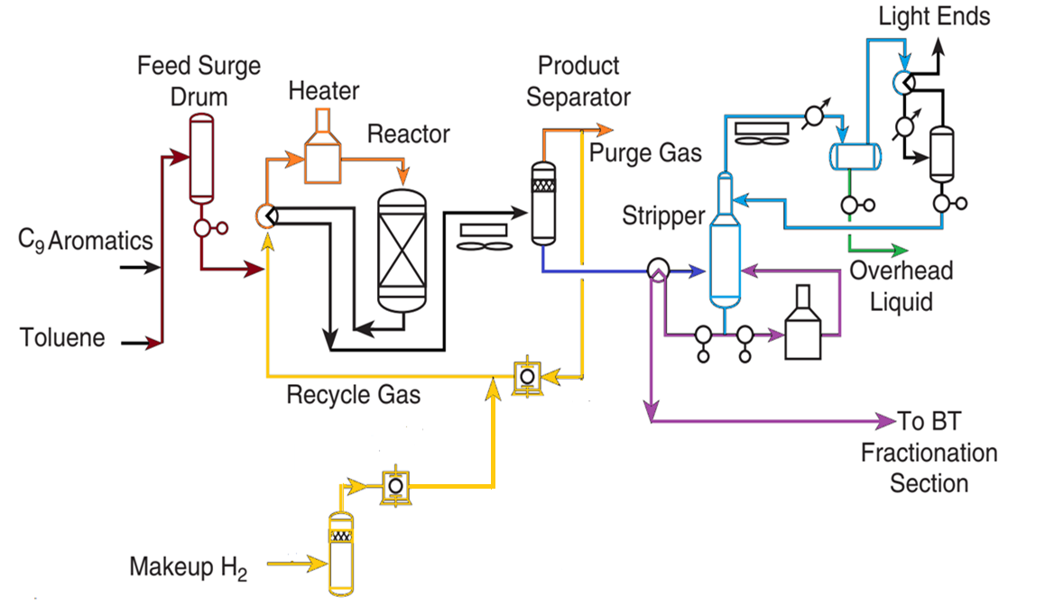
The TATORAY process

Slide 62
UOP PAREX PROCESS
https://www.youtube.com/watch?v=GB8veuKGyu0
https://www.youtube.com/watch?v=y1_J00jdyNc&t=1335s

Slide 64
UOP PAREX PROCESS
An inventive adsorptive separation technique for separating para-xylene from mixed xylenes is the UOP Parex process. A mixture of C8 aromatic isomers, such as ethylbenzene, para-xylene, meta-xylene, and ortho-xylene, is referred to as mixed xylenes. It is impractical to separate these isomers by traditional distillation since they boil so near to one another. By employing a solid zeolitic adsorbent that is specific for para-xylene, the Parex process offers an effective way to recover para-xylene. The Parex technique, in contrast to traditional chromatography, replicates the countercurrent flow of a liquid feed over a solid bed of adsorbent. Feed and products enter and leave the adsorbent bed continuously at nearly constant compositions.
The Parex unit is integrated with a UOP Isomar unit and situated downstream of the xylene column in a contemporary aromatics complex. The C8 aromatics product from the CCR Platforming unit and the xylenes generated in the Tatoray unit make up the feed to the xylene column. High-purity para-xylene is recovered in the extract of the Parex unit, which receives the C8 fraction from the overhead of the xylene column.
The Parex raffinate is then sent to the Isomar unit, where the other C8 aromatic isomers are converted to additional para-xylene and recycled to the xylene column.
In a single pass, UOP Parex units are engineered to recover over 97% of the feed's para-xylene while maintaining a minimum product purity of 99.9 weight percent. The Parex design is incredibly dependable, mechanically straightforward, and energy-efficient.
Prior to the development of the Parex process, fractional crystallization was the only method used to create para-xylene. When the mixed-xylenes feed is cooled to -75°C (-103°F) during the crystallization process, the para-xylene isomer precipitates as a crystalline solid. Then, either centrifugation or filtration is used to separate the solid from the mother fluid. Washing the para-xylene crystals with toluene or part of the para-xylene product allows for final purification.
The UOP Parex technique, which was first presented in 1971, swiftly rose to prominence as the go-to method for recovering para-xylene worldwide.

Slide 65
Size comparison
Compound | Effective Size (Å) | Relative Size
p-Xylene | ≈ 5.8 Å | Smallest
m-Xylene | ≈ 6.1 Å | Medium
o-Xylene | ≈ 6.4 Å | Larger
Ethylbenzene | ≈ 6.6 Å | Largest
p-Diethylbenzene
≈ 7.5–7.8
Zeolite pores ≈ 5.7–6 Å Only p-xylene fits properly

Slide 66
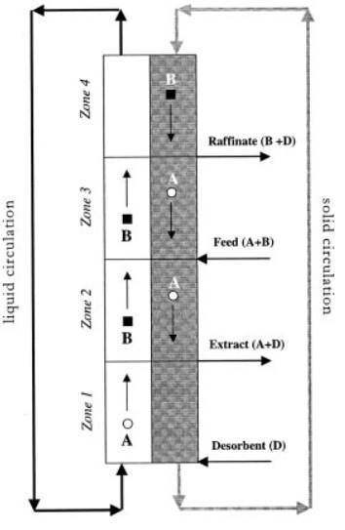
Inlets 1 Feed → (A + B) 2 Desorbent → (D)
Outlets 1 Extract → (A + D) → p-Xylene recovery
2 Raffinate → (B + D) → Isomerization
Zone 1 – Desorption Zone (Between: Desorbent inlet & Extract outlet)
Desorbent D enters here
Removes adsorbed A (p-xylene)
Forms: A + D (Extract)
Function: Remove product from adsorbent
TMB-True moving bed
Zone 2 – Purification Zone (Between: Extract outlet & Feed inlet)
Removes B impurities from A. B pass out in liquid stream. B is gradually displaced from the pores by A and D
Prevents B from entering extract
Function: Purify p-xylene
Zone 3 – Adsorption Zone (Between: Feed inlet & Raffinate) outlet
Feed (A + B) enters
A gets adsorbed
B passes out
Raffinate = B + D
Function: Adsorb p-xylene
Zone 4 – Regeneration Zone (Between: Raffinate outlet & Desorbent inlet)
Removes remaining B from adsorbent/ draining of D
Prepares bed for next cycle
Function: Regenerate adsorbent

Slide 67
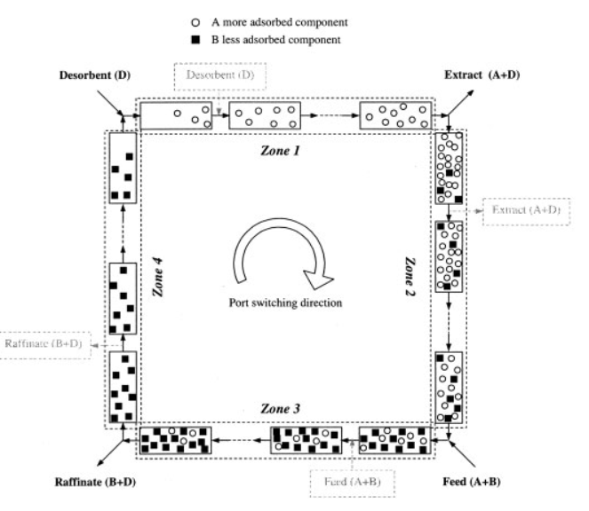

Slide 68
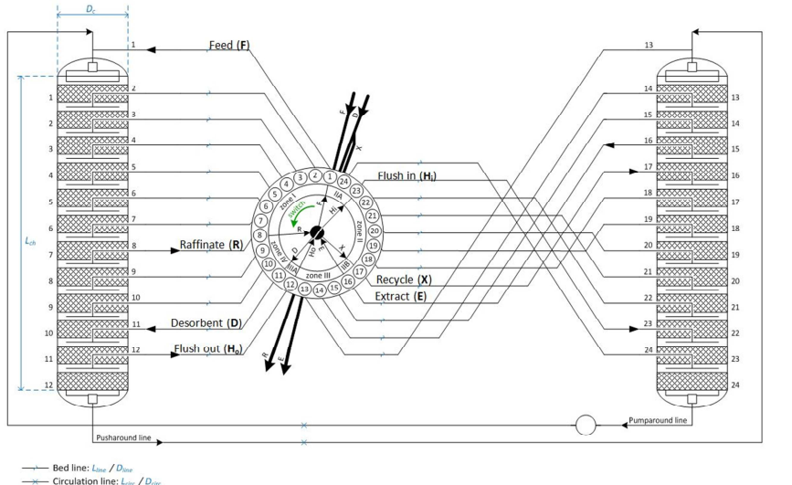

Slide 69
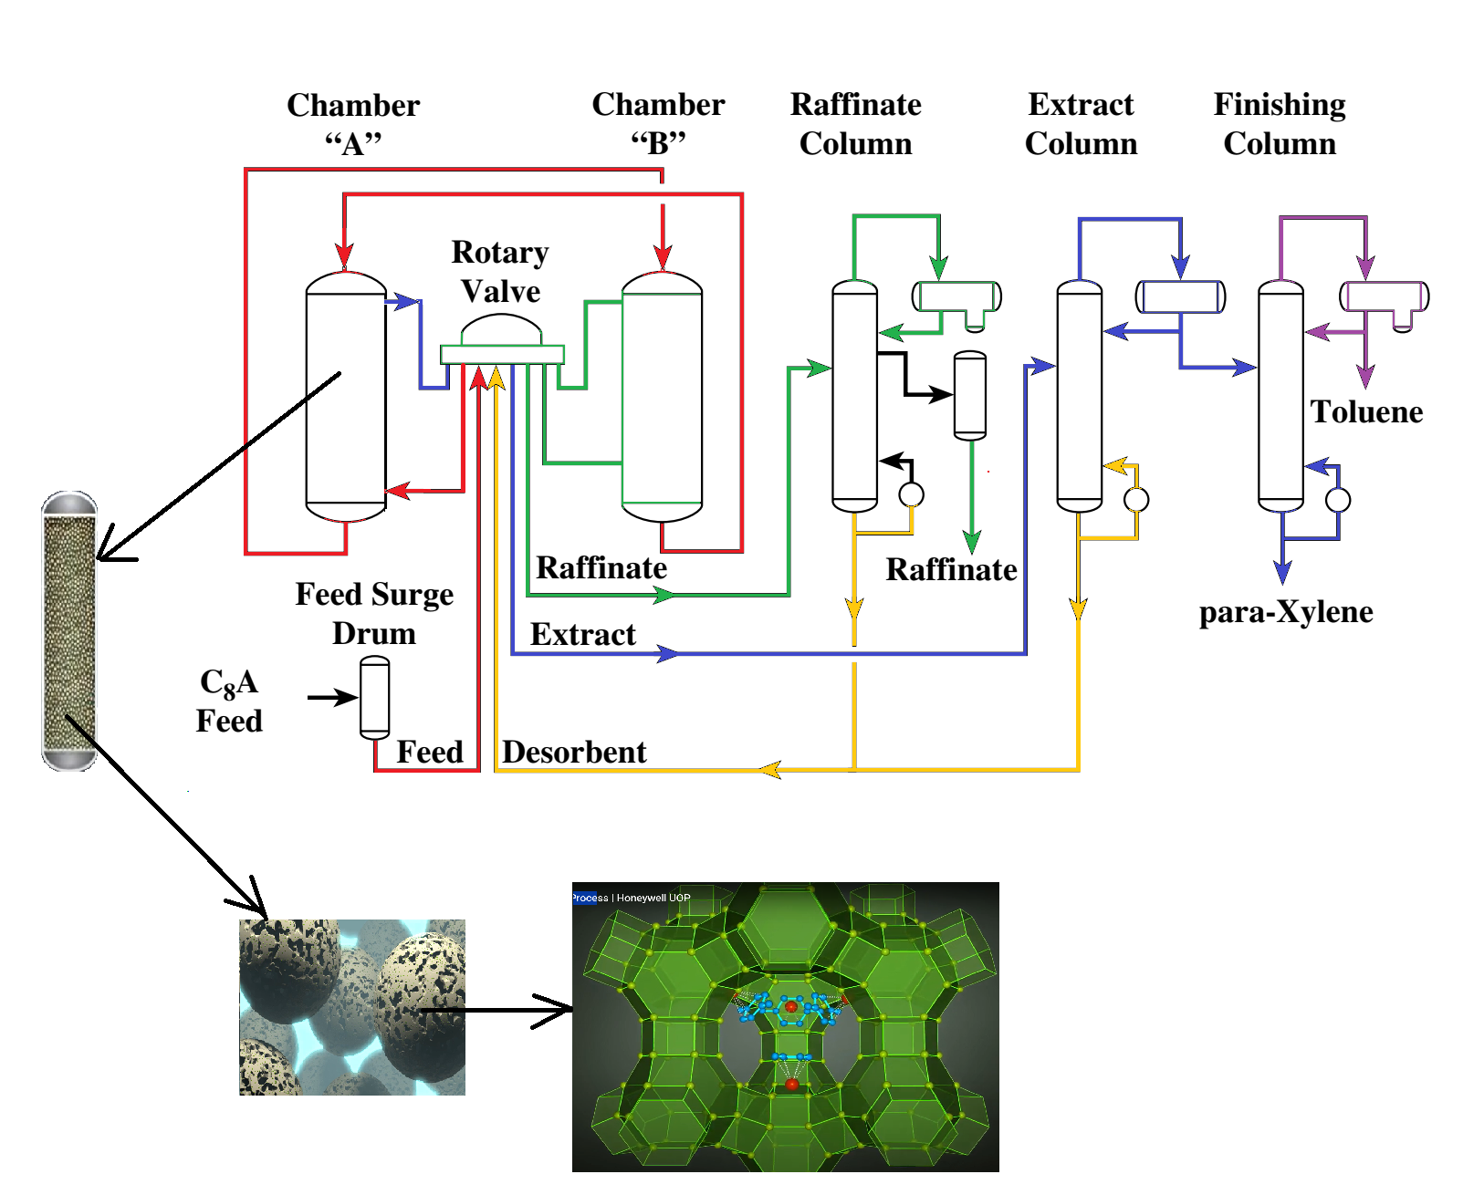
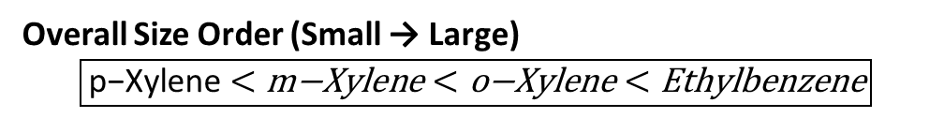
Overall Size Order (Small → Large)
$$\boxed{\text{p}\text{−}\text{Xylene}<\text{m}\text{−}\text{Xylene}<\text{o}\text{−}\text{Xylene}<\text{Ethylbenzene}}$$
faujazite zeolites
Zeolite pores ≈ 5.7–6 Å Only p-xylene fits properly
The inlet (feed and eluent/desorbing agent)
The outlet (extract and raffinate)

Slide 70
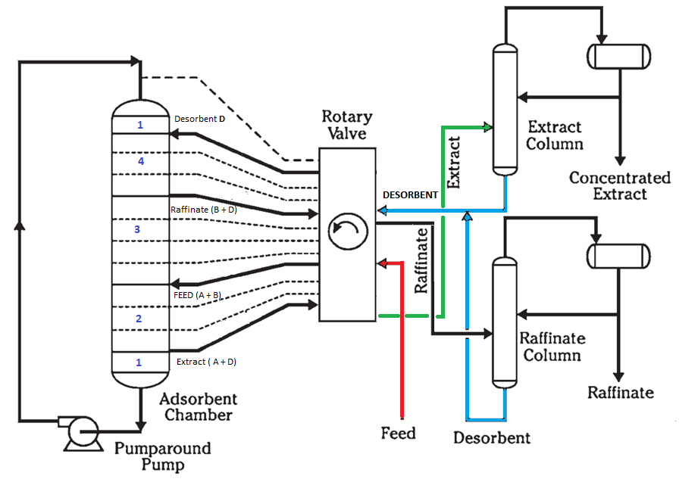
Countercurrent flow is simulated by periodically changing the points of liquid injection and withdrawal along a stationary bed of solid adsorbent. In this simulated moving-bed technique, the concentration profile actually moves down the adsorbent chamber. As the concentration profile moves, the points of injection and withdrawal of the net streams to the adsorbent chamber are moved along with it.

Slide 71
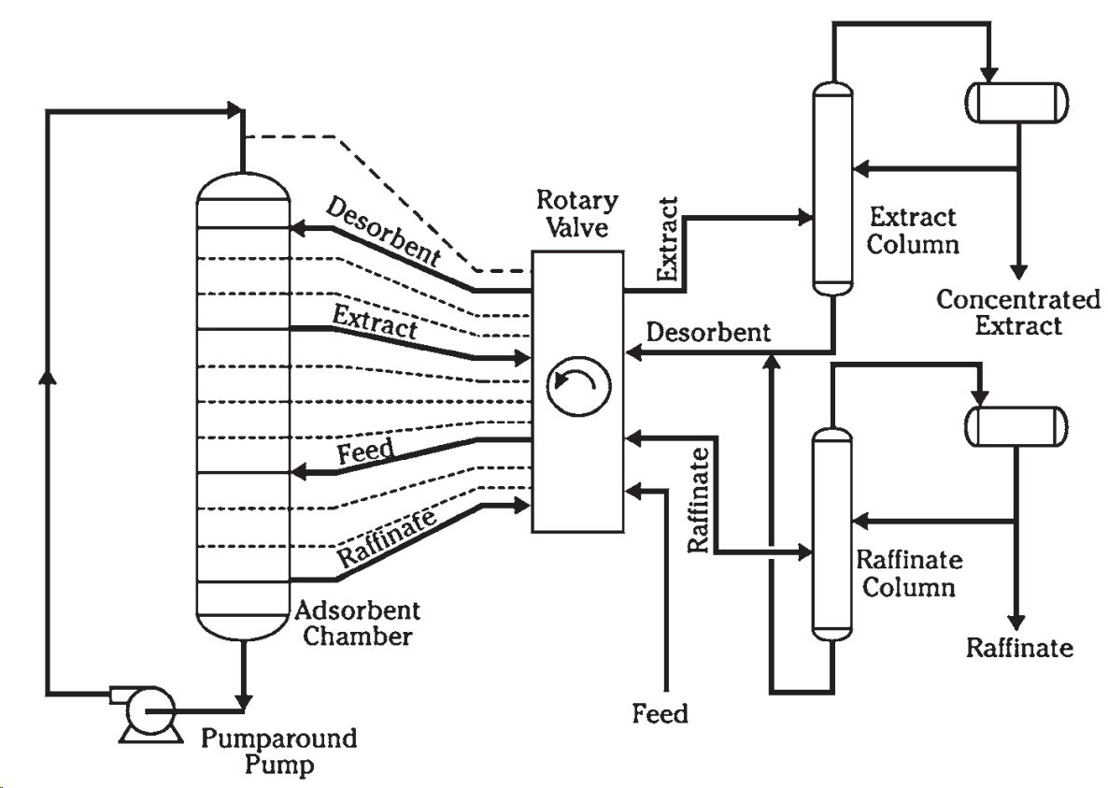
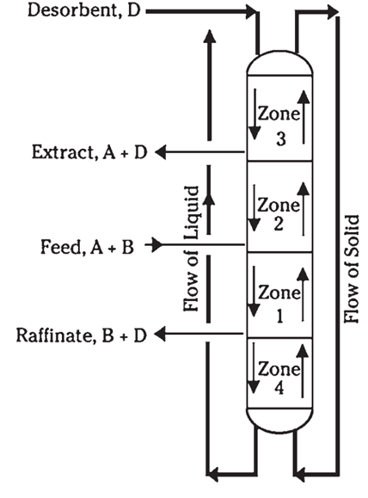
Fig. 2
Desorbent: Para-diethylbenzene (PDEB)
Countercurrent flow is simulated by periodically changing the points of liquid injection and withdrawal along a stationary bed of solid adsorbent. In this simulated moving-bed technique, the concentration profile actually moves down the adsorbent chamber. As the concentration profile moves, the points of injection and withdrawal of the net streams to the adsorbent chamber are moved along with it.

Slide 72
How Para-Diethylbenzene (PDEB) Removes Para-Xylene from Zeolite in the PAREX Process
In the PAREX process, p-xylene is first selectively adsorbed inside the pores of a zeolite molecular sieve. Later, it is removed (desorbed) using para-diethylbenzene (PDEB).
This happens by a displacement + washing mechanism.
1. Selective Adsorption of p-Xylene
Zeolite has uniform pores (~5.7–6 Å)
p-Xylene (≈5.8 Å) fits perfectly
Other isomers are too bulky
So:
p-Xylene enters pores and gets adsorbed strongly
Others flow out as raffinate
2. Introduction of Desorbent (PDEB)
After adsorption, PDEB is passed through the same bed.
Important property:
Size of PDEB ≈ 7.5–7.8 Å
Too large to enter zeolite pores
So:
PDEB cannot be adsorbed
PDEB stays in liquid phase outside pores

Slide 73
3. Displacement (Competition Effect)
When PDEB flows through the bed:
It has high affinity for p-xylene
It changes the concentration balance
This creates a driving force for p-xylene to leave the pores.
Result:
Adsorbed p-xylene becomes unstable
It starts coming out of the pores
This is called desorption by displacement.
4. Washing / Sweeping Action
PDEB also acts as a carrier liquid.
As p-xylene leaves the pores:
PDEB dissolves it
Carries it along the bed
Forms the extract stream
So:
PDEB “washes” p-xylene out of the zeolite

Slide 74
5. Formation of Extract Stream
At outlet of bed:
Mixture = PDEB + p-Xylene
This stream is sent to fractionation where:
p-Xylene is recovered
PDEB is recycled
Does the Solid Adsorbent Bed Actually Move in the PAREX (SMB) Process?
The solid adsorbent bed does NOT physically move.
In the PAREX process, the adsorbent remains fixed in place inside the columns.
Instead, the process simulates movement by changing the positions of feed and outlet streams.
That is why it is called Simulated Moving Bed (SMB).

Slide 75
The PAREX (SMB) unit consists of a set of columns connected in series; the countercurrent flow of solid and liquid phases is simulated by the periodic shifting of inlet (feed and desorbent) and outlet streams (extract and raffinate) in the direction of the fluid flow (Fig.). The reference adsorbent is Ba exchanged faujasite-type of zeolite. The adsorbent is in form of spherical pellets with an average pellet diameter 0.062cm (pellets between 0.03-0.1cm) and crystal size 1-2μm. The ion exchanged faujasite zeolites selectivity to p-xylene depends on the pre-adsorbed water in the zeolite, 2-6 wt%. The desorbent used in Parex process either toluene(B.P. 111 °C) or p-diethyl benzene(B.P. 187°C)
The purpose of the Parex unit is to separate Paraxylene from all other C8 Aromatics. The Parex process belongs to the UOP family of adsorption separation technologies based on the Sorbex separation concept.

Slide 76
Tracking One Column
Time | Zone | Role
0–5 min | Zone 3 | Adsorbs A
5–10 min | Zone 2 | Purifies
10–15 min | Zone 1 | Desorbs A
15–20 min | Zone 4 | Regenerates
20–25 min | Zone 3 | Adsorbs again

Slide 77
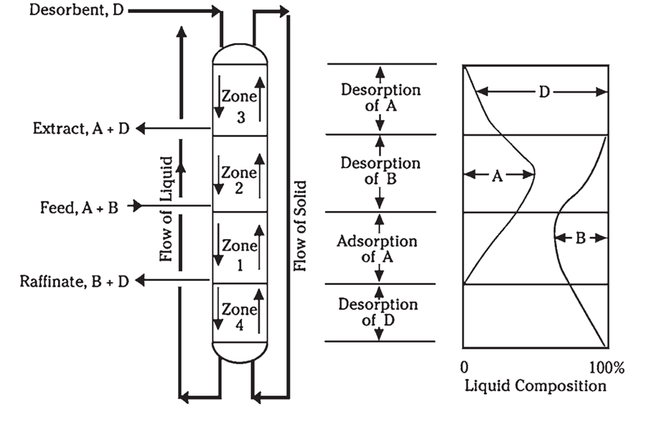
Fig.1
https://www.slideshare.net/DevMehta5/final-short-2003
https://slideplayer.com/slide/4563290/

Slide 78
Zone 3 : Adsorption of component A. This zone is between the point of feed injection and raffinate withdrawal. As the feed flows down through zone 1, countercurrent to the solid adsorbent flowing upward, component A is selectively adsorbed from the feed into the pores of the adsorbent. At the same time, the desorbent (component D) is desorbed from the pores of the adsorbent to the liquid stream to make room for A in the pores.
Zone 2: Desorption of component B. This zone is between the point of feed injection and extract withdrawal. At the fresh-feed point, the upward-flowing solid adsorbent contains the quantity of component A that was adsorbed in zone 1. However, the pores will also contain a large amount of component B, because the adsorbent has just been in contact with fresh feed. The liquid entering the top of zone 2 contains no B, only A and D. Thus, B is gradually displaced from the pores by A and D as the adsorbent moves up through zone 2. At the top of zone 2, the pores of the adsorbent contain only A and D. As process advances, the solid, which contains A, B and D, encounters a fluid that is increasingly rich in eluant (either extract or raffinate) B is thus displaced until it disappears completely.
Zone 1: Desorption of component A. This zone is between the point of desorbent injection and extract withdrawal. The adsorbent entering zone 3 carries only components A and D. The liquid entering the top of the zone consists of pure D. As the liquid stream flows downward, component A in the pores is displaced by D. A portion of the liquid leaving the bottom of zone 3 is withdrawn as extract; the remainder flows downstream into zone 2 as reflux.
Zone 4: Isolation zone. The main purpose of zone 4 is to segregate the feed components in zone 1 from the extract in zone 3. At the top of zone 3, the adsorbent pores are completely filled with component D. The liquid entering the top of zone 4 consists of B and D. Properly regulating the flow rate of zone 4 prevents the flow of component B into zone 3 and avoids contamination of the extract.

Slide 79
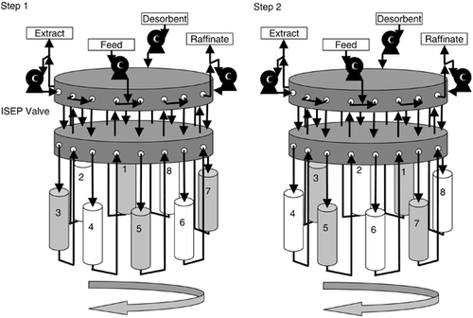

Slide 80
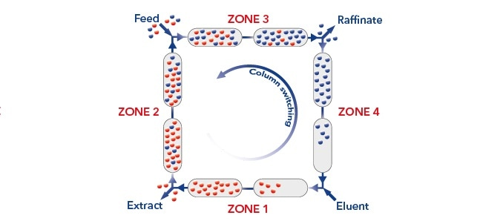

Slide 81
In practice, actually moving a solid bed of adsorbent is difficult. The biggest problem in commercial-size units is ensuring uniform plug flow across large-diameter vessels while minimizing axial mixing. In the Sorbex process, the countercurrent flow of liquid feed and solid adsorbent is accomplished without physical movement of the solid. Instead, countercurrent flow is simulated by periodically changing the points of liquid injection and withdrawal along a stationary bed of solid adsorbent. In this simulated moving-bed technique, the concentration profile shown in Fig.1 actually moves down the adsorbent chamber. As the concentration profile moves, the points of injection and withdrawal of the net streams to the adsorbent chamber are moved along with it.
A simplified flow diagram for a typical Sorbex unit is shown in Fig. 2. The separation takes place in the adsorbent chamber, which is divided into a number of adsorbent beds. Each bed of adsorbent is supported from below by a specialized grid that also contains a highly engineered flow distributor. Each flow distributor is connected to the rotary valve by a “bed line.” The flow distributors between each adsorbent bed are used to inject or withdraw liquid from the chamber or to simply redistribute the liquid over the cross-sectional area of the adsorbent chamber. The numbers of adsorbent beds and bed lines vary with the Sorbex application. In the Sorbex process, four major streams are distributed to and from the adsorbent chamber by the rotary valve. These net streams include
Feed in: raw mixture of all feed components
Dilute extract out: selectively adsorbed component or components diluted with desorbent
Dilute raffinate out: rejected components diluted with desorbent
Desorbent in: recycle desorbent from the fractionation section

Slide 82
At any given time, only four of the bed lines are actively carrying the net streams into and
out of the adsorbent chamber. The movement of the net streams along the adsorbent chamber is effected by a unique rotary valve, specifically developed by UOP for the Sorbex process. Although, in principle, this switching action could be duplicated with a large number of separate on/off control valves, the UOP rotary valve simplifies the operation of the Sorbex unit and improves reliability.
Functionally, the adsorbent chamber has no top or bottom. A pump-around pump is used to circulate process liquid from the last adsorbent bed at the bottom of the adsorbent chamber to the first bed at the top of the chamber. The concentration profile in the adsorbent chamber moves smoothly down past the last bed, through the pump, and back into the first bed. The actual liquid flow rate within each of the four zones is different because the rate of addition or withdrawal of each net stream is different. As the concentration profile moves down the adsorbent chamber, the zones also move down the chamber. The overall liquid circulation rate is controlled by the pump-around pump. This pump operates at four different flow rates, depending on which zone is passing through the pump.
The dilute extraction from the rotary valve is sent to the extract column for separation of the extract from the desorbent. The dilute raffinate from the rotary valve is sent to the raffinate column for separation of the raffinate from the desorbent. The desorbent from the bottom of both the extract and raffinate columns is recycled to the adsorbent chamber through the rotary valve.

Slide 83
UOP ISOMAR PROCESS

Slide 84
Background
The Isomar process is most often applied to paraxylene recovery, but it can be used to maximize the recovery of ortho-xylene or metaxylene.
When it comes to recovering para-xylene, a mixed-xylene feed is fed into a UOP Parex unit, which then selectively extracts the para-xylene isomer at 99.9 weight percent purity and 97% recovery per pass.
After nearly all of the para-xylene is removed, the Parex raffinate is transferred to the Isomar unit.
By essentially generating more paraxylene from the remaining ortho and meta isomers, the Isomar unit restores a nearly equilibrium distribution of xylene isomers. After that, the Parex unit receives recycled effluent from the Isomar unit in order to recover more para-xylene. The EB and its ortho- and meta-isomers are thus recycled until they extinct.
Catalyst: zeolite ZSM-5 containing 0.2 to 0.8 Wt.% platinum used in Mobil process

Slide 85
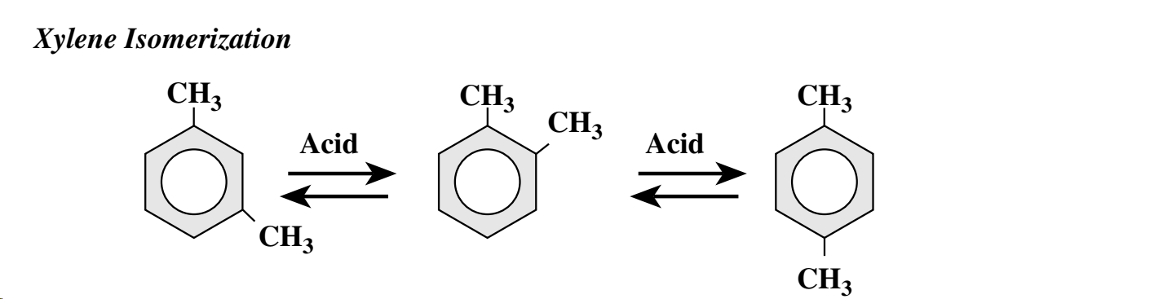
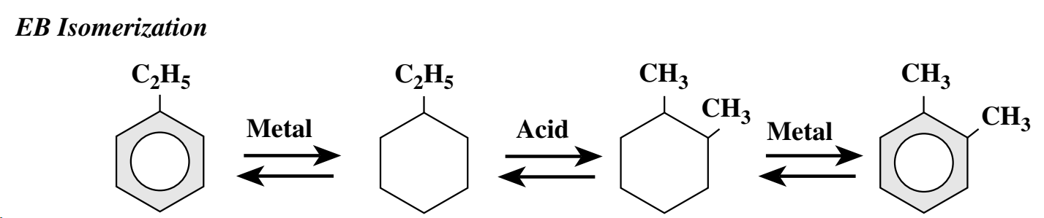
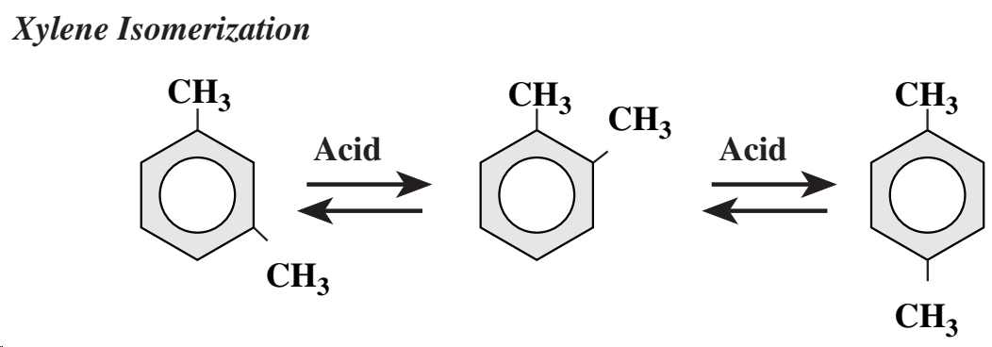
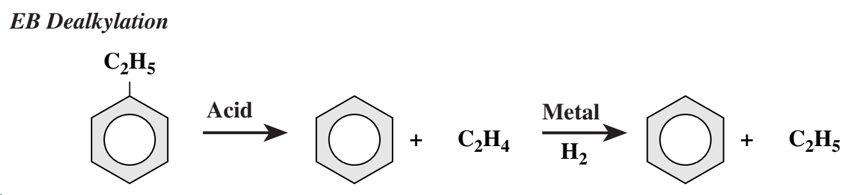
Process Chemistry

Slide 86
UOP offers both EB isomerization catalysts I-9*, I-210, and I-400 and EB dealkylation catalysts I-300 and I-330.
These kinds of catalysts are bifunctional, containing an equal number of catalytic sites for metal and zeolitic (acid) activities. Every catalyst's acid function serves for the same purpose, which is the isomerization of xylenes.
EB isomerization to xylenes is carried out by the EB isomerization catalyst systems I-9 and I-210 via a naphthene intermediate.
The EB is first saturated to ethyl-cyclohexane by the metal function; it is next isomerized to dimethylcyclohexane by the acid function; and lastly, the metal function dehydrogenates the naphthene to xylene.
Because the isomerization of EB is an equilibrium-limited reaction, the conversion of EB is usually limited to about 30 to 35 wt % per pass.
In an aromatics complex with the I-9 catalyst, naphthenes are recycled to the Isomar unit via the xylene column and Parex unit. This suppresses naphthenes production and increases the yield of para-xylene from the complex.
The EB dealkylation catalyst systems I-300 and I-330 employ an EB dealkylation mechanism in which the acid function of the catalyst cleaves the ethyl group off the aromatic ring.
Because this reaction does not involve a naphthene intermediate, C8 naphthenes do not need to be recycled via the Parex-Isomar loop.
All xylene isomerization catalysts exhibit some by-product formation across the reactor. A large portion of the total feed to the Parex-Isomar loop is recycled from the Isomar unit. The typical Parex-Isomar loop is designed with a recycle/feed ratio of 2.5 : 3.5.
*halogen promoted alumino-platinum catalyst I-9.

Slide 87
Isomar-process description
Isomar process is combined with the UOP Parex process for para-xylene recovery. The Parex-Isomar loop receives fresh mixed-xylenes and sends them to a xylene column. The column can be suited to recover ortho-xylene or reject C9 aromatic components to fulfill feed parameters for the Parex unit.
The xylene column overhead is then directed to the Parex unit where 99.9 wt % para-xylene is produced at 97 wt % recovery per pass. The Parex raffinate from the Parex unit, which contains less than 1 wt % para-xylene, is sent to the Isomar unit.
The feed to the Isomar unit is first combined with hydrogen-rich recycle gas and makeup gas to replace the small amount of hydrogen consumed in the Isomar reactor.
The combined feed is then preheated by exchange with reactor effluent, evaporated in a fired heater, and brought up to reactor operating temperature.
The heated feed vapor is then directed to the reactor and passes radially via a fixed bed of catalyst (400-500°C, 3*10⁶ Pa). The reactor effluent is cooled through exchange with the combined feed before being transferred to the product separator.
Hydrogen-rich gas is extracted from the top of the product separator and returned to the reactor. A small quantity of recycle gas is purged to eliminate any accumulated light ends from the recycle gas loop.
The liquid from the bottom of the product separator is charged into the deheptanizer column. The C7- overhead from the deheptanizer is cooled and split into gas and liquid components. The deheptanizer overhead gas is routed to the fuel gas system. The overhead liquid is recycled to the Platforming unit, therefore any benzene in this stream can be be recovered in the Sulfolane process.
The C8 fraction from the bottom of the deheptanizer is claytreated, combined with fresh mixed-xylenes feed, and recycled to the xylene column.
In a UOP aromatics complex, the reformate from the CCR Platforming unit is separated into C7- and C8+ components. The C7- portion is transported to the sulfolane unit, which recovers high-purity benzene and toluene. The EB dealkylation catalysts I-300 and I-330 enable the recovery of high-purity benzene using fractionation alone.
Modern low-pressure CCR Platforming units create aromatics with high severity, resulting in a C8 fraction with few nonaromatic contaminants. This fraction can be transferred directly to the complex's xylene recovery.

Slide 88
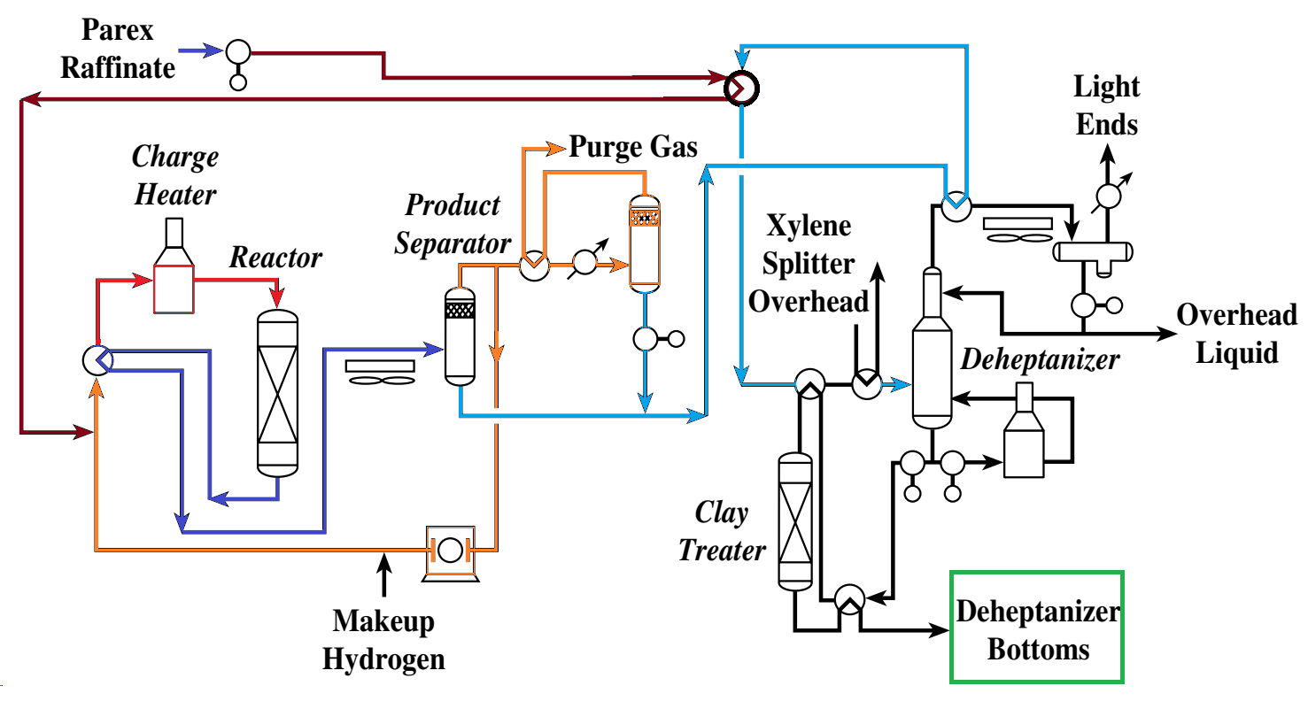
Isomar-process flow diagram

Slide 89
BP-UOP CYCLAR PROCESS
(converting LPG to petrochemical-grade benzene, toluene, and xylenes (BTX) )

Slide 90
BP-UOP-Cyclar process
Since production sites are frequently situated in isolated locations far from customers or well-established processing facilities, complex infrastructure for product transportation is needed. Pipelines can move natural gas economically, but the amount of LPG that can be transported in this manner is restricted by condensation issues. As a result, the majority of LPG is transported using relatively costly methods like railcars or special-purpose tankers. LPG's value at the manufacturing site is frequently diminished by the high cost of transportation.
After realizing how difficult it was to transport LPG, British Petroleum (BP) started investigating a method in 1975 to transform LPG into more valuable liquid products that could be transported more affordably. Through this effort, a catalyst that could convert LPG into benzene, toluene, and xylenes (BTX) of petrochemical grade in a single step was developed.
As soon as BP realized that the catalyst in this application needed to be continuously regenerated, it turned to UOP and its well-established CCR technology.
Initially created for the UOP Platforming process, UOP applied the radial-flow, stacked-reactor design and created a high-strength formulation of the BP catalyst that would function in CCR service. The BP-UOP Cyclar process is what this excellent technical collaboration produced.
LPG is directly converted in a single step by the Cyclar process into a liquid aromatics product. It is thermodynamically favored at temperatures above 425°C (800°F), and the reaction is best described as dehydrocyclodimerization. The dehydrogenation of light paraffins (propane and butanes) to olefins is the rate-limiting step. When the extremely reactive olefins are formed, they oligomerize to produce larger intermediates, which cyclize quickly to produce naphthenes. These reactions-dehydrogenation, oligomerization, and cyclization—are all acid-catalyzed.

Slide 91
In addition to encouraging the cyclization reaction, the catalyst's zeolite component's shape selectivity restricts the size of the rings that can form. The naphthenes' dehydrogenation into the appropriate aromatics is the last stage of the reaction. This reaction is highly favored at Cyclar operating conditions, and the result is virtually complete conversion of the naphthenes.
Methane and ethane can also be produced by a side reaction involving the hydrocracking of the reaction intermediates. Because methane and ethane are inert under Cyclar operating conditions, this side reaction results in a yield loss.
Of course, olefins can be added to the feed to the Cyclar unit since they are an essential reaction intermediate. Pentanes and other heavier paraffins can also be added to the feed. The Cyclar unit is almost entirely capable of converting olefins and pentanes, but it still needs to be built to handle them because their catalyst-coking rate is higher than that of pure butane and propane feedstocks.
The overall reaction is highly endothermic due to the preponderance of dehydrogenation reactions, despite the reaction sequence containing some exothermic steps. For every mole of aromatic components formed from propane or butane, five moles of hydrogen are produced.
Because butanes and propane are relatively non-reactive, a high activity catalyst is needed for the Cyclar process. Simultaneously, it's important to reduce the amount of methane and ethane that result from unintended hydrocracking side reactions.
At normal process conditions, carbon deposition on the catalyst occurs slowly and steadily, accounting for less than 0.02 wt% of the feed processed. Because the carbon levels on spent catalyst are low, regeneration is relatively simple. Mild regeneration conditions extend the catalyst's life and make it tolerant to process upsets and changes in feedstock composition.

Slide 92
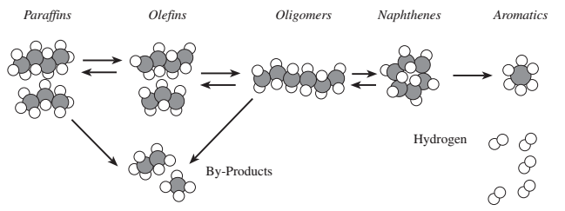
Process chemistry
PtZn/SiO₂ +ZSM-5 bifunctional catalysts

Slide 93
Parameter | Typical Range
Temperature | 425-600°C
Pressure | 3–10 bar
WHSV | 1–5 hr⁻¹
Catalyst | Ga-ZSM-5
WHSV: Weight Hourly Space Velocity
WHSV=Weight of catalyst/Weight of feed per hour​

Slide 94
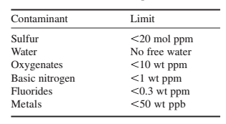
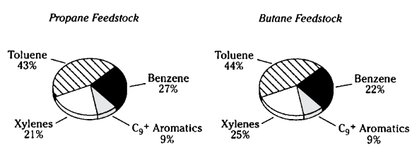
Feed consideration
The principal constituents of the feedstock for a Cyclar unit ought to consist of propane and butanes. As inert diluents, the C1 and C2 saturates ought to be kept to a minimum.
Less than ten percent of the feed should contain olefins. Higher olefin concentrations necessitate hydrogenating the feed. In Cyclar units intended for LPG service, the C5 and C6 components should be restricted to less than 20 and 2 weight percent, respectively, as they accelerate the rate of coke formation in the process. If required, Cyclar units can be built to process much larger volumes of C5 and C6 materials. In general, the feed to a Cyclar unit should meet the specifications outlined in Table.
The overall aromatics yield increases from 62 wt % of fresh feed with an all-propane feedstock to 66 % with an all-butane feed.

Slide 95
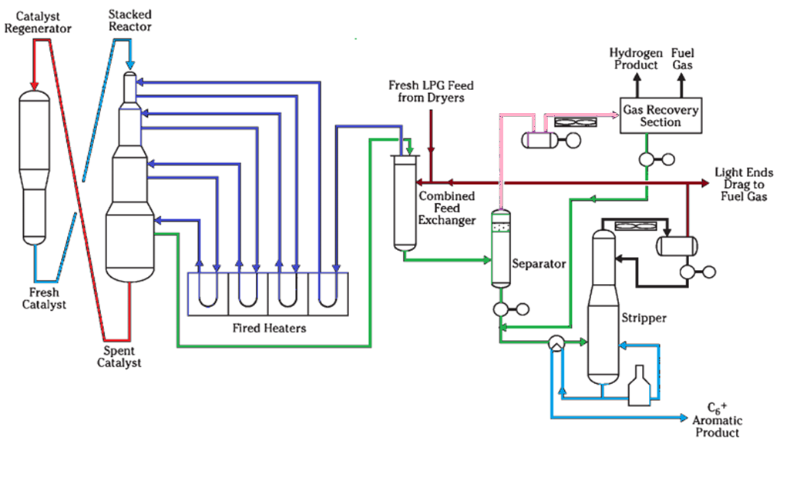
CYCLAR FLOW DIAGRAM

Slide 96
UOP OLEFLEX PROCESS
for light olefin production from paraffin

Slide 97
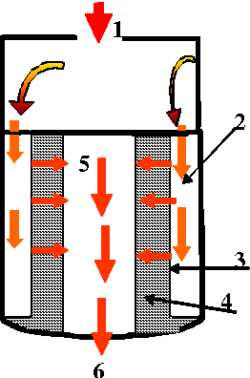
Background
The UOP Oleflex process is a catalytic dehydrogenation technology for the production of light olefins from their corresponding paraffins. One specific application of this technology produces propylene from propane.
Propylene is the world’s second largest petrochemical commodity and is used in the production of polypropylene, acrylonitrile, acrylic acid, acrolein, propylene oxide and glycols, plasticizer oxo alcohols, cumene, isopropyl alcohol, and acetone. The growth in propylene production is primarily driven by the industry demand for polypropylene, which is used in such everyday products as packaging materials and outdoor clothing. The growth rate of polypropylene is expected to be 5% per year for the near future.
In addition, the Oleflex process utilizes UOP’s proprietary equipment and systems for optimal operations, including PSA Polybed units, modular CCR, UOP lock hopper control, MDTM distillation trays, High-Flux tubes, and process instrumentation controls (PIC). Integration of these products within the Oleflex process results in significant capital and operating cost savings for the complex and provides an overall guarantee for the Oleflex process and products. With the use of CCR catalyst regeneration, the processing unit does not have to be shut down to change out the catalyst.
The Oleflex process provides producers with a high-quality propylene, which then leads to high quality polymers. This process consumes less polymerization catalyst because of fewer impurities in the propylene product and has the potential to be integrated with existing downstream technology.
MD™ = Multiple Downcomer Tray

Slide 98



Slide 99
The UOP Oleflex process is separated into three different sections: the reactor section, the product recovery section, and the catalyst regeneration section.
The reactor section of the Oleflex process consists of four radial-flow reactors, charge and interstage heaters, and a reactor feed-effluent heat exchanger.
In the product recovery section, the reactor effluent is cooled, compressed, dried, and sent to a cryogenic system to separate hydrogen from hydrocarbon.
The net gas is recovered at 85 to 93 mol-% hydrogen purity. Separator liquid is sent to a selective hydrogenation process (SHP) unit to eliminate diolefins and acetylenes.
Then the liquid goes to a deethanizer and propane-propylene (P-P) splitter to produce a chemical or polymer-grade propylene product. Unconverted propane is recycled to the reactor section.
The selective diolefin and acetylene hydrogenation step is accomplished with the Hüls SHP process licensed by UOP. The catalyst regeneration section burns coke off the catalyst and returns it to fresh activity.

Slide 100
Feedstock
The feedstock to a C3 Oleflex process unit is propane. Propane is recovered from propane-rich
LPG streams from gas plants. Propane is also available in smaller quantities as a byproduct from such refinery operations as hydrocracking, fluidized catalytic cracking (FCC) and (RCC) resid catalytic cracking units.
Catalyst
Platinum/tin with an alkali metal promoter on an alumina support, primarily θ-Al₂O₃
The Olexflex process uses a platinum catalyst to promote the dehydrogenation reaction. The DeH-14 catalyst, introduced in 2001, represents the fifth generation of catalyst. Not only does the DeH-14 maintain the high activity and selectivity and low attrition rates required for the dehydrogenation process, it also has lower platinum investment than earlier catalysts.

Slide 101

C3 Oleflex Complex : Block diagram

Slide 102

C3 Oleflex: Process flow diagram

Slide 103
C₃​H₈​ → C_{3​}H₆ ​+ H₂ ​(Endothermic)
Parameter | Typical Range
Temperature | 540–680°C
Pressure | 1–3 bar (low pressure)
WHSV | 1–3 hr⁻¹
H₂/HC ratio | Small added hydrogen
Conversion per pass | 30–40%
Overall yield (with recycle) | 85–90%+

Slide 104


PACOL process
Paraffin Conversion to Olefin
UOP’s Pacol catalytic dehydrogenation process

Slide 105
Background
Pacol process (for paraffin conversion to olefins), was first commercialized in 1968.
The long chain n-paraffins (kerosene or gas oil fractions in the C₁₀ to C₁₄ range) to olefins is the first step in the manufacture of linear alkylbenzene sulfonate (LABS), an important refinery process for the synthesis of biodegradable surfactants(detergent).
Dehydrogenation of long chain n-paraffins, in the carbon number range C₁₀–C₁₄, is a key step in the process for manufacture of bio-degradable synthetic detergent raw material, Linear Alkyl Benzene (LAB). Since its discovery in 1968, the process has undergone several improvements in the architecture of dehydrogenation catalysts towards achieving higher selectivity for mono-olefins formation, increase in LAB yield and quality, raw materials consumption and minimization of by-products, accompanied by several modifications in the process steps.
The UOP Pacol process for selective long-chain paraffin dehydrogenation to produce linear mono-olefins is shown in Figure in combination with the UOP detergent alkylation process. The Pacol process consists of a radial-flow reactor and a product recovery section. Worldwide, more than 2 million metric tons per year of linear alkyl benzene is produced employing this process.
By contrast, the most direct method for obtaining C₁₀-C₁₄ olefins consists in dehydrogenating the corresponding n-paraffins, which may be obtained by extraction on molecular sieves. This technique was researched by many companies and industrialized by UOP under the name Pacol. Dehydrogenation produces a mixture of olefins and unconverted paraffins which can be subjected directly to the alkylation of benzene to yield a linear alkylbenzene which, by sulfonation yields a biodegradable detergent (LABS). The paraffins are easily separated from the alkylate and recycled.

Slide 106
Dehydrogenation takes place in a fixed bed reactor in the gas phase, at a temperature of about 400 to 500°C, and low pressure 0.2 to 0.3×10⁶ Pa) and in the presence of hydrogen (H₂/feedstock molar ratio = 5/10).
Fresh normal paraffin is mixed up with re-circulating hydrogen gas and enters the dehydrogenation reactor. Besides the main reactions (i.e. dehydrogenation), side reactions, such as dehydrocyclization, aromatization, isomerization, cracking, and coking, are possible under the process conditions.
A slight improvement in the catalytic dehydrogenation step can influence the cost and quality of the final product intensively and has a subsequent impact on energy consumption and resulting greenhouse gas emissions for the entire process. Some of the operational parameters that can influence the conversion rate of the dehydrogenation catalysts are temperature, pressure, hydrogen/hydrocarbon ratio, etc.
The first-generation catalyst: heterogeneous platinum catalysts supported on an alumina base. In 2001, DeH 201 catalyst was introduced by UOP which is the latest till date. This catalyst, is a layered sphere, allows for higher conversion operation than previous Pacol catalysts.
The Pacol process operates at a lower severity, catalyst runs are significantly longer, and CCR technology is not needed

Slide 107

PROCESS DESCRIPTION
The catalytic reaction pathways involved in the dehydrogenation of n-paraffins to mono-olefins [linear internal olefins (LIO)] as well as other thermal cracking.
The conversion of n-paraffins to mono-olefins in the Pacol reaction mechanism is close to equilibrium, resulting in a small but significant amount of diolefins and aromatics production. During the alkylation process, diolefins consume 2 moles of benzene to produce heavier di-phenylalkane compounds or heavier polymers that become part of the heavy alkylate and bottom by-products of the hydrofluoric (HF) acid regenerator. Thus, diolefin formation results in a net loss of alkylate yield. UOP invented the DeFine process in 1984, which converts diolefins back to mono-olefins through highly selective catalytic hydrogenation.
The dehydrogenation of n-paraffins is an endothermic reaction with a heat of reaction of about 125 kJ/g. mol. Equilibrium conversion increases with temperature but decreases with pressure and increasing hydrogen-to-hydrocarbon ratio.

Slide 108

PROCESS DESCRIPTION

Slide 109
PROCESS DESCRIPTION
The figure illustrates the flow scheme of an integrated complex incorporating Pacol, DeFine, and HF Detergent Alkylate units or Pacol, DeFine, and Detal units.
The Pacol process converts linear paraffins to linear olefins in the presence of hydrogen using a selective platinum dehydrogenation catalyst. An adiabatic radial-flow reactor with feed preheat is typically used to compensate for endothermic temperature drop and minimize pressure drop within an efficient reactor volume.
Relatively high space velocities are used so that only a modest amount of catalyst is required.
Hydrogen and some by-product light ends are separated from the dehydrogenation reactor effluent, and a portion of the hydrogen gas is recycled back into the reactor to reduce coking and improve catalyst stability.
The separator liquid is an equilibrium mixture of linear olefins and unconverted n-paraffins, which are fed into a DeFine reactor to selectively convert diolefins to mono-olefins.
A near-stoichiometric amount of hydrogen is also charged to the DeFine reactor.
The DeFine reactor effluent is stripped of dissolved light hydrocarbons. The stripper bottoms, a mixture of mono-olefins and unconverted n-paraffins, are charged with benzene to the alkylation unit, where it is alkylated with the mono-olefins to produce LAB.
Small amounts of heavy alkylate and, if HF is used, polymer from the acid regenerator bottoms are also formed.
Benzene and n-paraffins are separated from the alkylation reactor effluent and recycled into the alkylation and Pacol reactors, respectively. The final column fractionates the LAB product above while recovering heavy alkylate as the bottom product.

